Slide 1

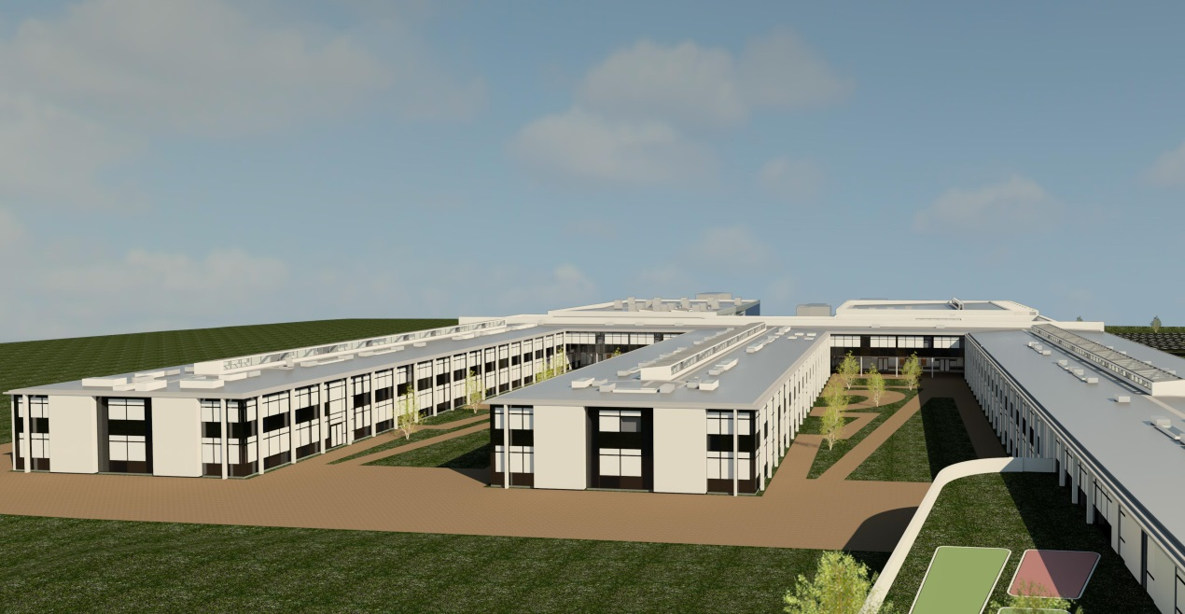
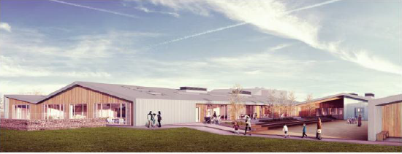
Wick Community Campus and Noss Primary
Stakeholder update report 02
8th December 2014

Slide 2
Introductions
Area Director: Scott Alexander
Project Director: Cameron Stewart
Wick Campus
Senior Project Manager: Hamish Robertson
Site Manager: Douglas Small
Commercial Manager: Neil Grant
Surveyor: Jason Bramley
Design Manager: Austin Mullan
M & E Manager: David Baker

Slide 3
Introductions
Area Director: Scott Alexander
Project Director: Cameron Stewart
Noss Primary
Project Manager: John Ritchie
Construction Manager: Chris Connor
Site Manager: Donald MacKay
Commercial Manager: Stewart Johnston
Design Manager: Austin Mullan
M & E Manager: David Baker

Slide 4
2.00 Programme - Campus

Slide 5
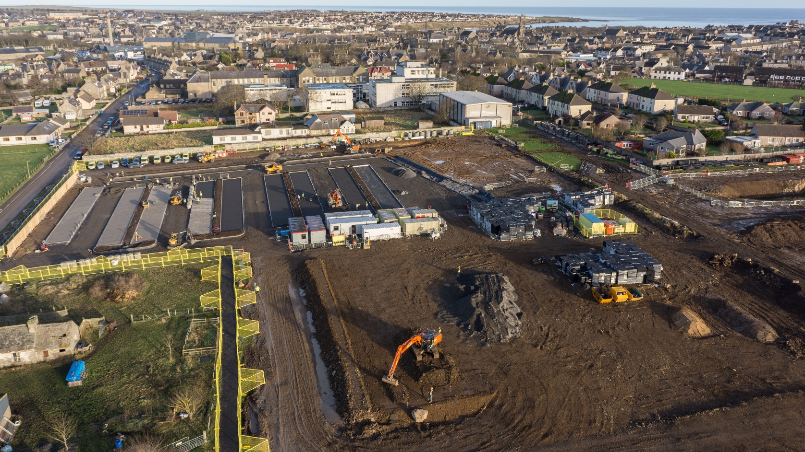
2.02 Photographs for Wick Campus
2.02 Photographs for this period:

Slide 6
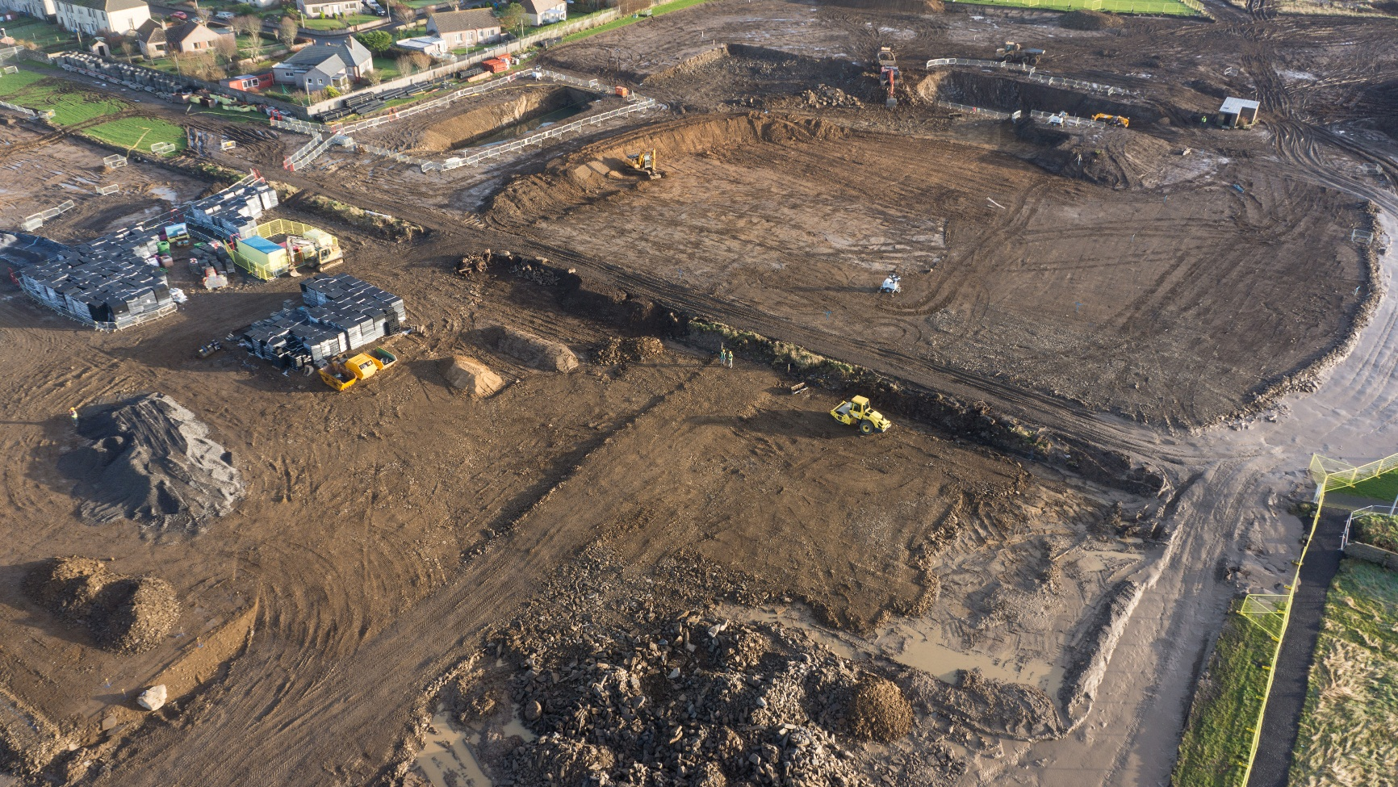
2.02 Photographs continued

Slide 7
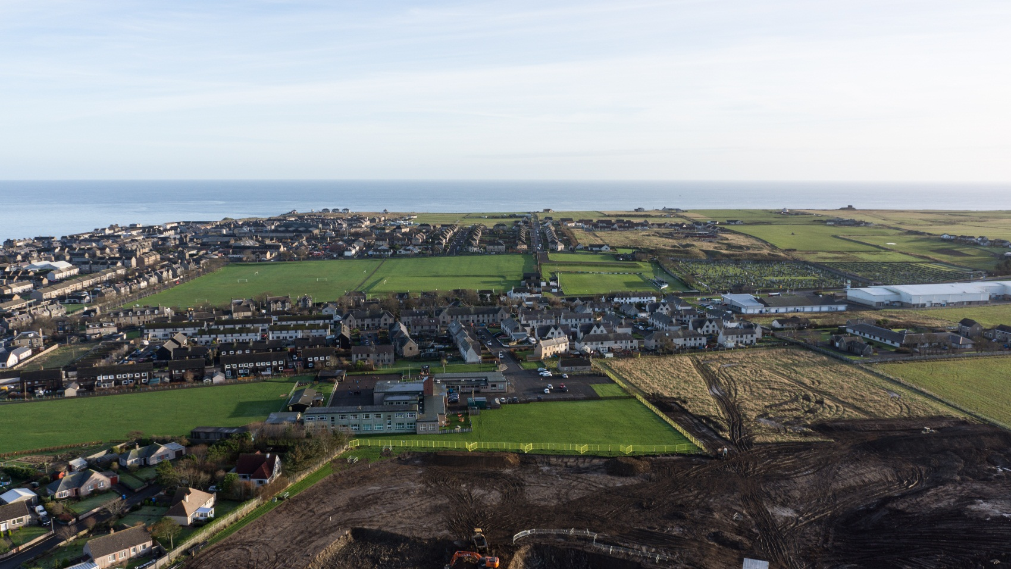
2.02 Photographs continued

Slide 8
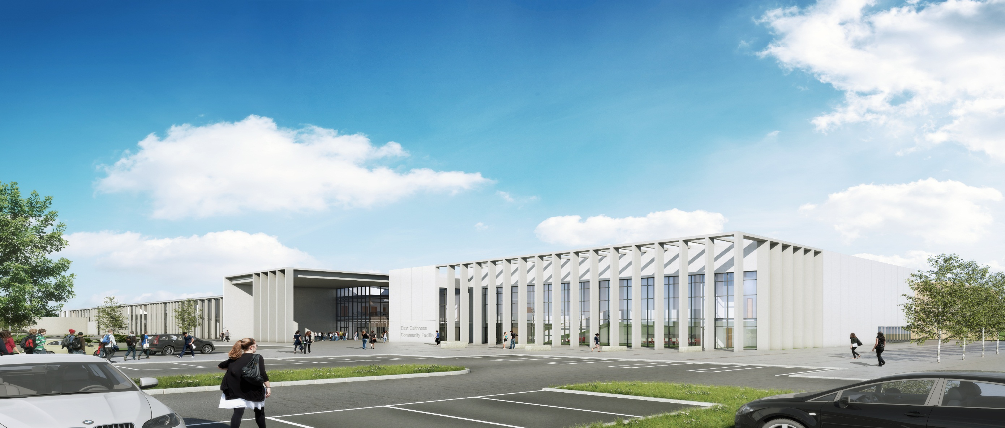
3.00 Overview of Wick Campus

Slide 9
2.00 Programme – Noss Primary

Slide 10
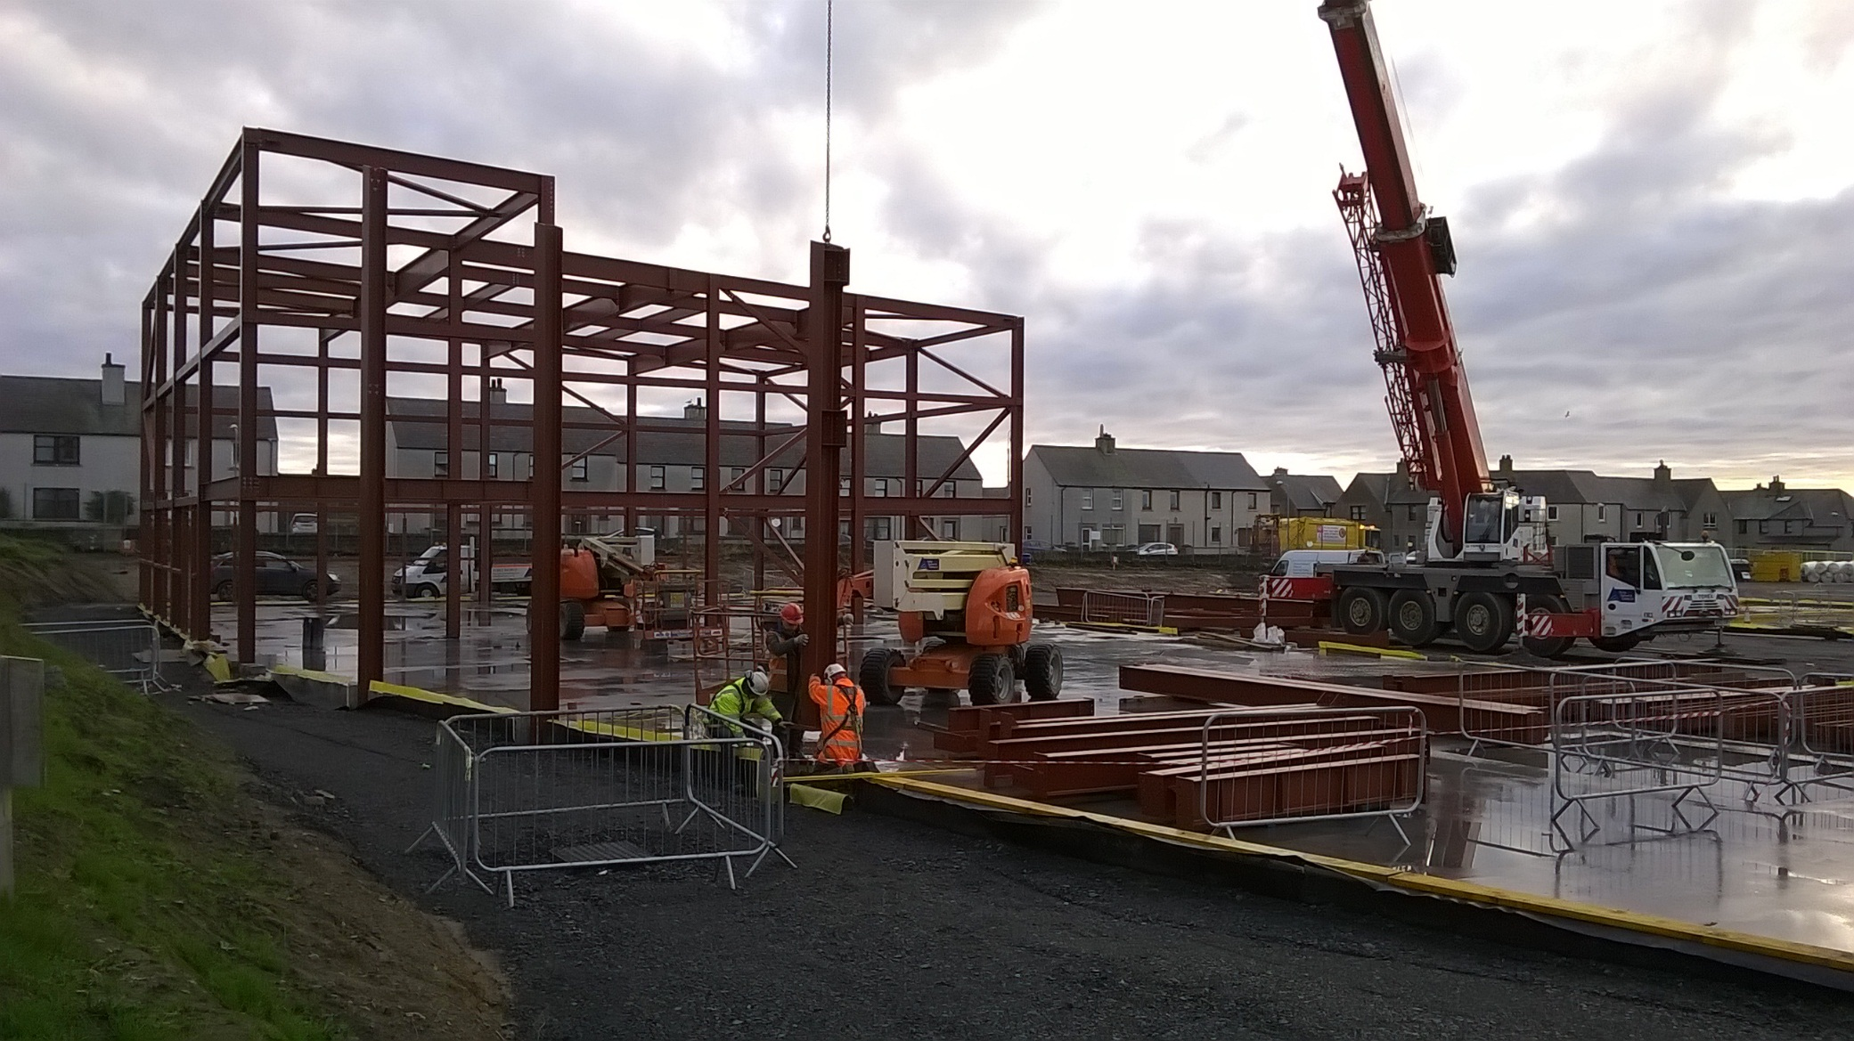
2.02 Photographs for Noss Primary
2.02 Photographs for this period:

Slide 11
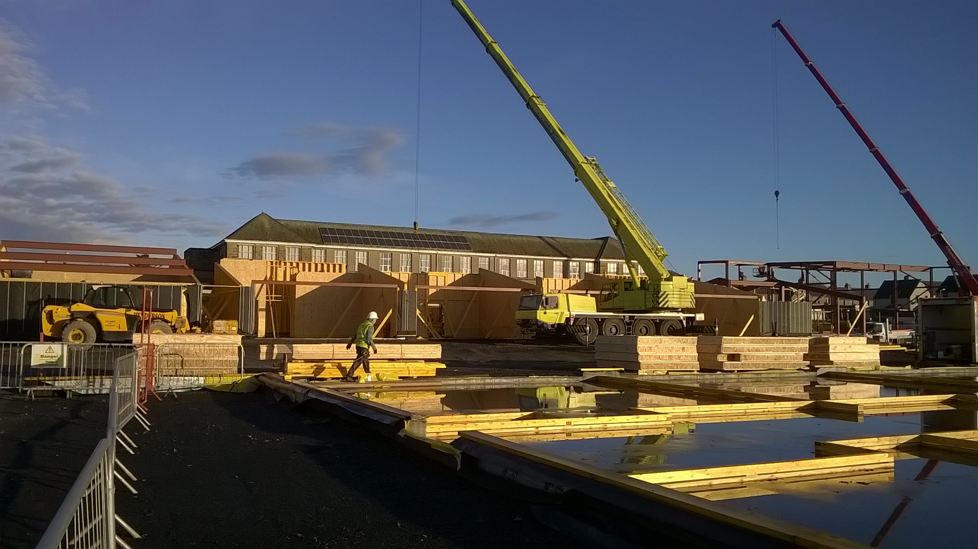
2.02 Photographs continued

Slide 12
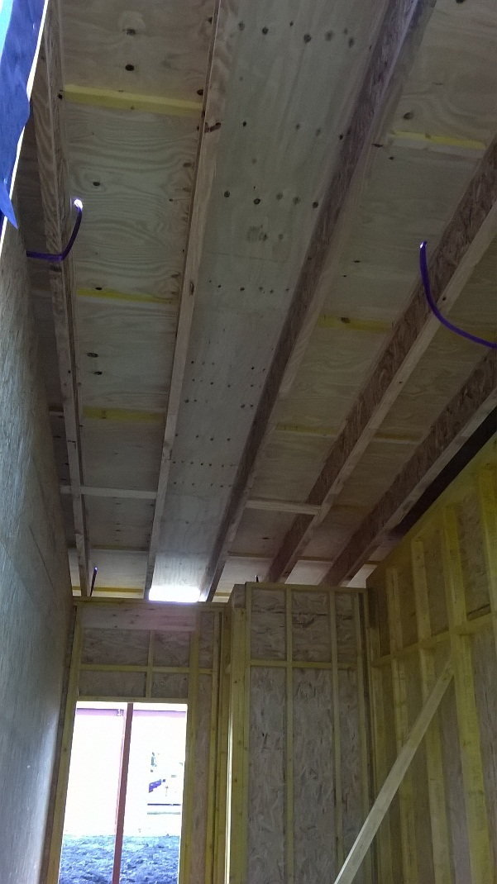
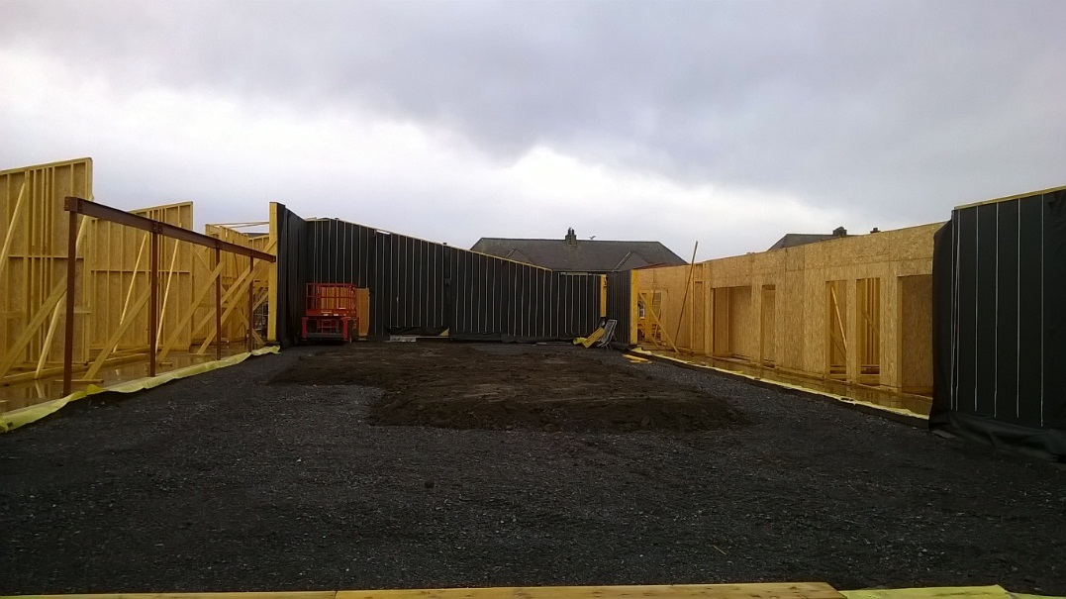
2.02 Photographs continued

Slide 13
4.00 Local Employment undertaken
The following has been undertaken by Morrison and our Sub contractors
Local Quarry products being used
Local Plant Hire being used
4 number local employees by GT
2 number local employees by PJC
1 Modern Day Apprenticeship for Admin identified
5 local companies employed across both projects
Pultney Town People’s Project (PPP) have been offered work experience
Work experience students from Wick High school in the new year

Slide 14

5.00 Community
5.00 Summary:
An application has been submitted to register Wick Campus with the Considerate Constructors scheme, and will go live 8th December 2014 once FC reached.
Noss Primary awarded Performance Beyond Compliance certificate further to November Site Inspection and Audit by the CCS Scheme Monitor.

