Slide 1

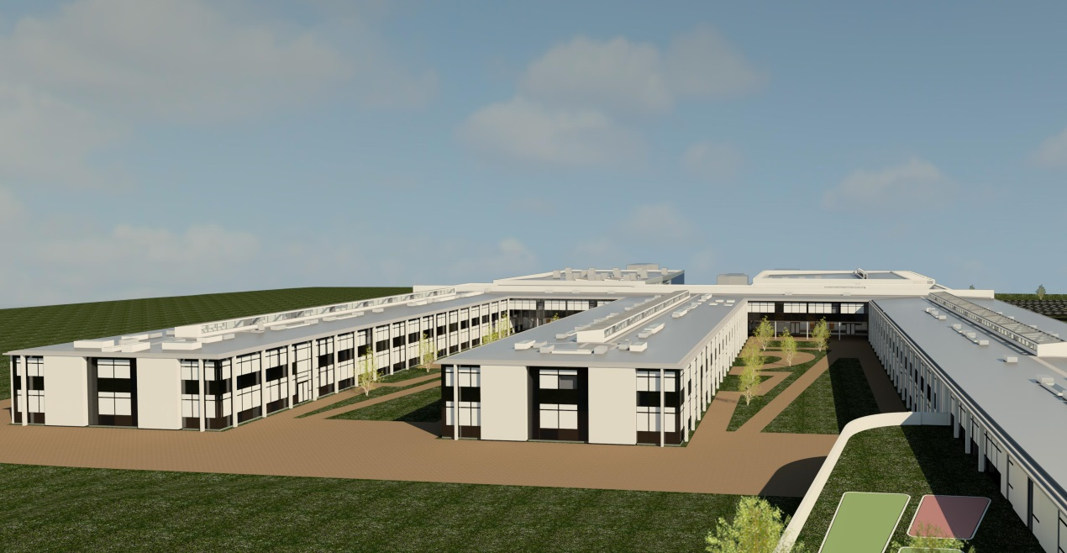
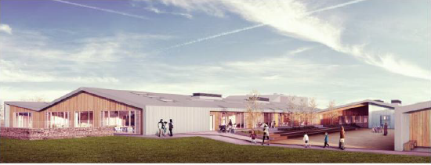
Wick Community Campus and Noss Primary
Stakeholder update report 03
23rd February 2014

Slide 2
Introductions
Area Director: Scott Alexander
Project Director: Cameron Stewart
Wick High School, Newton Park Primary and Community Campus
Senior Project Manager: Hamish Robertson
Project Manager: Craig Struthers
Site Manager: Douglas Small
Commercial Manager: Neil Grant
Surveyor: Jason Bramley
Design Manager: Austin Mullan
M & E Manager: David Baker
Site Administrator: Carole Swan

Slide 3
Introductions
Area Director: Scott Alexander
Project Director: Cameron Stewart
Noss Primary
Project Manager: Chris Connor
Site Manager: Paul MacKintosh
Site Supervisor: Dougie Sutherland
Commercial Manager: Stewart Johnston
Design Manager: Austin Mullan
M & E Manager: David Baker
Admin Apprentice: Beth MaCualay

Slide 4
2.00 Programme - Campus

Slide 5
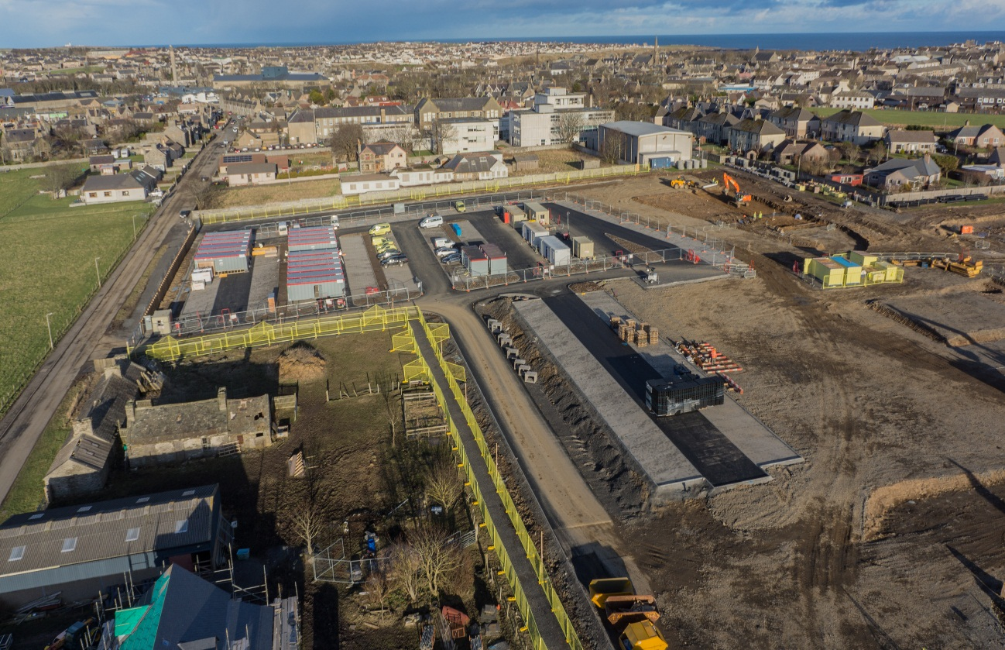
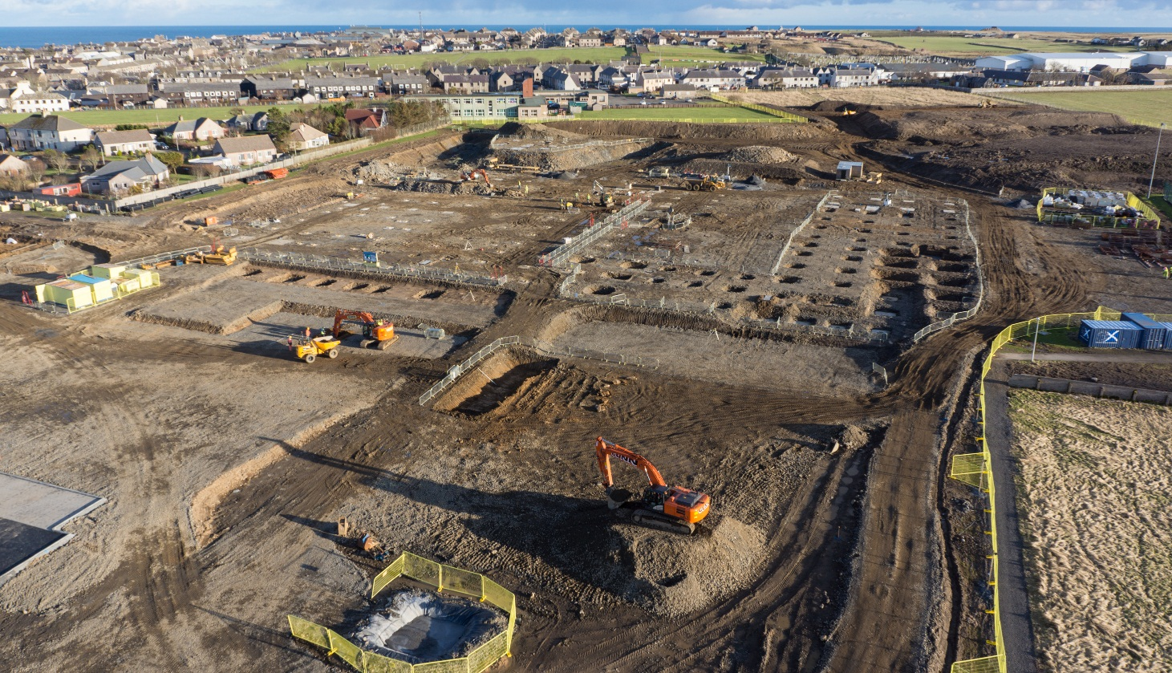
2.01 Photographs continued

Slide 6
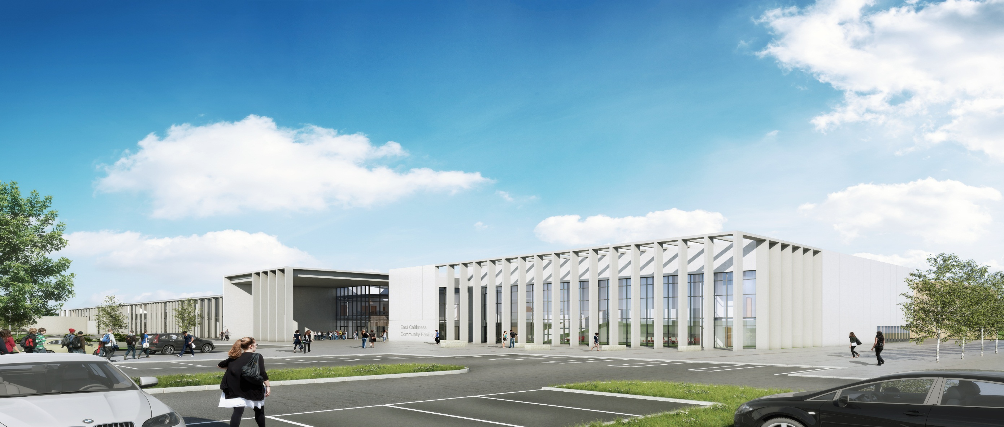
3.00 Overview of Wick Campus

Slide 7
2.00 Programme – Noss Primary

Slide 8
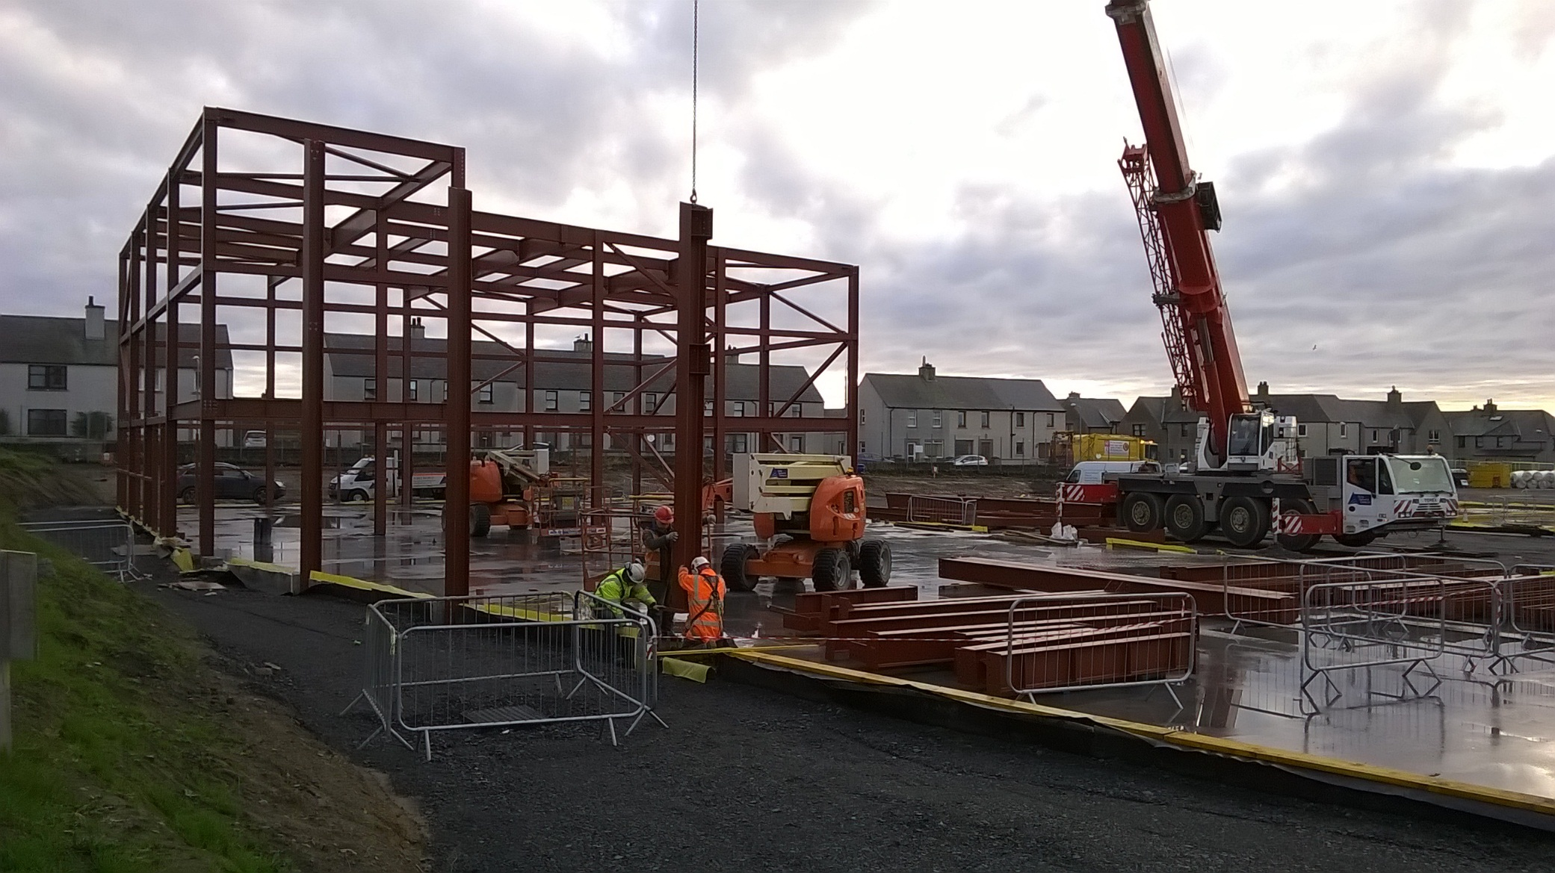
2.02 Photographs for Noss Primary
2.02 Photographs for this period:

Slide 9
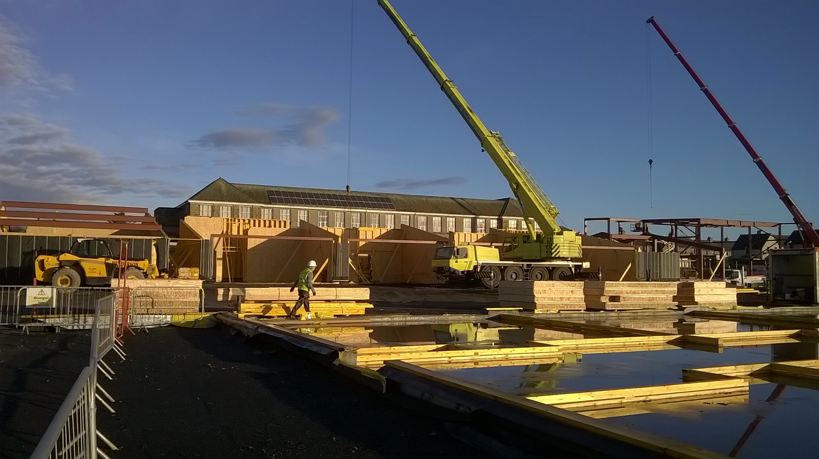
2.02 Photographs continued

Slide 10
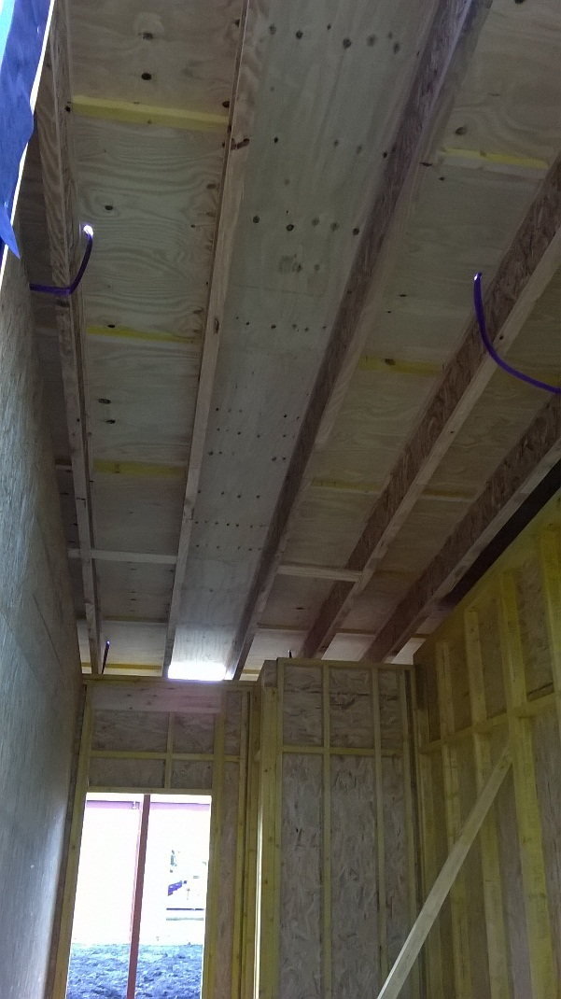
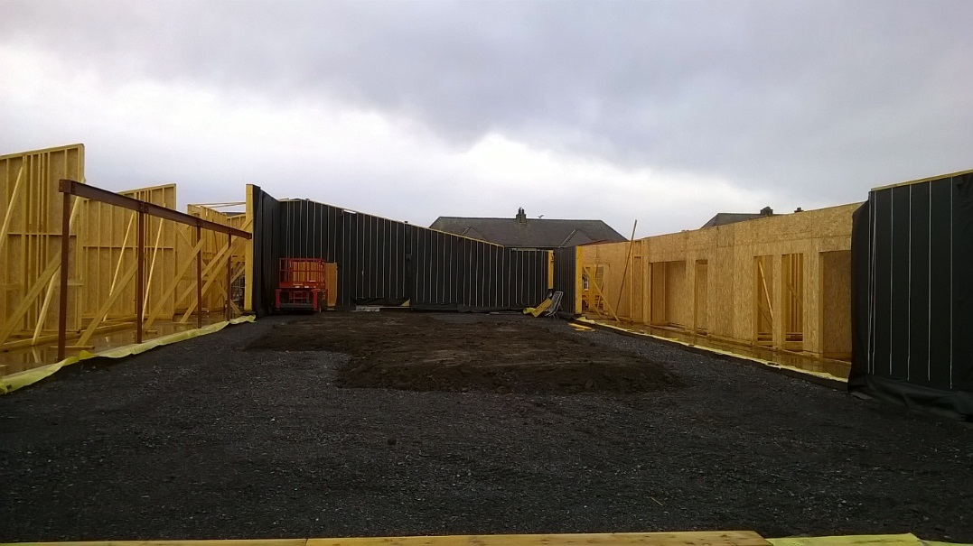
2.02 Photographs continued

Slide 11
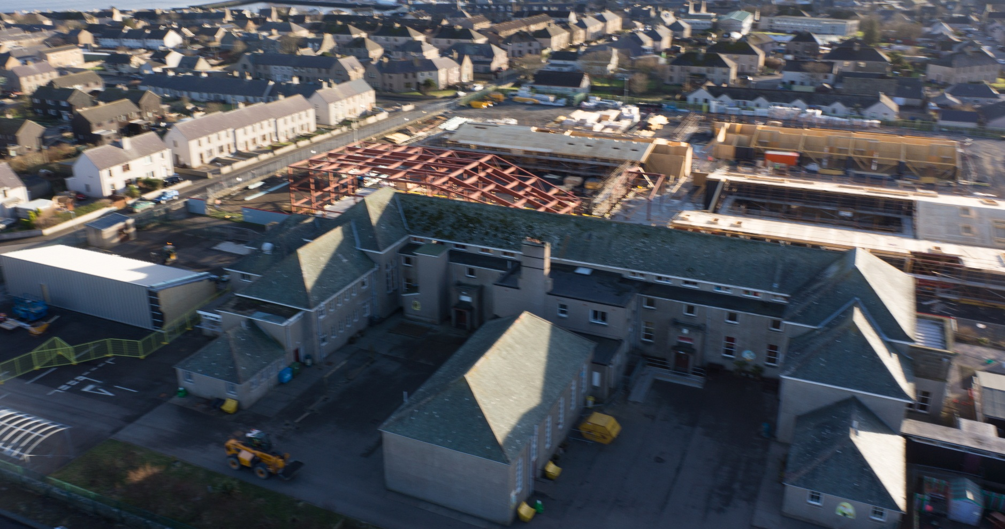
2.02 Photographs continued

Slide 12
4.00 Local Employment undertaken
The following has been undertaken by Morrison and our Sub contractors
Local Quarry products being used
Local Plant Hire being used
6 number local employees by GT
7 number local employees through sub contractors
1 Modern Day Apprenticeship for Admin identified
1 work experience student and 1 to commence summer at High School
2 number positions for apprentice Joiners
5 local companies employed across both projects
Pultney Town People’s Project (PPP) have been offered work experience

Slide 13

5.00 Community
5.00 Summary:
Campus is now registered and awaiting the first visit.
Noss Primary awarded Performance Beyond Compliance certificate further to November Site Inspection and Audit by the CCS Scheme Monitor. Next visit due March 2015

