Slide 1
Westhill Community Council Meeting 11th November 2015

Slide 2
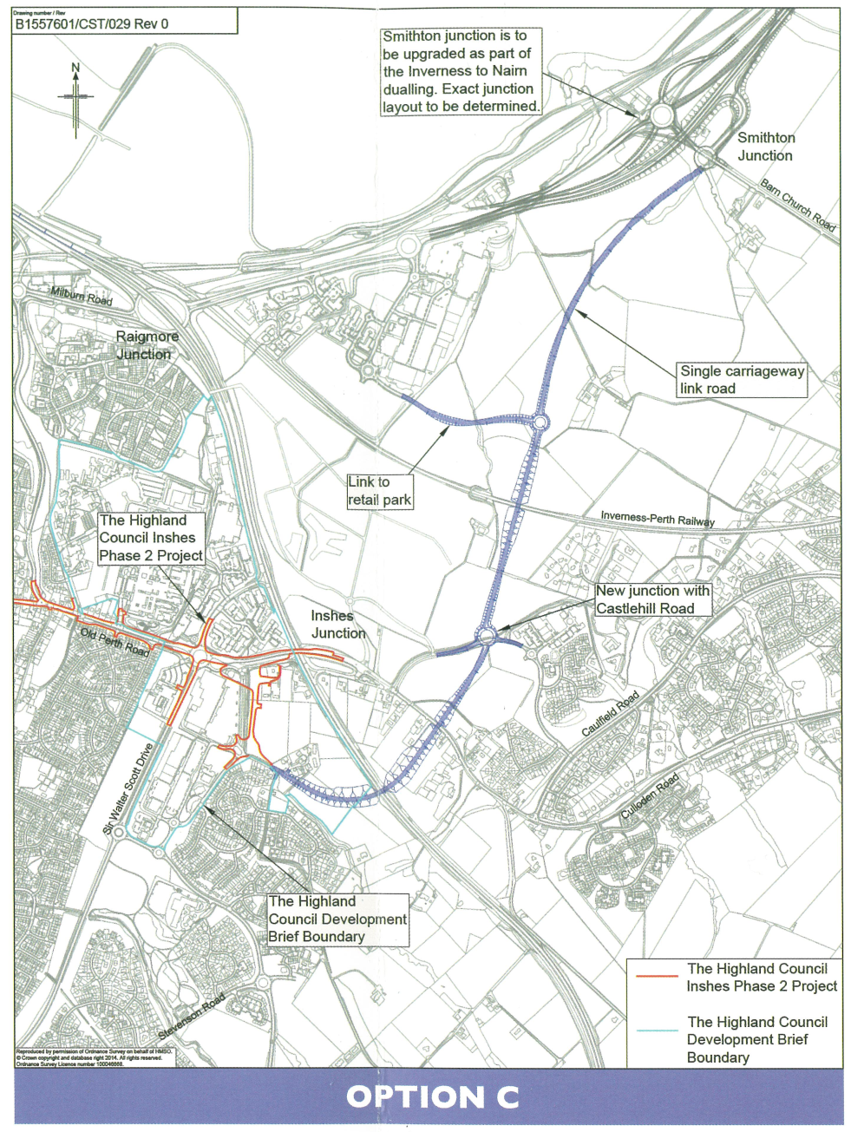
Transport Scotland Option C

Slide 3
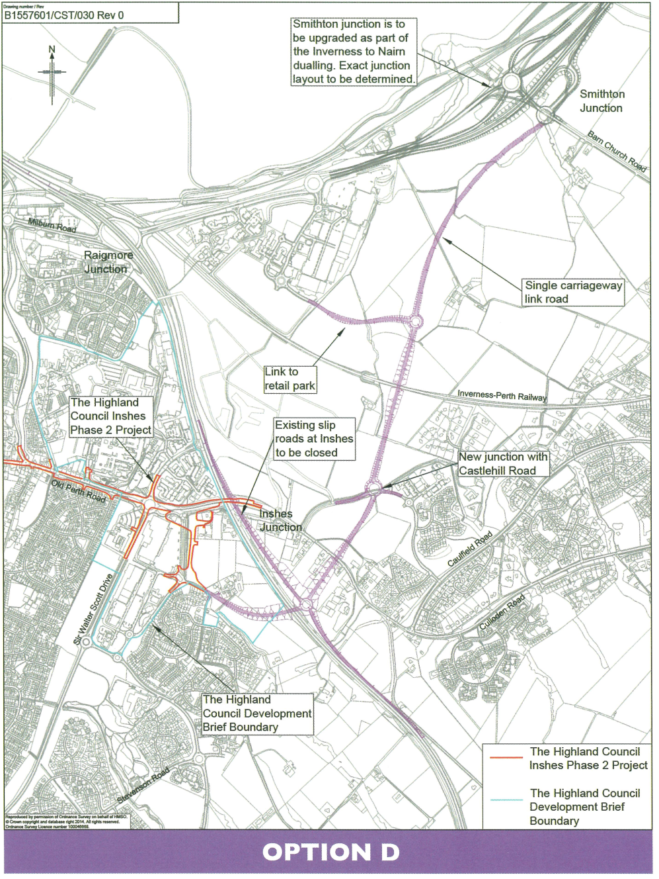
Transport Scotland Option D

Slide 4
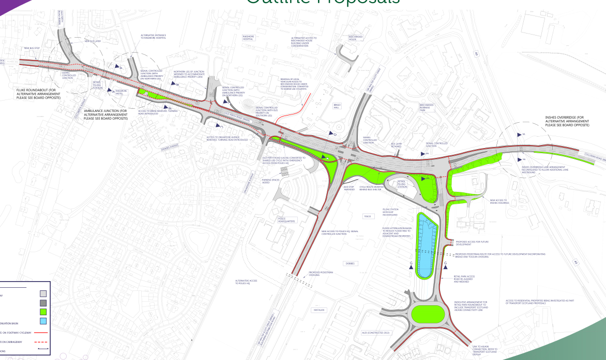
Inshes Junction Improvements - Outline Proposals

Slide 5
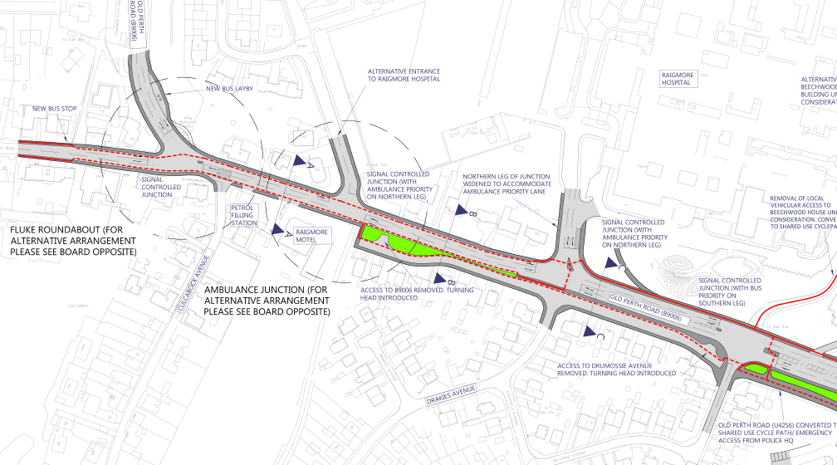
Inshes Junction Improvements - Outline Proposals

Slide 6
Existing roundabout approaches

Slide 7
Flaring on Sir Walter Scott Drive

Slide 8
Flaring on Culloden Road

