Slide 1
Redesign Board Workshop
15.8.17

Slide 2
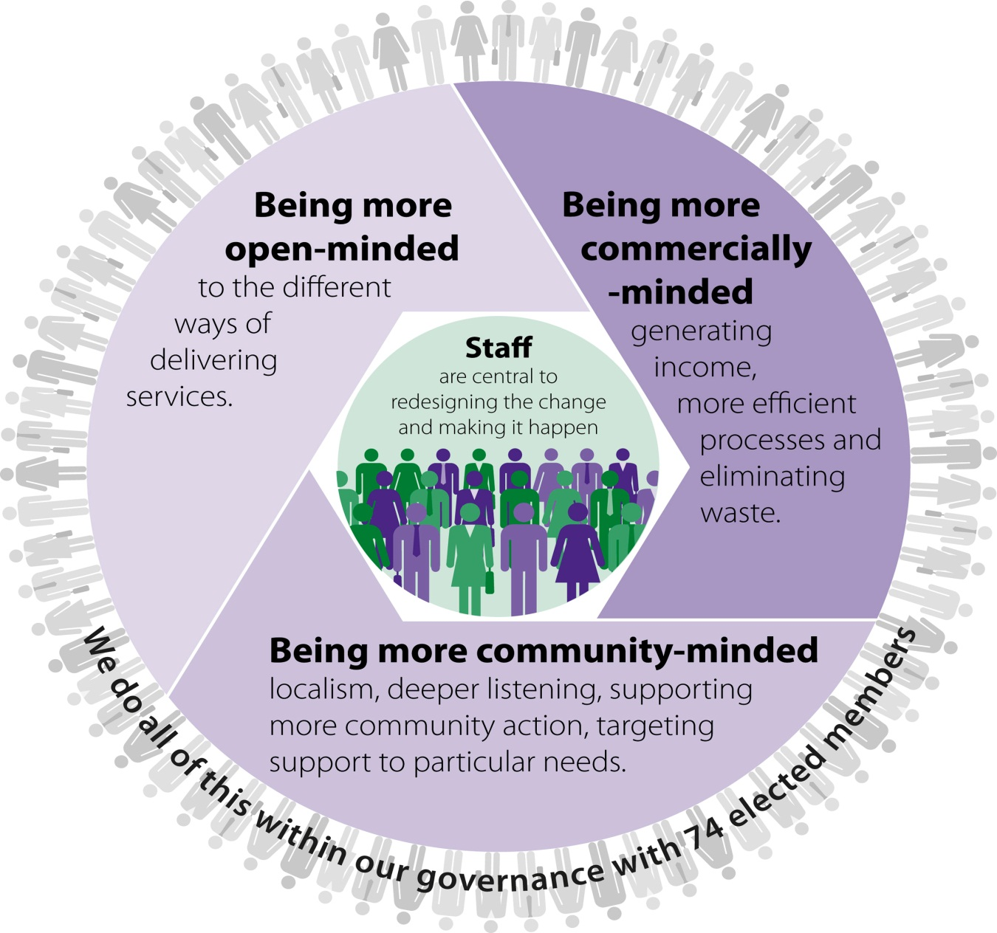
Redesign statement and recommendations

Slide 3
Informing the work plan
  Council already agreed
  Redesign statements – circulated in advance
  New governance arrangements
    Redesign Board for another year
    Fewer strategic committees, supported by policy development groups
    Commercial Board
    Greater community participation in local decision-making and supporting more community action – role of Board in overseeing this
    Board’s strong interest in identifying and being part of the process of peer reviews, updates on Lean reviews
    Outstanding action from former Redesign Board Programme to support organisational change
    Views on what still needs to be done

Slide 4
Workshop to identify what else should shape the work plan
How do you feel about the views of the outgoing Board on what to do next?
How well do you think we are demonstrating the values of redesign?
What do we need to pay more attention to?
What do you want to see achieved by your Board by June 2018?
Notes:
Review reports being finalised this month and will come back to the Board for Member views.
From the work done so far, some options favoured over others

Slide 5
So …
How do you feel about the views of the outgoing Board on what to do next?
8 cards each – place them on the table on the sheets, depending on whether you think they:
Are already in hand
Should be a new area of work
Not seen to be of benefit
Notes:
Review reports being finalised this month and will come back to the Board for Member views.
From the work done so far, some options favoured over others

Slide 6
So …
How far are we on the values scale?
4 dots, one for each value. Stick the dots on the scale.
no evidence of this at all
very little evidence
some evidence
good evidence
we see this every day
Some feedback on your choices.
Notes:
Review reports being finalised this month and will come back to the Board for Member views.
From the work done so far, some options favoured over others

Slide 7
Defining the best possible demonstration of values
Form 4 groups, pick 1 value and describe what ’10’ on the scale would look like and feel like for you. Write up all the views expressed (15 mins)
Think of a scenario
When I ask staff for something or suggest something ...
When I raise with other Members…….
When a constituent /community group approaches me, I can offer them ….
When a constituent /community group approaches me, I can ask them ….
I demonstrate this value by ……..
When I engage with partners I…………….
Notes:
Review reports being finalised this month and will come back to the Board for Member views.
From the work done so far, some options favoured over others

Slide 8
And about your views …
Dialogue walk – 20 mins – as far as you like
See the cards for instructions
When you come back write down on separate post-it notes
The change you want to see in the Council
Your hopes on what your Board should achieve by next year.
This will also tell us the work of the Board
If we have time we will share/discuss these views
Notes:
Review reports being finalised this month and will come back to the Board for Member views.
From the work done so far, some options favoured over others

Slide 9
Next steps …
All of the work today will help draft the remit and work plan.
Ready for you to see:
As a draft for the formal Board meeting on 29th August – discuss and amend at that Board meeting
As your recommendation for Council on 7th Sept.
Notes:
Review reports being finalised this month and will come back to the Board for Member views.
From the work done so far, some options favoured over others

