Slide 1
eRoad Construction Consent
Customer Briefing Session
Monday 11th December 2017

Slide 2
Speakers
Name | Role | Team/Location | Service
Richard Gerring | Transport Planning Manager | Transport Planning - HQ | D & I
Laura Williamson | Performance & Systems Support Officer | Planning & Environment - HQ | D & I
Jane Bridge | Senior Engineer | Transport Planning - HQ | D & I
Mark Clough | Senior Engineer | Transport Planning - HQ | D & I
Mark Smith | Senior Engineer | Area Roads – Lochaber, Nairn & Badenoch | Community Services
Joanne Sutherland | Senior Engineer | Area Roads – Caithness & Sutherland | Community Services

Slide 3
Agenda
Background
Key areas of focus
Planning Pre-app Plus Street Engineering Review
eRCC - CC9 Application Checklist
Web Pages, Forms and Guidance
eRCC - Submission and Approval
  Registration, Validation, Technical Approval
  Road Bond Value – Form & Guidance
  Issue of Approved RCC
Other Permissions
Road Bond Management
Road Construction Compliance Notification Plan (RCCNP)
Construction Phase
• Pre-Commencement
• Inspections & Stages of Completion
• Road Bond Management
• Amendments & Extensions of Time
Adoption Process
Next Steps

Slide 4
Background
Internal Audit
  Consistency of recording and monitoring
  Roles and responsibilities
  Clearer processes required
SG Aligning Consents framework
  To support Designing Streets
  Provide consistency & certainty of outcomes
  Making submission requirements clear
Customer Engagement Sessions – April 17
  Earlier engagement at Planning
  Consistency of response
  Clarification on Bond Value
  Clarification on process for Inspections and Bond release
  Clarification of Adoption Process

Slide 5
Key areas of focus…
Earlier engagement at Planning Stage
RCC Submission & Approval Process
Review of RCC Forms – New RCC Web pages
Information Required – CC9 Checklist
Use of ePlanning.scot Portal (existing functionality)
RCC Approval – Content of Issue Pack
Construction Phase
Pre-commencement & Notice of Start of Works
How Inspections are requested
Stages of completion and reduction of bond
Amendments and Extensions of Time
Adoption

Slide 6
Planning Pre-app +SER
Aspirations - Customer Engagement Sessions – April 17
  provide consistency between consents
  give earlier certainty for applicants
  allow flexibility
Key principles
  Consider key requirements for road construction consent at an early stage.
  Align planning consent with the requirements for road construction consent allowing road construction consent to focus on technical detail.
  Collaborative approach between Transport Planning, Planners & Community Services
Planning Pre-application Advice Plus Street Engineering Review (SER)

Slide 7
Planning Pre-app + SER
What is it?
  Optional addition to existing Major Planning Pre-app process
  Second meeting once road layout available
  Engagement with Scottish Water and Area Roads Engineers
  Will provide more detailed written feed back to help enable the planning permission submission to be aligned with the requirements for Road Construction Consent
  Not just for major developments
Piloting at present
  Upper Achintore, Stratton and Alness East
  Any other pilot proposals welcomed
  A charge for this Service will introduced in April 2018
  If you have a development that could benefit from this approach, please contact our Major Pre-application Advice Service in the first instance at majorpreapps@highland.gov.uk

Slide 8
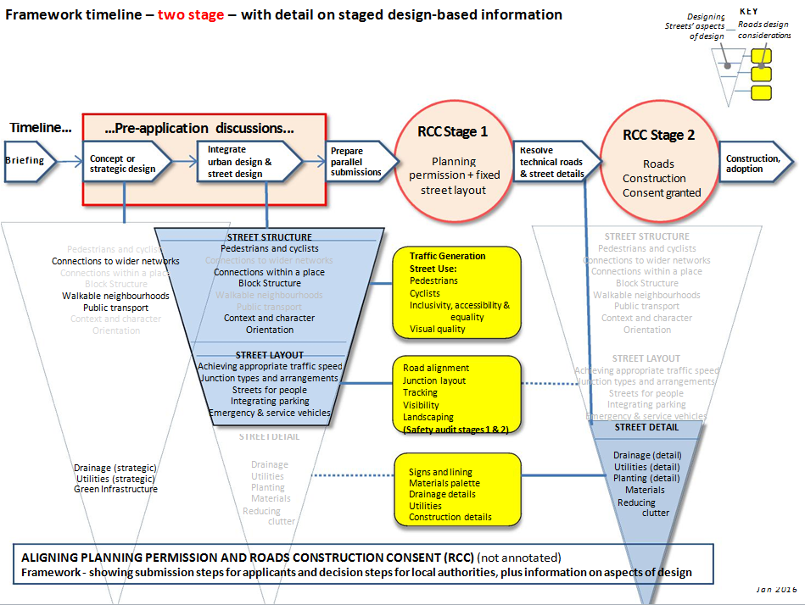
Planning Permission
RCC Stage 1
Road Construction
Consent
RCC Stage 2
Notes:
Adapted extract from Scottish Government’s Aligning Consents Framework - http://www.creatingplacesscotland.org/designing-streets/process/aligning-consents

Slide 9
Pre-app +
  Gateway Check undertaken for Pre-app+SER
  Prior to Planning Submission
  To ensure requirements highlighted and agreed during the pre-application process have been submitted and to explain any changes that have occurred.
Timescales
  Planning and RCC may be submitted at the same time.
  Generally RCC will not be issued prior to planning consent. It is not efficient to consider detail whilst there is significant uncertainty about major issues.
  The Pre-app + process should minimise the requirement for changes to planning layouts and submission of unforeseen additional information at RCC and lead to reduced time scales for RCC.

Slide 10
Pre-app +
Follow Up once eRCC and Pre-app + have gone live
  Aware there is more work to do on Technical aspect of THC guidance
  Internal Staff workshop on Designing Streets principles, typical details and materials.
  Refresh guidance.

Slide 11
CC9 - Application Checklist (1)
Notes:
CC9 – Application Checklist
Will be published on RCC web pages - https://www.highland.gov.uk/downloads/file/18675/cc9_-_road_construction_consent_submission_checklist_-_v10
Structured checklist - All required info.
Two parts (ePC and Transport Planning Team)
Should be completed and submitted electronically as part of your RCC Submission
We really want to work with you all as much as possible to reduce the amount of to-ing and fro-ing in order just to get RCC apps in a state where they are ready for Technical Review
As well as the pre-app Plus SER option available at pre-planning, we have also reviewed the CC9 checklist to be consulted and completed at the RCC submission stage
Here is snapshot the first page of the Validation Checklist - This is effectively the eProcessing Centre’s Validation Check – This approach has worked well for planning apps and so we have adopted this for RCC

Slide 12
CC9 – Application Checklist (2)
Trial Applications – Invalid Reasons
Drainage Assessment Missing
Street Lighting Plan not supplied (on all)
No Consultee Layout Plan, Kerb Layout Plan, Sign and Road Markings details, Flood Routing Plan, Services Routing Plan, Ground Information, Landscaping Plan provided
No Existing Levels Plan, Road Adoption Plan, Drainage Long Section Plan, Drainage Construction Details not provided
Notes:
Over the last couple of months we have been trialling the new approach to validating RCC applications
The above are the most common reasons we have found RCC applications to be INVALID

Slide 13
eRCC – Forms & Guidance
New RCC Web Pages
From the Home Page click on Transport and Streets then under ‘Information On’ click on Roads we maintain
On the left under ‘Related pages’
Road Construction Consent – Guidelines and how to apply including link to CC9 – Application Checklist
  Road Bonds – Guidance and how to lodge bonds
  RCC Forms – Application, Construction Phase & Adoption

Slide 14
eRCC – Submission & Approval (1)
Two part registration process
CC1 Form + 1 x copy of drawings IN PAPER to our eProcessing Centre
On receipt of acknowledgement – Upload completed CC9, CC2 Form and drawings electronically via ePlanning.scot using PSAD online form
No specific RCC online forms as yet – Using EXISTING ePlanning.scot Portal functionality.
Validation
Validation Check will be carried out by our ePC
Invalid applications will remain invalid for 28 days
If no further info received, the application will be CLOSED
Valid applications will be onward assigned to TPT for Technical Review

Slide 15
eRCC – Submission & Approval (2)
Why paper?
  Reduction in paper copies – three to one
  Still need paper to assist with assessment
Why Electronic?
  Full picture of related development consents
  Associated applications highlighted on Public Access
  Less chance of information going missing
  Better audit trail of what submitted and when
  Electronic means the information can get to the case officer quickly
  Can be handed over to the Areas quicker

Slide 16
eRCC – Submission & Approval (3)
Notifying interested parties can only start when application is VALID and drawings are available on Public Access
The RCC Issue Pack will be clear and with sufficient guidance
Won’t be the same s what you used to get – will help you with the next step - Area Contact, CCNP, Bond Style etc.
Status updates will be available on Public Access
  Under Consideration (Technical Review)
  Road Construction Consent Granted

Slide 17
Road Bond
Standard wording agreed with Council (Legal Services)
Contained in Issue Pack and on web pages
Save time in reviewing
Developing a new bond determination form and guidance to assist in calculating the Bond Value
We will establish summarised rates

Slide 18
eRCC – Submission & Approval (3)
RCC Issue Pack
All of the following will be issued via our Public Access site
Covering letter
RCC Approval Document
Bond Determination Sheet – Will be emailed separately
Style Bond
Lodge a Cash Bond Form
Road Construction Compliance Notification Plan (RCCNP)
Notice of Work Stage Completed (NWSC)
Notification of Start of Works (NCSW)

Slide 19
eRCC – Submission & Approval (4)
RCC Issue
RCC Issue Pack - Issued Electronically via Public Access
No longer be issuing Fee invoice at this Stage
  This will be issued to you following pre-commencement
We will not issue any RCCs until the 28 day Neighbour Notification period has passed
Will not normally issue RCC until planning permission is granted
Prior to issue we will require 1 x hard copy of approved drawings to be submitted

Slide 20

QUESTIONS?

Slide 21
Other related permissions
Other Permissions
Planning Permission
Permits for working on public roads
Notice Periods required
Fees for these payments
Maintenance periods associated with them
There will also be a link to this web page in the RCC Covering letter

Slide 22
Road Bond Management
Lodging a Bond
Value of Bond will continue to be stated in the RCC Approval
Bonds MUST be lodged with Council PRIOR to housebuilding commencing
Cash Bonds or Financial Guarantees accepted
Bonds should be submitted to our eProcessing Centre
Lodge a Cash Bond Notification Form
Style Bond (Financial Guarantees) will be on website and in RCC issue pack
Bonds received will be checked by Finance & Legal Services (only Finance if use standard Bond Style)
Will be treated by us as ‘draft’ initially
You will receive confirmation that your Bond has been received and is acceptable
Notes:
As noted the value of the Road Bond will be agreed during the approval process with the Transport Planning Team and approved methods of submitting a Bond will outlined in the approval
The online eRCC system will have the appropriate forms and guidance for lodging a Road Bond
The Road Bond status and ongoing requirements will be included as an item in the prestart meeting and any subsequent meetings, (out with inspections)

Slide 23
RCCNP (1)
Road Construction Compliance Notification Plan (RCCNP)
Adopted from Building Standards
Engagement Sessions - Points at which Inspections required not clear
Sets out when we would like to be notified
Area Roads decision to inspect or not
This document will be discussed at pre-commencement
Notification of Pre-commencement is first item on this document…
Notes:
The Road Construction Compliance Notification Plan has been adopted to provide a clear and consistent information source.
It covers the contacts for the development and Council
It also notes the main elements that are required in the ongoing inspection and monitoring process
The form will be used at the pre-commencement meeting to advise on inspection requirements and for noting element that are completed through the development construction period

Slide 24
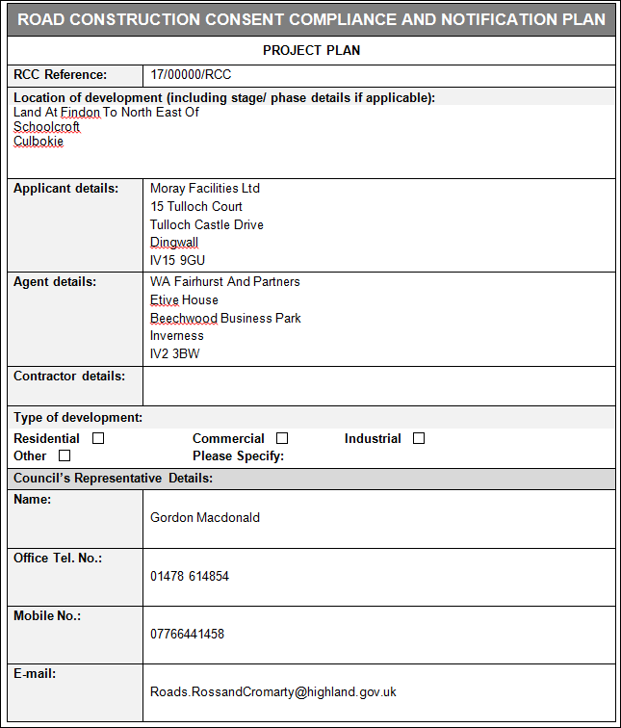
RCCNP (2)
Notes:
Here is an extract of the RCCNP document
Location and confirmation of contact details for all relevant parties

Slide 25
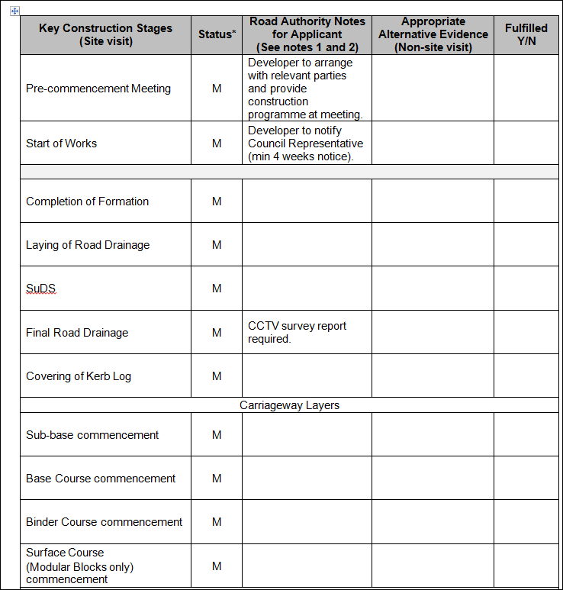
RCCNP (3)
Notes:
Here is an extract of the RCCNP document
This shows the inspection elements required for notification
We recognise that the elements noted are going to be phased and multiple inspections may be required for each construction element but we will endeavour to group inspections for elements
The form updates will be completed and signed then electronically filed in the development folder

Slide 26
Construction Phase
Pre-Commencement
Email Area Roads generic email to notify date of pre-commencement meeting – 4 Weeks Notice Required
Representative from Area Roads will attend
Discuss/Agree the RCCNP document /Works Programme
Notice of Start of Work – 4 weeks notice now required
Invoice for Inspection Fee will be raised (New)
Staged Payment will be considered if required e.g. three annual payments
Notes:
The development representatives will be required to make contact through the generic Area email address noted on the RCCNP form to arrange a Pre-commencement meeting 4 weeks prior to start
Contractors programme will be required to advice the initial inspection requirements and copies of the amended/updated programme will be required by the Area staff through the contract period.
Item 3.2.1.1 “Notice of Commencement” in the current Roads and Transport Guidelines for New Developments it states that 2 weeks notice must be given. This has been extended to 4 weeks to allow greater flexibility in the meeting arrangement.
The appropriate value of the inspection fees will be confirmed and stage payment dates agreed if required
An appropriate invoice will be raised to the specified recipient.

Slide 27
Construction Phase
Inspections & Stages of Completion
Notice of Work Stage Completion Form should be used to notify us
Should be submitted to eProcessing Centre – online or in paper
48 hours notice required prior to completion of item/stage
Area Roads will decide if inspection required or not
You will receive a covering letter and Certificate for each stage reached
Area Roads issuing this will trigger the appropriate reduction of the Bond
Bond is released when we are satisfied is road completed (Final Completion)
Notes:
The Notice of Stage completion form should be submitted to request an inspection for Substantial completion which on completion will trigger the start of the one year Maintenance Period of the development
We have provisionally reduced the notice period for the inspection request for the construction elements.
This is to reduce the amount of time that the Contractor has to have the layer open such as the formation.
Completed and protected with the next layer will ensure a better finish.
It is also intended to reduce the possibility of abortive inspection visits due to the layer not being finished.
The shorter timescale gives the Contractor an easier timescale to deal with.
Item 3.2.3.1 “Notice of Operations” in the current Roads and Transport Guidelines for New Developments states that a minimum of 5 working days written notice must be given for the
approval of formation,
Commencement of construction layers
Concrete pours etc.
As stated this reduction is provisionally reduced – if issues arise during the construction that

Slide 28
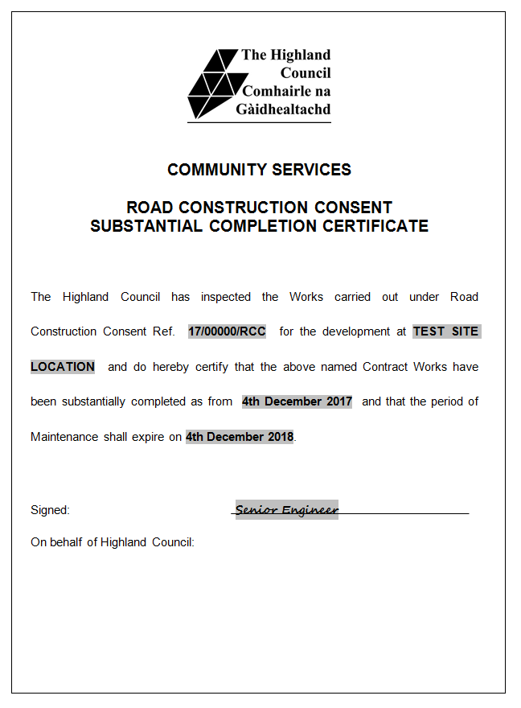
Construction Phase
Stage Completion Certificate
Notes:
This is an example of the Substantial Completion Certificate that will be issued to confirm that greater than 90% of the road and associated works have been completed
It will be issued after a formal inspection is carried out and the snagging list of works agreed
The issue of this Certificate will trigger the commencement of the Developers One Year Maintenance Period

Slide 29
Amendments & Extensions of Time
Amendments to RCC
  Applications should be made to the Transport Planning Team using the appropriate form
  Form will be available on the web pages
  Same submission process as original RCC submission
Extensions of Time to RCC
  Area Roads may agree this course of action where the RCC has expired (3 years)
  There will be a 6 month reminder internally
  You will be contacted by Area Roads to clarify plans for completing the road
  Transport Planning Team would re-issue documentation
Notes:
Any proposed Amendment to the Certified development details must be discussed with the Area Inspection team.
Small scale amendments such as relocation of light columns, gully positions and minor kerb realignments can be agreed with the Area inspection team but Amendments that have a greater effect on the design will be referred to the Transport Planning Team that processed the RCC application
The Extension of Time for an RCC maybe considered and approved for developments that have suffered some form of unavoidable delay.
A programme for the completion of outstanding works will be required from the Developer/Contractor to justify the extension requested.

Slide 30
Request Adoption
Introduced an Application for Adoption Form
  Issued with Substantial Completion documentation
  Also available on new web pages
  Details supporting information required and a table to set out what you are submitting
Adoption does NOT happen automatically – You have to submit the above form and following documentation:
  AS Built drawings
  Health & Safety File
1 x paper copy of AS BUILTS and 1 x electronic copy to ePC
  Electronic copy of original CAD file should be submitted on disc to ePC
Notes:
To take into account that some developers do not want their development road/s adopted by the council there will be a new form introduced to the Substantial Completion documentation package. The Application for Adoption form will require to be submitted to confirm the desire for adoption.
There will be a Final Completion Inspection carried out prior to the end of the One year Maintenance period to confirm all items on the snagging list have been carried out and that no further defects have developed that will require repairs before the road is adopted by the Council.
Please note the documentation requirements prior to adoption is possible.
It is expected that all documentation and residual repairs, if required, are completed within 4 weeks of the Final Completion Inspection and are lodged with the Council. If all information is in place the Adoption procedure will be carried out. If the time period is greater, the Area Staff may require to carryout a further inspection before adoption

Slide 31
Next Steps
Now and Go Live
Any developments that would benefit from Pre-app Advice Plus SER would be welcome for the pilot between now and April 2018
Go Live Date - Monday 8th January
Initial go live period of 3-6 months
Happy to take comments on the new process and documentation to ercc@highland.gov.uk
Post Go Live
Review of THC Guidelines for new road developments
Cross-service Internal Workshop
April 2018 – Pre-application Advice Plus SER Charge

