Slide 1
Redesign Board – 2018
Best Value Audit Reviews (BVAR)
Background
Best Value - Statutory duty under the Local Government Scotland Act 2003 - places specific duties to: ‘make arrangements which secure Best Value’.
Area of external audit interest – extent to which Council meetings its statutory duties. High reputational risk.
The Accounts Commission implementing a new approach to assessing Best Value (BV) compliance through Best Value Assurance Reports (BVAR).
Last Best Value Audit of the Council was in 2009 (overall very positive report). New regime, new environment, cannot be complacent.

Slide 2
Redesign Board – 2018
BVAR
Accounts Commission Key Messages:
14 Councils had not has a BV report in the past five years (applies to HC);
15 current Chief Executive have not had a BV audit (applies to HC);
Concern there is a perception a BV indicates a poor or failing Council;
Concern Councils are coasting;
Identified a need for more frequent assurance;
Need for greater focus on impact of BV arrangements and on improvement;
Consider the potential of bringing Local Government audit work together to provide a more collective views and judgements.

Slide 3
Redesign Board – 2018
BVAR
What we know so far:
New external audit appointments started in 2016/17 (new HC Auditors Grant Thornton) and BV reporting will be over the 5 year cycle of external audit appointment;
HC report on our Local Scrutiny Plan by external audit in May 2016 stated that HC was recommended for some early Best Value scrutiny;
Early indications now are this may be either thematic or a focused risk based approach rather than a full Council BV and will link to ongoing work of our external auditors;
1st tranche of BVAR reports during 2017/18 have been consistent and while the focus and evidence gathered will differ they have all covered:
Does the Council have a clear strategic direction?
How well is the Council performing?
Is the Council using its resources effectively?
Is the Council working well with its partners?
Is the Council demonstrating continuous improvement?

Slide 4
Redesign Board – 2018 BVAR
Key areas of audit:
The Council’s Vision (priorities);
Performance and outcomes;
Change and improvement plans (City Region Deal, Digital First, budget decisions);
Process and results of self evaluation;
Financial management and planning;
Workforce planning;
Community & citizen engagement (Citizen’s panel, participatory budgeting);
ALEO’s governance arrangements;
Transformational change and service redesign – new and more effective ways to provide local services.

Slide 5
Redesign Board – 2018 BVAR
Approach to Audit:
Interviewing councillors, senior officers and partners;
Observing a range of council and committee meetings;
Reviewing documents and performance data;
Conducting focus groups with councillors and officers;
Drawing on current external audit reports and assessments.

Slide 6
Redesign Board – 2018
BVAR so far in Scotland
Councils were commended for:
Clear plans and priorities
Good communication with staff and the public
Staff/ Elected Member development programmes
Councils were criticised for:
Poor training and development for Elected Members
Unclear plans & strategies with outcomes not clearly defined
Poor workforce planning and forecasting.
Councils were encouraged to work on:
Better reporting and monitoring of the link between performance indicators and priorities/ outcomes
Providing training and development for Elected Members

Slide 7
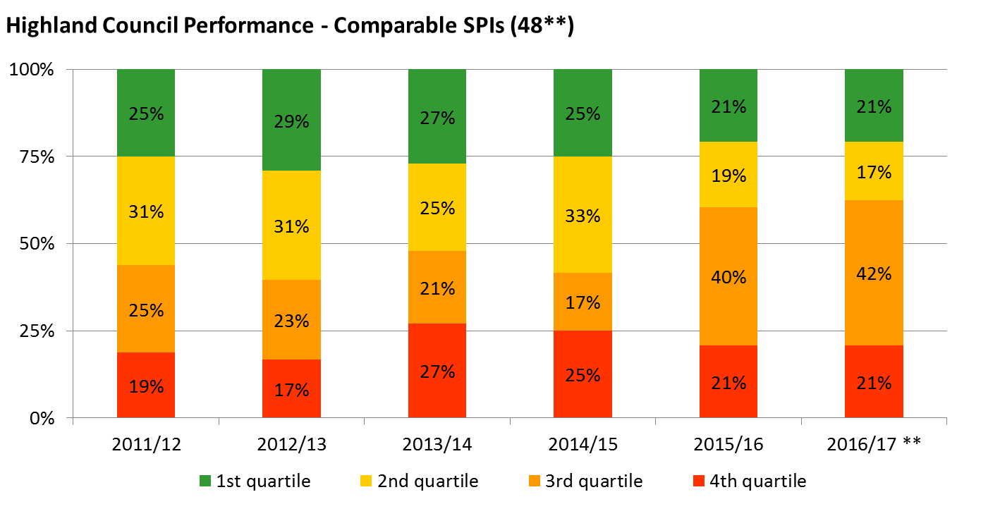
**LGBF data not yet published for five comparable Children’s indicators for 2016/17 (previously three of these were in the top quartile, one in the third quartile, and one in the bottom quartile. These are assumed to be the same for 2016/17 as the previous reporting year
Notes:
*LGBF data not yet published for five comparable Children’s indicators for 2016/17 (previously three of these were in the top quartile, one in the third quartile, and one in the bottom quartile

Slide 8
0%
24%
20%
38%
40%
44% top 2 quartiles, 38% third, 18% bottom
63%
75%
71%
Children’s Services (17) | Corporate Services (8) | Social Work (4) | Housing (5) | Culture & Leisure (8) | Environ. Services (14) | Corporate Assets (2) | Economy (5)
0%
22%
38%
25%
40%
39% top 2 quartiles, 42% third, 19% bottom
60%
63%
50%
Children’s Services (18) | Corporate Services (8) | Social Work (4) | Housing (5) | Culture & Leisure (8) | Environ. Services (14) | Corporate Assets (2) | Economy (5)
Notes:
Data is provisional and a few indicators are not included as data has not been published.
Can be updated w/c 5th Feb

Slide 9
Redesign Board – 16 Jan 2018
BVAR – role of Redesign
Redesign is demonstrating a strategic approach with a well defined methodology which provides evidence that the Council:
Has a clear strategic direction;
Reviews how well it is performing;
Considers how effectively it is using and deploying resources;
Where appropriate assesses if partnerships are working well;
Can demonstrate continuous improvement.
To date these areas have been the main focus of BVAR

