Slide 1
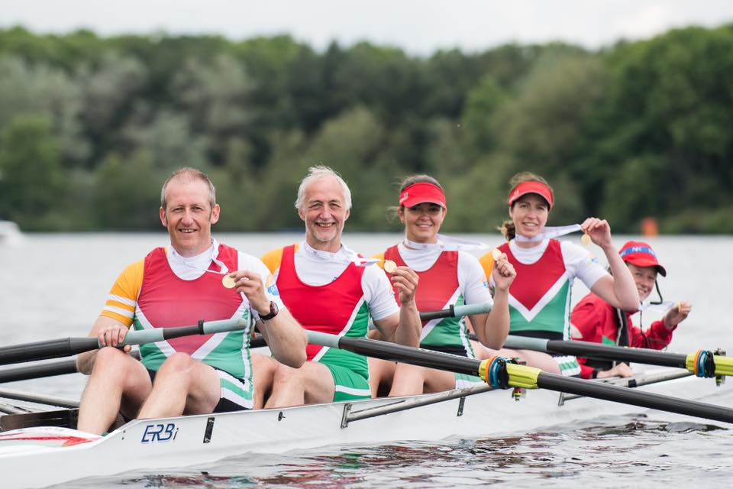
Inverness Rowing Club Development Plans

Slide 2
Club History and Highlights
Founded 30 years ago
Around 50 active members (ages 12 to 76)
Two World Champions and One Olympian
World Masters Champions
British Junior and Masters Champions
Many Scottish Champions
Run biggest “Head” Races in Scotland in November and February
500 boats racing over 4.5km from Dochgarroch to Inverness over 4 divisions and 2 days
600+ visitors for these weekends

Slide 3
Current Situation
Boathouse
Full to capacity
One WC, cold water tap, small diesel generator
Not fit for modern expectations
Waiting List
Growth constrained by lack of boat storage space
Better facilities required before we can offer social as well as competitive rowing
West Link
Delayed our proposed (2004) boathouse extension
Architect designed extension no longer affordable

Slide 4
Plan B

Slide 6
Design Summary
Accommodation Pod
Land training
Crew briefing
Rest & recovery area
Shelter for visitors
Changing Pod
Boat Storage
On land released by move of Torvean Golf Course
Community Asset Transfer
Capacity to grow to 200 members
Potential for future growth (UHI and Schools Clubs)

Slide 7
Key Milestones
Pre-planning application (July 2019)
Community Consultation
Community Council
Other Inverness sports clubs (Sportscotland)
Scottish Rowing
Design Finalisation
Community Asset Transfer
Application Q3 2019, Completion Q3 2020
Planning Permission
Needed by Q1 2020
Grant Application
Sportscotland Apr 2020
Others Q2 2020
RJ McLeod
Leave site Q4 2020
New Facility Opening
Q4 2020/ Q1 2021

