Slide 1
Social Media Do’s & Don’ts

Slide 2
Creating a safe & secure online experience
Why is it important ?
The internet is a technological wonder, pushing the boundaries of the way we live. We communicate through email and facetime, share our thoughts and opinions on twitter, buy stuff on Amazon, conduct business transactions online, watch movies on Netflix and even medical diagnosis is done via the internet. It is impossible to imagine life as we know today without the power of internet.
While the internet brings with it countless benefits, it is crucial for us to be aware of growing safety, security and privacy risks in the cyber world. Information in the wrong hands could have catastrophic effects on personal and professional lives.

Slide 3
Why use social media ?
Hear and be heard | A free & open platform (almost) | It is direct and instant
It is the easiest way to broadcast your ideas and get feedback from your community | In principle, social platforms do not discriminate and everyone’s welcome Beware of selective censoring of content based Understand that social platforms make money through advertising served to users | Instantly get feedback on your content Your content directly reaches your followers

Slide 4
But first, some hygiene checks
Social media accounts | Passwords | Privacy
Keep track of your active and inactive accounts Fewer the better Scan for bogus/fraudulent accounts regularly and report them | Never ever share passwords Change passwords regularly Don’t write down passwords | Go through privacy settings for your account Make sure you understand who sees what before sharing anything on social media

Slide 5
Check, re-check the source
It’s on google and hence it is true NOT ALWAYS ! | How reputed is the information source? Ask yourself: Do you trust the person/organization? | Does it look like fake news? Watch out for manipulated headlines / hooks / images / videos

Slide 6
Be aware of the content you share
Be sensitive to gender / racial / age / class stereotyping | Post only appropriate content – no explicit material | Get your facts right ! – always publish referenceable sources

Slide 7
Remember…
Once on the internet,
always on the internet !!

Slide 8
Understanding accounts and logins
Security Tip
In many cases, such as Facebook and Twitter, your email id is used as username.
However, remember to create a different password for each website/service you sign up for and never use your email password.
Most websites/apps offering any service requires you to create an account. The account has a username and a password which you will use to login to the account
For additional security, some services provide a 2 factor authentication. Along with a password, a 2nd level of authentication may be applied. This 2nd level of authentication is typically done via your mobile phone (SMS based one time passwords, approval via specialized apps on your phone etc)

Slide 9
First, some basics
The world’s largest social media platform. Users across all ages
A very popular platform for tweeting short messages. Celebrities and heads of states use this extensively
Owned by Facebook, a 1 to 1 and group communication app
A photos driven platform, alternative to Facebook. Also owned by Facebook. Popular with youngsters
The largest video sharing website
Extremely popular with millennials. A short video sharing platform
Another photos/stories driven social media platform popular with youngsters
A professionals only social networking platform

Slide 10
To get started, you’ll need
1
Laptop
Mobile
Tablet
OR
OR
AND
2
Mobile Number
(for verification and authentication)

Slide 11
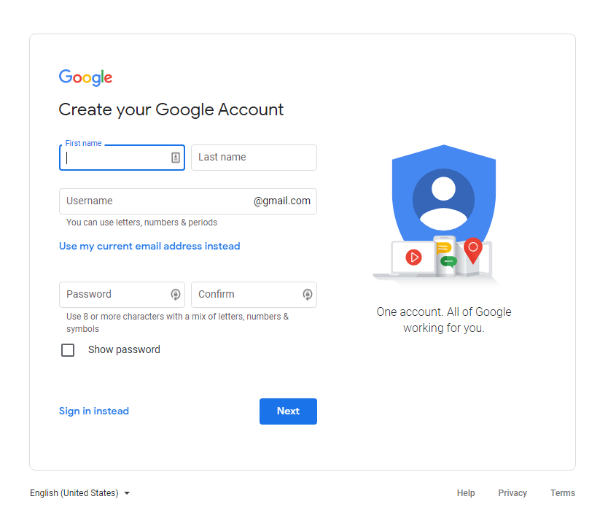
Creating an email account
Visit Create your Google Account for Gmail.
or type https://accounts.google.com/SignUp in your web browser
There are many email service providers such as
GMAIL, YAHOO, HOTMAIL
In this example, we will look at GMAIL.
Setting up a free Gmail account is a quick, easy process that takes little time to complete. Below are the step-by-step instructions you'll need to create an account and start using Gmail in no time.

Slide 12
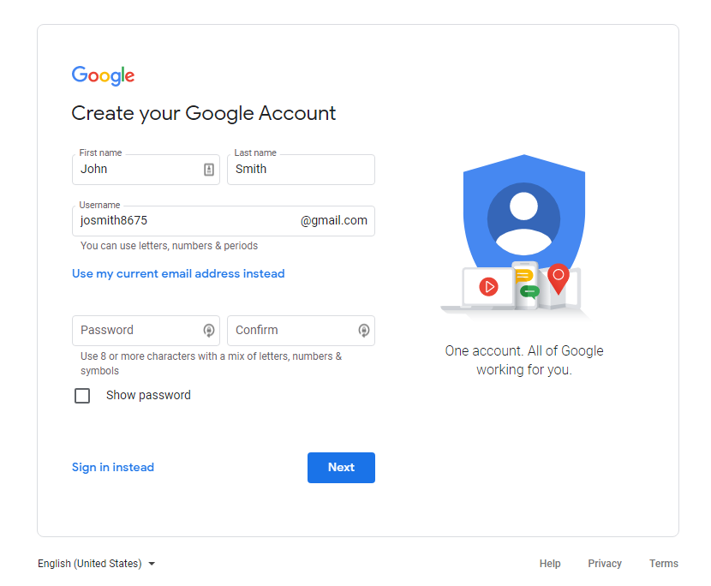
Creating an email account
2. Enter your first and last name.
Tip
Your Gmail email address will be your username followed by "@gmail.com." If your Gmail username is "example," for instance, your Gmail address is example@gmail.com.
Google needs some fairly basic stuff to open your Gmail account: your first name, last name, the username you want, and a password typed twice.
While there’s no rule that you have to use your real name like with Facebook, bear in mind that this is how your emails’ recipients will see you.

Slide 13
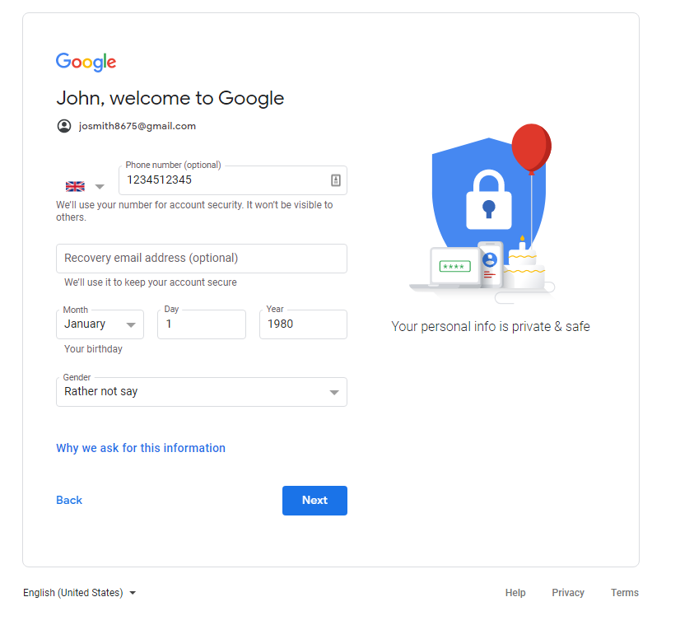
Creating an email account
3. Enter your mobile phone number and/or an alternate email address for account verification and authorization. Google uses this information to to allow you to recover a lost password.
Enter your birth date and gender (all fields are required).
Select Next.

Slide 14
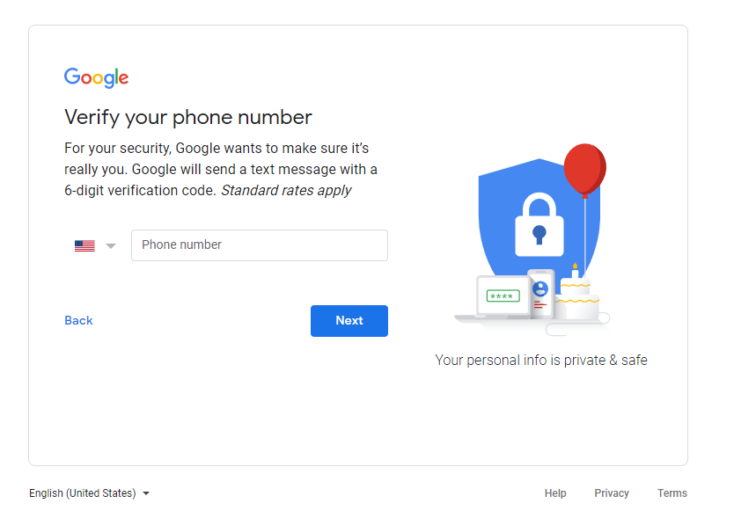
Creating an email account
4. You will be asked to verify your phone number or alternate email. It is a useful feature that can help with authentication and recovering your password in case you forget it.
Click Next

Slide 15
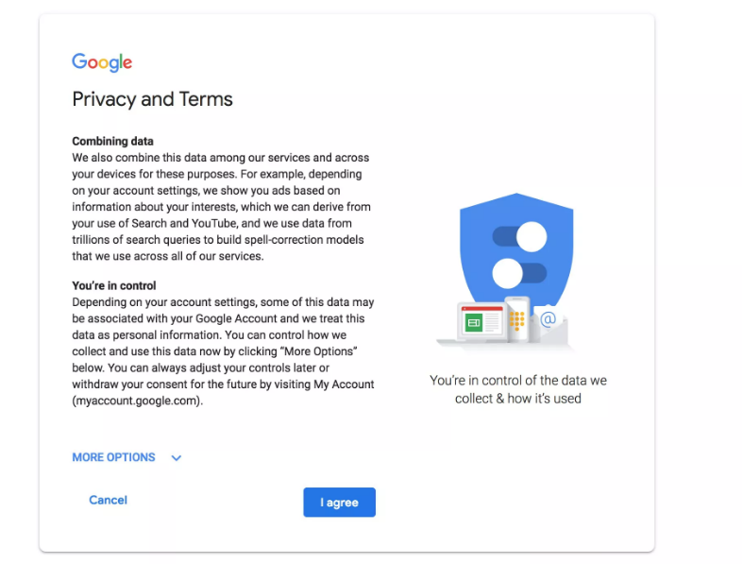
Creating an email account
5. Read and the Privacy and Terms and then select I Agree to continue. If you click Cancel, you will not be able to create a gmail account.
6. You'll be directed to the My Account page for the email address you just created. From there, you can sign into your account, manage your personal information, and set your account preferences.

Slide 16
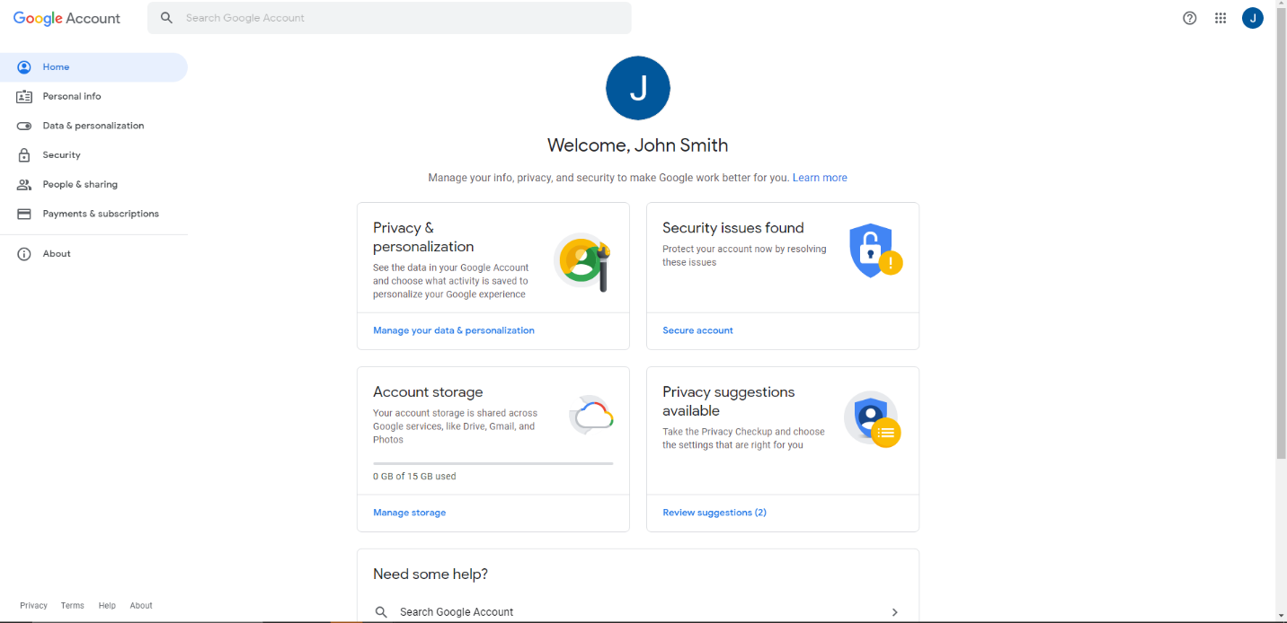
Creating an email account
6. You'll be directed to the My Account page for the email address you just created. From there, you can sign into your account, manage your personal information, and set your account preferences.

Slide 17
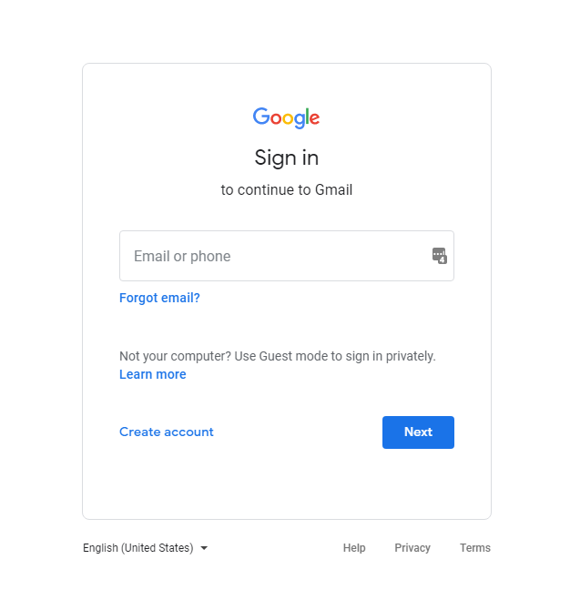
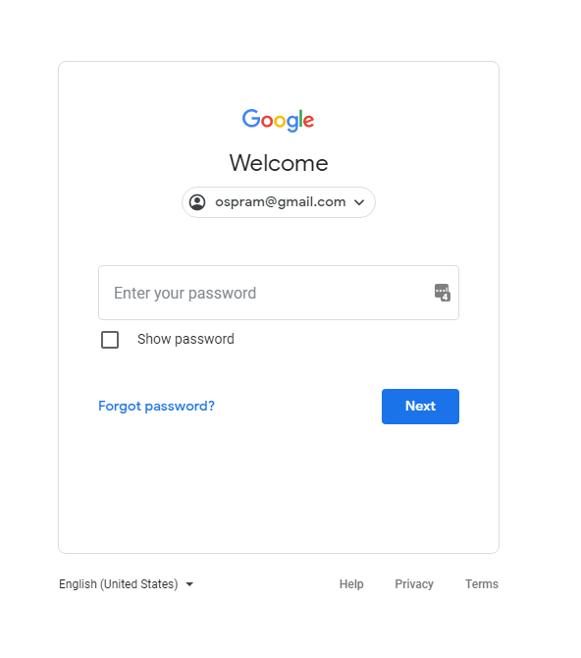
Accessing Gmail
Type in www.gmail.com on your web browser
Or
For android devices, open gmail app
Or
For Apple devices, download gmail app from app store
Enter your email address (which you just created) and enter your password in the next screen to login

Slide 18
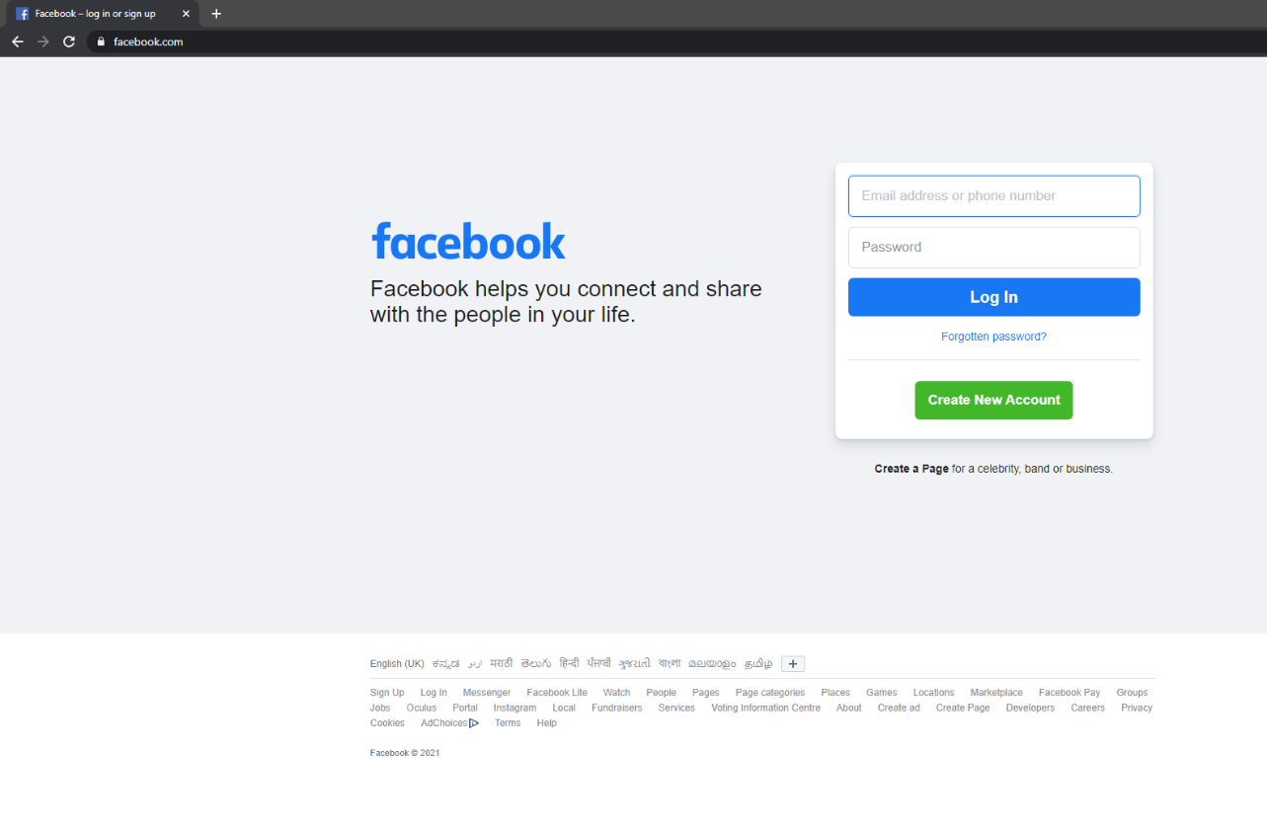
Setting up a Facebook account
Go to facebook.com on your web browser
Click on
Create New Account

Slide 19
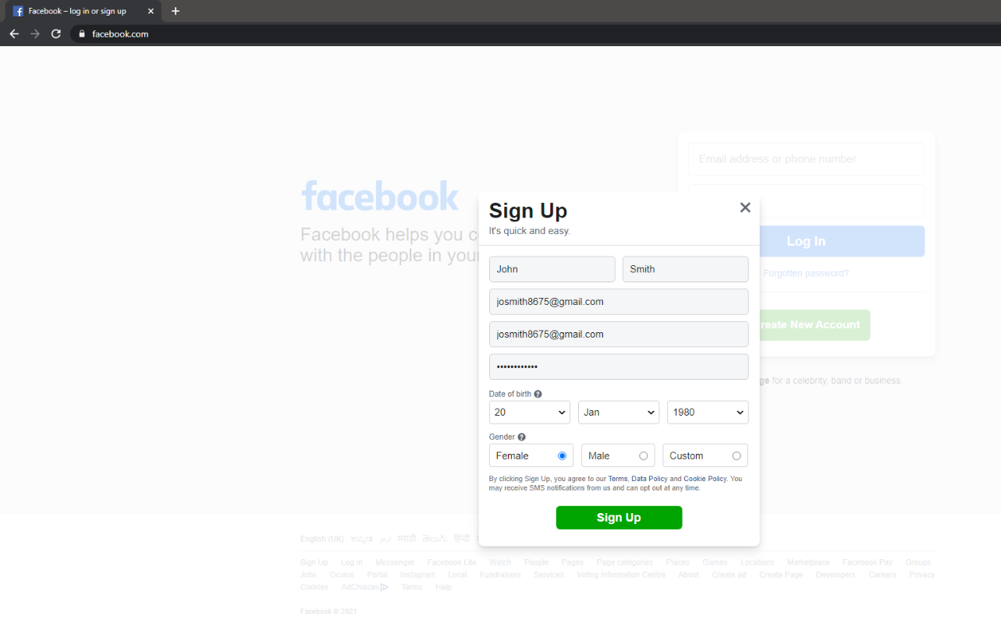
Setting up a Facebook account
Fill in your name and your email address
Fill in a password for your Facebook account.
Remember that this is NOT the same password as your gmail account.
A good security practice is to have unique passwords for each service you sign up.
Click on
Sign Up

Slide 20
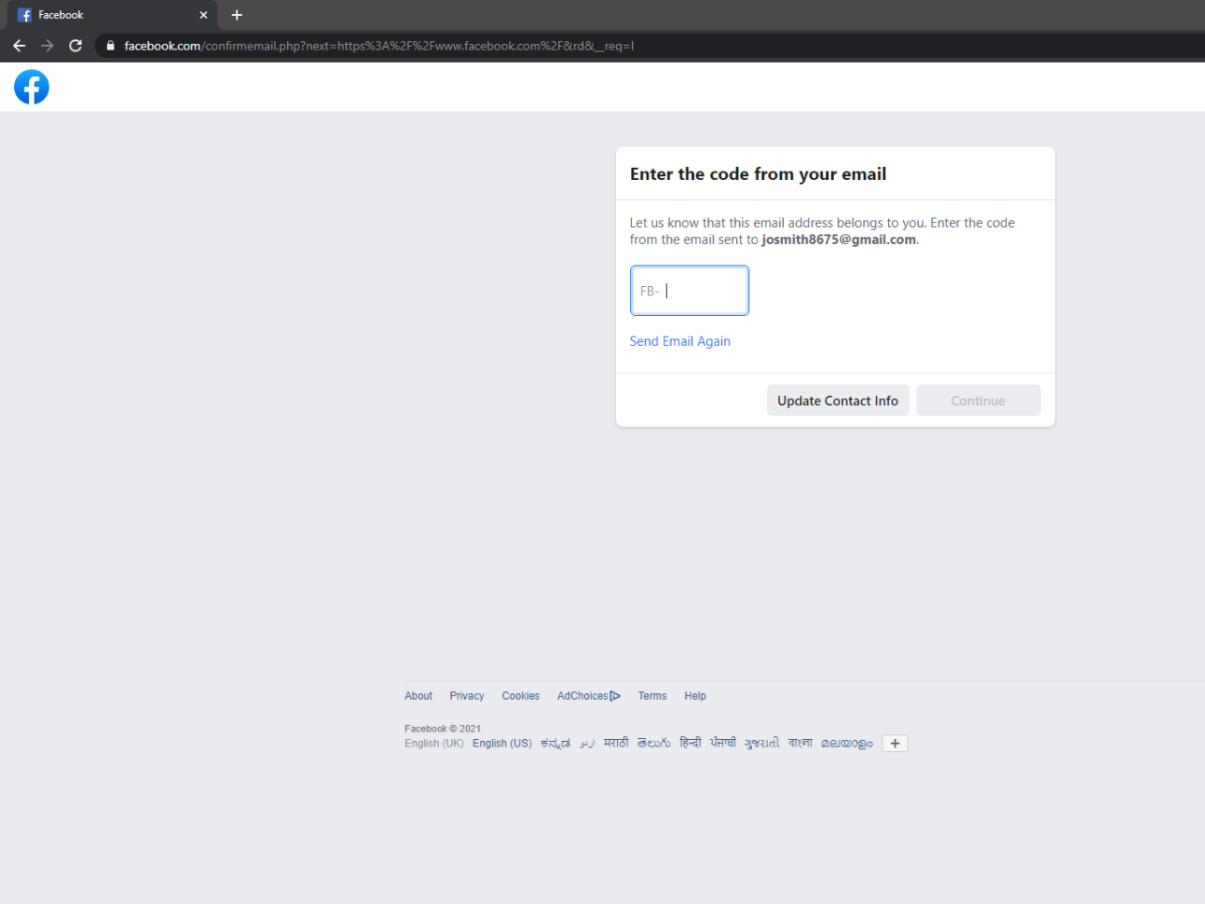
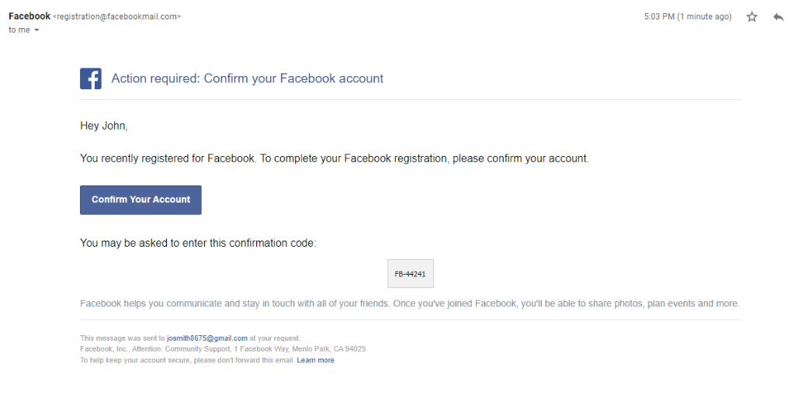
Setting up a Facebook account
Facebook would have sent you a code to the email address you entered in the previous step. Enter the code and click on Continue.
This is to ensure you are the right owner of the email address and verify.
The email from Facebook will look something like the image below

Slide 21
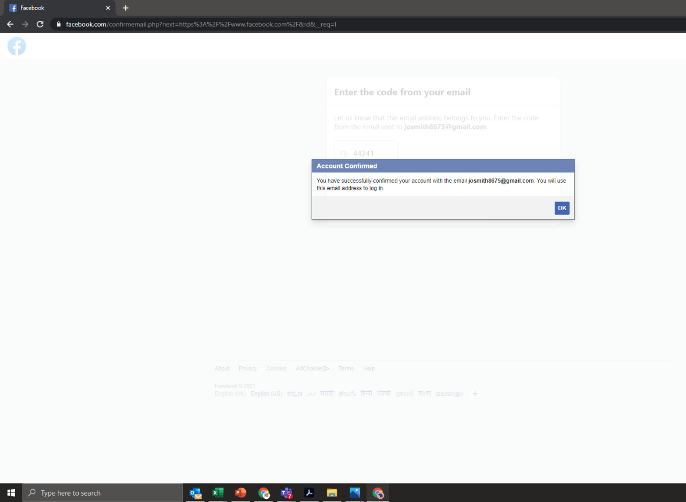
Setting up a Facebook account
Once you click Continue, you will get a confirmation message

Slide 22
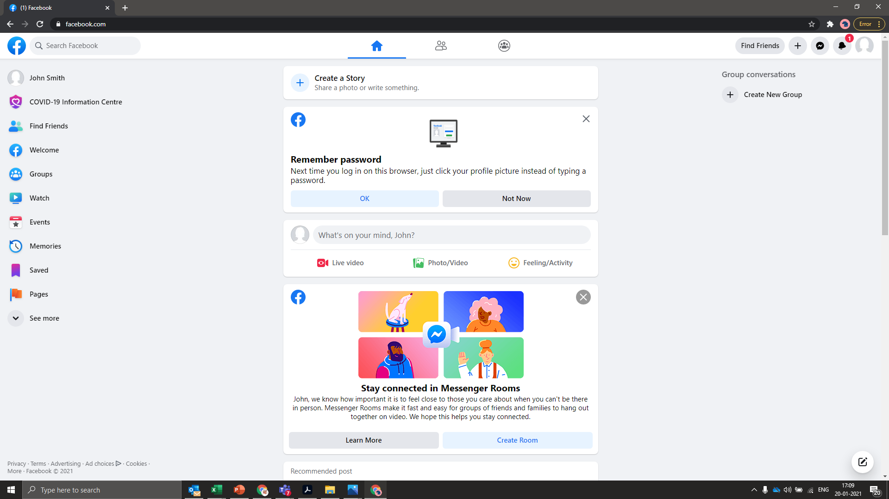
Setting up a Facebook account
You will now be taken to your account home page
The red highlighted box can be used to share photos/videos and text updates
The blue highlighted box can be used for searching interesting content, groups and for searching people who you may know

Slide 23
Thank You

