Slide 1

FUTURE OPTIONS FOR CROY AND NEW SCHOOL AT TORNAGRAIN
December 2023

Slide 2
STATUS OF DISCUSSION
This discussion is part of what we term Informal or Pre-Consultation
The establishment of a new school is subject to statutory consultation
Requires approval of Education Committee – we have not yet approached them
Must be over a minimum of 30 school days and must include a public meeting.
Also involves Education Scotland – School Inspectors

Slide 3
FUNDING
The Council is currently updating its school roll forecasts, but we anticipate that that future numbers will significantly exceed the available capacity at Croy Primary
New primary school for Tornagrain has been agreed as part of the revised HC Capital Plan for the next 5 years.

Slide 4
OPTIONS
1. Close Croy PS – Incorporate Croy into new Tornagrain
2. Retain Croy PS and build new standalone Tornagrain PS – Need to define catchment of new school

Slide 5
Option 1 Pros and Cons
PROS
Would promote morale and ethos of new school community
Economies of scale
Existing Croy PS could take on new purpose – community benefits?
Modern facilities
CONS
Extra Capital Cost from larger build
Would lose existing reasonable quality building, along with its capacity
Would require stat cons on closure of Croy with Ministerial decision

Slide 6
OPTION 2 PROS AND CONS
PROS
Would allow for additional school capacity locally at lower capital costs than Option 1
Would retain current morale and ethos of Croy PS
Stat Cons would be Council only decision
Less disruption to existing pupils
CONS
May engender divisions between Croy and Tornagrain
Modular units may have to be retained for medium term
Higher revenue costs to running two schools

Slide 7
OPTION 2 CATCHMENT CHOICES
If Croy PS were to be retained, we would need to define the new catchment area for Tornagrain, to be created from current Croy catchment.
Options to follow
Paper Survey will also issue

Slide 8
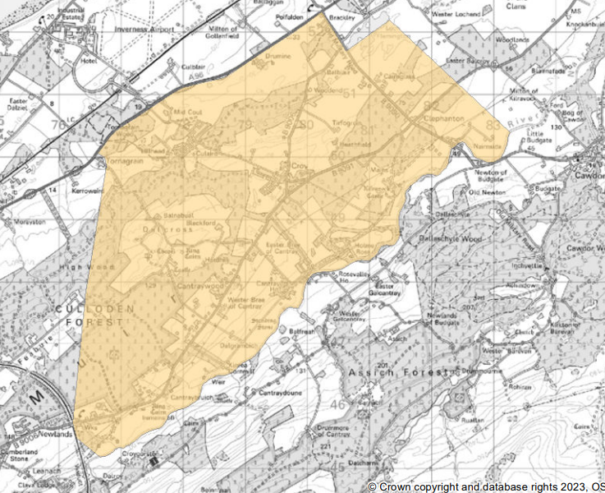
Current Croy PS catchment

Slide 9
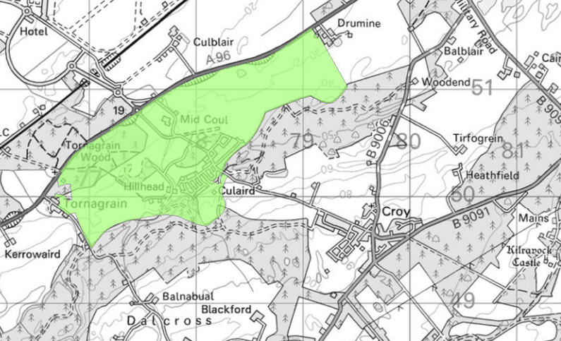
Tornagrain Catchment Option 1

Slide 10
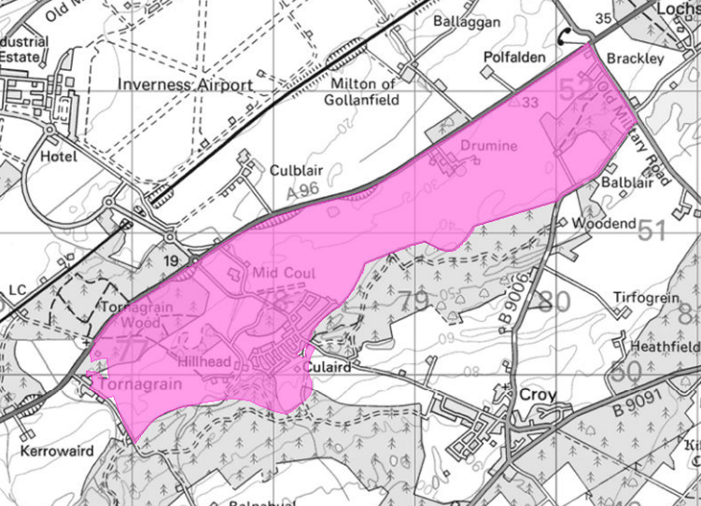
Tornagrain Catchment Option 2

Slide 11
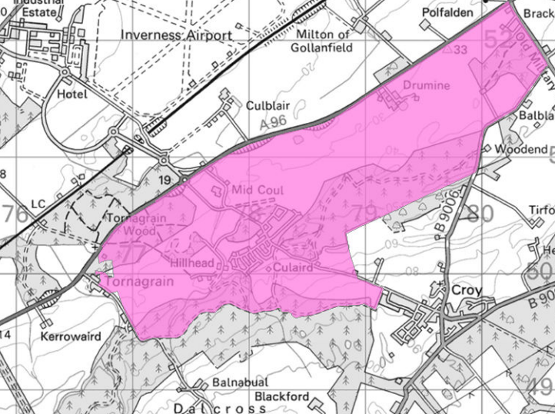
Tornagrain Catchment Option 3

Slide 12
CONCLUSION
We will be issuing a survey via the web as well
VIEWS?

