Slide 1
Midwifery Income Maximisation Project
Sandra Harrington
Midwifery Development Officer

Slide 2
Background to the project
Journey so far
Challenges
Key learning
Way forward

Slide 3
“Having insufficient money to lead a healthy life is a highly significant cause of health inequalities”
Fair Society, Healthy Lives: Marmot Review, 2010.

Slide 4
Inequalities in pregnancy
Maternal health and the development of the baby are strongly influenced by the social, economic, and environmental circumstances that surround them.
Birth weight decreases steadily with decreasing social status
Poorer infants are more likely to be born small and /or early
Good birth weight and gestational age are the main determinants of early survival

Slide 5
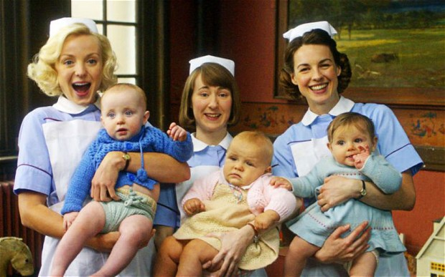

Slide 6
Making Scotland the best place in the world to grow up Key Themes
Attachment and child development
Continuity of Care in Transitions
27-30 month review
Developing parent’s skills
Early support for pregnancy and beyond
Family engagement to support learning
Addressing child poverty
Notes:
South lanarkshire

Slide 7
Aim and background of the project
Prevention and early intervention
Addressing child poverty at the earliest stage - prior to a baby’s birth
Increase uptake of Healthy start
Test an opt out scheme in one area of Highland
Tested in Dingwall for 3 months

Slide 8
Customer contacts

Slide 9
Customer contacts

Slide 10
How customers benefit
Client and her partner have been living off their savings, she had to give up work due to ill health and her partner was made redundant, we advised clients to claim Employment and Support Allowance (ESA), (they were able to make the claim themselves) Housing Benefit (HB), Council Tax Reduction(CTR) and a Discretionary Housing Payment(DHP) and discussed benefits when the child is born. Our Income Max adviser will also make contact with the client nearer her due date to offer more assistance. In addition to this money advice have also supported this family. Gain to date: ESA - £113.70 per week (in assessment phase). £1364.40 lump sum HB - £90.90 a week with benefit backdated. £2272.50 lump sum CTR - £22.30 a week with a backdate. £557.50 lump sum DHP - £870.46 Total Benefit gain: £226.90 per week / lump sum £4,194.40

Slide 11
How customers benefit
Client and her husband arrived in Scotland in July 14. They were living in a private rent with a Notice to Quit (NTQ). Client has not worked since entering the UK and her husband works 40 hours per week. The couple were referred towards the end of August as they had to leave their private rented property by the 30th August 14. Our Income Max Adviser made an immediate referral to the Homeless Prevention Team who are currently working with the family. Our Income Max Adviser undertook a benefits check for the couple, if they satisfy the DWP Habitual Residence Test they will have potential benefit gains when the baby is born in November 14 of: Housing Benefit £53.77 / Council Tax Reduction £2.64 / Working Tax Credits £90.86 Child Tax Credits £63.28 / Child Benefit £20.50 = Potential total benefit gain per week: £231.05 Our Income Max Adviser and the Homeless Prevention Team continue to work with this family.

Slide 12
Customer feedback
Found contact reassuring and supportive. Adviser will keep in contact and they will use service later in pregnancy.
Found service useful for everyone and good such a team available to help people.
Found service really good, very helpful to have and had a quick response.
Very pleased with the service received - found it very helpful.

Slide 13
Next Steps
Before implementation or spreading
Adjustments
Infrastructure
Belief in change
Accountable ownership
Resources

Slide 14
Spread
Belief in change - benefits were substantial to families. Midwives were reassured that an expert was supporting family around income
Wanted to test in busier team - decision made to rollout across whole of Highland
Resources and infrastructure -bid submitted to Highland Council resources committee for additional funding – 2 options
Make adjustments develop project contract. Alter leaflet for families and request form. Review Driver Diagram
Accountable ownership
Met with all midwifery and CAB teams across Highland

Slide 15
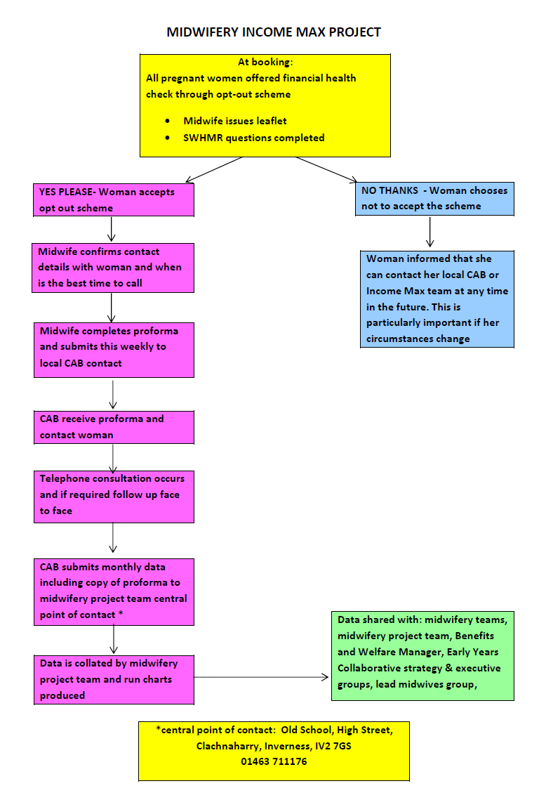

Slide 16
 | Benefits, Tax Credits and National Insurance – Maternity Allowance, Universal Credit, Child Tax Credit, Working Tax Credit, Child Benefit, Guardian’s Benefit, Kinship Care Allowance, Jobseekers Allowance, Personal Independence Payment, Disability Living Allowance, Attendance Allowance, Carers Allowance, State Pension, Pension Credit, Scottish Welfare Fund, Social Fund, Housing Benefit, Income Support, Bereavement Benefits, Industrial Injuries Benefits, National Insurance.
 | Debt – Rent/mortgage arrears, credit card debt, phone debts, fuel debts, benefit/tax credit overpayments, debt remedies,
 | Education – Any issues arising from places providing education from preschool to further education, students, accommodation
 | Employment – Statutory Maternity Leave/Pay, Statutory Paternity Leave/Pay, Parental and Carers Rights, Terms and Conditions of Employment, Contractual and Statutory Sick leave/pay, Dismissal, Notice, Holiday leave/pay, Flexible Working Rights.
 | Health and community care – Carer Issues, Community Care Provision, Charging for Care, Information About Services.
 | Housing – Housing Applications and Allocation, Homelessness – threatened and actual, Homeless Prevention, Tenancy Agreements, Eviction, Rents and Deposits, Local Authority/Owner Occupier/Private Sector/Registered Social Landlord issues.
 | Legal – Divorce, Adoption, Residence, Interdicts, Sheriff Court actions, Compensation, Incapacity (Power of Attorney, Guardianship), Wills, Confirmation.
 | NHS Concern or Complaint – any feedback, concerns or complaints about NHS services generally dealt with through Patient Advisory and Support Service.
 | Relationship – Parental rights, Child Support, Childminding/childcare, Adoption, Domestic abuse, Death and Bereavement,
 | Tax – Income Tax, Council Tax including CT Reduction, Road Tax, VAT.
 | Travel, transport and holidays – Blue Badge Scheme, Travel Insurance, Concessionary bus travel,
 | Utilities and communications – phones, fuel, broadband, contracts
 | Financial Products and Services – banks, savings, credit, charities, financial products, HP, conditional sale, contracts
 | Immigration, Asylum and Nationality – nationality, citizenship, settlement, leave to remain, workers, visitors, students, asylum seekers, refugees

Slide 17
Challenges
Setting up system for data collection
Accessing admin support to collect and manage data, make contact with individual CAB teams
Obtaining feedback and data – copies of request form, monthly stats– lots of correspondence
How women are engaged. Learning from original testing – 3 calls and a letter
Length of time it takes for women to engage alters data, when is it captured?
Non engagement for a variety of reasons
How women benefitted is important to capture

Slide 19
Month | Benefits, Tax Credits & NI | Debt | Education | Employment | Health & Community Care | Housing | Legal | NHS Concern or Complaint | Relationship | Tax | Travel, transport and holidays | Utilities & Communications | Financial Products & Services | Immigration, Asylum & Nationality
October | 27 |  |  |  |  |  |  |  |  |  |  |  | 1
November | 9 |  |  |  |  |  |  |  |  | 1 |  |  | 1
December | 3
January | 11
February
March
April
May
June
July
August
September

Slide 21
MIDWIFERY INCOME MAX – DATA FROM RETURNED REQUEST FORMS JUNE 2015 – FEBRUARY 2016
Midwifery Team /CAB | Total Bookings | Referrals | Dates of request forms
Caithness & Thurso | 45 | 39 | June – Jan 16
East Sutherland (Golspie) | 53 | 49 | June – Feb 16
NW Sutherland | 7 | 6 | June – Jan 16
West Ness | 29 | 26 | June - Dec
B & S | 32 | 31 | June - Dec
Black Isle (Fortrose) | 18 | 12 | June - Dec
Inverness | 274 | 273 | June - Dec
INVERNESS CAB TOTAL | 353 | 342
Lochaber | 101 | 67 | June – Jan 16
Nairn | 72 | 61 | June – Jan 16
Dingwall | 68 | 68 | June – Jan 16
Gairloch/Ullapool/Lochcarron | 22 | 22 | June – Jan 16
Invergordon/Tain | 115 | 112 | June – Jan 16
ROSS-SHIRE CAB TOTAL | 205 | 202
Skye | 33 | 25 | June - Dec
TOTALS | 869 | 791

Slide 22
Key learning
Any contact is a benefit
Even if no immediate entitlements, circumstances can change in a year or more. Encourage families to get back in touch
Many women will be worse off when they have a baby – fully informed decision making. Having that conversation
Prevention – addressing child poverty at the earliest stages of family life. Enabling and empowering families
Low income families benefit the most from the project
Is it making a difference to Healthy Start applications? CAB more aware and supporting women around applications
Teams working together who haven’t before – developing networks
Client feedback – working with Inverness CAB

Slide 23
Way forward
Project started June 2014 for one year
Members within the Highland Council have just agreed to extend further funding until March 2017
Future funding?

