Slide 1
The Main Issues Report
Inner Moray Firth Proposed Local Development Plan 2
The Main Issues Report

Slide 2
The Plan Process
Ward Briefings
5 Area Committees consider MAIN ISSUES REPORT (MIR)
Public consultation on MIR
6 Local/City Committees and Economy & Infrastructure Committee
consider responses to MIR and agree PROPOSED PLAN
Public Consultation on PROPOSED PLAN (objections)
EXAMINATION of objections by Reporter
2020
2021
2022

Slide 3
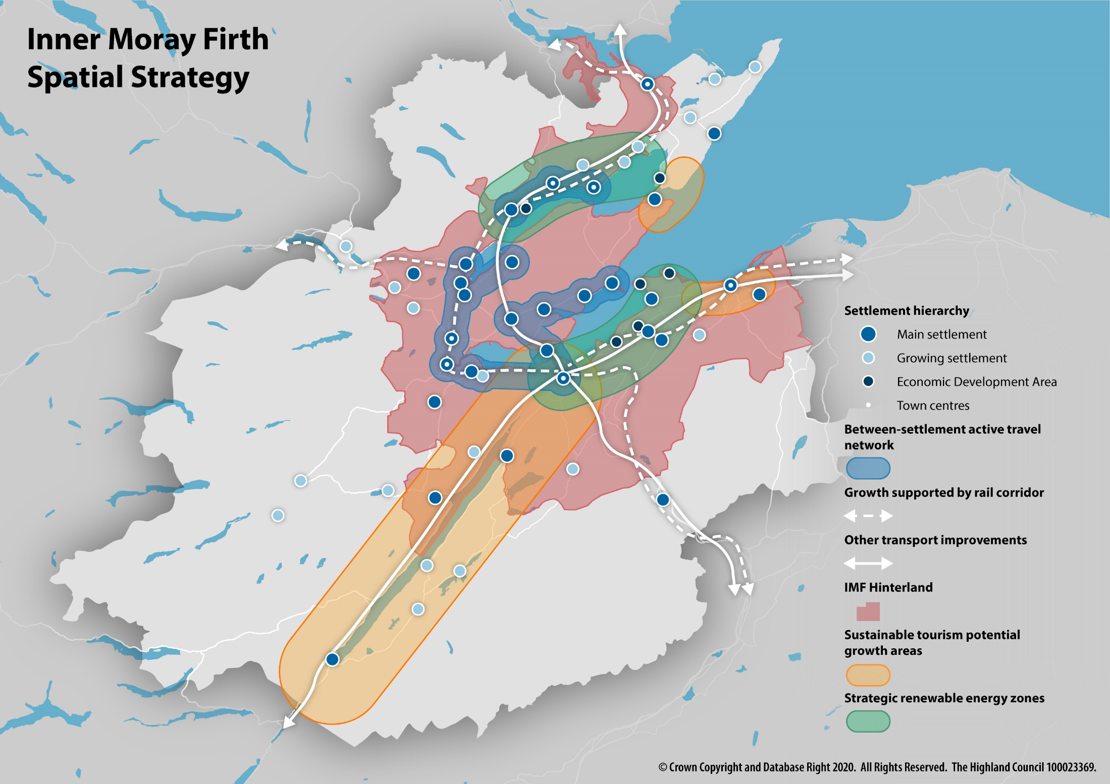

Slide 4
Scale of Growth | Sustainability | Hierarchy | Tier | Settlements/Locations
Strategic | Most sustainable | Main Settlements | 1 | Alness, Beauly, Dingwall, Invergordon, Inverness City, Muir of Ord, Nairn, Tain, Tornagrain.
Modest | Sustainable |  | 2 | Ardersier, Conon Bridge, Drumnadrochit, Evanton, Fort Augustus, North Kessock.
Local | Partially sustainable |  | 3 | Auldearn, Avoch, Croy, Fortrose and Rosemarkie, Kiltarlity, Maryburgh, Seaboard Villages, Strathpeffer, Tomatin.
Limited | Least sustainable |  | 4 | Cromarty, Culbokie, Dores, Kirkhill, Munlochy, Tore.
"Infill" only | Bolstering the smallest established rural communities | Growing Settlements | 5 | Abriachan, Balnain, Barbaraville, Cannich, Cawdor, Contin, Farr/Inverarnie, Foyers, Garve, Gorthleck, Inchmore, Hill of Fearn, Inver, Milton of Kildary, Marybank, Portmahomack, Rhicullen/Newmore, Tomich, Whitebridge.
Typically single unit development | Generally poor sustainability unless connection with rural land use / business | Countryside | 6 | All housing groups not otherwise classified as part of a settlement. Wider open countryside (no general restriction). "Hinterland" open countryside (general restriction on housing).

Slide 5
Previous & Proposed Consultation
Previous – over 1,400 comments on Main Issues Report – record number
Methods - Postcard mailshot, social media campaign, online videos, Teams/Zoom meetings, phone arounds, paper copy option
Proposed – at least 8 weeks duration from March 2022 same methods + consider face-to-face events if permissible

Slide 6
Strategic Plan Content (Appendix 2)
Economy & Infrastructure Committee decision but views of each of 6 Local/City committees sought on:
Reordered Outcomes to emphasise climate change and economic recovery
Reordered settlement hierarchy
Maximised Housing Land Requirements within justifiable limits
13 new or revamped general policies – e.g self build
Housing in the Countryside Hinterland Boundary

Slide 7
Settlement-specific Plan Content (Appendix 1)
Local/City committee decision on:
Which sites to earmark for development
List of acceptable land uses for each site
Which sites to safeguarded from development as vital greenspaces
Housing capacities of development sites
Placemaking Priorities

Slide 8
Settlement-specific Plan Content (Appendix 1)
Main Settlements:
Avoch
Cromarty
Culbokie
Fortrose & Rosemarkie
Munlochy
North Kessock
Tore

Slide 9
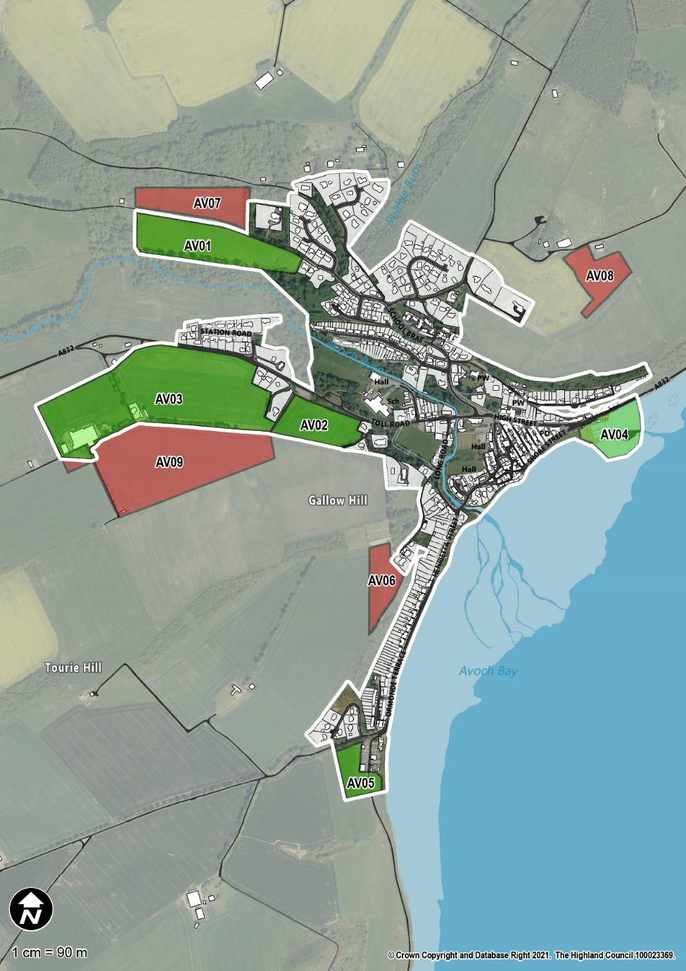
AVOCH
Site Name | Acceptable Use(s) | Indicative 10 Year Housing Capacity
Rosehaugh East Drive | Housing | 30
Memorial Field | Housing | 46
Muiralehouse | Housing, Business, Community, Industry | 80
Harbour | Business / Tourism (harbour related only) | n/a

Slide 10
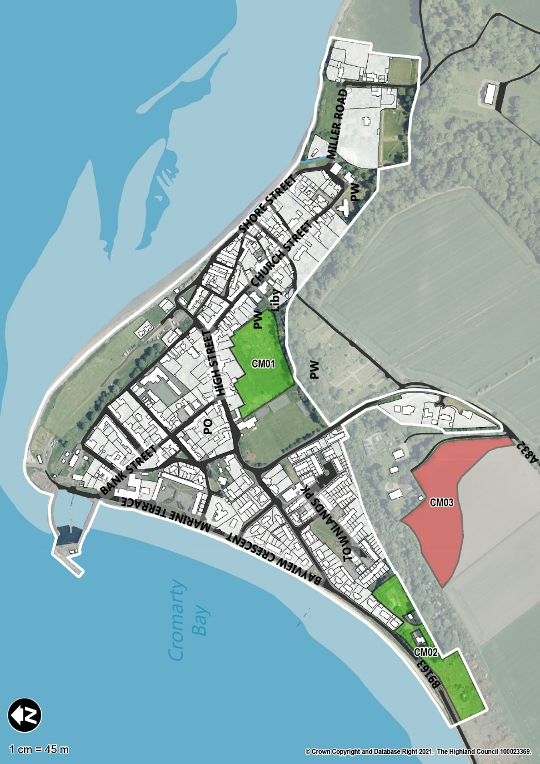
CROMARTY
Site Name | Acceptable Use(s) | Indicative 10 Year Housing Capacity
Sandilands | Housing, Community Business | 33
Bayview Crescent | Community Business | n/a
South of Manse | Housing, Community Business | 25

Slide 11
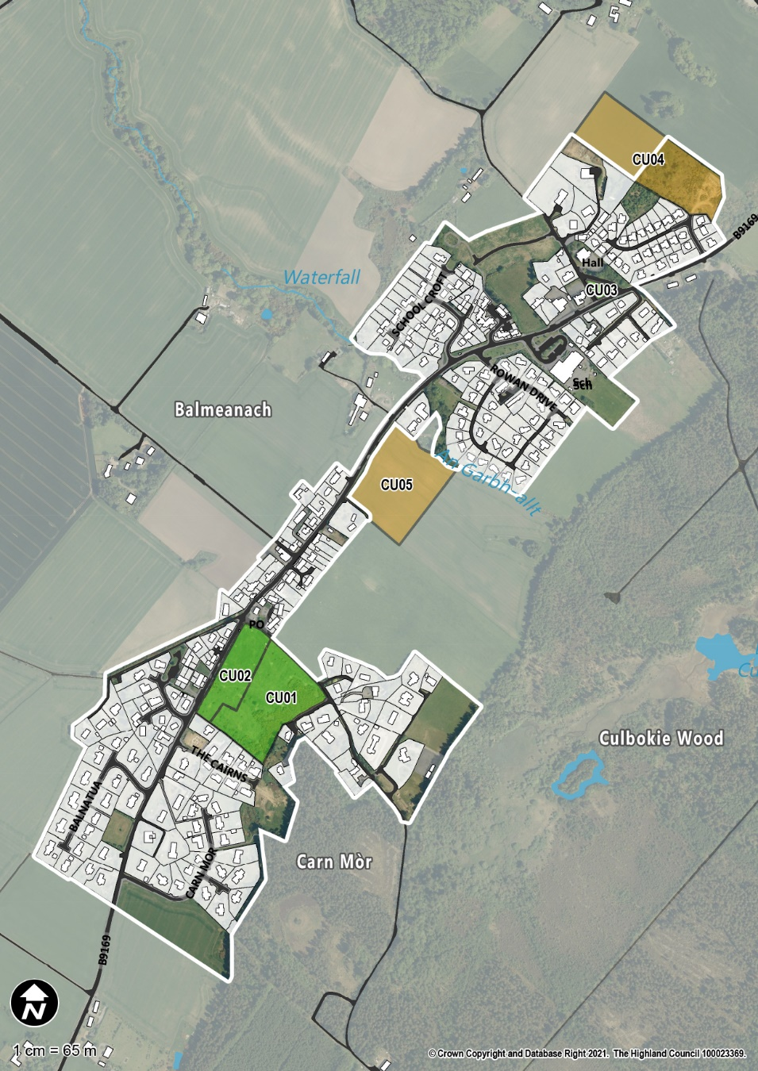
CULBOKIE
Site Name | Acceptable Use(s) | Indicative 10 Year Housing Capacity
North of Cairns | Housing | 33
North of Schoolcroft | Housing | 20
South of Village Store | Housing, Community, Business | 6
East of Former Primary School | Community, Business | n/a

Slide 12
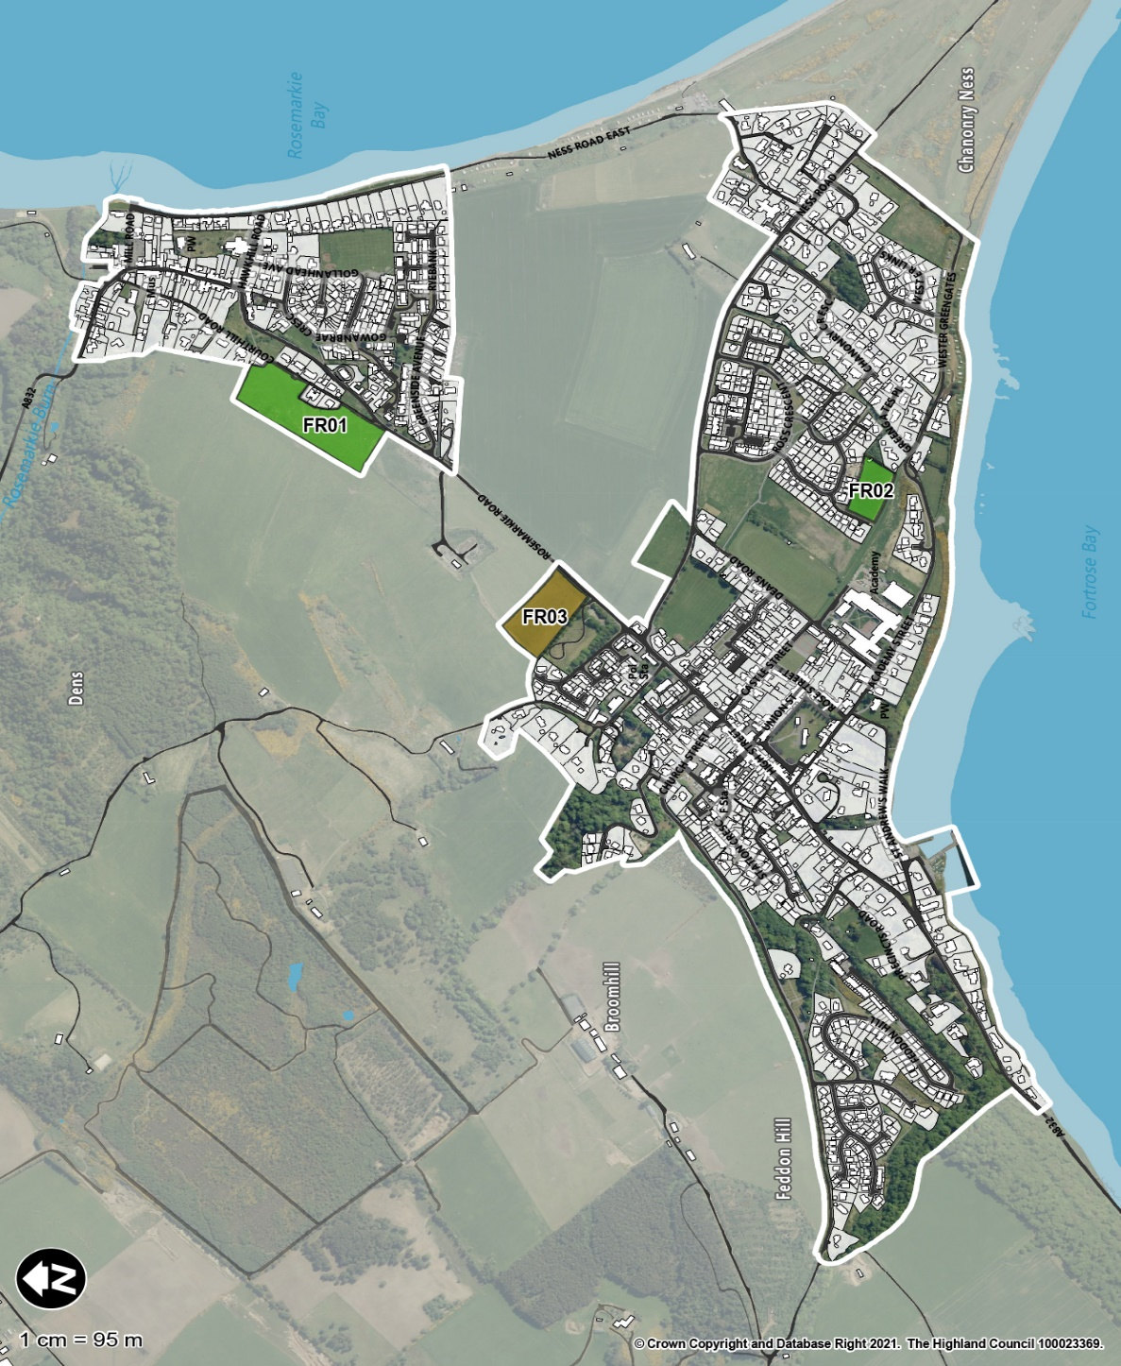
FORTROSE & ROSEMARKIE
Site Name | Acceptable Use(s) | Indicative 10 Year Housing Capacity
Greenside Farm | Housing | 50
Ness Gap | Housing | 12

Slide 13
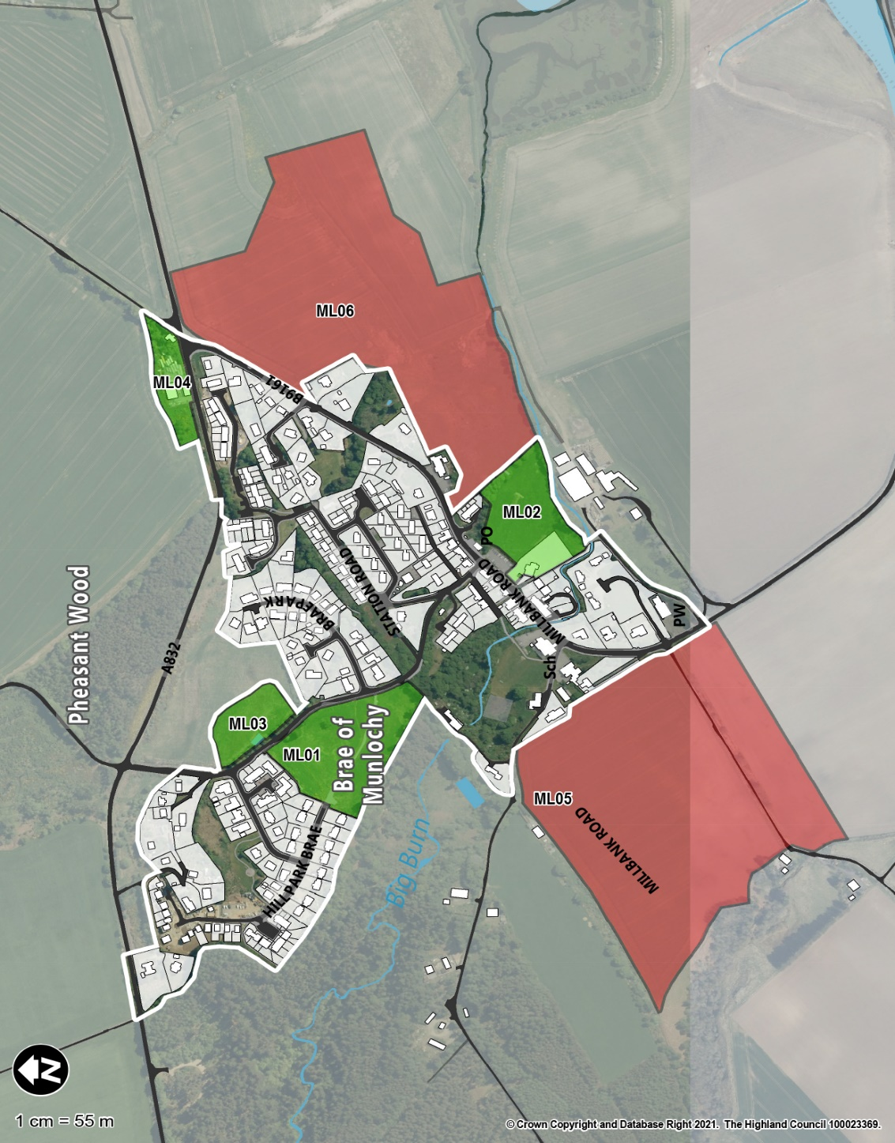
MUNLOCHY
Site Name | Acceptable Use(s) | Indicative 10 Year Housing Capacity
Hillpark Brae | Housing | 32
Land South of the Post Office | Housing, Community, Business, Retail | 15
Station Brae | Community | n/a
Land North of the A832 | Business | n/a

Slide 14
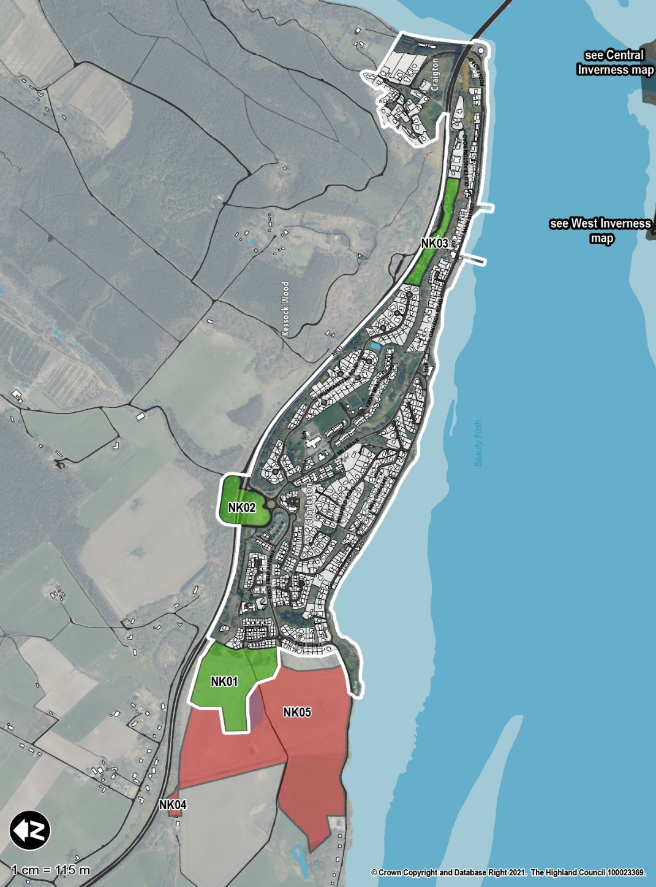
NORTH KESSOCK
Site Name | Acceptable Use(s) | Indicative 10 Year Housing Capacity
Bellfield Farm | Housing, Community, Business | 80
Land Adjoining A9 Junction | Community (Park & Ride/Choose), Retail | n/a
A9 Northbound Car Park | Business | n/a

Slide 15
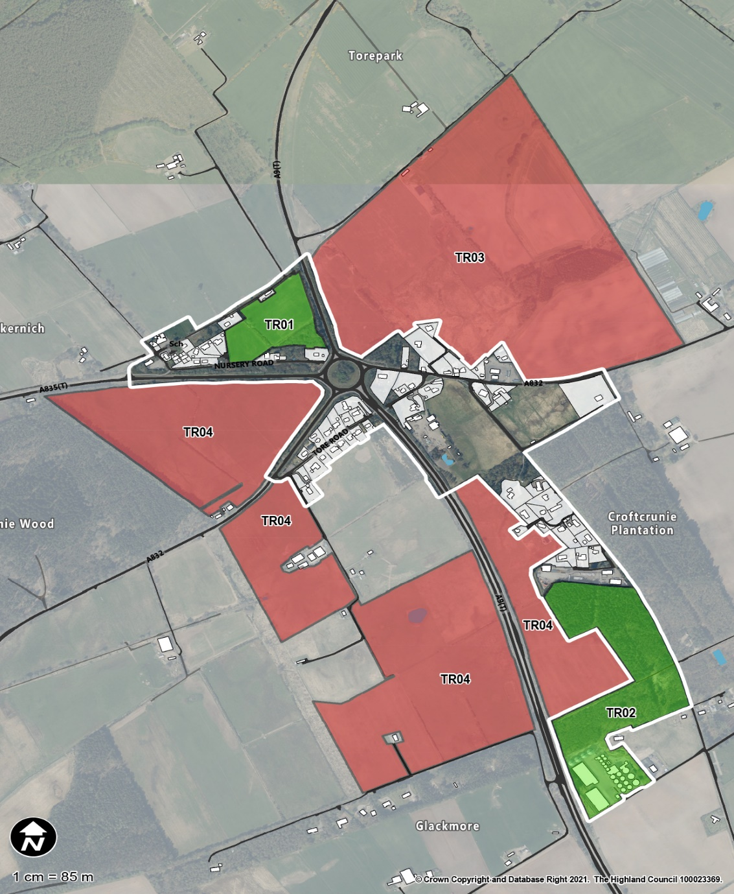
TORE
Site Name | Acceptable Use(s) | Indicative 10 Year Housing Capacity
By Woodneuk | Housing | 14
Land North of the Grain Mill | Industry, Business | n/a

Slide 16
Recommendations Questions?

Slide 17
Housing Requirements
10 Year (2020-2029) Inner Moray Firth Plan Area Minimum Housing Requirement (MHLR) Based on 2020 HNDA
Housing Market Area (HMA)(1) Housing Sector (2) | Inverness | East Ross | Mid Ross | Nairn | West Ross (part) | Plan Area Totals (3)
Affordable | 4,292 | 513 | 830 | 363 | 99 | 6,097
Open Market | 1,435 | 239 | 526 | 151 | 39 | 2,390
Totals (3) | 5,726 | 752 | 1,356 | 513 | 137 | 8,484
(1) Assumes a zero requirement for that portion of the Badenoch & Strathspey HMA that lies within the IMFLDP area because the housing numbers are negligible. 26% of West Ross HMA based on geographic area proportion.
(2) The Market sector is defined as owner occupier and private rent homes. The Affordable sector is social rent and other below market rent properties.
(3) Some column and row totals don't sum exactly due to rounding.

