Slide 1
Council Redesign
Transport Services

Slide 2
Transport Services
Statutory Quality Partnership
Local Transport Strategy
Public and Community Transport
Corran Ferry

Slide 3
Key Actions to Consider
Public and Community Transport
Re-phase (rolling, area by area) tendering and engage communities
Explore central management minibus fleet → efficiency and support for in-house and CT provision
Provide facilitation, advice and resources for CT operators
Corran Ferry
Explore ALEO/ new operator options

Slide 4
Public and Community Transport

Slide 5
Public and Community Transport
Contracted bus services
Contracted dial–a-bus and subsidised taxis
In-house service (plus HC minibus fleet?)
Community Transport
Concessionary Fares (non-bus)
Contracted Ferry Services (exc. Corran Ferry)
Home-to-school transport (C&L Budget)
NB Statutory

Slide 6
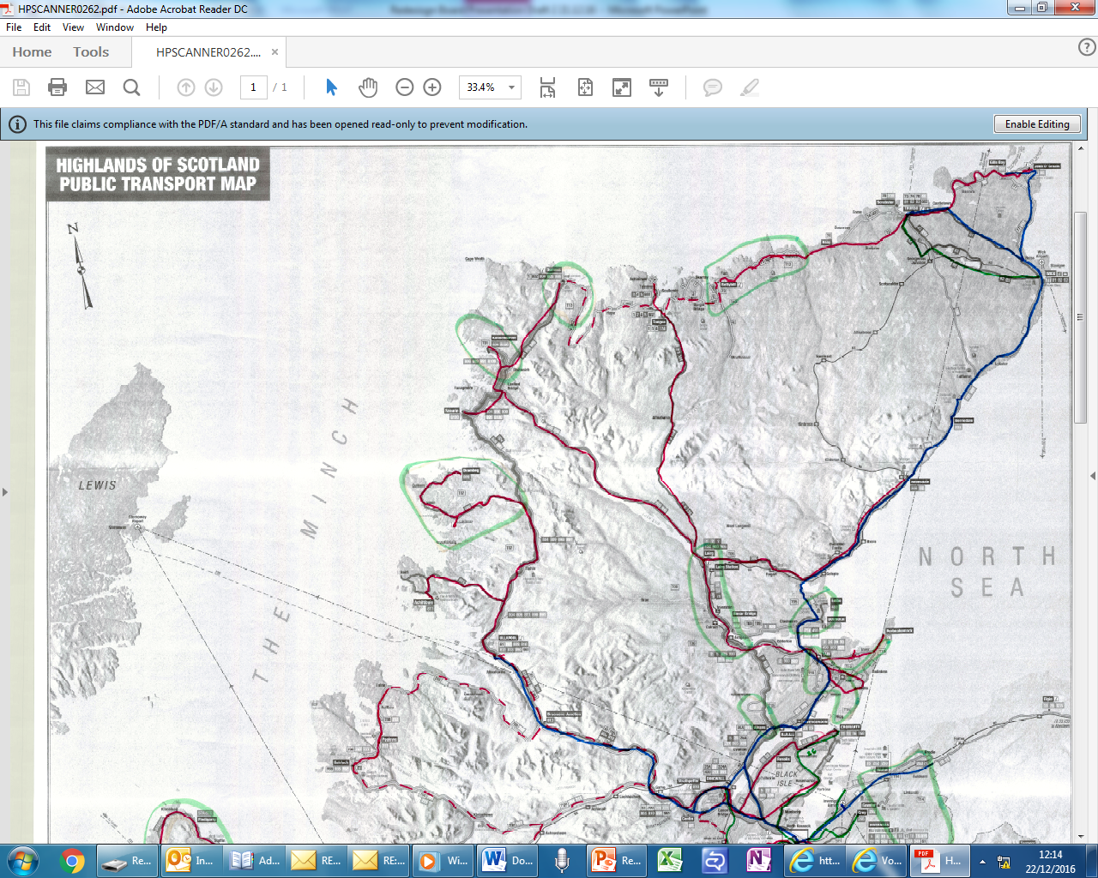
Public Transport (North)

Slide 7
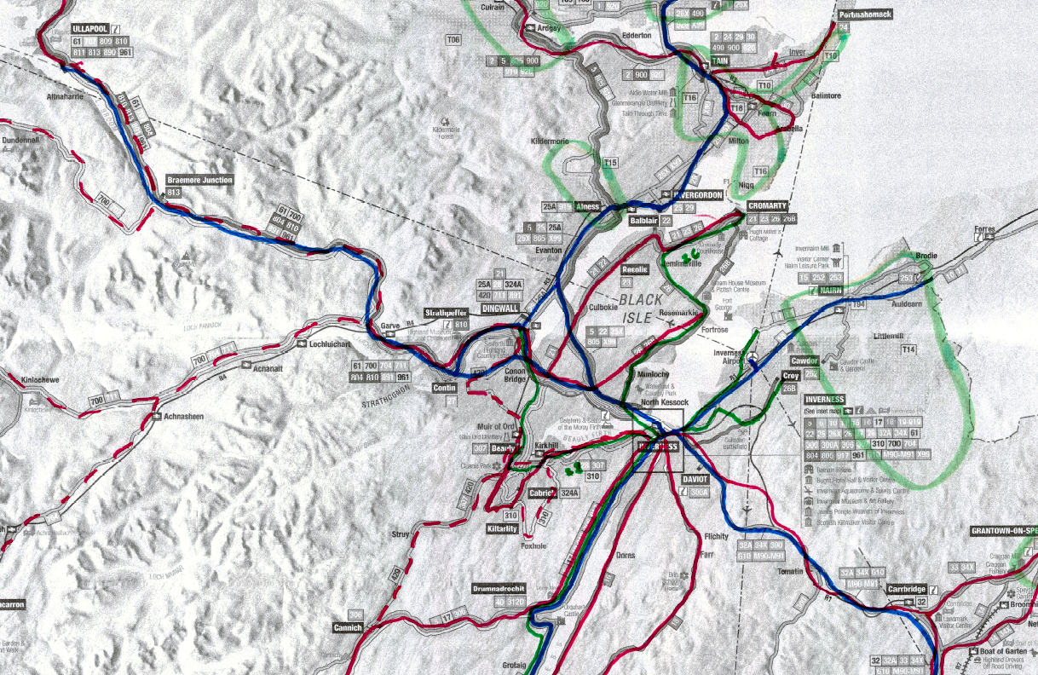
Public Transport (Mid)

Slide 8
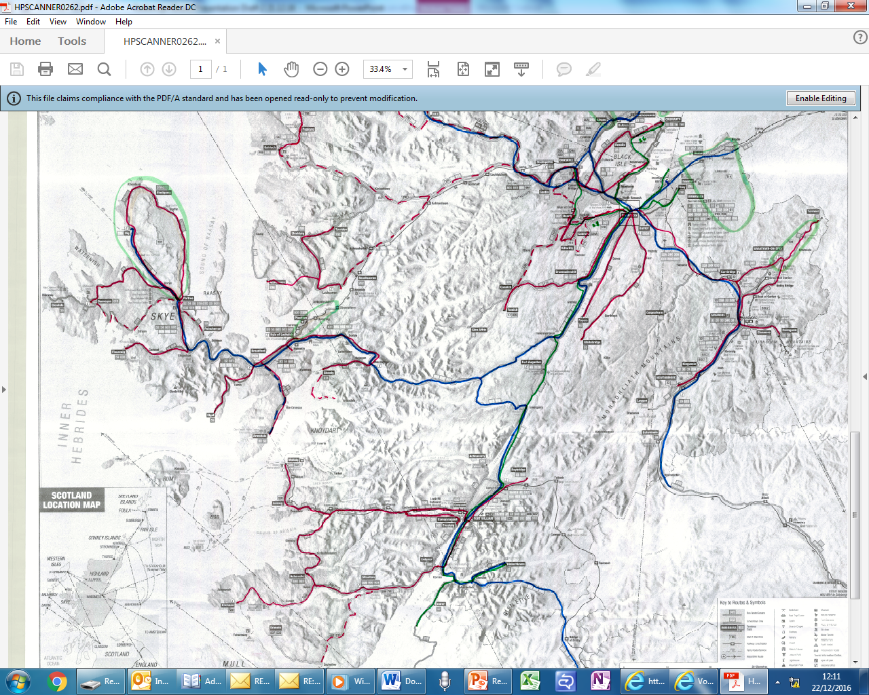
Public Transport (South)

Slide 9
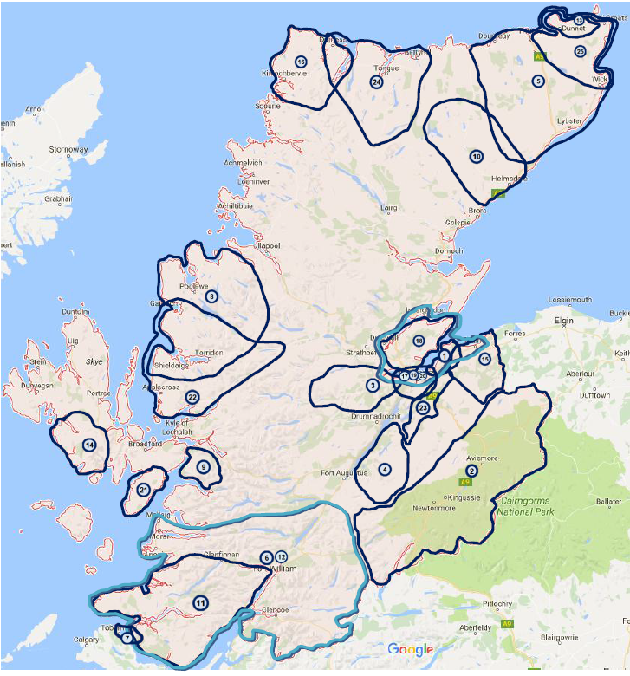
Community Transport

Slide 10
16/17 Contracts and Grants
New Public and Home-to-School contracts | £13.286m
Sutherland contracts (let 2015) | £1.252m
Total Public and Home-to-School | £14.538m
of which…
Public only contracts | £1.268m
Community Transport grants | £0.376m

Slide 11
16/17 Contracts and Grants
New Public and Home-to-School contracts | £13.286m
Sutherland contracts (let 2015) | £1.252m
Total Public and Home-to-School | £14.538m
of which…
Public only contracts non-statutory | £1.268m
Community Transport grants non-statutory | £0.376m
Total non-statutory | £1.644m

Slide 12
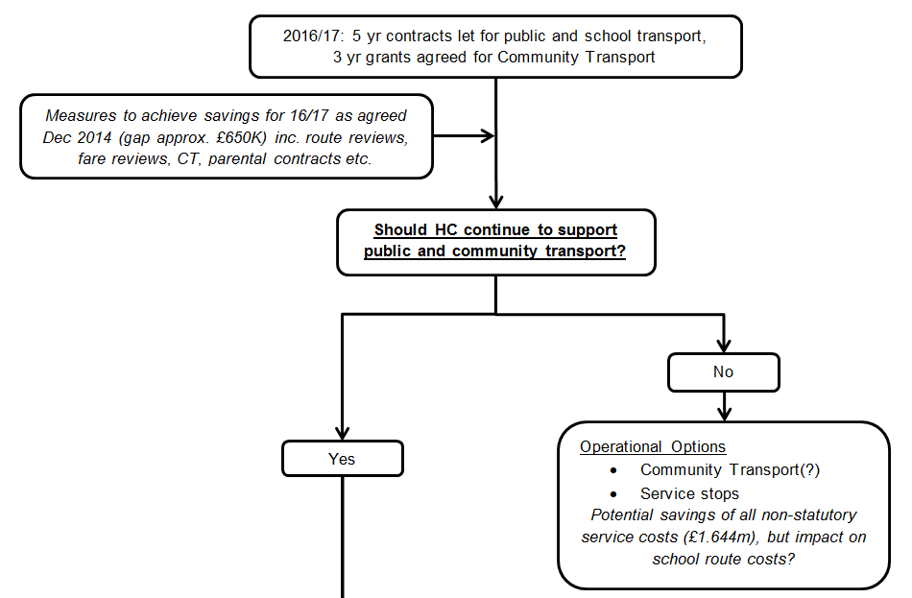
Future Options 1

Slide 13
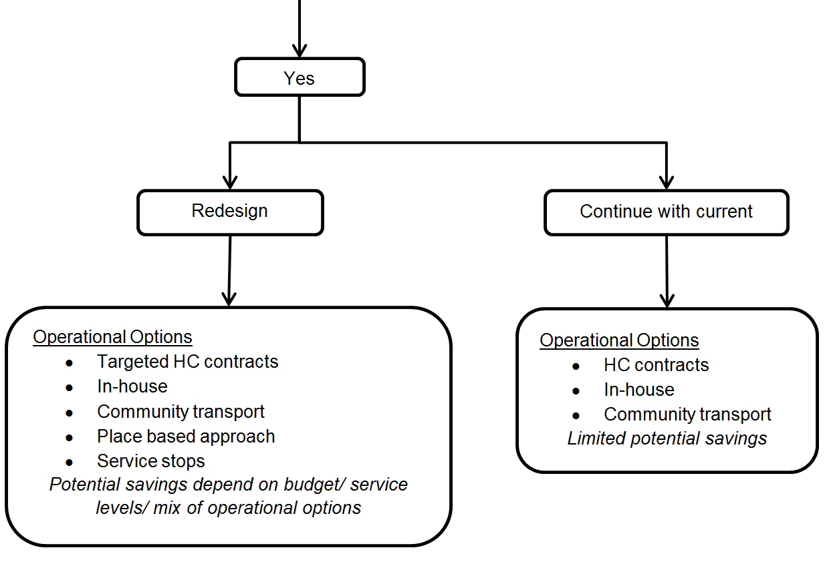
Future Options 2

Slide 14
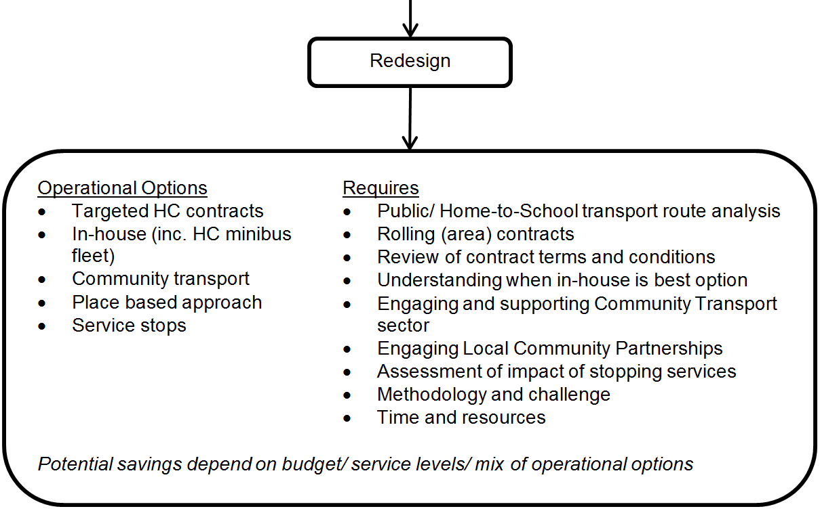
Future Options 3

Slide 15
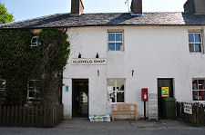
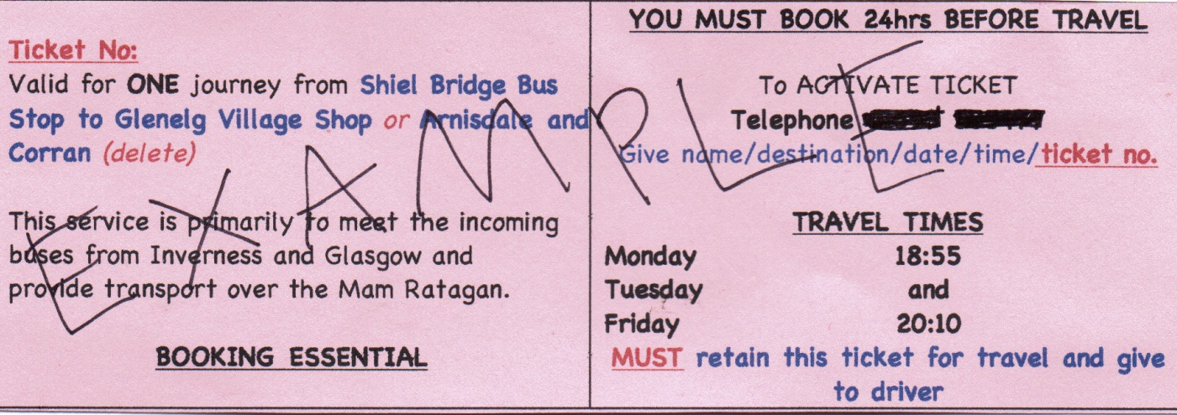
Glenelg and Arnisdale BUG
Supported by HC CT grant (£3,100/yr)
Public service open to all
Subsidised taxi connects with commercial network (Citylink) at Shiel Bridge
Operates evenings complementing contracted bus service (runs mornings only)
Tickets available from village shop (£3)
Grant £3,100 vs bus contract to Kyle £28K

Slide 16
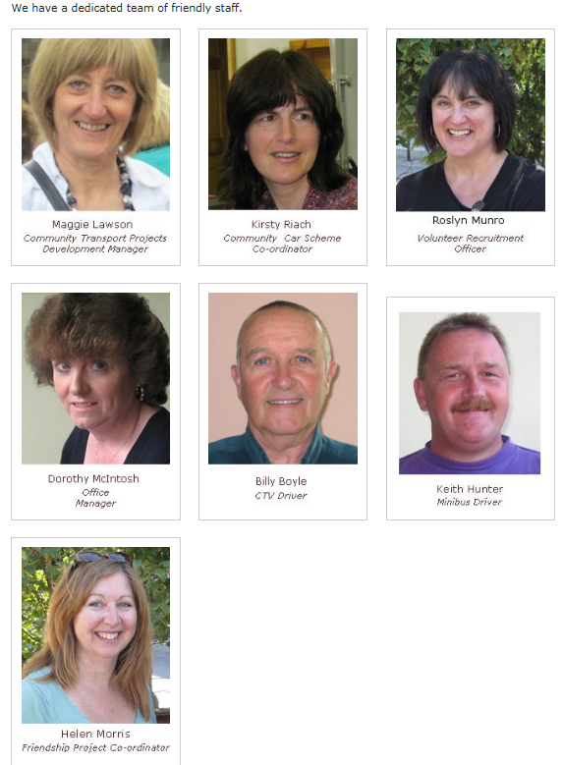
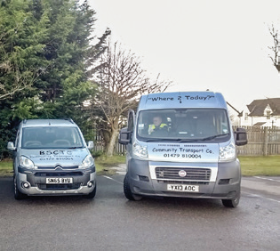
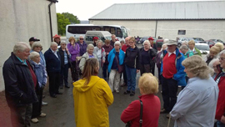
Badenoch & Strathspey CTC
HC CT grant (£30k, approx. 10% total inc.)
Also supported by Lottery, NHS, etc.
Elderly, disabled, no access to transport
1600 members; 160 volunteers; 7 staff (5FTE)
Community Car scheme (members only)
s19 (members only) day care/ activities
s22 dial-a-bus (public can access)
3 wheelchair accessible vehicles

Slide 17
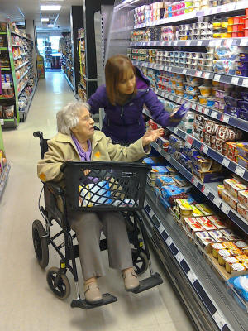
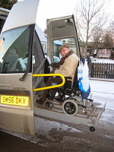
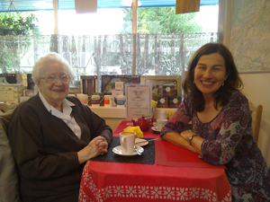
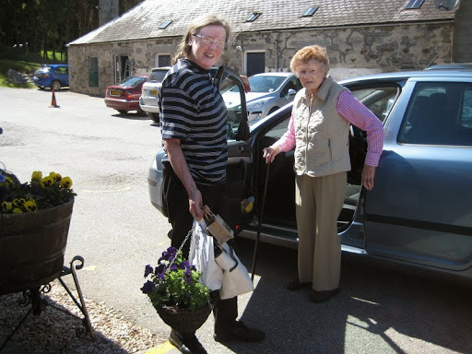
Badenoch & Strathspey CTC
Social inclusion focus – transport is “enabler”
“Door to door is best in rural areas”
Operation requires full time coordination
Reliance on volunteers limits capacity to expand regular services
s22 attracts grants and reimbursements, but regulation and bureaucracy

Slide 18
Other Public Transport
Contracted Ferries (£0.2m)
Fort William – Camusnagaul (£70K)
Nigg – Cromarty (£48K)
(Mallaig – Inverie: lifeline service £75K)
Concessionary Fares (£0.21m)
Rail (£125K)
Ferries (£75K)
(Subsidised Taxis – no bus – approx. £10K)

Slide 19
Corran Ferry

Slide 20
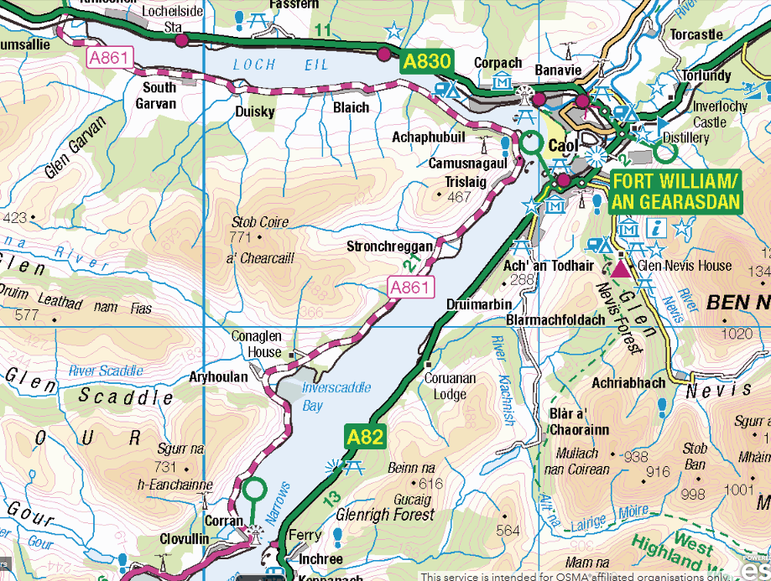

Slide 21
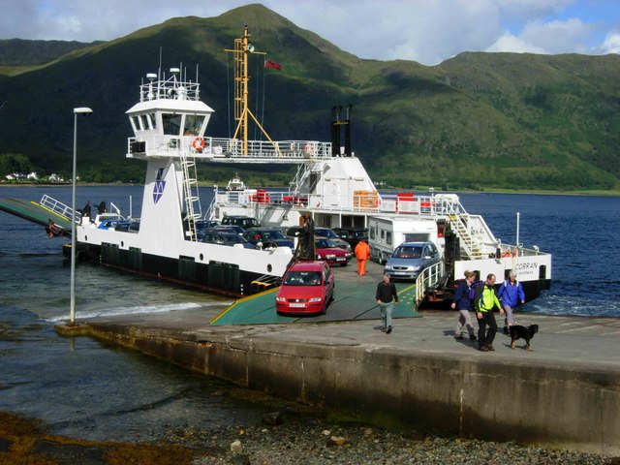

Slide 22
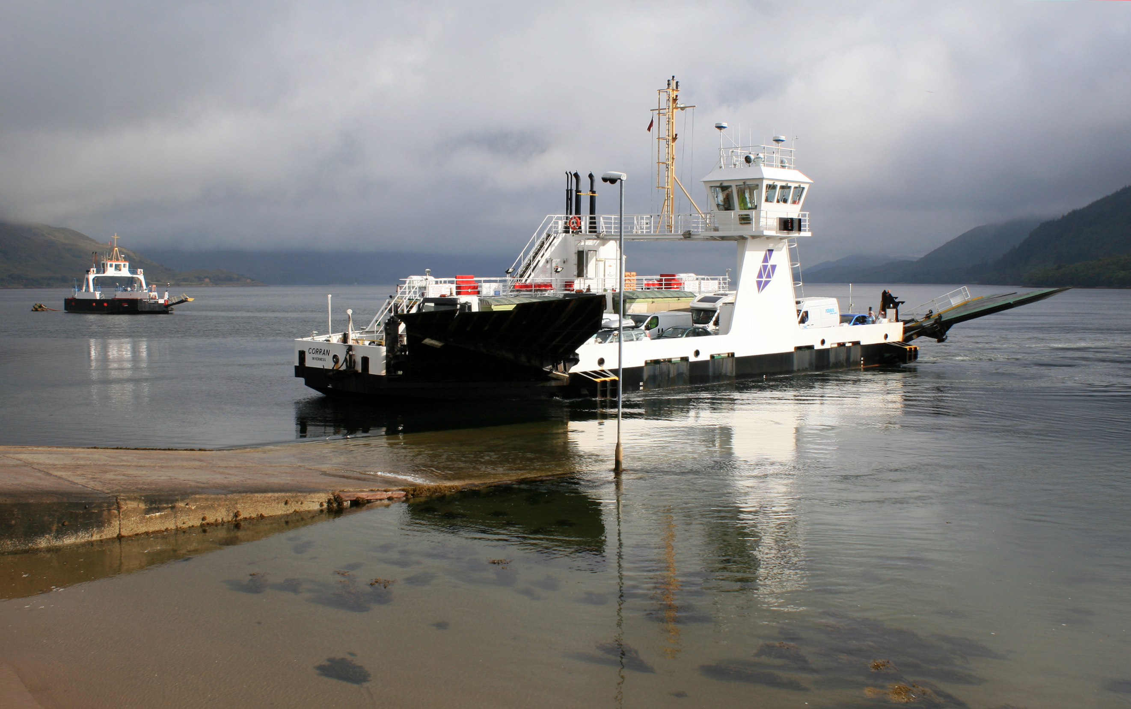

Slide 23
Actual Inc/Exp
 | 2013/14 | 2014/15 | 2015/16
Expenditure
Employee Costs | 675,217 | 658,120 | 686,884
Property Costs | 27,231 | 26,037 | 26,780
Fuel Costs | 188,534 | 169,843 | 119,230
Transport Costs | 7,576 | 4,904 | 4,363
Insurance | 64,614 | 48,576 | 60,361
Refit Costs | 213,396 | 270,502 | 161,019
Engine Repairs & Maintenance | 167,382 | 55,656 | 52,425
Other Costs | 52,666 | 50,437 | 43,570
Total Expenditure | 1,396,616 | 1,284,075 | 1,154,632
Income
Ferry Dues | (1,141,596) | (1,260,048) | (1,312,793)
Other | (33,346) | (34,442) | (33,455)
Total Income | (1,174,942) | (1,294,490) | (1,346,248)
(Surplus)/Deficit | 221,674 | (10,415) | (191,616)

Slide 24
Actual Inc/Exp
 | 2013/14 | 2014/15 | 2015/16
Expenditure
Employee Costs | 675,217 | 658,120 | 686,884
Property Costs | 27,231 | 26,037 | 26,780
Fuel Costs | 188,534 | 169,843 | 119,230
Transport Costs | 7,576 | 4,904 | 4,363
Insurance | 64,614 | 48,576 | 60,361
Refit Costs | 213,396 | 270,502 | 161,019
Engine Repairs & Maintenance | 167,382 | 55,656 | 52,425
Other Costs | 52,666 | 50,437 | 43,570
Total Expenditure | 1,396,616 | 1,284,075 | 1,154,632
Income
Ferry Dues | (1,141,596) | (1,260,048) | (1,312,793)
Other | (33,346) | (34,442) | (33,455)
Total Income | (1,174,942) | (1,294,490) | (1,346,248)
(Surplus)/Deficit | 221,674 | (10,415) | (191,616)

Slide 25
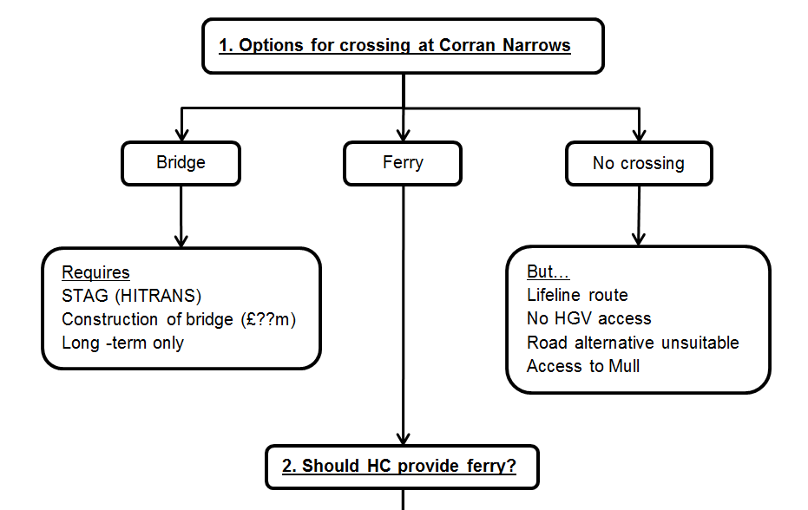
Future Options 1

Slide 26
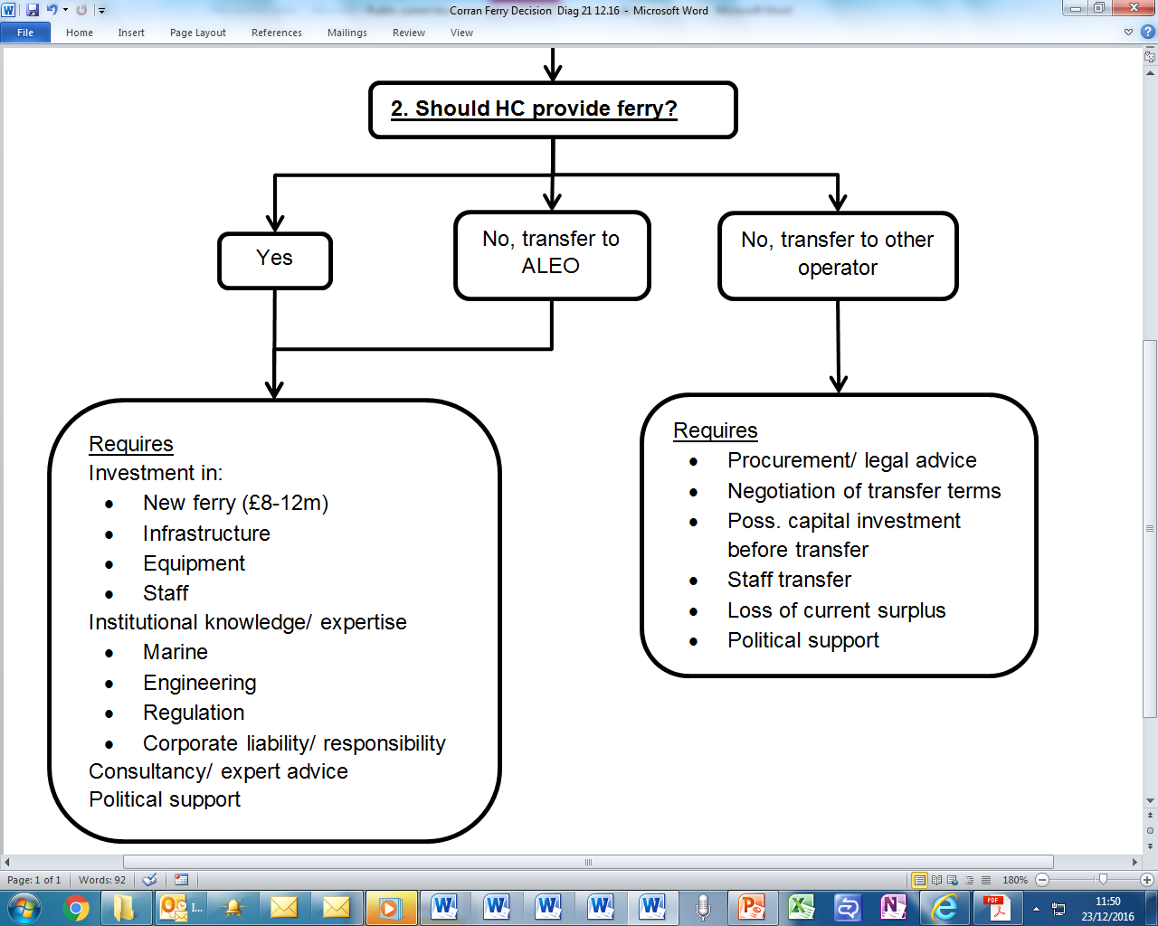
Future Options 2

Slide 27
Next Steps 1. Public and CT
1. Agree to continue support for public and CT
2. Agree strategy for implementation
Complete actions for budget gap (£650K)
Develop route analysis methodology and challenge
Re-phase (rolling, area by area) contracts and review T’s&C’s
Identify circumstances where in-house appropriate (inc. HC minibus fleet)
Understand/support CT capacity to deliver additional transport
Develop and pilot role for Local Community Partnerships and communities

Slide 28
Next Steps 2: Corran Ferry
Decide whether HC continues to operate service
Explore ALEO/ new operator options for comparison with current provision
Develop strategy for investment or transfer

Slide 29
Key Actions
Public and Community Transport
Re-phase (rolling, area by area) tendering and engage communities
Explore central management minibus fleet → efficiency and support for in-house and CT provision
Provide facilitation, advice and resources for CT operators
Corran Ferry
Explore ALEO/ new operator options

