Slide 1
Charleston Academy
Stakeholder Group Meeting No. 4
Project Update
17th November 2021
Robert Campbell, Estate Strategy Manager

Slide 2
Current Position
Report on the review of the capital programme deferred from October meeting to December meeting of Council.
Further dialogue with colleagues in Planning regarding the masterplan for Charleston Academy and Kinmylies Primary.
More detail on proposals for work to the existing building as part of the project.
Continue to provide information to support the bid for additional funding to allow larger extension block to be built (Science, Art, Technical and Music).
Notes:
Think back to income and expenditure slides…..

Slide 3
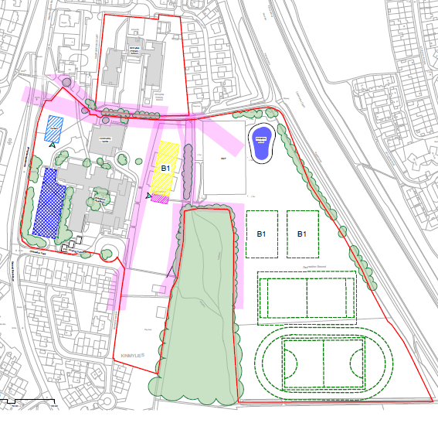
Phase 1 – Site Plan
Notes:
Think back to income and expenditure slides…..

Slide 4
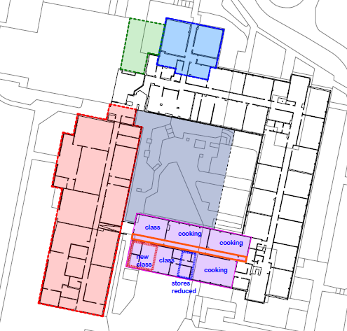

Phase 1 – Alterations to Main Building
Notes:
Think back to income and expenditure slides…..

Slide 5
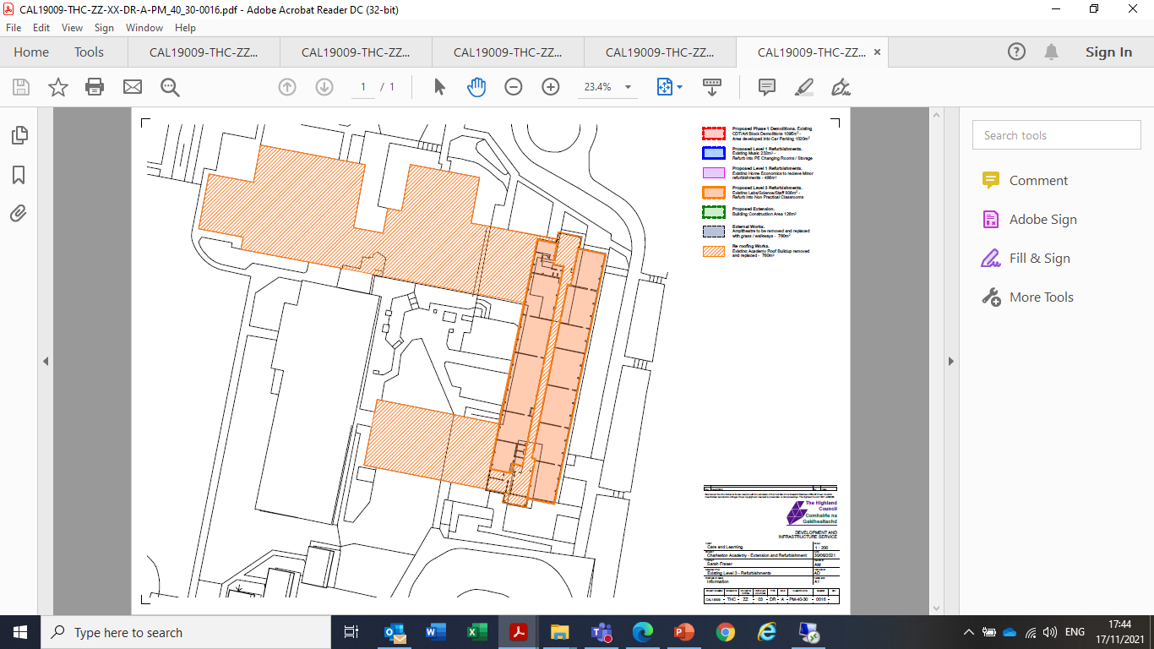
Phase 1 – Refurbishment/Re-Roofing
Notes:
Think back to income and expenditure slides…..

Slide 6
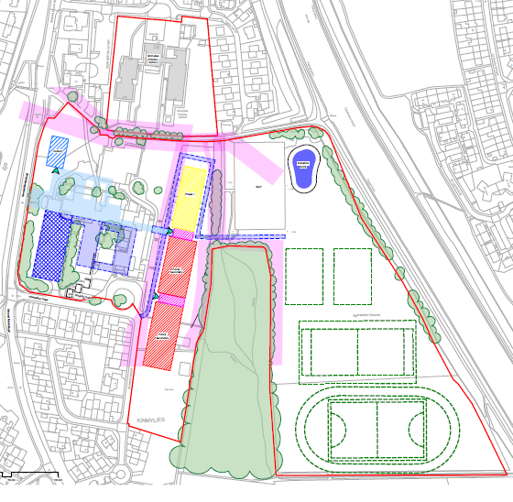
Complete New Build – Site Plan
Notes:
Think back to income and expenditure slides…..

Slide 7
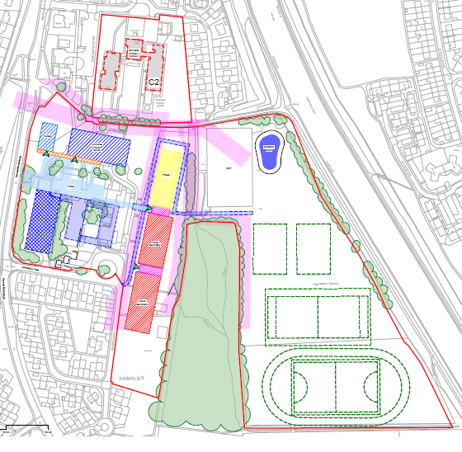
New Primary School Building – Completed Site Plan
Notes:
Think back to income and expenditure slides…..

Slide 8
Next Steps
Conclude dialogue with colleagues in Planning, Transport etc on updated masterplan.
Engage with Morrison’s and their design team on the proposals.
Report on the review of the capital programme to the Council meeting on December 9th.
Notes:
Think back to income and expenditure slides…..

