Slide 1
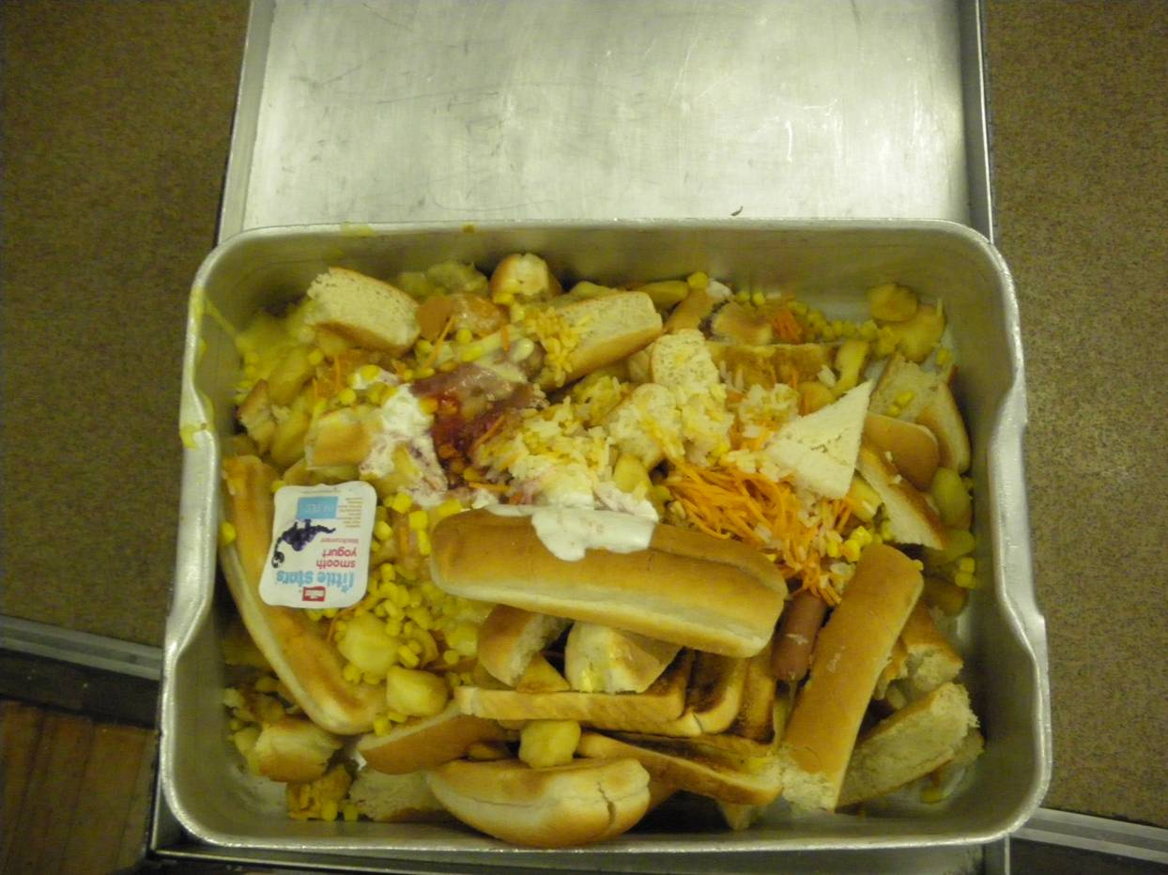
Schools Waste Audit

Slide 2
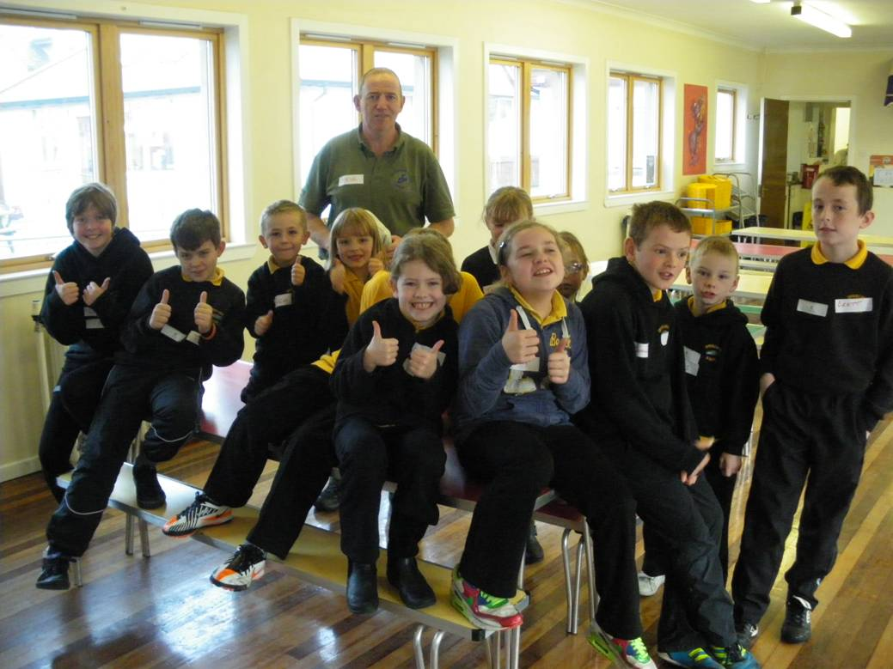
Inverlochy Primary
Eco-committee
Staff
Janny
Canteen staff
Notes:
But what’s wrong with rubbish?
Can you think of any other words meaning rubbish?
(take some responses…….litter, waste)
So is rubbish nice?
How we can stop making so much rubbish

Slide 3
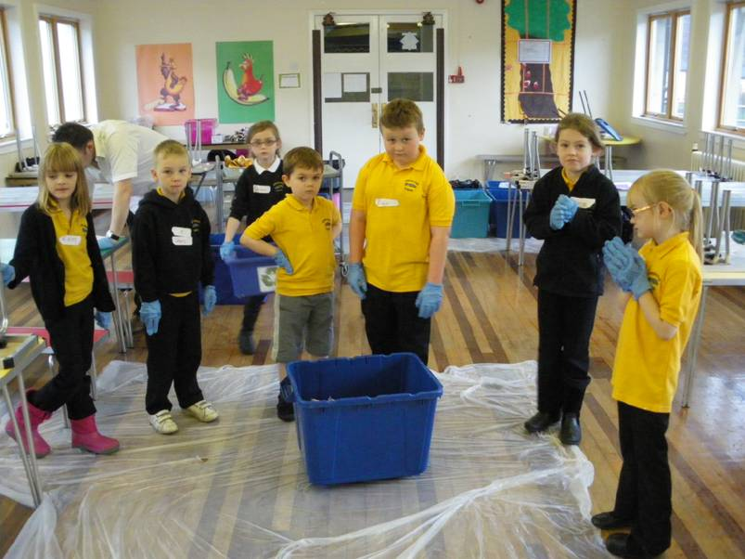
Pre Audit Meeting
Id work area
Boxes for canteen staff
Bins all empty on day
Bin audit and tick sheet
Numbers of pupils on day
All waste & recycling bins empty

Slide 4
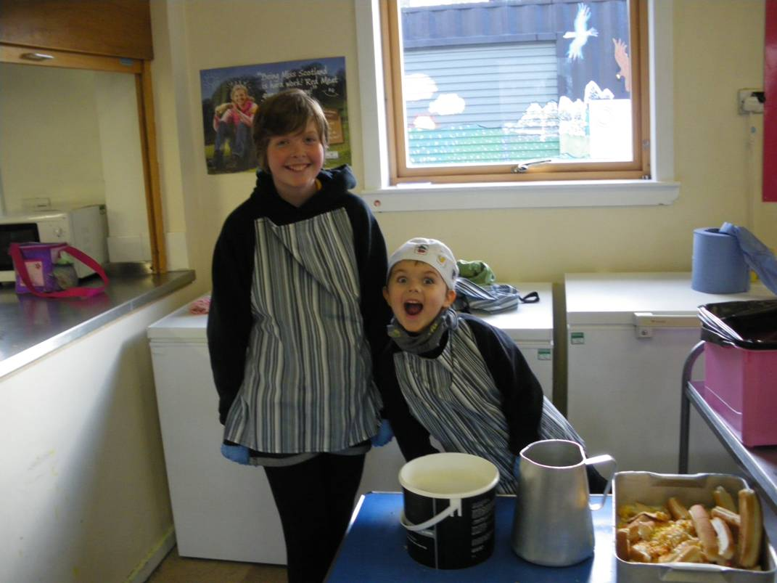
Kit for the Day
Gloves
Aprons
Scales
Boxes
Clear bags
Litter picker
Recording sheets
Clipboard
Stickers

Slide 5
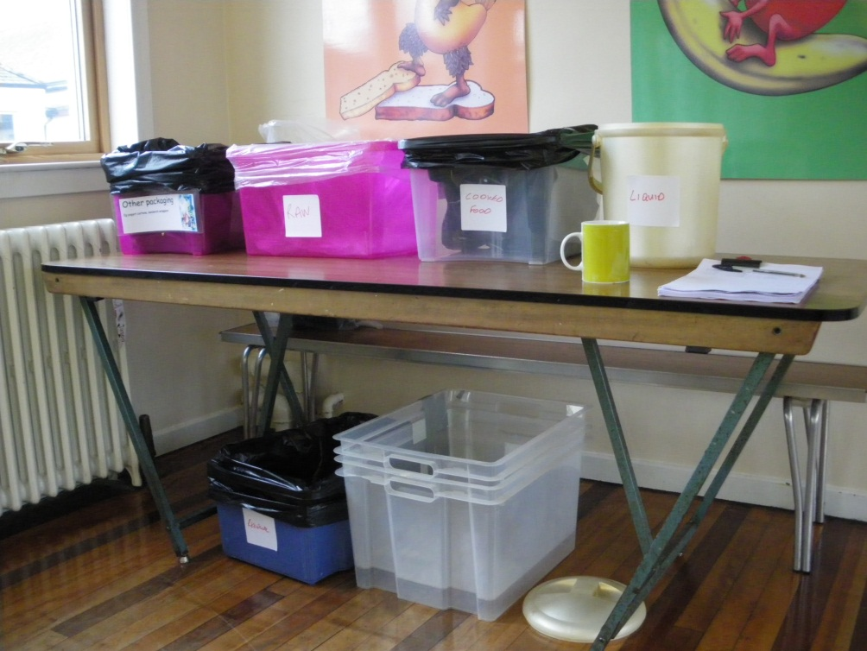
On the Day
Don’t have two many kids
2/3 Adults
Task rota
Organised work area
Lots of patience

Slide 6
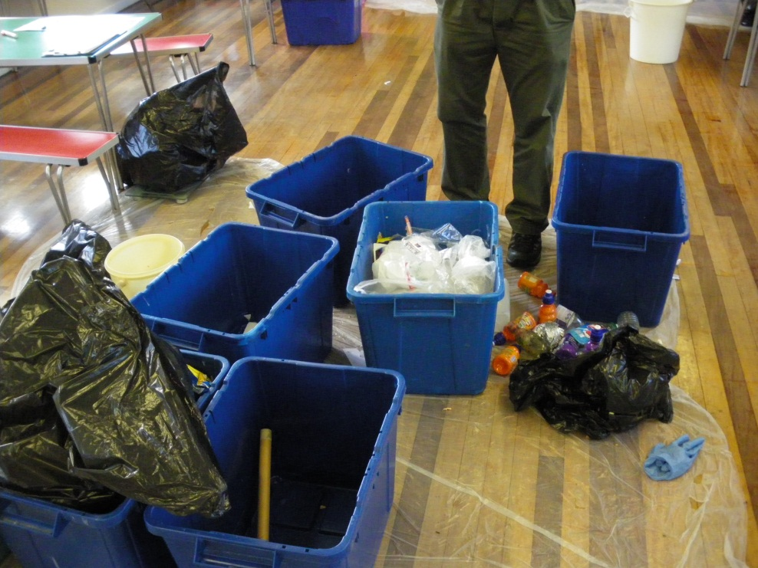
On the Day
Collect
Sort
Weigh
Record

Slide 7
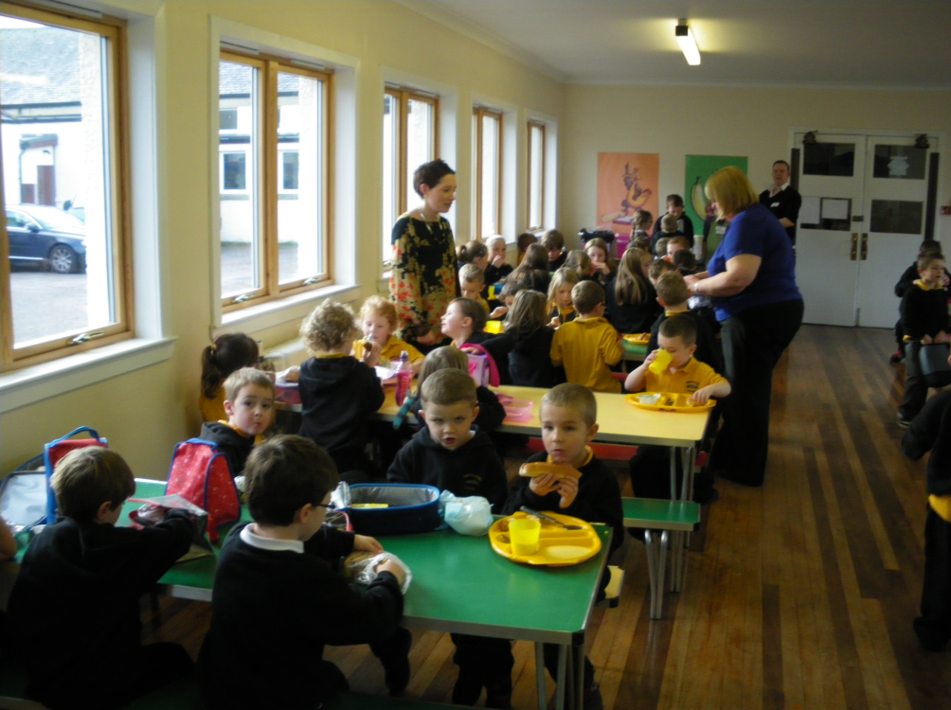
Later in the Day
Kitchen waste
Packed lunch waste
School dinner waste
External bins
Internal bins

Slide 8
Collect, Sort, Weigh (Dry)
Dry Recyclate
Depends on what is being collected
One pile for each area
Sort
Weigh in tared box
Record
Notes:
.

Slide 9
Collect, Sort, Weigh (Mixed)
Residual
Messy
Bag and label each bin
Sort into bagged boxes
Tare scales
Weigh and record
Don’t forget liquid

Slide 10
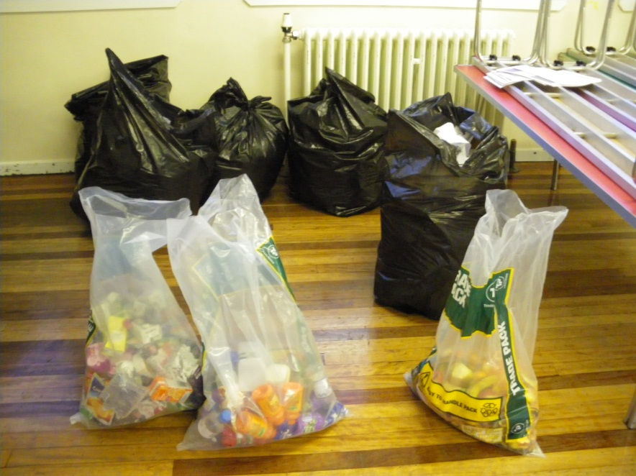
Recording and Feedback
Global footprint
School assembly
Visuals
Resources

Slide 11
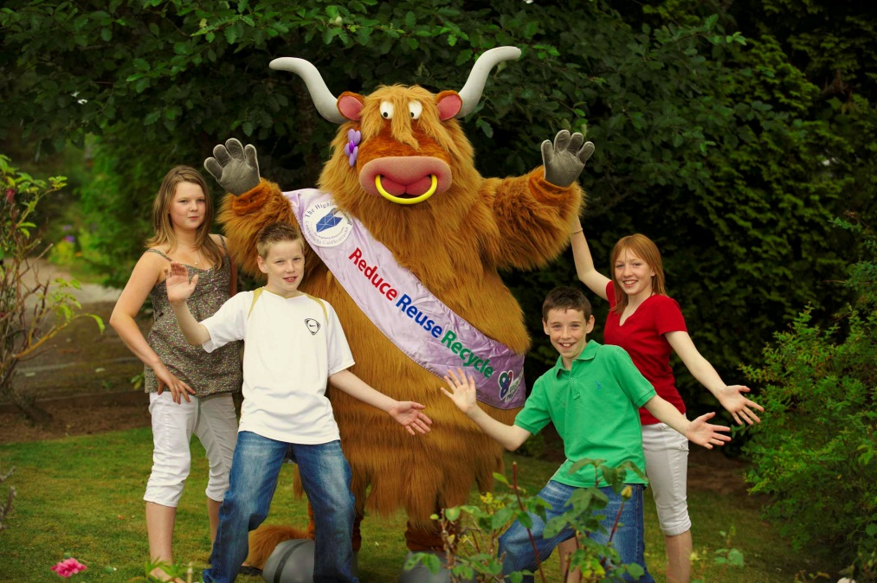
Resources
Presentations
Photo library
Games
Books
Website
Wormeries
Waste Free Lunches
Mascot
Internet

Slide 12
WHY IS RUBBISH A PROBLEM?
?
Notes:
So why is all this rubbish such a big problem? What’s wrong with just burying it in a big hole and forgetting about it?
Well, it uses up lots of land. And we are running out of space for landfill sites.
It gives off a nasty smell – that sickly sweet smell is methane which is a very powerful Greenhouse gas which causes Global Warming…..
And there are other threats to wildlife from the litter itself – plastic bags for example.
It wastes raw materials – everything is made from something.. What is paper made from? (discuss things we cut down trees for, then throw away – not just paper (furniture etc)
What about Glass? Steel? Aluminium? Made from minerals – sand, clays, rocks – some containing metals (known as ores)
And making all these things, especially from raw materials, takes lots of energy.
Which causes more pollution.

Slide 13
Why should I recycle?
Saves energy
Requires less transportation
Saves resources
Reduces pollution
Reduces need for landfill sites
Helps wildlife
Notes:
So let’s just recap on why we should recycle:
Saves energy (remember a can made from recycled steel saves 75%, one made of aluminium saves up to 95%)
Reduces pollution
Reduces need for landfill sites
Helps wildlife

