Slide 1
Nairn Academy
Stakeholder Group Meeting No. 8
Project Update
7 December 2023
Robert Campbell, Service Lead
Capital Planning & Estate Strategy

Slide 2
Progress Since Previous Meeting in June
The Council wrote to the Scottish Government in August to formally request that the occupation date in relation to the Learning Estate Investment Programme funding conditions is extended to the start of the new school session in August 2026. No response has been received to date, but receipt of the letter has been acknowledged.
The public consultation event was held at Nairn Academy on 6th September. The feedback was generally positive, and no significant concerns were raised.
The review of the Council’s capital programme was concluded in September. The 5-year programme includes an increased budget for the Nairn Academy project that is based on the revised timescales.
The planning application has been lodged and is awaiting verification by Planning and uploading to the ePlanning portal. A link will be sent to Stakeholders once this is available.
Notes:
Think back to income and expenditure slides…..

Slide 3
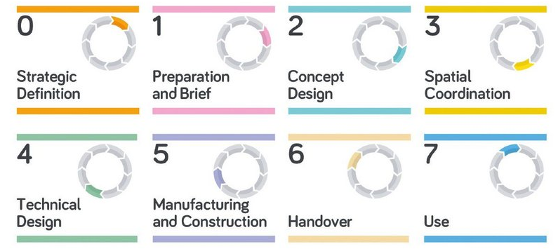
Design Process
The table below summarises the Design Stages from the RIBA Plan of Work that all major projects follow.
The project is at Design Stage 4 with the main activities being completion of the technical design and market testing of individual work packages. The key outcomes will be approval of the planning application and reaching financial close with the contractor to allow award of contract.
Notes:
Think back to income and expenditure slides…..

Slide 4
Key Risks/Mitigations
Cost: Market conditions (e.g., inflationary factors and availability of sub-contractors) continue to potentially impact on the cost of some work packages. Additional time was taken at the end of Stage 3 and start of Stage 4 to address some of the key issues.
Programme: Although the planning application was submitted later than previously advised, this was not on the critical path of the overall programme. We will continue to liaise with colleagues in Planning to identify and resolve any potential issues as soon as possible.
Start on Site: Consideration is being given to an “enabling works” contract that would allow a start on site on the programmed date but prior to the final agreement of the overall contract amount if this cannot be achieved for any reason.
Notes:
Think back to income and expenditure slides…..

Slide 5
Next Steps
Continue to progress Design Stage 4 and the market testing of individual work packages.
Continue to work with Academy staff on the internal layouts, equipment and furniture requirements, and the external areas.
Continue to liaise with colleagues in Planning and Building Control.
Develop options for use of existing building footprint and any residual areas; Academy staff and Ward Members initially then other interested parties.
Nairn Library – the potential relocation of the Library to the new building has still to be considered by Members.
Notes:
Think back to income and expenditure slides…..

