Slide 1
Roads and Infrastructure Members Induction Day
Tuesday 24 May 2022

Slide 2
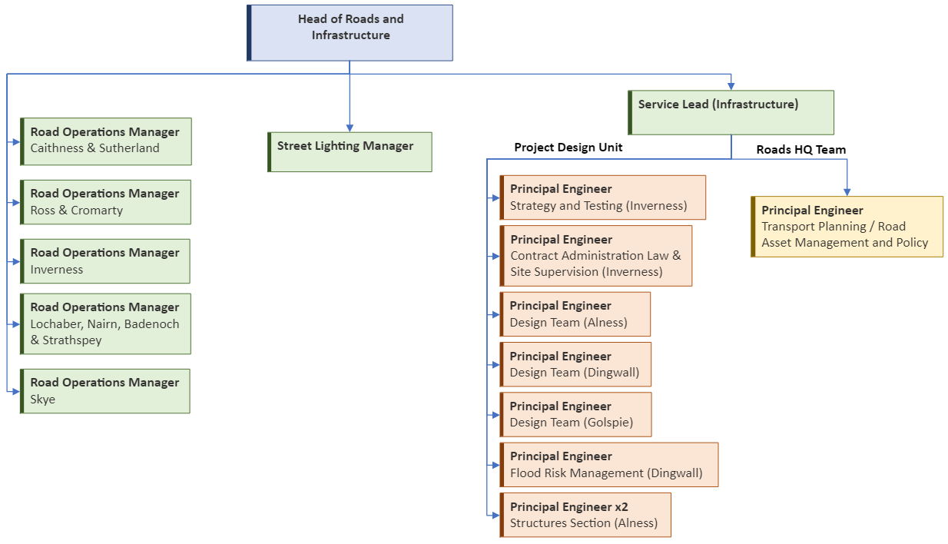
R&I Structure

Slide 3
Roads & Lighting
Statutory Duties and Legislation
  Roads (Scotland) Act, etc
Assets (Carriageways, Structures, Footways, Cycleways, Lighting, Drainage, VRS, Signs, Road Markings, Signals, Flood Alleviation Schemes, etc.)
Budgets
  Revenue: Maintenance, Set Annually
  Capital: Improvements, 5 year plan
Road Works Register (planning and co-ordination)
Resources – staff involved in winter duties also are the operatives used to maintain the network

Slide 4
Roads & Lighting Maintenance
Resurfacing
Surface Dressing
Bridge Repairs
Pothole Repairs
Patching
Drainage
Gully Emptying
Signs & Bollards
Road Markings
Bus Shelters
Verge Maintenance
Vehicle Restraint Systems (Safety Barriers)
Cattle Grids
Culverts
Retaining Walls
Coastal Defences
Watercourse Maintenance
Flooding Alleviation
Winter Service
Footway Repairs
Emergency/ Incident Response
Street Furniture
Street Lighting
Traffic Signals
Illuminated Signs

Slide 5
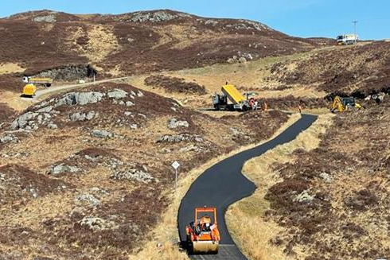
Resurfacing
Drumbeg – previous scheme

Slide 6
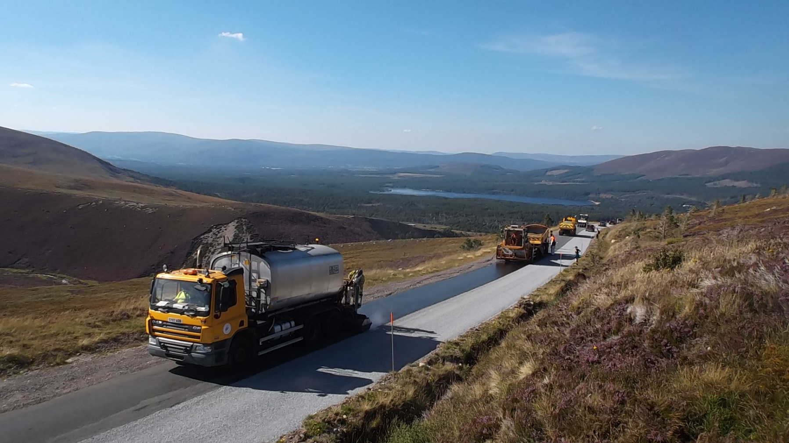
Surface Dressing
Cairngorm – previous scheme

Slide 7
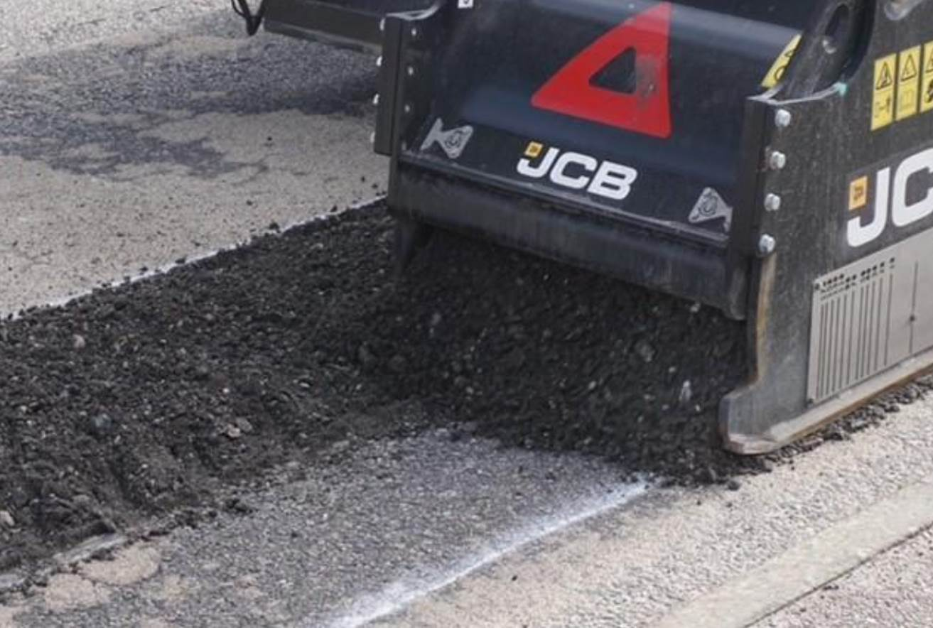
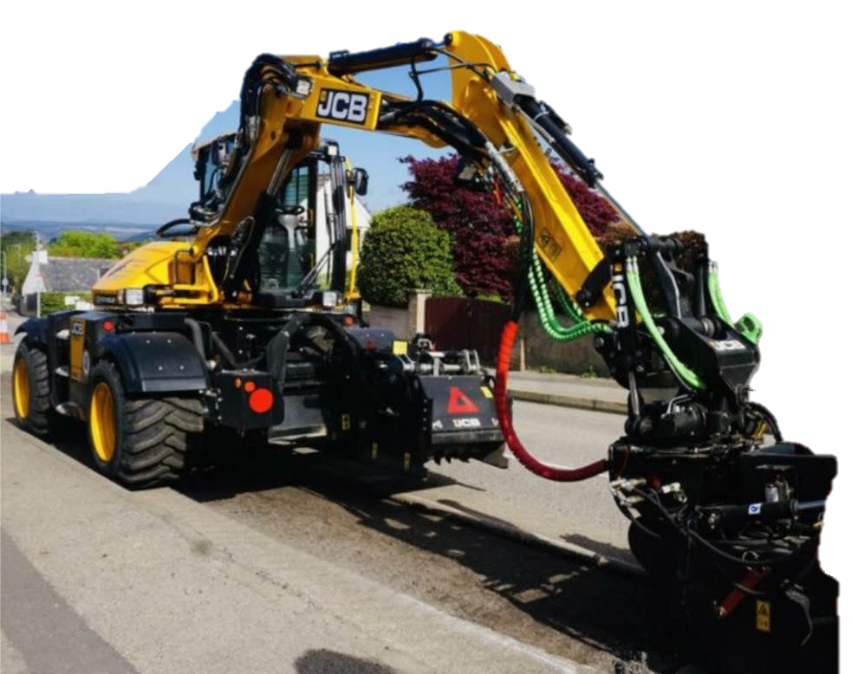
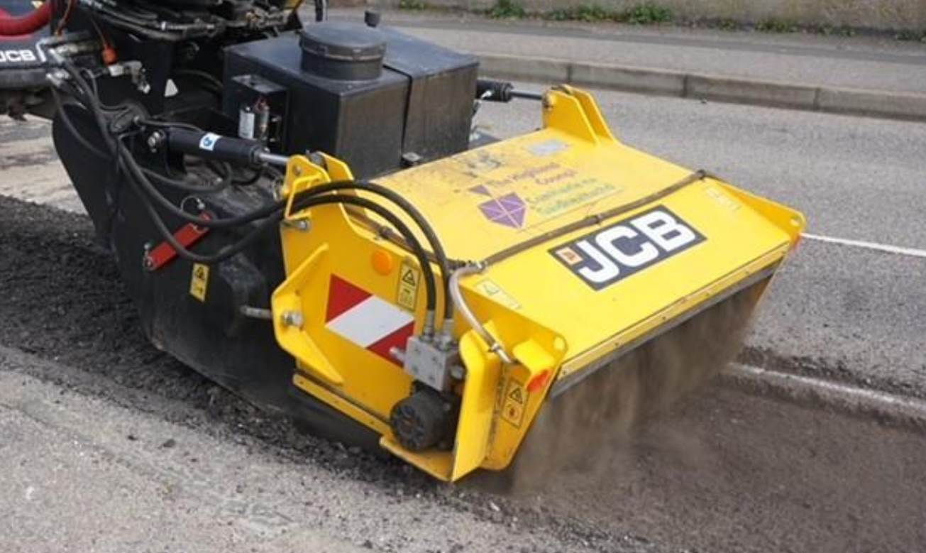
Pothole Pro
Patching in Balloch
Planing
Cleaning

Slide 8
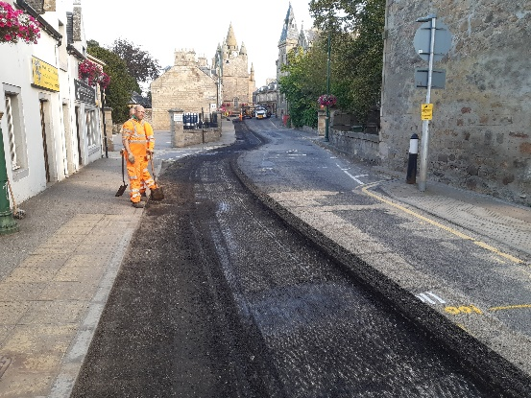
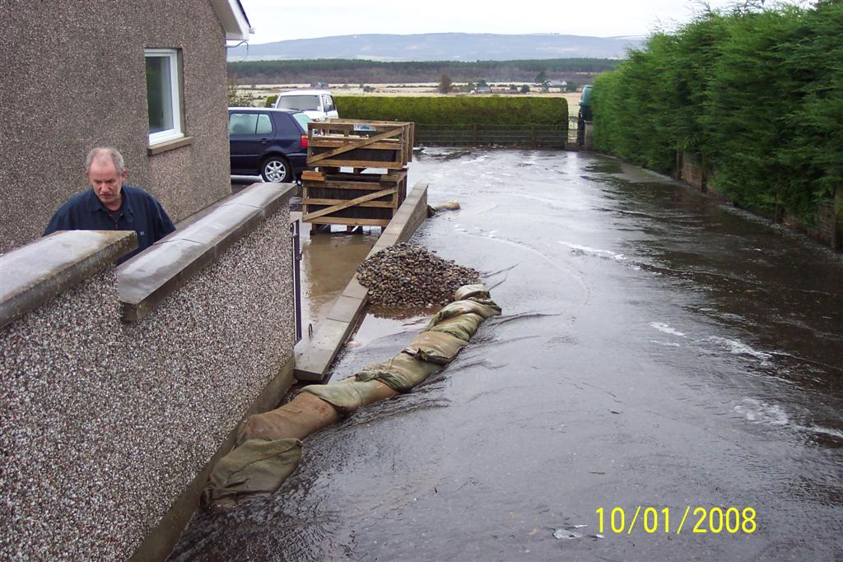
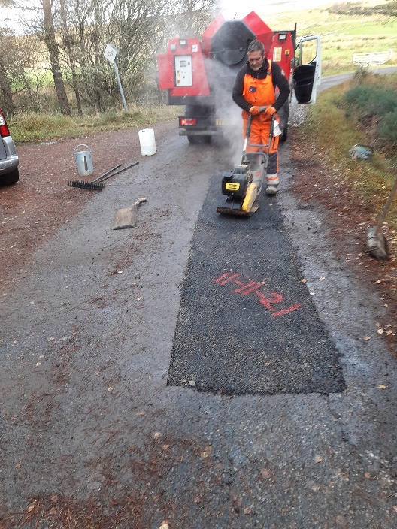
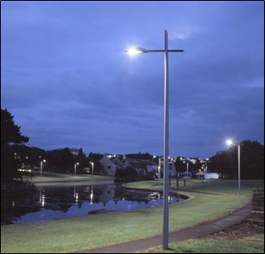
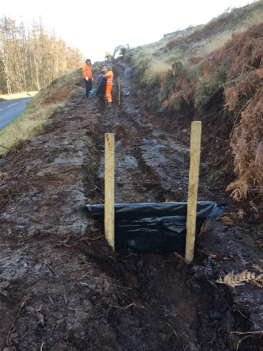
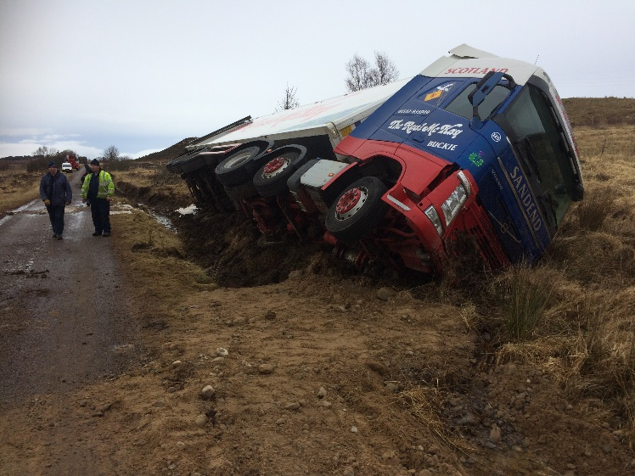
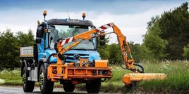
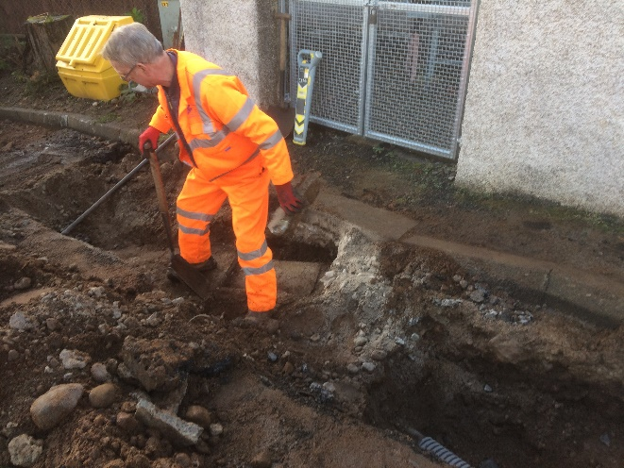
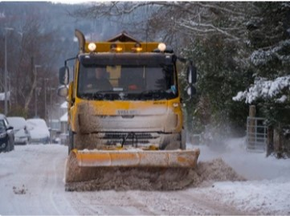
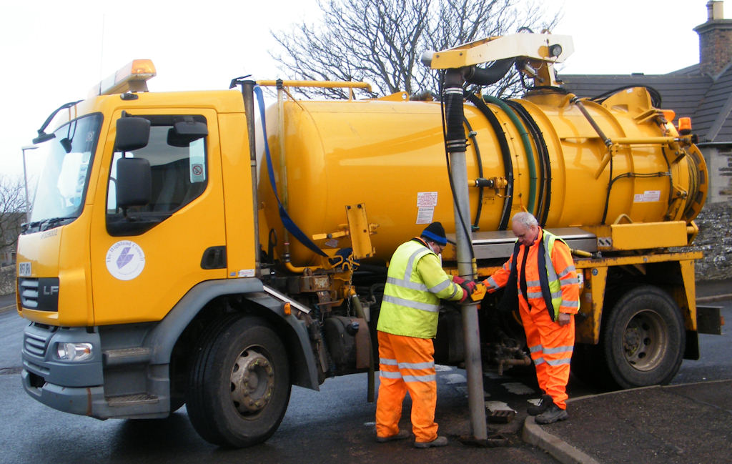
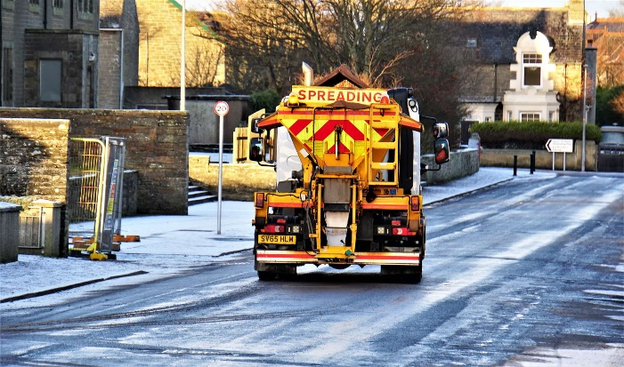
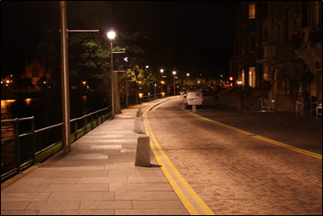
Capital & Revenue Activities

Slide 9
Engineering Services
Scottish Roadworks Register Notices
Permits for opening or occupying the road
Road Works Co-ordination and Inspection
Road Adoptions
Overhanging Trees/ Vegetation
Structural Schemes
Roads & Structures Inspections
Footway Obstructions
Road Construction Consents
Planning Consultations
New Development Inspections
Compensation Claims
Traffic Orders
Tourist Sign Applications
Timber Transport
Events
Speed Surveys & Traffic Counts
Asset Management Database
Liaison with various stakeholder groups
FOI / CRM/ Member/ C Council Responses
Government Returns (PI information)
Lighting Scheme Design

Slide 10
Reporting
Report defects through CRM system (online or by phone):
  https://www.highland.gov.uk/info/20005/roads_and_pavements/96/road_faults
  https://www.highland.gov.uk/info/20005/roads_and_pavements/110/street_lighting_and_traffic_signals
Reporting directly to officers creates double handling as it needs to be added to CRM system.
Report through CRM then obtain reference number which officers can look up.
DON’T encourage use of third party websites or social media as information may not reach us.

