Slide 1
Health and Social Care Directorate
Elected Members
Induction Briefing
May 2022

Slide 2
What is Health and Social Care?
we work alongside the Council’s partners, across all sectors, and within our communities, to ensure that children, young people and their families receive the help and support they require to optimise their health and wellbeing at every stage
We offer support to our care experienced young people and ensure our role as corporate parents is regarded as a priority at all times.
We work with NHS Highland as part of our Lead Agency agreement to support the delivery of adult social care across the Highlands. This is in addition to providing a Mental Health Officer and Justice Service.

Slide 3

Health and Social Care
Child Health
Mental Health Officers
Out of Hours
Fostering Adoption
Kinship
Youth Justice
Residential Child Care
Criminal Justice
Disability Teams
Business Support & Intelligence
Children & Families Social Work
Home to Highland Team

Slide 4
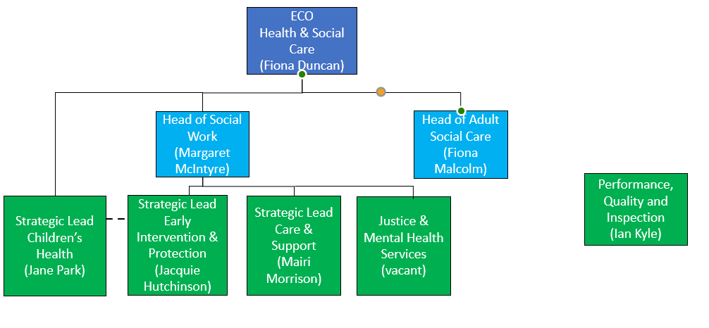
OVERVIEW – Health & Social Care

Slide 5
Staff
Health and Social Care headcount = 1023
Children’s = 660
Child’s Health = 200
Justice = 70
MHO = 23
(plus a number of temporary/fixed term contracts across all services

Slide 6
Budget 2021/22
Function | Budget (2021/22)
Service Management and Support
Management Team | £173,000
Business Support | £830,000
Covid 19 Response | £2600,000
 | £3603,000
Adult Services
Commissioned Adult Services | £108,104,000
Mental Health Teams | £1,178,000
Criminal Justice Service | £62,000
Other Services for Vulnerable Adults | £1,314,000
 | £110,658,000
Children’s Services
Looked After Children | £25,950,000
Family Teams | £18,393,000
Other Services for Children | £6,387,000
Commissioned Children's Services Income from NHSH | -£10,676,000
 | £40,054,000
TOTAL HEALTH AND SOCIAL CARE | £154,315,000

Slide 7
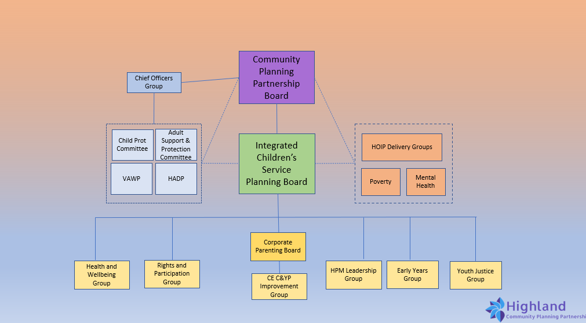

Slide 8
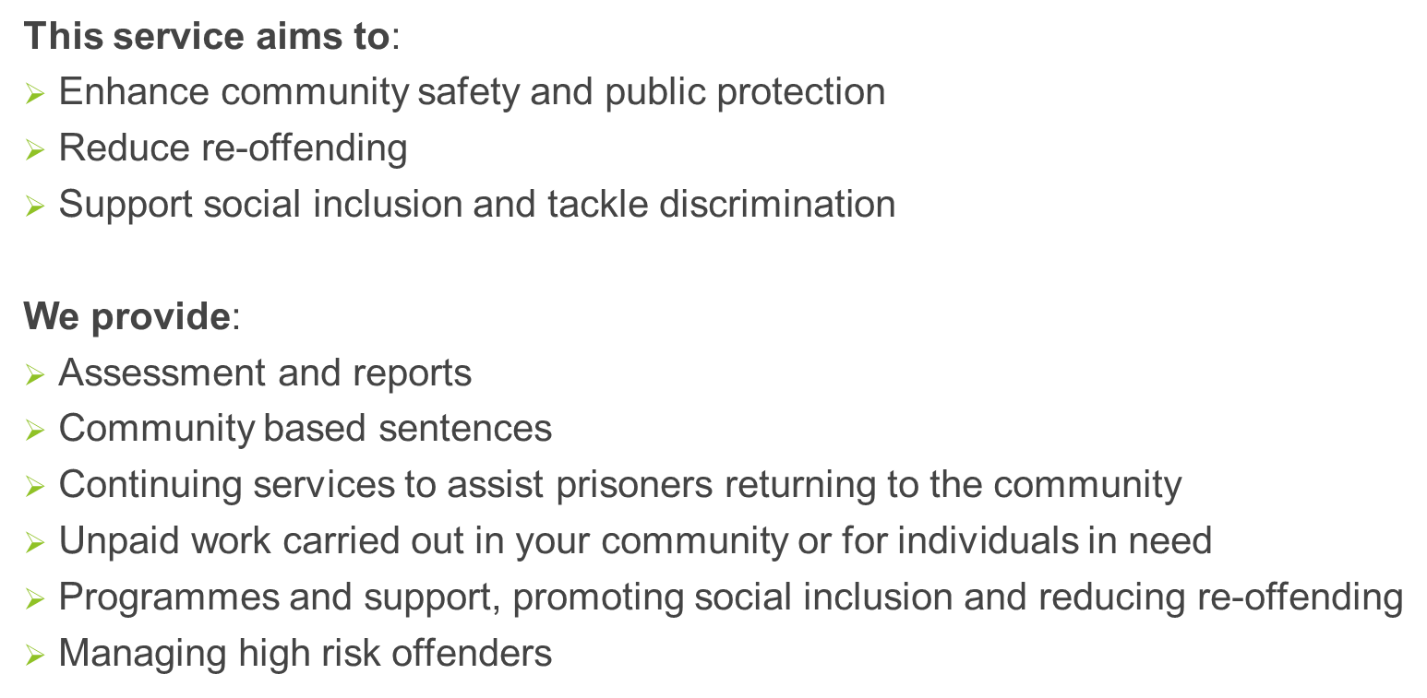
Justice Service

Slide 9
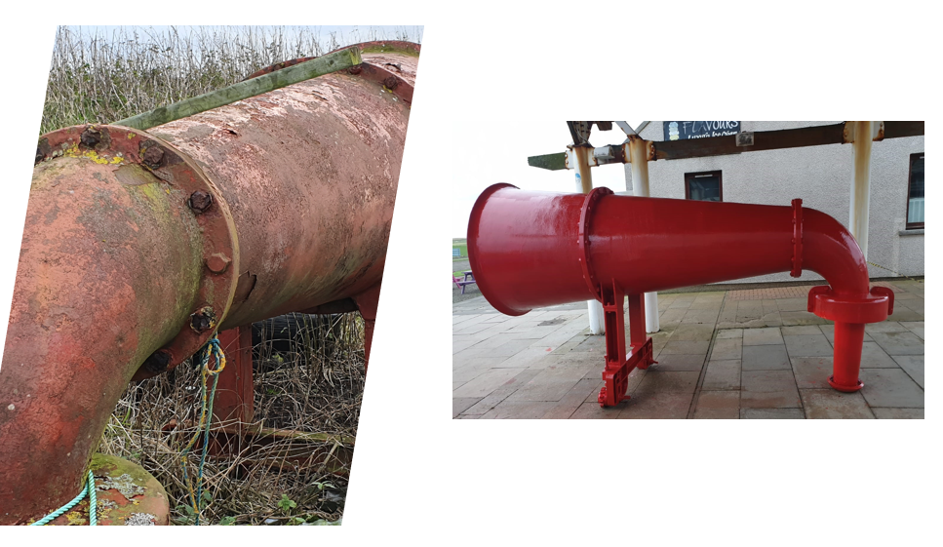

Slide 10
Mental Health Officer Service
Advise service users of their rights in law and assist them to exercise them
Applicant to the Sheriff Court or the Mental Health Tribunal
Secure the appropriate mental health reports
Are involved in compulsory treatment in a community setting
Consider alternatives
Are Professional Mentors

Slide 11
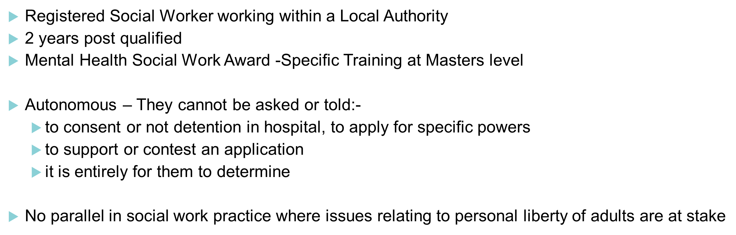
What is a Mental Health Officer

Slide 12
Delivery of Adult Social Care
Integration using 2002 Community Care and Health (Scotland) Act developed lead agency model in 2012.
Lead Agency model means that one agency leads provision of a shared vision.
Statutory functions are delegated, but statutory duties are not transferred... They remain with the responsible authority.
This means that Adult Care Services are delivered by NHS Highland but Highland Council remains responsible through the Chief Social Work Officer (CSWO)
Take account of proposed National Care Service

Slide 13
What that means now?
Highland Health and Social Care Partnership delivers services to the people of Highlands.
The Council delivers Children’s Services AND the Commissioned Child Health Service on behalf of the NHS
NHS Highland delivers health services AND adult social care services on behalf of the Council
Both organisations require to work in partnership to ensure positive outcomes for people
Governance is through the Joint Monitoring Committee which is a joint committee including 3rd sector

Slide 14
CHIEF SOCIAL WORK OFFICER (CSWO)
THE CSWO IS A ROLE AND FUNCTION
(RATHER THAN A JOB DESCRIPTION)
THE CSWO ROLE APPLIES TO THE PROFESSIONAL LEADERSHIP OF, AND ACCOUNTABILITY FOR, ALL ASPECTS OF LOCAL SOCIAL CARE AND SOCIAL WORK SERVICES

Slide 15
CHIEF SOCIAL WORK OFFICER (CSWO)
The provision of professional advice in the discharge of the local authority’s statutory functions
The provision of strategic and professional leadership in the delivery of social work services
Assistance to the local authority and their partners in understanding the complexities and cross-cutting nature of social work services
The support of overall performance management and management of corporate risk

Slide 16
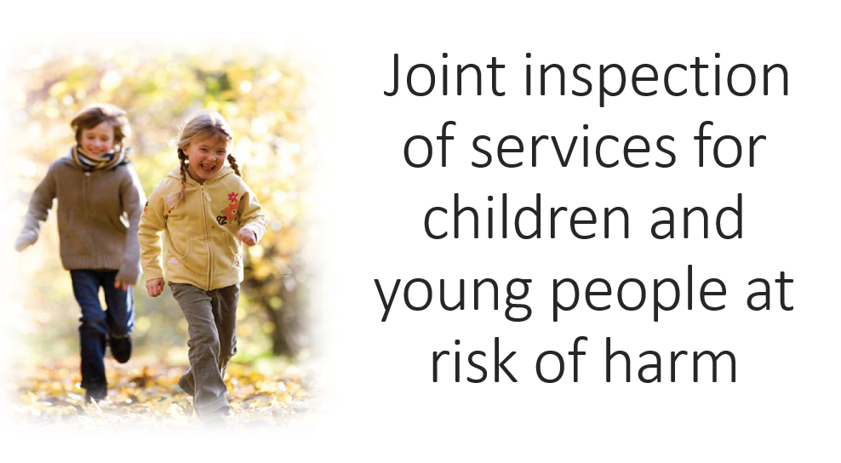

Slide 17
Who are children and young people at risk of harm?
Definition:
Children and young people who have been subject to a child protection investigation and this has not led to registration on the child protection register
Children and young people whose names have been placed on the child protection register
Children and young people involved in vulnerable young person’s processes and those involved in care and risk management processes

Slide 18
Key dates
Staff Survey – 30th May
Partnership discussion 1 – 1st June
Partnership discussion 2 - 20th July
Submission of a joint position statement and supporting evidence – 11th August
Engagement week w/c 22nd August
Partnership discussion 3 – 14th September
Report published – 25th October

