Slide 1
Training event delivered by PAS for:
Highland Council Elected Members
6 June 2022
Welcome
Introduction to Planning &
the Role of Elected Members

Slide 2
Today …
From PAS (Planning Aid Scotland):
John Bury
Keith Winter
From Highland Council:
Dafydd Jones (Planning Area Manager – North)
David Mudie (Planning Area Manager – South)
Iain Meredith (Solicitor)
Scott Dalgarno (Development Plans Manager)
Andrew Puls (Principal Officer - Environment)

Slide 3
Objectives
Overview of the Scottish Planning System
Role of Elected Members
Competent planning decision-making
How the system is changing
Introduce you to PAS & how we can help
Interactive & relaxed: plenty of time for questions & discussion

Slide 4



Group Guidelines
Timeframe: 9.30 am – 4.00 pm
Housekeeping
3 x 15 minute breaks
Lunch at 1.00 pm
Slides will be circulated after event
We won’t have time for detailed discussion of specific local planning applications
Notes:
Emojis:
1: We will start and finish on time
2. Any questions, comments, examples, etc – just raise your hand
3. Please respect other participants' views which may be different from your own

Slide 5
Introduction to PAS

Slide 6
PAS (Planning Aid Scotland)
We are here to help people navigate the
planning system & shape the future of their places
Impartial
Independent
Educational Charity
Social Enterprise
Volunteer-led
We act with integrity
We are inclusive
We are collaborative
We are impartial
We promote participation
Our volunteers offer their time and expertise to help people with planning & placemaking
www.pas.org.uk
Notes:
AS Slide?//

Slide 7
What We Do: Planning Advice
Our original & flagship service
Free advice on any aspect of planning.
Used by many Community Councils, community groups, business start-ups & members of the public.
You are running a wonderful & much needed service –thank you
Independent & impartial
Confidential
Advice from chartered planners
Volunteer-led
Facilitating approach
Eligibility criteria apply
So glad I contacted you & did not expect such a personal service
www.pas.org.uk/advice
Notes:
Please note that this is a very relevant service for Elected Members to let members of the public in their wards know about.
We can also potentially offer short talks on planning to community groups

Slide 8
What We Do: Training
For: Community Councils, stakeholder groups, planners, Elected Members & PAS Volunteers
Totally brilliant – I had been worried I would find it a snooze-fest – however, the absolute opposite! – interesting, invigorating & instilled confidence in tackling planning matters as a Community Councillor
Focusing on:
Understanding planning
Effective input & involvement
Community engagement & facilitation skills
… & much more
www.pas.org.uk/projects

Slide 9

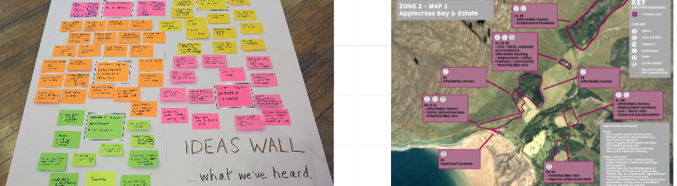
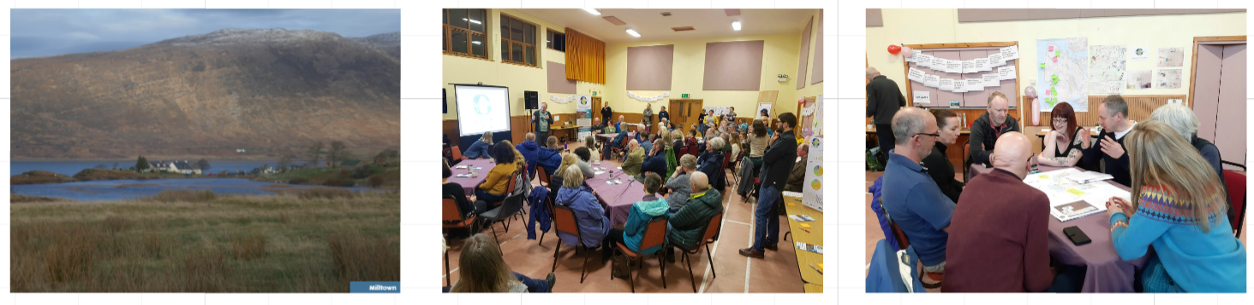
What We Do: Community Led Plans
Plan-It Applecross
Focus on identifying sites for new and affordable homes
www.pas.org.uk/projects
Notes:
This has been a big part of PAS work in the last 8-9 years or so – facilitating the development of a range of Community-led plans. Also Isle of Rum Community Land Use Plan and Morvern Community Action Plan

Slide 10



We’ll invite you in groups of 2-3
to discuss your experiences of planning

Slide 11
Part 1: Context

Slide 12
Planning: Why is it important?
A key public service
Working in the long-term public interest
Planning for the future
Impacts for health, well-being & equality
Impacts on day-to-day life: householder alterations to affordable homes to large new developments
Change can lead to strong feelings & controversy

Slide 13

Planning: Origins & Evolution
1900 -- | Early housing & town planning Acts
1947 | Establishment: public interest; health; forward planning; regulatory
1950-70s | Mass home-building; new towns
1970s | Public consultation agenda
1990s | Sustainability agenda
2006 | Planning Act: introduced National Planning Framework
2019 | Planning Act: focus on climate change; new homes; collaboration & other significant changes

Slide 14

Roles & Responsibilities
Scottish Parliament
Scottish Government
Local Authorities
Transport Scotland
Regional Transport Partnerships
Public Health Scotland
Statutory Consultees
Applicants & Developers
Community Councils
Stakeholder Groups
Community Groups
Only community group with a statutory role in planning

Slide 15
Agencies/Statutory Consultees
Provide expert advice where needed on planning matters:
Historic Environment Scotland
NatureScot (formerly Scottish Natural Heritage)
SEPA (Scottish Environment Protection Agency)
Scottish Water
Sport Scotland
Transport Scotland
Community Councils
Have right to request statutory consultee status on any planning application

Slide 16




Role of Scottish Government
Planning Legislation
National Planning Framework
Policy (eg, Designing Streets)
Planning Circulars
Planning Advice Notes
Appeals & Inquiries
Called-In Applications

Slide 17

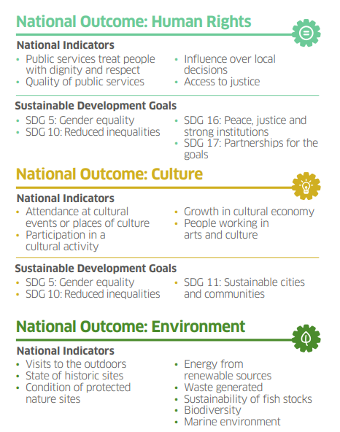
National
Performance
Framework
Prepared by Scottish Govt & COSLA
Click here for more info

Slide 18
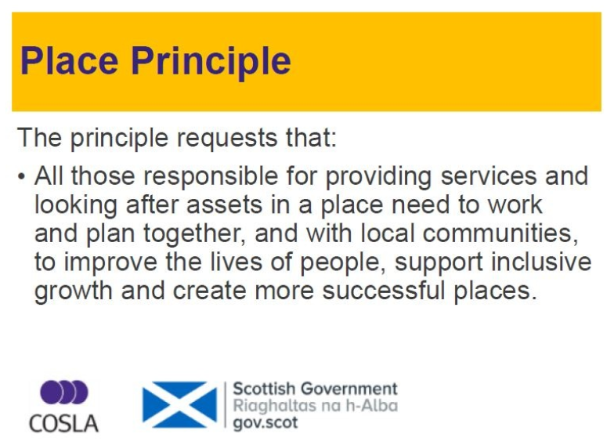
Placemaking
Click here for more info

Slide 19
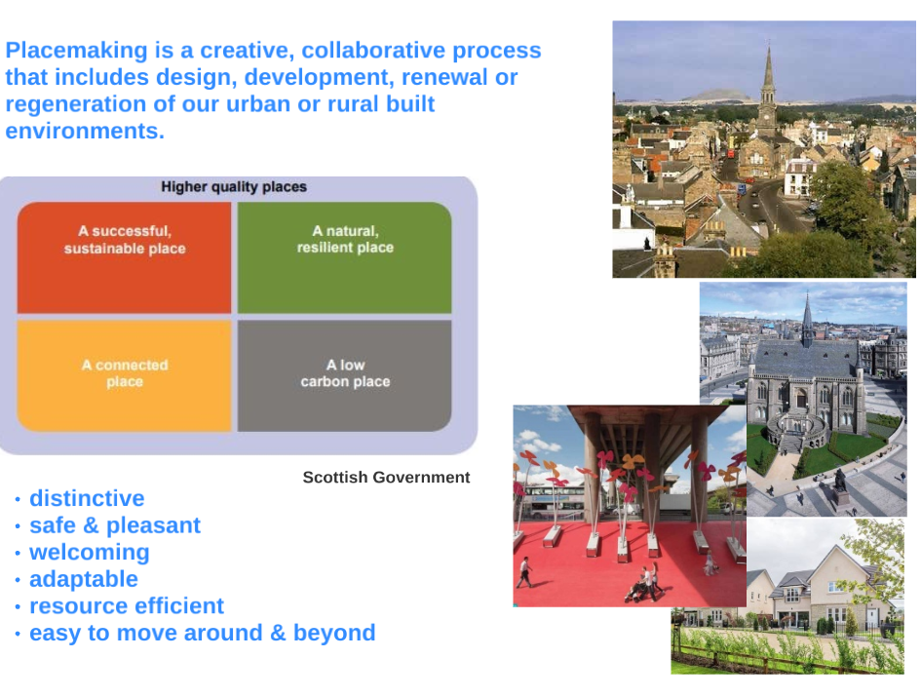
Placemaking

Slide 20
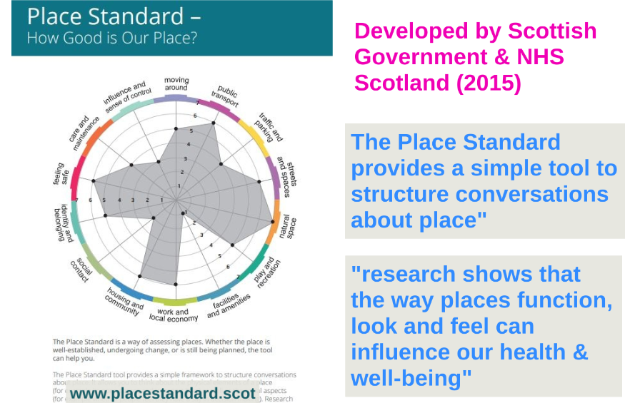
The Place Standard
Developed by Scottish Government & NHS Scotland (2015)
www.placestandard.scot

Slide 21
Role of Local Authorities
3 key inter-related functions
Development Planning
Enforcement
Development Management

Slide 22


Role of Community Councils
Statutory role in development management/applications
Consulted on planning & other matters
Duty to reflect local opinion
Elected Members may attend Community Council meetings
156 Community Councils (not all active)

Slide 23

Elected Members: interaction with planning
Signing off Local Development Plan
Planning Applications Committees
Pre-Determination Cttee/Full Council Hearings
Local Review Body
Attending Community Council meetings
Planning - a key ward matter

Slide 24

Elected Members: planning - your responsibilities
to take ownership of your Local Development Plan
(& encourage people to get involved in the process)*
to make competent planning decisions*
to help members of your public in wards with planning queries
*(more on this later)
Planning decisions will significantly influence the future of places and people’s lives – whether larger developments or householder matters

Slide 25
Part 2:
The Development Plan

Slide 26
The “Development Plan”: what does this term mean?
A key planning term – meaning can change based on what planning legislation stipulates
Currently for Highland Council
=
4 x Local Development Plans
Note: the 4 Scottish city regions currently* also have
Strategic Development Plans as part of their Development Plan
*This is changing based on 2019 Act – more later …

Slide 27
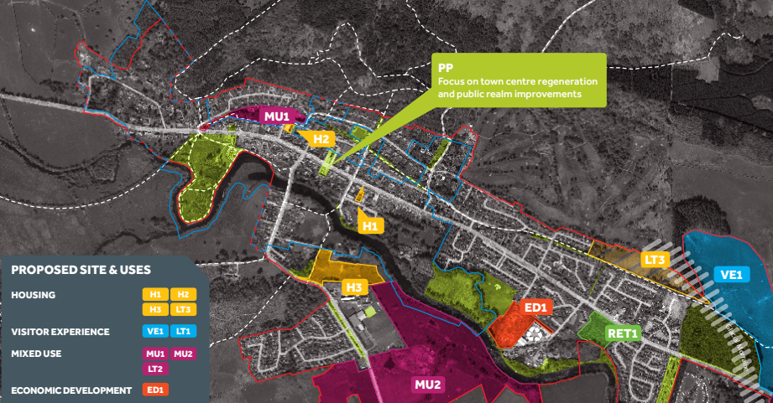
The Local Development Plan
The statutory plan
Allocates land for new homes
& more
Prepared every 10 years
Spatial Strategy
Settlement Maps
Planning Policies
Action Programme & focus on delivery … requires partnership working, eg NHS, Transport Scotland
Links to: Economic Strategy; Local Housing Strategy; Regional Transport Strategy

Slide 28

Discussion:
What do you think a LDP should cover/include?

Slide 29

Your Development Plan
Comprises 4 x Local Development Plans:
The Highland-wide Local Development Plan
3 x Area Local Development Plans:
Inner Moray Firth Local Development Plan
Caithness & Sutherland Local Development Plan
West Highlands & Islands Local Development Plan

Slide 30
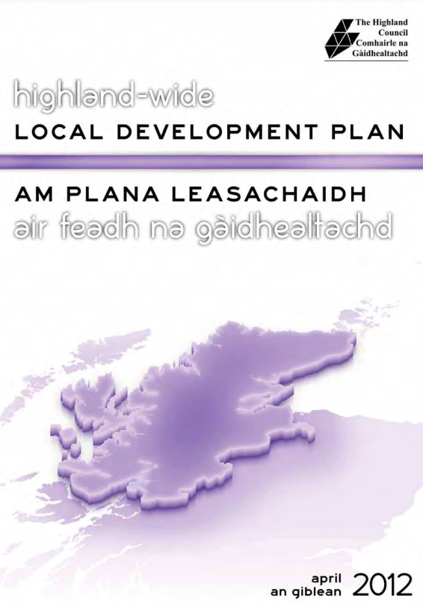
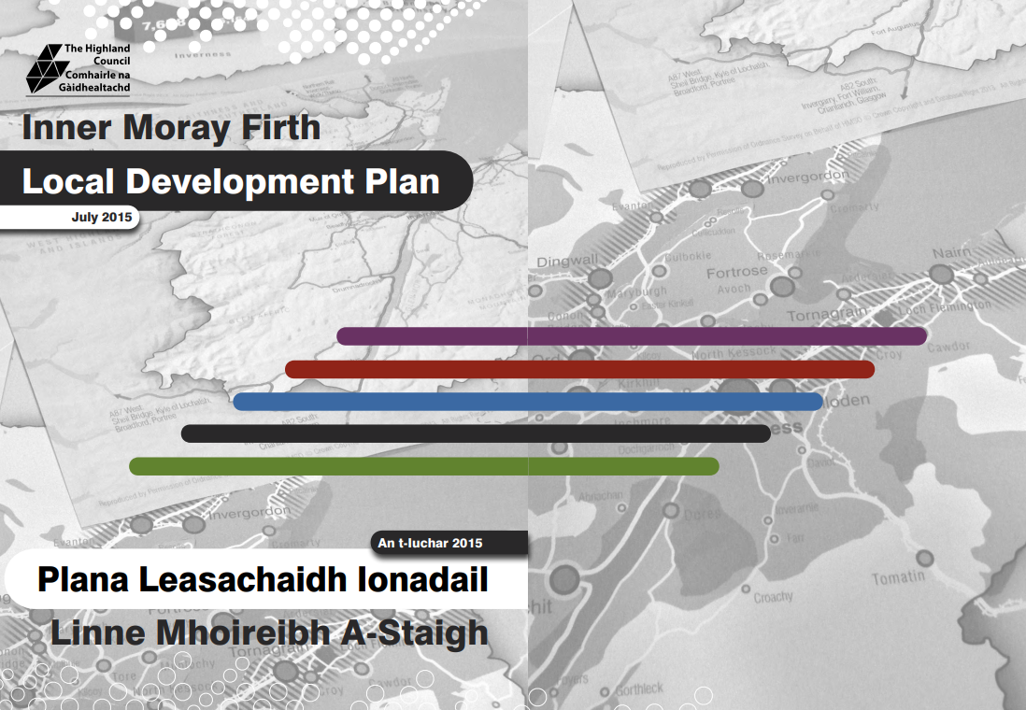
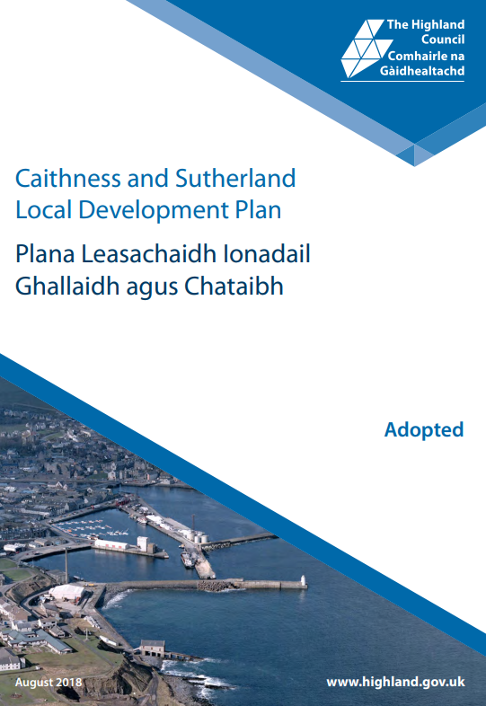
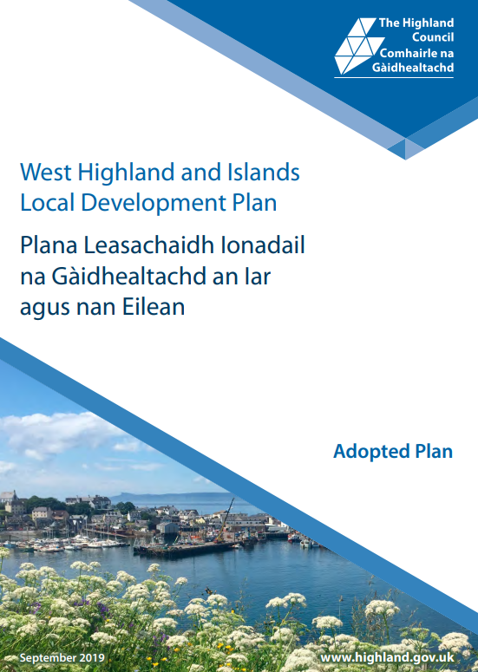
Your Development Plan
Highland-wide Local Development Plan:
focuses on topic-based planning policies
Area Local Development Plans:
focus on place-based matters
Click here to view

Slide 31

Highland-wide Local Development Plan: Polices
The Highland-wide Local Development Plan contains:
49 policies on specific planning topics
These are your key reference point planning decision-making

Slide 32
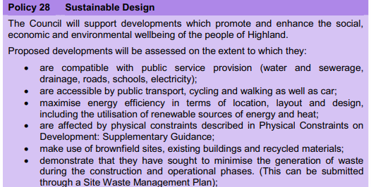
Policy 28: Sustainable Design
extract
Highland-wide Local Development Plan

Slide 33
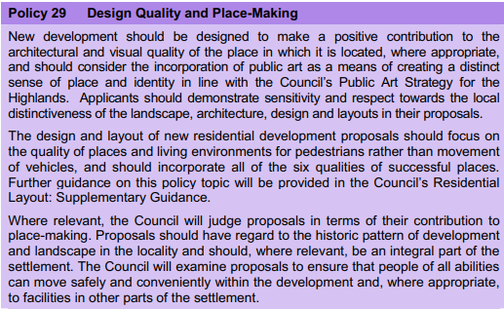
Policy 29: Design Quality and Place Making
extract
The design and layout of new residential development proposals should focus on the quality of places and living environments for pedestrians rather than movement of vehicles, and should incorporate all of the six qualities of successful places
Highland-wide Local Development Plan

Slide 34
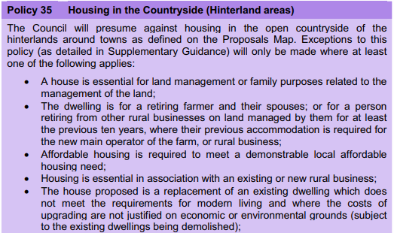
Policy 35: Housing in the Countryside
extract
Highland-wide Local Development Plan

Slide 35
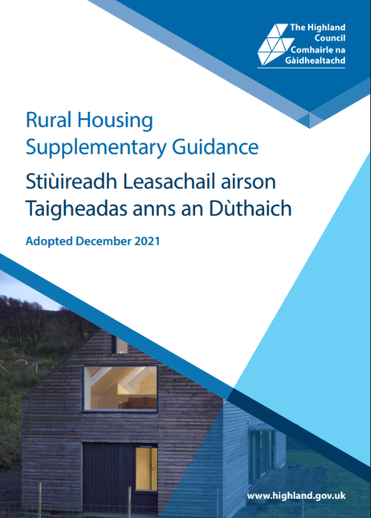
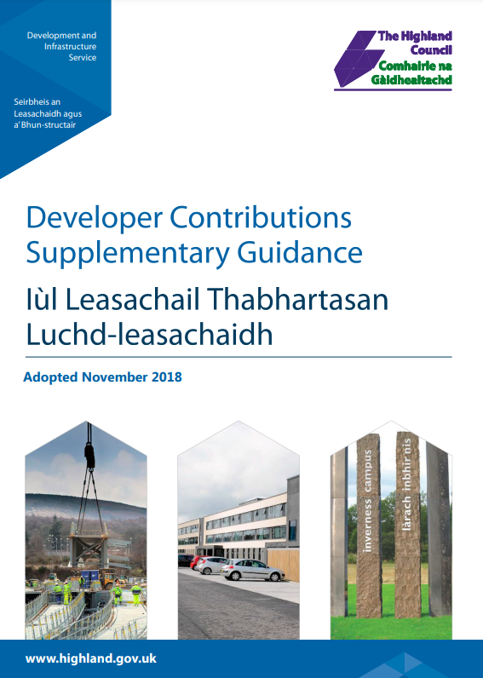

Planning Guidance
Click here to view
Explains in detail how planning policies are to be implemented
Taken into account in determining planning applications

Slide 36
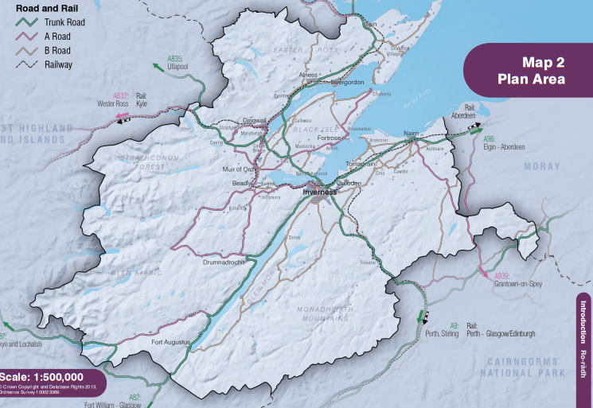

Area Local Development Plans
Purpose: to set out plans & proposals for delivering development reflecting on the unique characteristics & attributes of these areas
Inner Moray Firth
Local Development Plan

Slide 37
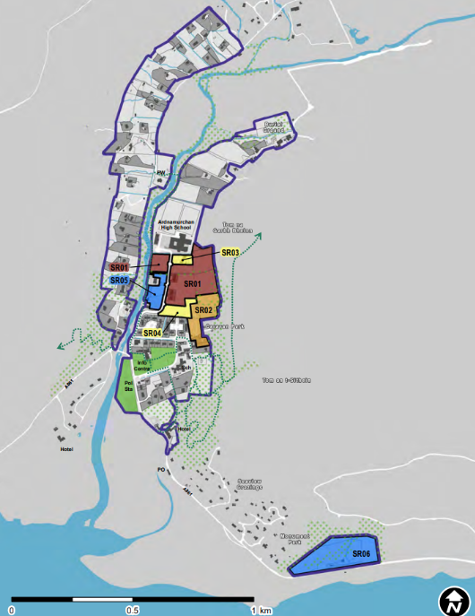
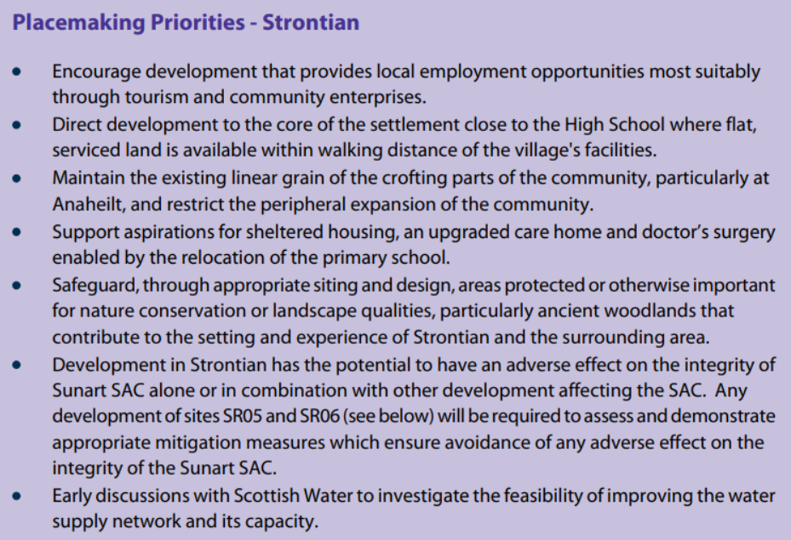
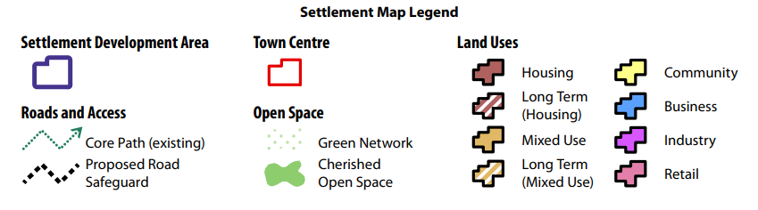
Area Local Development Plans
Strontian Settlement Map
West Highlands and Islands
Local Development Plan

Slide 38
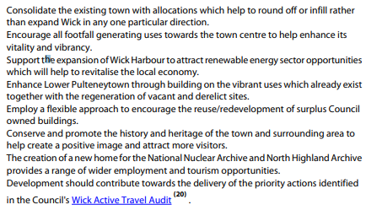
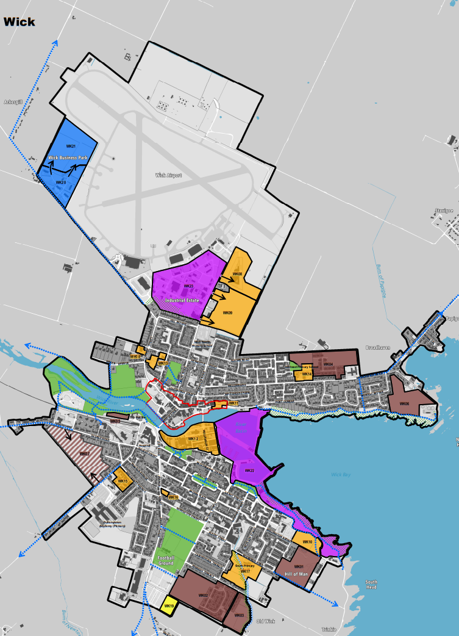
Area Local Development Plans
Wick Settlement Map
Wick
Placemaking Priorities
Caithness and Sutherland
Local Development Plan

Slide 39
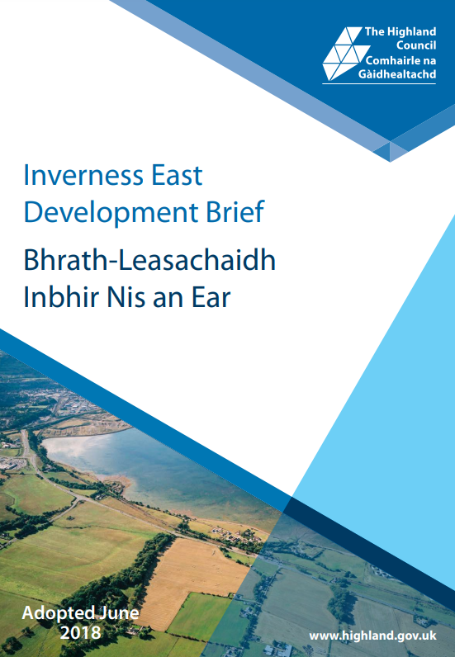
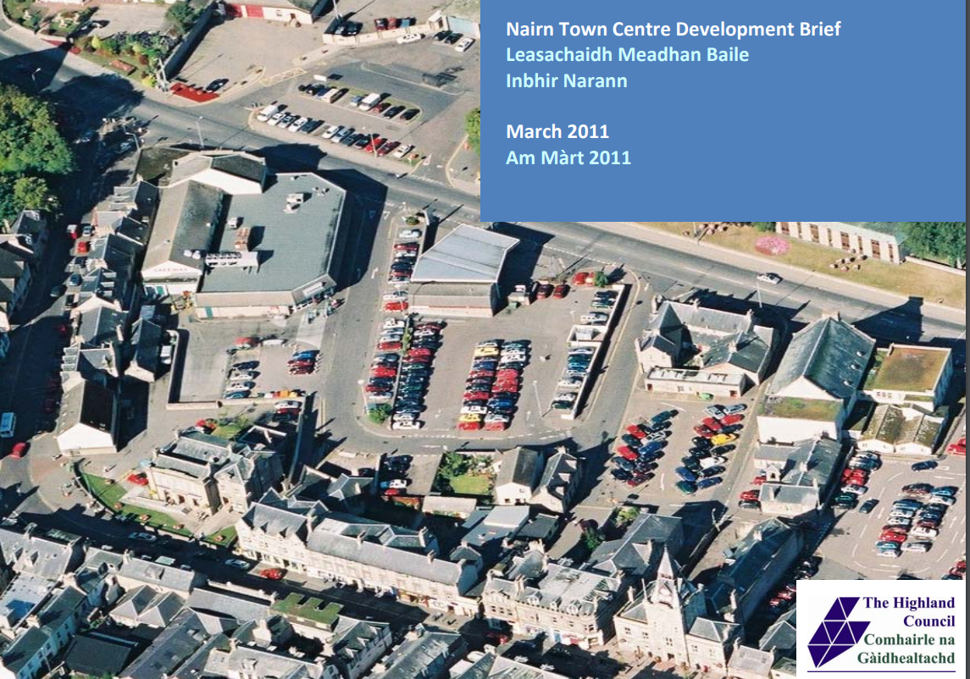
Planning Guidance to Area Local Development Plans
Place-based masterplans & site briefs

Slide 40
Why the Local Development Plan is so important
Owned by Elected Members
Sets context for future development of local areas
Primacy of the LDP: the statutory plan for deciding planning applications
(as required by planning legislation)
Opportunity for members of the public to be involved in future of their places

Slide 41
The Development Plan -
What’s Changing?
The Planning (Scotland) Act 2019

Slide 42
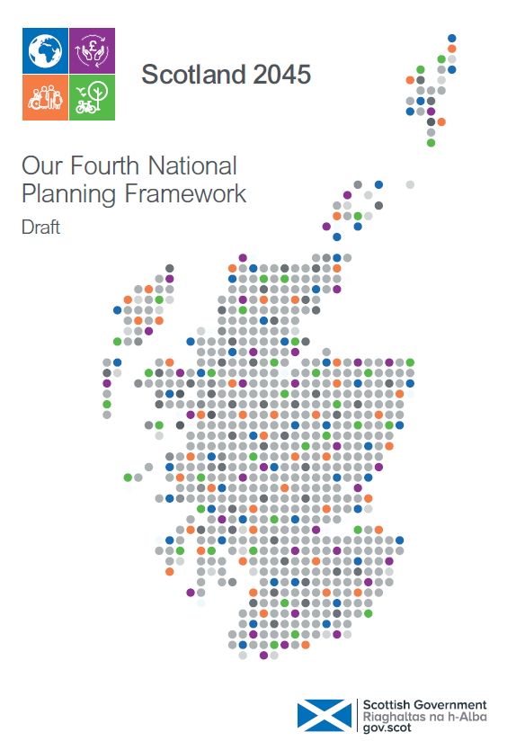
National Planning Framework 4
Why is it going to be so important?
Will be part of the Development Plan
Contains national planning policies
Key factor in deciding planning applications
Sets National Developments
Sets targets for the use of land for housing
Introducing new policy themes, eg Climate Emergency; 20 Minute Neighbourhoods
DRAFT
Click here to view
Public Consultation ended March 2022 – NPF4 may be approved later this year

Slide 43
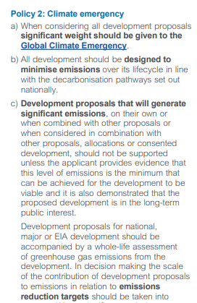
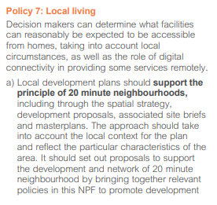
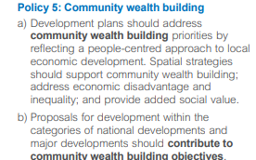
Draft NPF4 Policy examples

Slide 44
The Development Plan as it will be …
Regional Spatial Strategies
National Planning Framework
The Development Plan
Local Development Plan
Local
Place Plans
Based on: Scottish Government Local development planning - regulations and guidance: consultation

Slide 45
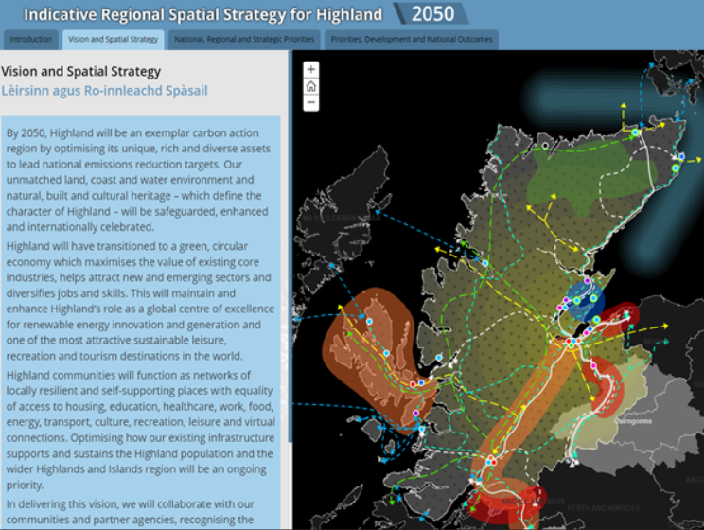
Regional Spatial Strategy

Slide 46
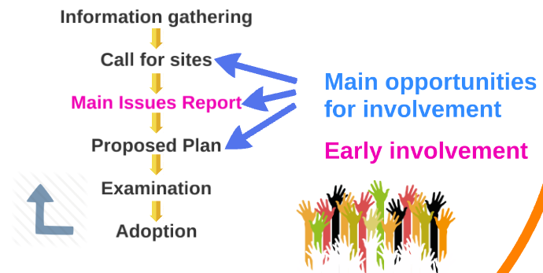
Local Development Plan –Preparation Process
Ideas
Delivery
Evidence Report
Note: this process is currently under consultation as part of the 2019 Act. This reflects how we expect the new process to be.

Slide 47


Local Place Plans
New statutory right for communities to prepare
a plan for their place – an opportunity
Must be about “use & development of land”
Must be prepared by a “Community Body”
Must have regard to NPF4 & Local Development Plan
Can suggest changes to the Local Development Plan
Elected Members could be involved
Process & outcomes to be reviewed after 7 years

Slide 48
Break
15 minutes

Slide 49

Welcome Back
Q&A
Discussion
Reflections

Slide 50


Discussion Theme:
How can planning contribute to addressing
climate change & the nature crisis?

Slide 51
Part 3:
Development Management
(Planning Applications & more)

Slide 52


Role of Development Management
Granting/refusing planning & other applications
Managing inappropriate development
Creating great places
Protecting & enhancing the environment
Protecting amenity
Decisions must be based on Local Development Plan policies in the first instance
… more on this later

Slide 53
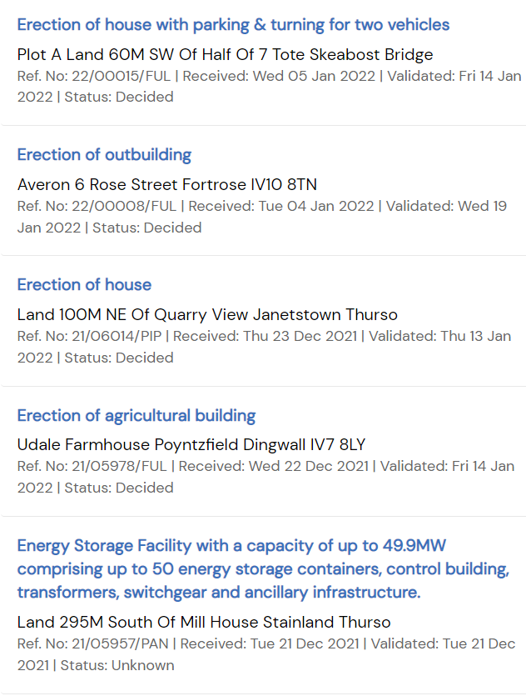
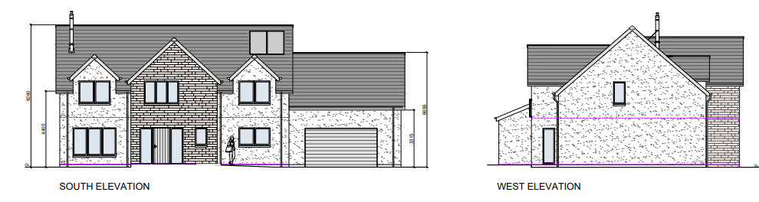
Types of Application
Detailed Planning Permission
Planning Permission in Principle
Listed Building Consent
Conservation Area Consent
Advertising Consent
Retrospective Applications
From the Weekly List:
Pre-Application Consultation:
Required for Major & National Proposals

Slide 54
Pre-Application Consultation
Statutory requirement for Major or National Development Proposals (eg 50+ homes); sites of 2 hectares or more
Proposal of Application Notice (PAN)
Based on the Development Hierarchy legislation
click here for more info
12 week period to advertise and engage
Minimum 1 x Public Event
Advertisement, Inform Community Council
Representations must still be made to the planning application once it’s submitted
Submit planning application accompanied by Pre-Application Consultation Report

Slide 55
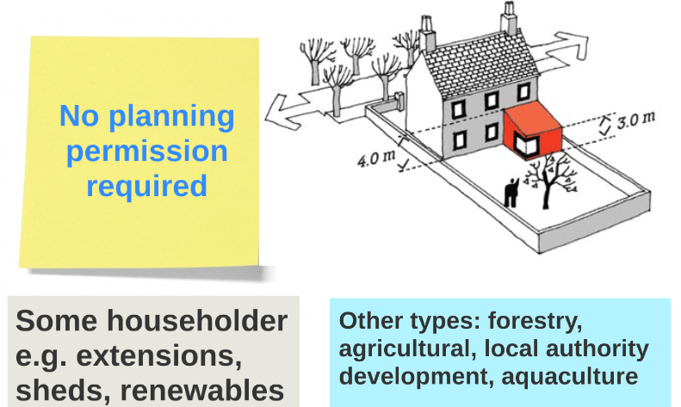
Permitted Development
Set by legislation - development that does not require planning application scrutiny; also remove fees
Householder PD will rarely apply in Conservation Areas or Listed Buildings – and is much more
limited for flats

Slide 56
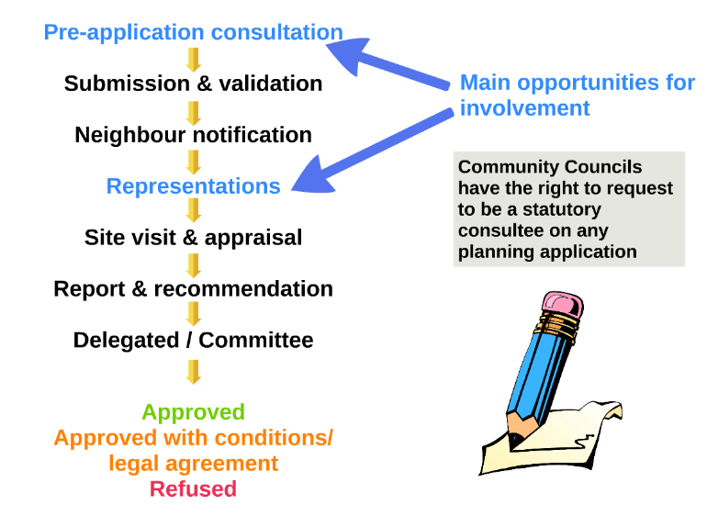

Planning Application Process
Major proposals only
It’s worth having a look at some officer Reports of Handling -
to access click here
Granted
Granted
Option to Appeal
Notes:
Click here goes to HC e=planning Portal Weekly list and they could search on decided applcations

Slide 57

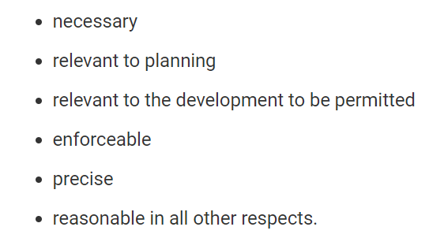
Planning Conditions
Planning conditions & reasons will be recommended in officers’ report
Planning conditions must be:
Click here for more info

Slide 58

Appeals & Local Reviews
If an application is refused, the applicant has the right to appeal, ie have a second opinion on the decision
3-month deadline to submit an appeal
Larger applications or determined at committee –
appeal goes to Scottish Ministers via:
DPEA – (Directorate of Planning & Environment Appeals)
(Methods: incl. Written Submissions/Hearing/Inquiry)
Delegated applications go to Council Local Review Body

Slide 59
Local Review Body
Will be covered in detail in afternoon session

Slide 60

Enforcement
Manages unauthorised development
eg, built without permission; not built to approved plans
Methods: retrospective planning application, Enforcement Notice, Stop Notice
But – a discretionary power
Not about punishing
Non-compliance can be a criminal offence (currently up to £20k penalty)

Slide 61
What Happens at
Committee?
The Council Scheme of Delegation stipulates that Planning Applications Committee will determine certain applications
Committee Process
Agenda & Committee papers circulated in advance
Site Visit – where appropriate
Presentation by planning officer for each application
Questions
Vote
Minuting of decision
Note - Committee meetings are often video recorded

Slide 62
Scheme of Delegation
Will be covered in detail in afternoon session

Slide 63
Q&A
Discussion

Slide 64
Break
15 minutes

Slide 65
Part 4:
Making Competent Planning Decisions & The Code of Conduct

Slide 66
How planning decisions must be made
Section 25 of the Planning Acts states that planning applications must be determined in accordance with the Development Plan unless material considerations indicate otherwise
Note - This adds an element of discretion to how planning decisions can be made

Slide 67
Material Considerations
Material considerations are not defined in planning legislation & must be applied on a case-by-case basis
Some very important factors about Material Considerations:
Not defined in planning legislation
Must relate to planning / use & development of land
Allow for some discretion in planning decision-making
Must relate to
the application under consideration
Have been set by legal case law & precedent

Slide 68



Quiz: Material Considerations
Which of the following would never be a valid material consideration …?
Ownership of site
Overlooking and/or overshadowing of neighbours
Not keen on change or the idea of the proposal
Site planning history
Moral considerations
Public objection
Notes:
Click brings in crosses on animation after full group discussion

Slide 69
Remember!
Know your Development Plan!
It’s the legal basis for making planning decisions

Slide 70
Competent decision-making
Planning decisions are made within a legal framework & must:
Be made legally
Follow correct procedures
Have valid reasons for approval/refusal
ie: Development Plan
& potentially Material Considerations
If you move for refusal –your officers will be expected to defend that decision at any subsequent appeal

Slide 71

Risks of Bad Decision-making
Local Authority Complaints Procedure
Scottish Public Services Ombudsman
Legal Challenge of decisions
Expenses – potentially 6 figure sums

Slide 72

Code of Conduct for Councillors (2021)
The Code sets out the conduct expected of every Elected Member of a local authority in Scotland
Section 7: “Taking Decisions on Quasi-Judicial or Regulatory Applications” covers planning decision making
To ensure impartiality in dealing with planning applications
To ensure transparency & fairness - avoid any perceptions of bias
AIMS:
To allow personal interests to be formally declared
To enable you to listen as long as no opinion expressed

Slide 73

Elected Members can …
Discuss policy & strategy, eg emerging Local Development Plan
Attend Pre-Application Consultation Events
Get involved in community-led plan type projects

Slide 74
Elected Members must …
Only form an opinion following due consideration at committee
Declare financial and personal interests
Follow correct procedures at site visits

Slide 75
Elected Members on committees* cannot …
*Planning Applications Committee; Local Review Body; also applies to full Council Hearings)
Make public statements on views on live planning applications
Pressurise officers making recommendation
Lobby other elected members

Slide 76

Examples of breaches of Code of Conduct
Lobbying by email other Elected Members to reject a planning application before committee (Scotland)
Not declaring personal ties to family of the applicant before voting in favour at committee (Scotland)
Not declaring membership of a group campaigning on a specific planning issue (Scotland)
Not declaring personal interest in a planning application to extend a property (England)

Slide 77
Before & at Committee …
Read committee papers sufficiently – be prepared
Listen carefully to presentations at committee:
(decisions to be made based on evidence presented on the day)
Understand planning/non-planning issues & potential Material Considerations
Give appropriate weight to views of members of the public that are planning matters/material considerations
Respect your officers’ professional opinion (even if you may not agree)

Slide 78
Q&A
Discussion

Slide 79
Key points summary so far
Abide by your Code of Conduct
Know & own your Local Development Plan
Understand Material Considerations
Encourage your ward community members to be involved in the Local Development Plan
Planning will be a key ward matter
Planning (Scotland) Act 2019 – watch the space

Slide 80
Thank you
www.pas.org.uk
david@pas.org.uk
@PAS_Tweets

