Slide 1
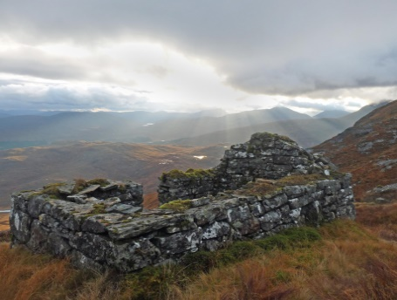
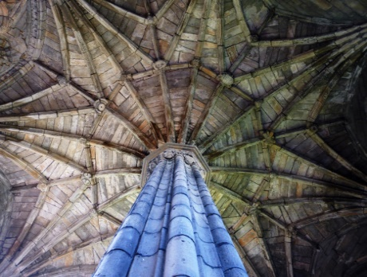
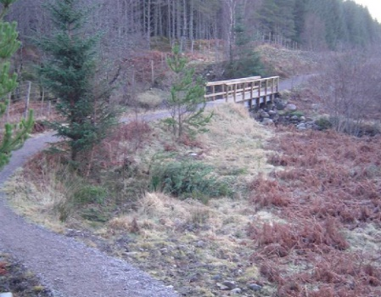
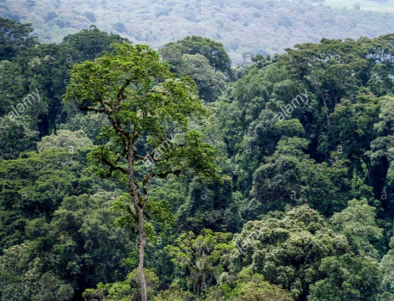
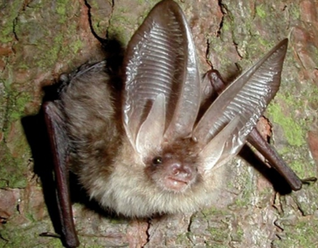
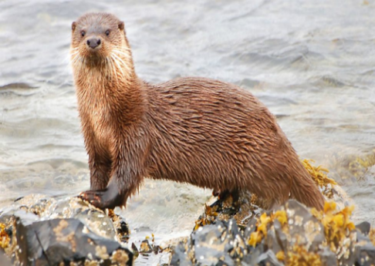
ENVIRONMENT TEAM
Providing advice on the countryside, heritage and natural resources to Council services, members and the public
Andrew Puls | Environment Team Leader / Conservation Officer
Historic Environment
Building Conservation
Archaeology
Historic Environment Record
Natural Environment
Trees and Forestry
Biodiversity
Ecology
World Heritage
Outdoor Access
Core Paths and Public Rights of Way
Long Distance Routes
Access Rangers
Countryside facilities
Notes:
We provide advice on a range of specialist areas, especially the ones highlighted in red. I don’t have time to run through all of these today, suffice to say that our remit covers everything from Tree preservation orders, biodiversity, core paths and archaeological sites.
Today, however, I will concentrate on listed buildings, and if there’s time, conservation areas, as these are two areas that can have a significant bearing on the outcome of planning applications

Slide 2
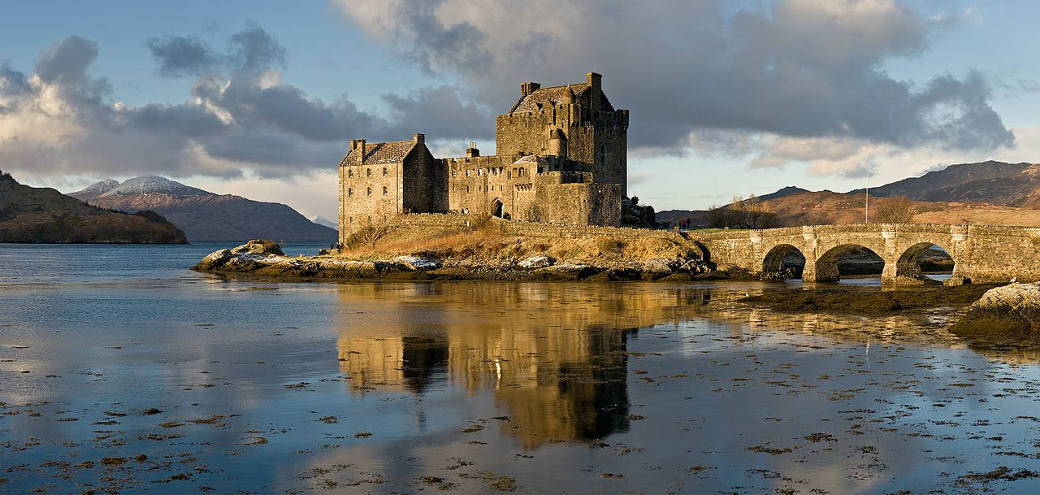
Historic Buildings & Areas
Why do they matter…?
Help create Scotland’s distinctive character
Record of people’s relationship with buildings and the land
Give an area local and regional distinctiveness – A sense of place
Help the vibrancy of an area
Can act as a catalyst for regeneration
Key economic driver – tourism, support construction industry, support traditional craft skills
Notes:
They are a visible and accessible part of Scotland’s image and play an important role in promoting Scotland – they are distinctive.
They are a physical record of how our relationship with buildings have changed over time
They give local areas a distinctive sense of place – the built heritage of Caithness is very different to that of Skye or Nairn for example.
Good, well maintained historic buildings can help retain the vibrancy of an area – the opposite is of course also true.
Historic buildings have traditionally been very good at kickstarting regeneration of a wider area and can help focus funding bodies and community initiatives
Historic buildings are an integral part of Scotland’s tourism industry. Each year at least 14 Million tourists visit historic buildings and sites and over half visit Scotland to visit its historic buildings, sites and monuments. They support a significant part of the construction industry with around 600 million spent every year on buildings that pre-date 1919.

Slide 3
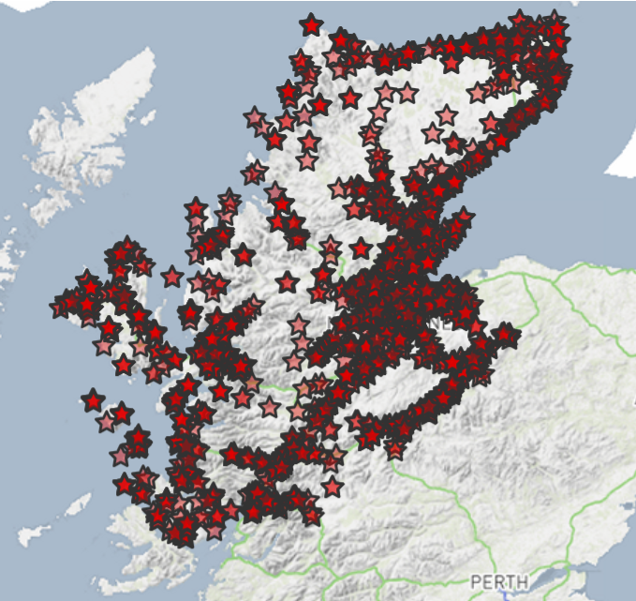
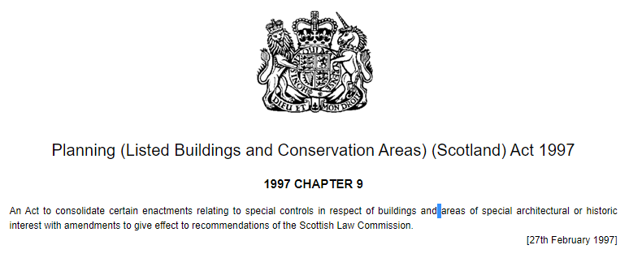
Listed Buildings
What is a Listed Building?
Building of special architectural or historic interest
Legal protection – Planning (Listed Buildings and Conservation Areas) (Scotland) Act 1997
The role of Historic Environment Scotland
3050 Listed Buildings in Highland
They come in all shapes and sizes………….
Notes:
There are many buildings that are of architectural or historic interest, but listed buildings are special in some way.
The 1997 Act gives legal protection to listed buildings and unauthorised works that affect their character are a criminal offence.
Its HES that are the responsible for maintaining The List, so it is them who add new buildings, amend or delete existing listings, although anyone can recommend a building is listed or delisted, and HES are required to assess that building against a set of fixed criteria. Once a building is included on the list it falls to the planning authority – both officers and members - to ensure the careful and sensitive management of change to that listed building.
We have just over 3000 listed buildings and they cover every age, date, type of structure you can imagine…
They can be both large and small and cover a wide range of buildings and structures of a variety of styles and dates.

Slide 4
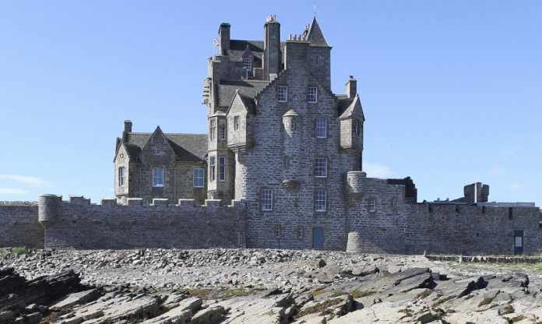
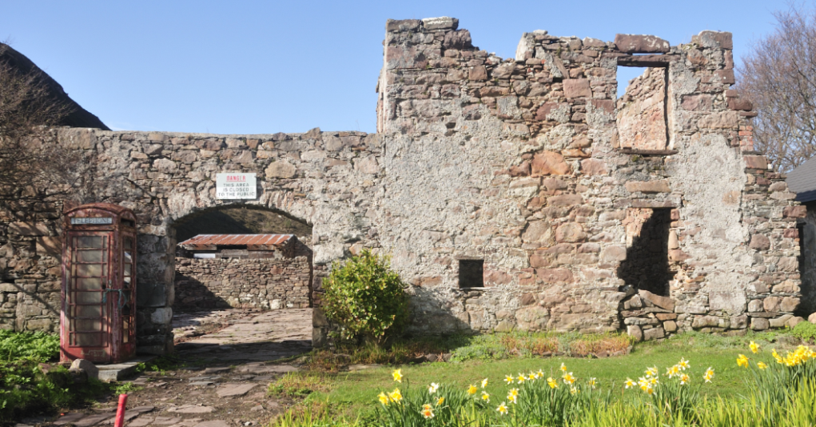
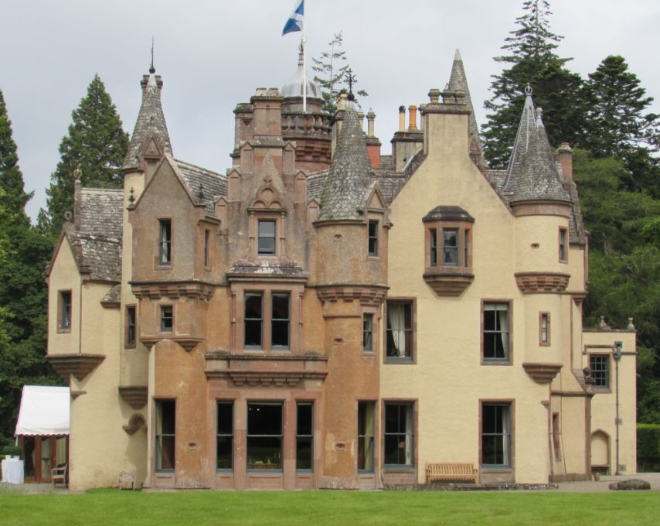
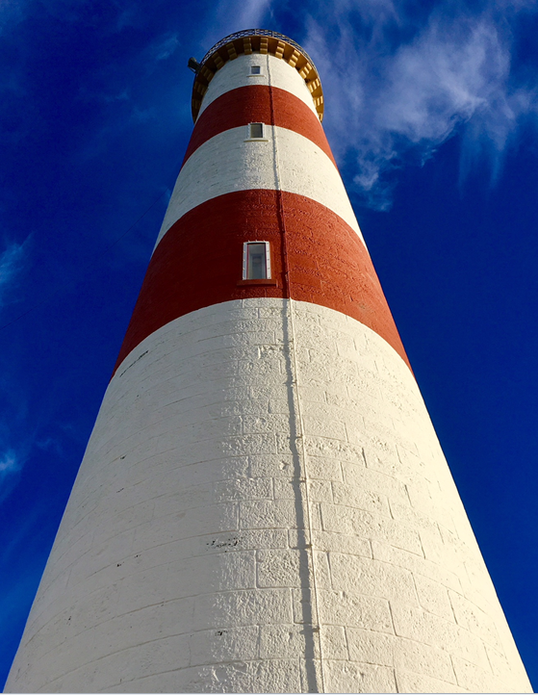
Notes:
From Scottish baronial tower houses… medieval castles, gate lodges, hunting lodges…

Slide 5
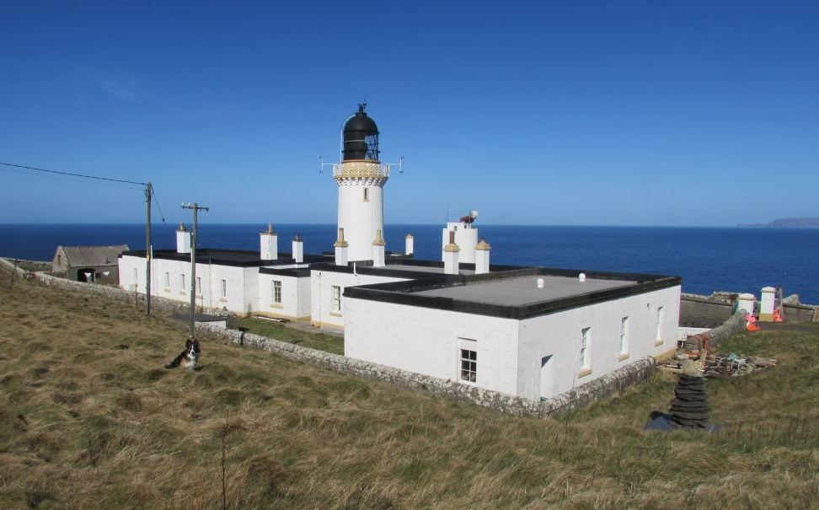
Notes:
To iconic lighthouses and other coastal infrastructure including harbours., piers and icehouses

Slide 6
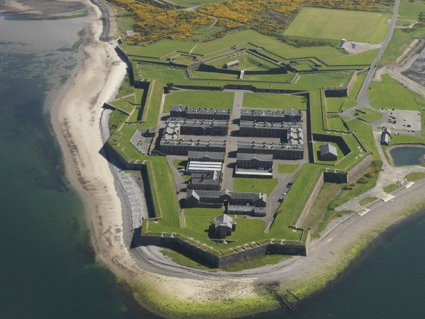
Notes:
Military fortifications, and also first and second world war gun emplacements, pillboxes, aircraft control towers…

Slide 7
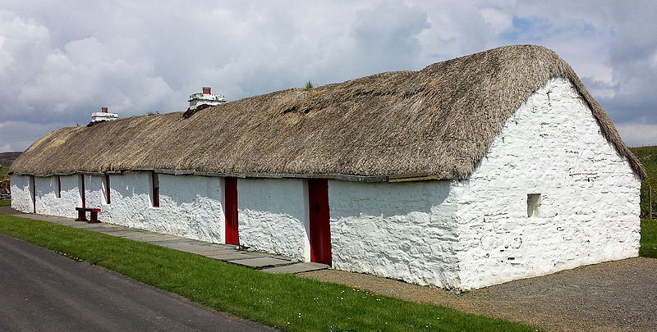
Notes:
The full range of vernacular buildings from 18th century thatched cottages through to the houses and villas of the late Victorian and Edwardian periods

Slide 8
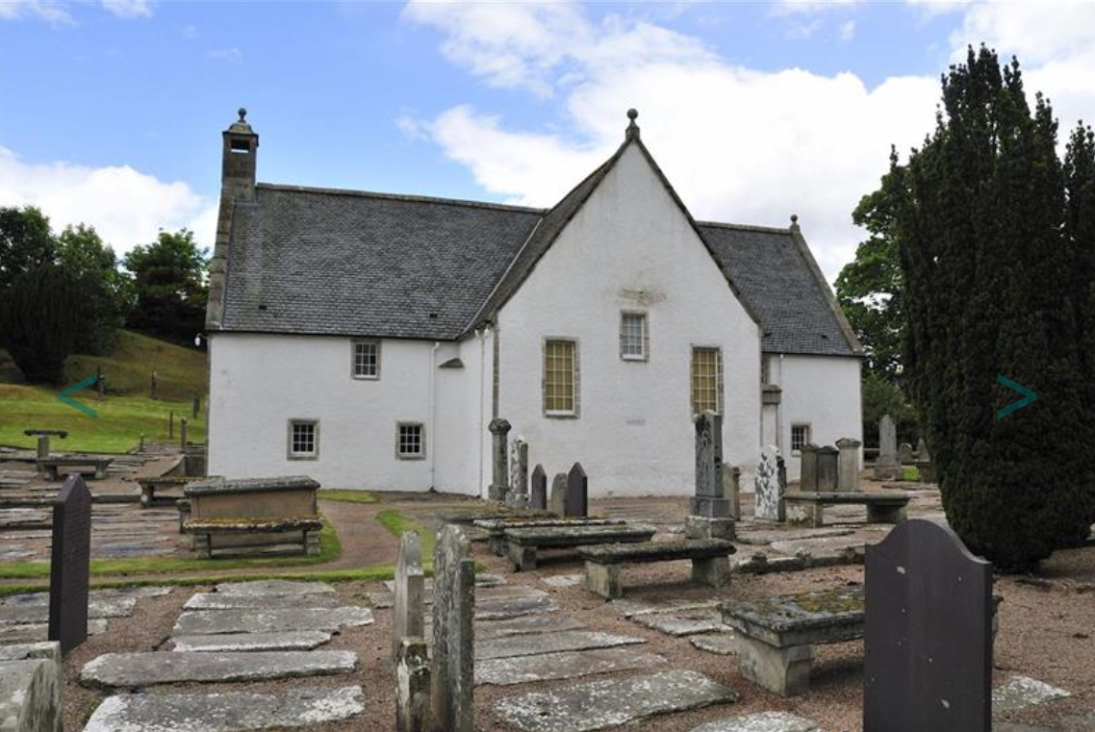
Notes:
Churches, cathedrals., graveyards and burial grounds

Slide 9
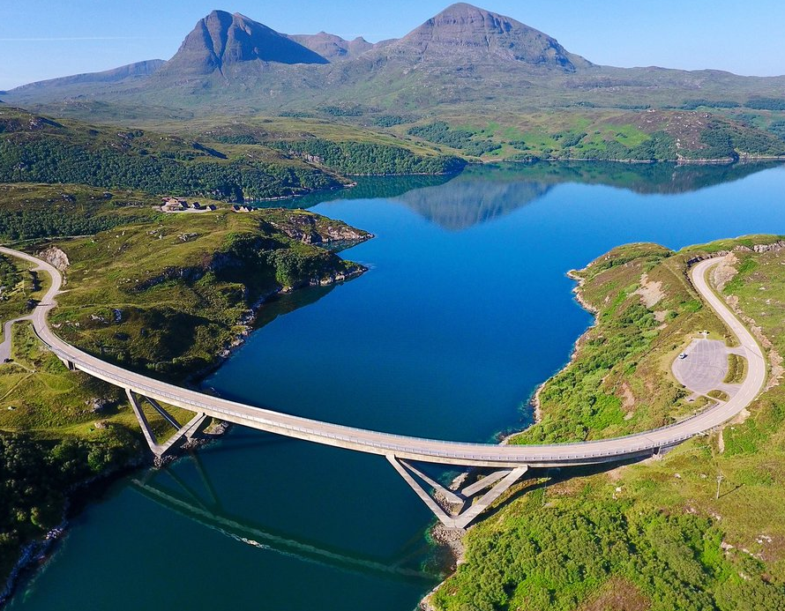
Notes:
A wide variety of transport infrastructure from aqueducts and viaducts to road bridges from small stone single span military bridges to the A listed Kylesku bridge, built in the 1980s

Slide 10
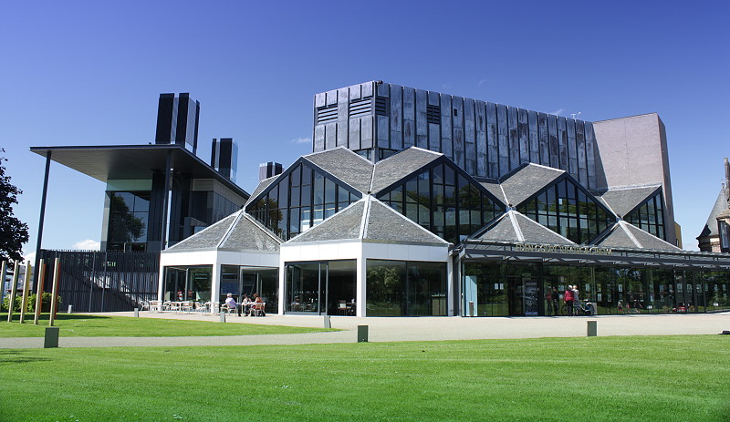
Notes:
Public buildings including museums, galleries, theatres …
Built in 1976 to much opposition on the grounds of cost and design. It won the Royal Institute of British Architects (RIBA) Award in 1977.

Slide 11
Listed Buildings
The A, B, Cs…
Category A: buildings of special architectural or historic interest which are outstanding examples of a particular period, style or building type.
Category B: buildings of special architectural or historic interest which are major examples of a particular period, style or building type.
Category C: buildings of special architectural or historic interest which are representative examples of a period, style or building type.
Notes:
You will all likely be aware that listed buildings are assigned a category – A, B or C.
Category is advisory only – it has no statutory weight and the legislation does not distinguish between different categories. This means that in real terms al listed buildings – regardless of category – are treated exactly the same.
However, it is nonetheless often the case that C listed buildings may have more scope to be sympathetically altered internally and externally that A or B listed buildings.
The category also has a bearing on when we consult HES – I’ll come to that later.
But, the important takeaway here, is that category does not affect what is listed, how we manage change or what works require consent.

Slide 12
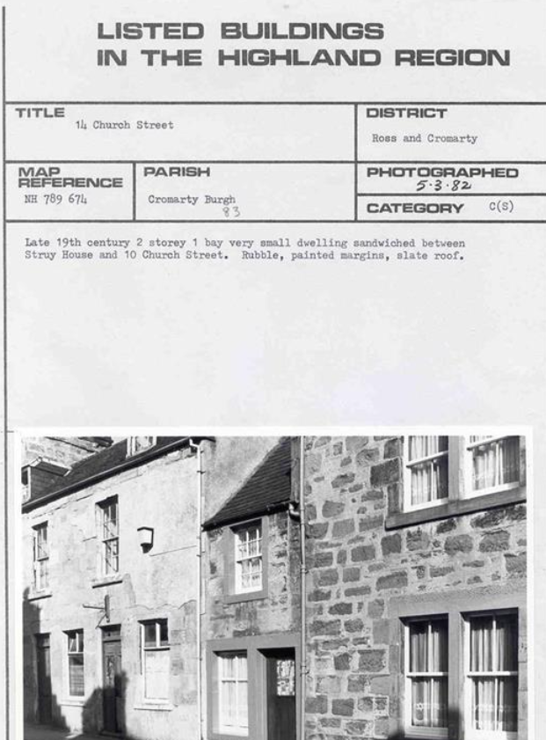
Listed Buildings
What is covered by a Listing?
Only the front…
Only the outside of the building…
What’s in the list description…
Just the building named on the listing…
You can’t change a listed building…
Notes:
There are a number of common misunderstandings that we often here from a variety of different people…
It is never the case that only the front or principal elevation of a building is listed.
Listing covers both the exterior and the interior of the building regardless of category.
Listings often come with a brief list description. This is only ever intended to be a very brief description and in the older listings it can be very short indeed. The description carries no weight and is not intended to be a definitive description of the building or identifying what’s important. So whilst it can be useful, it is not an indication of what is actually listed.
In fact, the only statutory part of a listing, is the address, so that’s the only part that actually matters but it doesn’t tell the entire story as a listing also covers buildings and structures that are part of its curtilage or land.
You can change a listed building, but that change is managed, must be sensitive and appropriate, and how much change can be accommodated depends on the specifics of the building – there is no one size fits all and each building and each proposal is considered on its merits, but the vast majority will be able to accommodate some form of change.

Slide 13
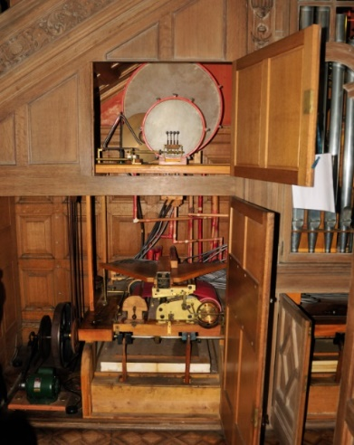
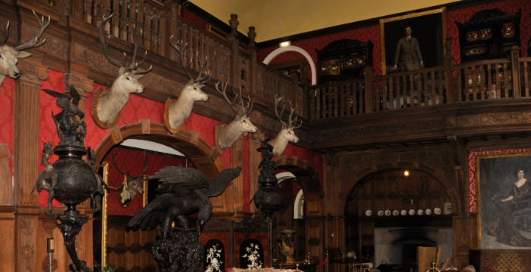
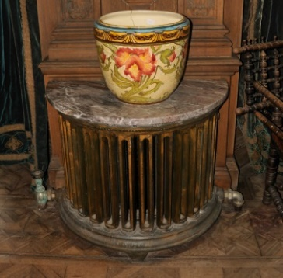
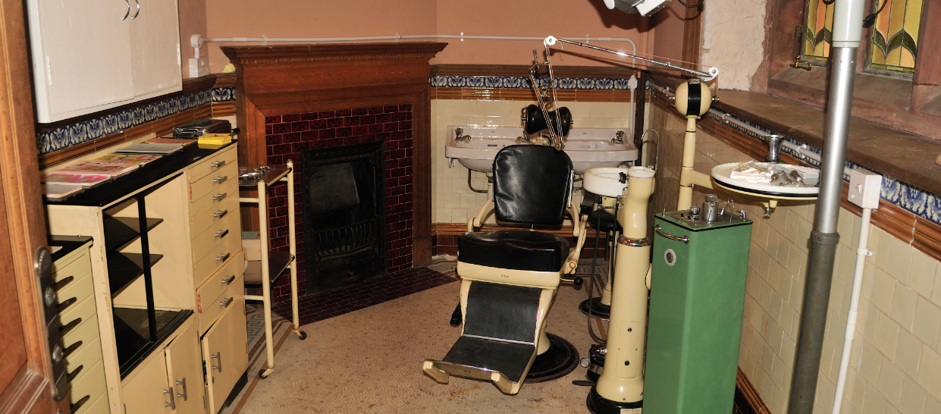
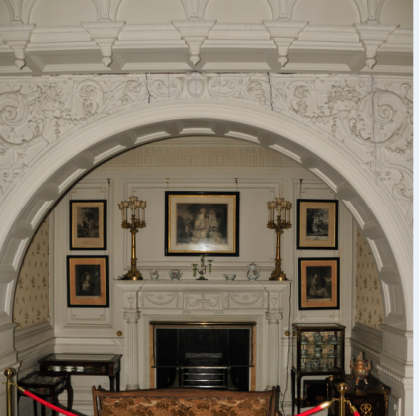
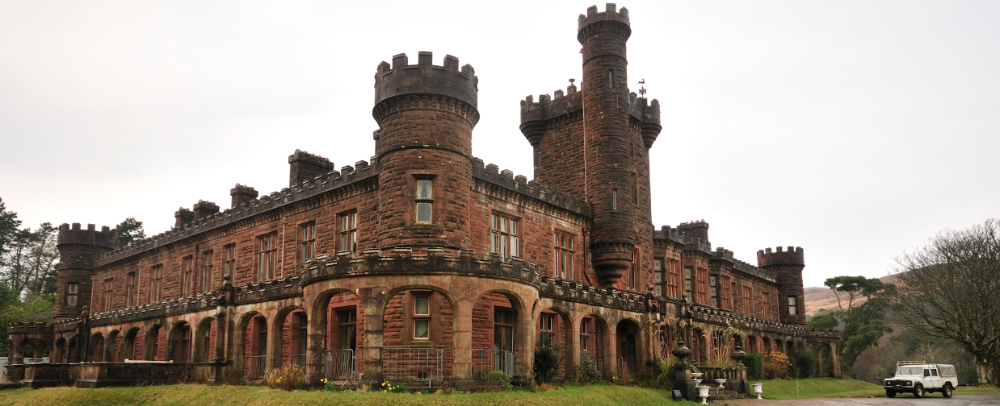
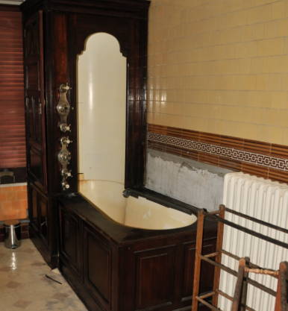
Listed Buildings
What is covered by a Listing?
All of the building is protected –
  Externally - front, back, sides, roof + any structure/building physically attached
  Internally - layout, doors, fireplaces, windows, ceilings, fittings, wallpaper, panelling, historic building services etc

Slide 14
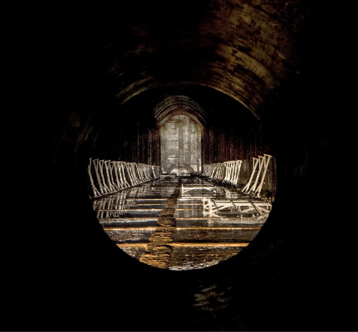
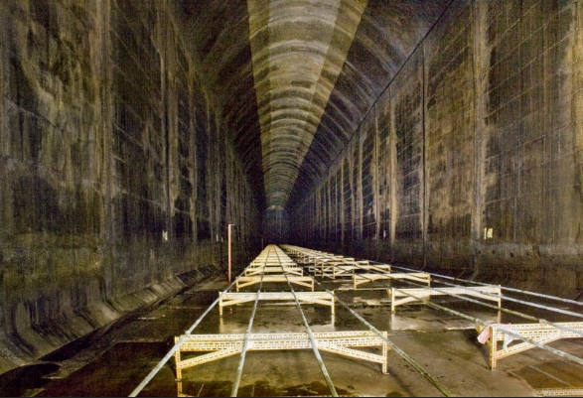
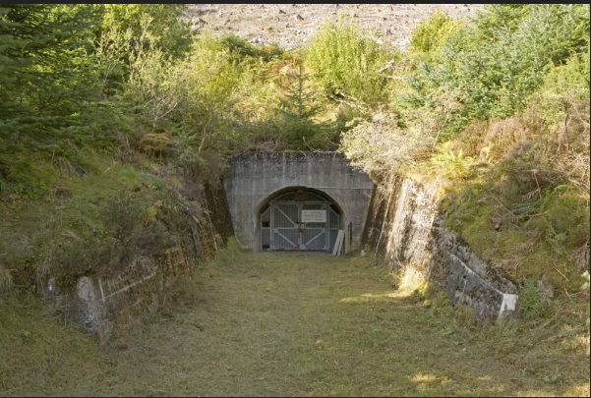
Notes:
This is the external elevation of one of the most audacious, monumental and complex engineering achievements ever undertaken in Britain, and the largest construction in the north of Scotland since the Caledonian canal.
Built into the hill side above Invergordon between 1938-1943 6 underground fuel storage reservoirs used to supply the naval base at Invergordon.
Each tank is 9m wide by 237 m long and 13.5m high.
To put that in context that’s the length of 1 and a half York Minsters.
Each tank has a capacity of 5.6 million gallons of fuel – you could fit in 1188 double decker buses over the 6 tanks.
Demonstrates that what’s on the inside can be much more important than what’s on the outside.

Slide 15
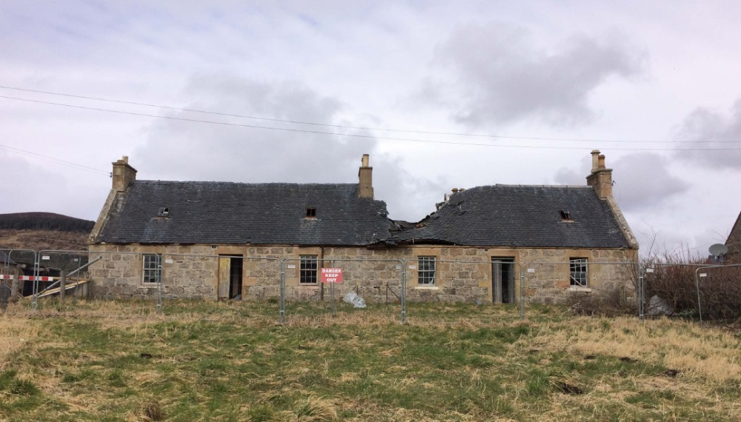
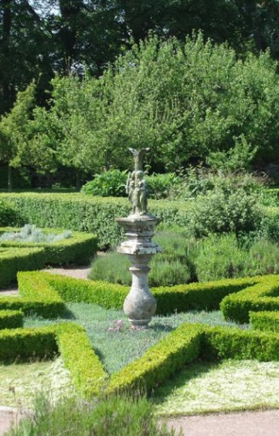
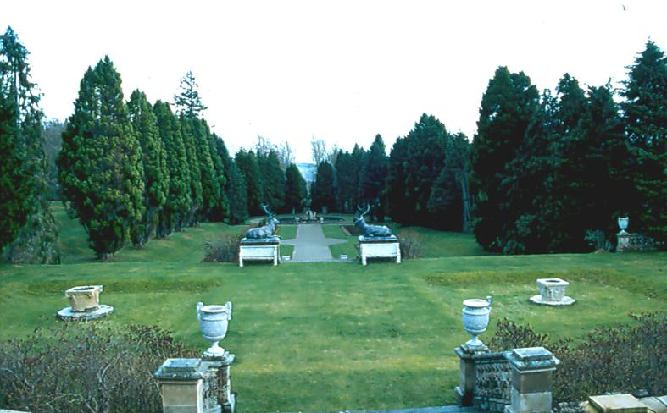
Listed Buildings
What is covered by a Listing?
Any building or structure located in the “Curtilage” of a Listed Building
Pre 1948
historically associated with a main Listed Building
in the same ownership at the time of listing
not be divided by later development
Any Listing could include other buildings (e.g. steadings and gate lodges), walls, gates and gatepiers and garden structures (e.g. statues, fountains, follies)
Notes:
Buildings and structures within the land, or curtilage of a listed building, that meet the criteria here are also covered by the listing. It is for the planning authority to define curtilage. And it can include buildings and structures that are physically well divorced from the main Listed Building.
Building and structures that are within the curtilage of a listed building are subject to the same process as any other listed building.

Slide 16
Listed Buildings
Listed Building Consent (LBC)
Any external or internal alteration or extension of a listed building is likely to require Listed Building Consent
Any alteration or extension which materially affects the external appearance of the building will also require planning permission
Any development within the curtilage of a listed building is likely to require planning permission
Any alteration or extension of a curtilage listed building will also require listed building consent and where there is material change planning permission
Routine Repairs & Maintenance – no LBC required
Notes:
You must get LBC from the planning authority if you wish to alter or extend (internally or externally), or demolish (all or part), of a listed building.
LBC is free and the process is similar to applying for planning permission and it’s a criminal offence to demolish, alter materially or extend a listed building without LBC.
For internal alterations just LBC is required, but for external alterations it is likely that both LBC and planning permission will be required.
Planning authorities are required to consult Historic Environment Scotland on all LBC applications for Category A and B listed buildings, demolitions, and Council-owned listed buildings.
Listing does not rule against alterations or even extensions being possible, but it does place a particular focus on sensitivity, subtlety and appropriate design and materials and this can make renovating or altering a listed building a complex and potentially costly process. Each building is unique and proposals must take account of the building’s special interest and be designed accordingly – although there are general conservation principles – one of which is not permitting cheap, unsustainable and inappropriate materials like plastics – each application must be considered on its merits

Slide 17
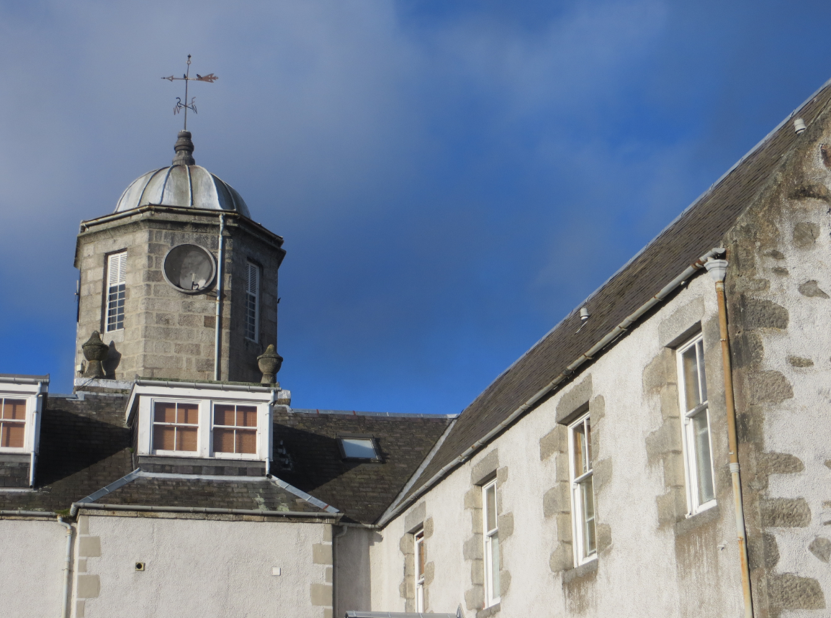
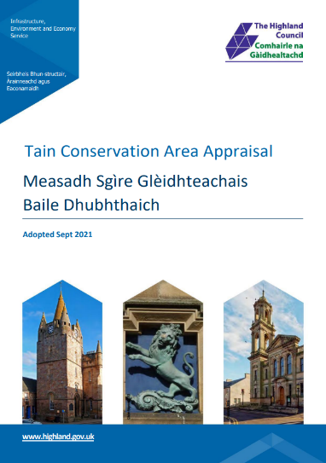
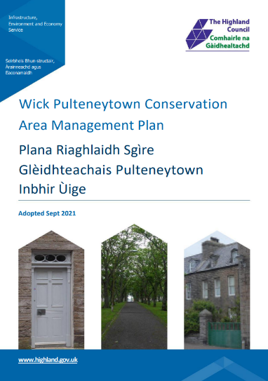
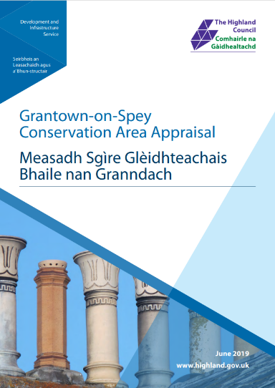
Conservation Areas
Planning (Listed Buildings and Conservation Areas) (Scotland) Act 1997
Section 64 defines a Conservation area as an area where:
“ special attention shall be paid to the desirability of preserving or enhancing the character or appearance of that area.”
Section 63 places a duty on the planning authority to:
“formulate and publish, from time to time, proposals for the preservation and enhancement of any parts of their district which are conservation areas.”
Notes:
Conservation areas are protected under the same legislation as Listed Buildings and are areas that of special architectural or historic interest the character and appearance of which it is desirable to preserve or enhance.
Unlike Listed Buildings, it is the planning authority’s responsibility to decide which areas should be conservation areas, to designate those areas and manage them.
Council has a statutory duty to preserve or enhance the special character of the area
The Council has a statutory duty to prepare proposals for the preservation and enhancement and we refer to these as conservation area character appraisals and management plans, and you may be asked to consider and approve these for your areas in due course.

Slide 18
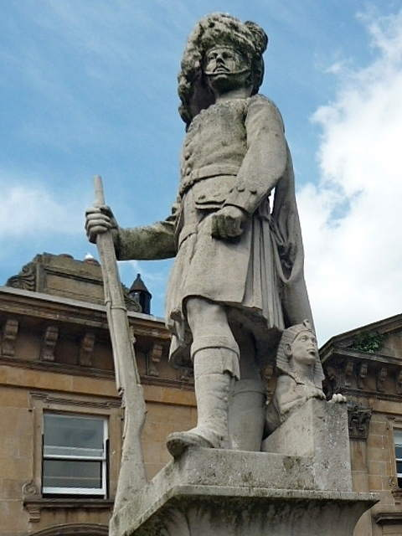
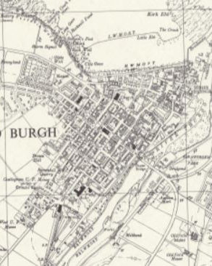
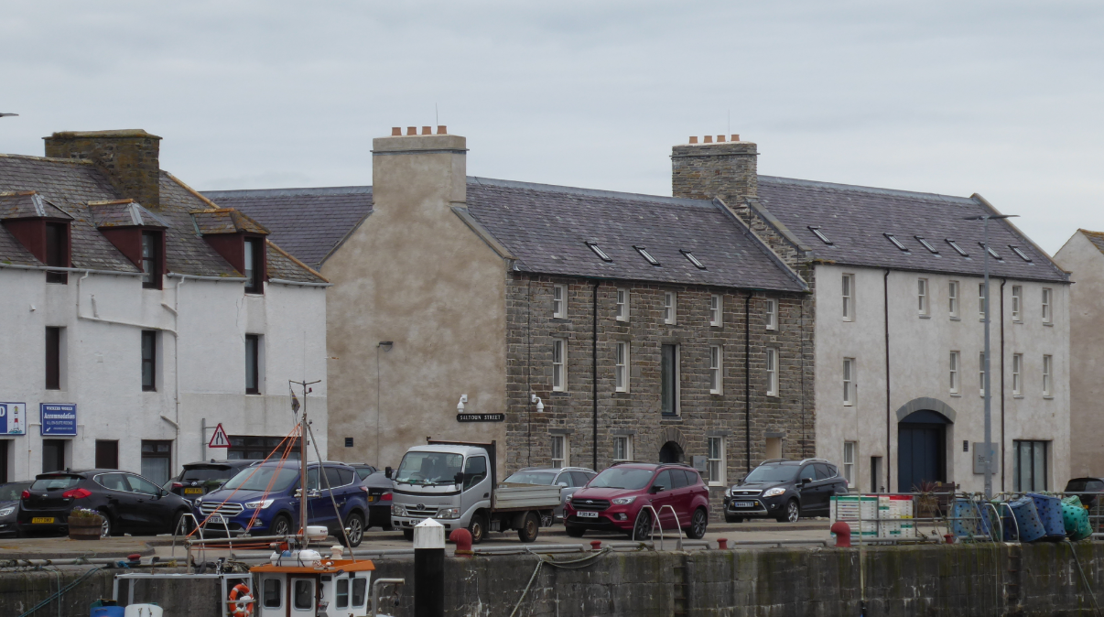
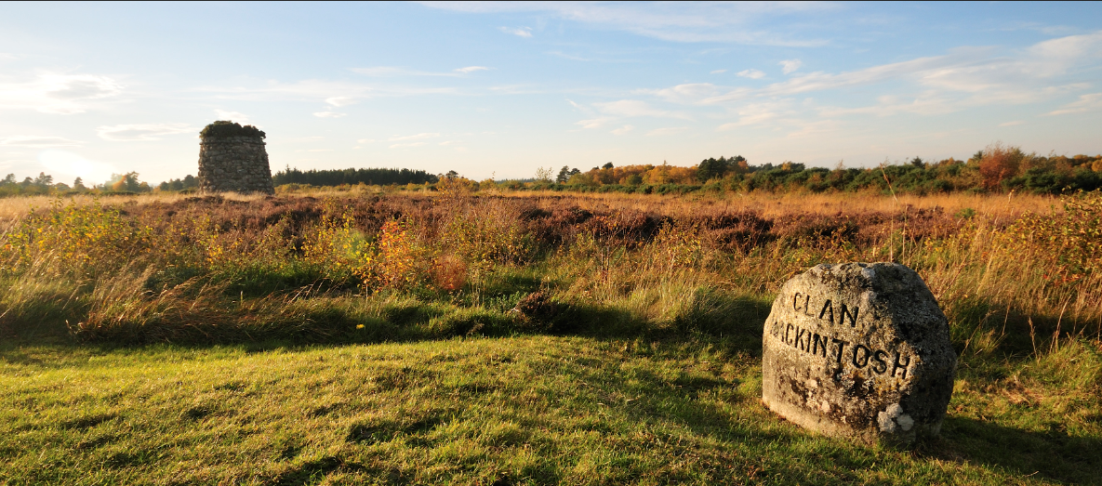
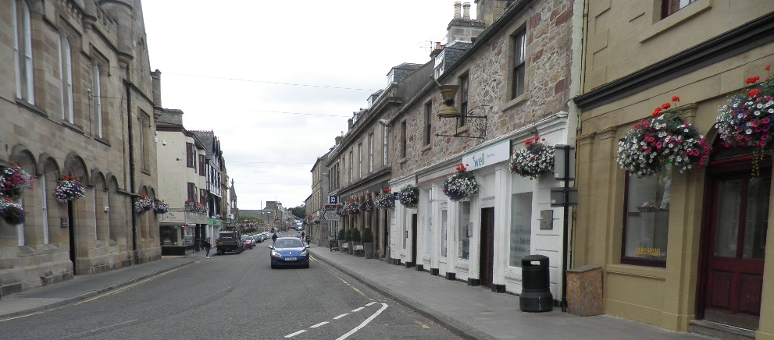
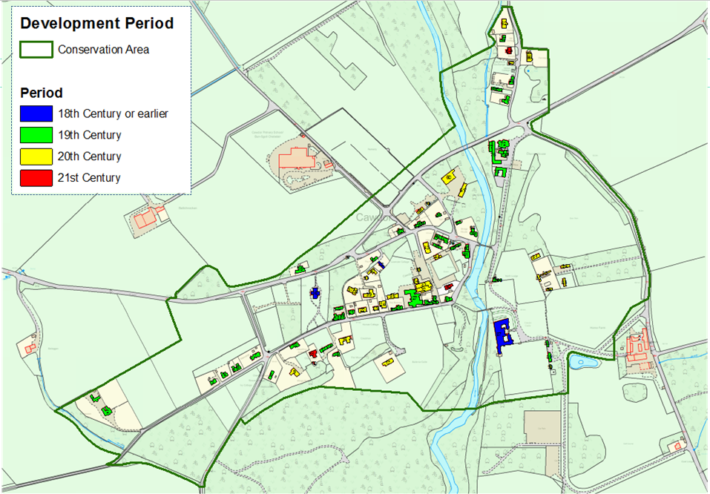
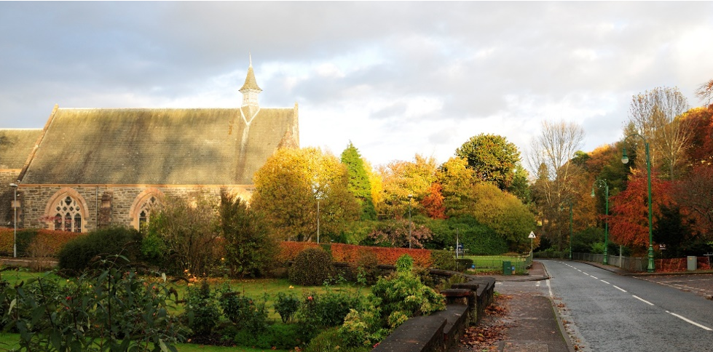
Conservation Areas
Notes:
There are a wide variety of conservation areas, from urban centres to isolated rural settlements and landscapes, such as Dornoch, Tain, Cromarty, Fortrose, Inverness, Plockton, Fort Augustus, but also historic landscapes such as Culloden Muir which includes Culloden battlefield and famous bronze age burial cairns at clava.
Conservation areas include many of Highland’s most historic, attractive and important places; places that make an immeasurable contribution to Highland identify, sense of place and play a fundamental role in the local economy. They also tend to be the most popular and attractive towns and villages for tourism.
In a conservation area it is both the buildings and the spaces between them that contribute to the area’s architectural and historic interest and planning control is directed at maintaining the area’s integrity. The Council has a duty to consider whether development proposals will preserve or enhance the character or appearance of the area.
Conservation areas are not static and should not be preserved in aspic – conservation area does not mean development or change is not allowed. We are, generally, very supportive of new development in conservation areas, and in many cases new development is essential in securing the future of a historic area, and ensuring it remains vibrant and relevant. But, new development must be of a high quality, with high quality materials and must utilise excellent design, that relates, responds and reflects the conservation area.

Slide 19
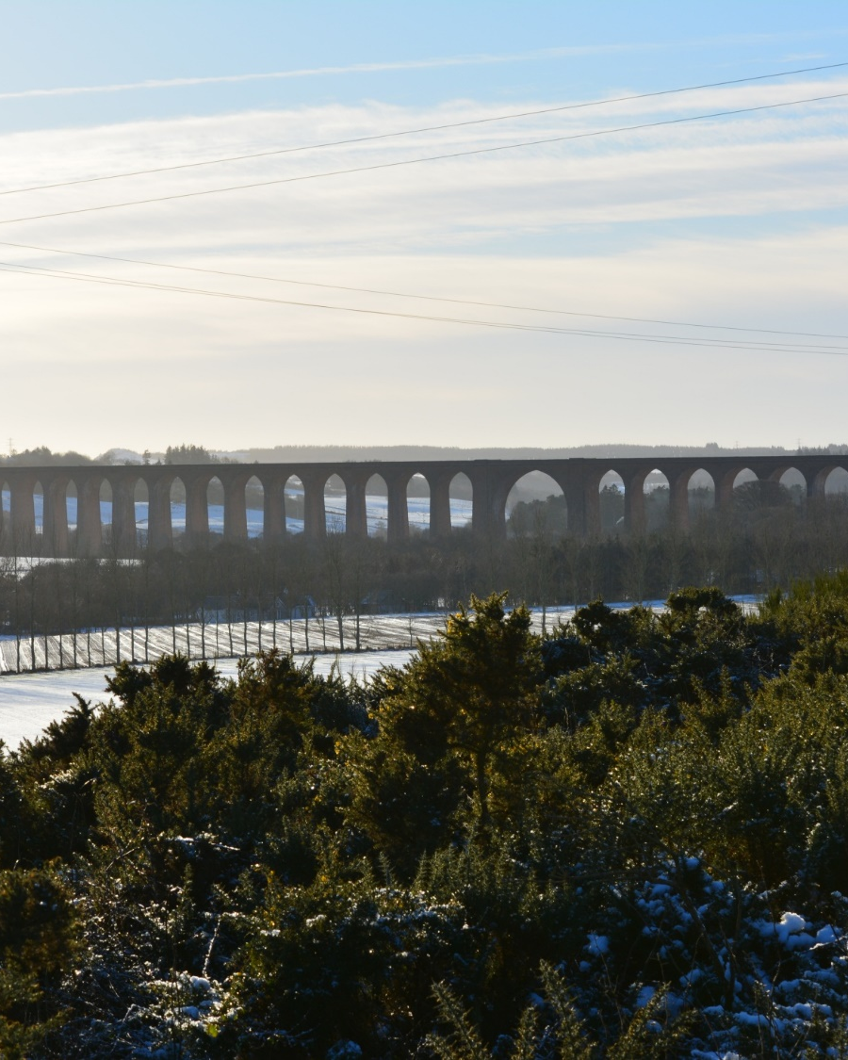
Conservation Areas
Permitted Development
Most permitted development rights were removed in conservation areas by the General Permitted Development Order Amendment 2011
Most development – even small scale alterations – require planning permission
Demolition is controlled through a separate consent process called Conservation Area Consent
Trees receive extra protection in a conservation area
Notes:
Change is managed through the planning p,rocess and planning permission is required for most changes within a conservation area.
For example, Householder development including house extensions, roof alterations, changes to windows and doors, stone cleaning and painting of the exterior, satellite dishes, provision of hard surfaces, the erection or alteration of gates, fences and walls;
There’s also additional control over ancillary buildings (such as sheds/garages) and raised decking/platforms and demolition is also controlled through a process called conservation area consent.

Slide 20
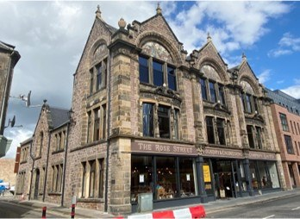
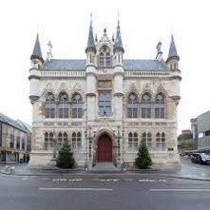
General Principles
Managing Change
Notes:
Every proposal must be site specific and responsive to the listed building or the conservation area and it is therefore difficult to generalise. However, for alterations directly to heritage buildings it is generally expected that a conservative conservation approach is adopted, with more scope for new additions, such as extensions, to adopt a more contemporary architectural language

