Slide 1
Meet the Team:
Depute Chief Executive
&
Performance and Governance

Slide 2
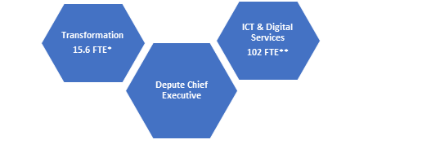
Depute Chief Executive
End Sep 2020
2021
Notes:
Add Checkpoint dates to this?

Slide 3
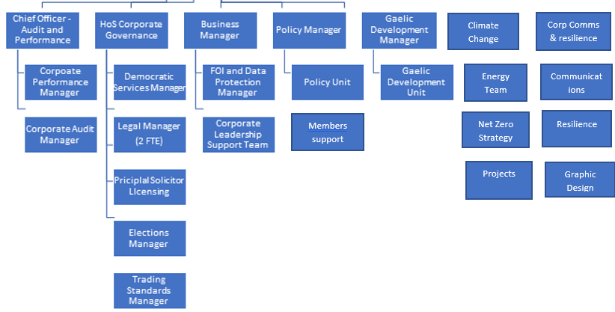
Performance & Governance

Slide 4
Committees
Council
Corporate Resources
Audit and Scrutiny
Gaelic
Climate Change

Slide 5
ICT & Digital
£10.7m revenue budget and £7.3m capital budget for 2022/23.
Now a largely in-house service after 23 years of being outsourced to ICL, Fujitsu and most recently Wipro.
Team of 104 people (up to 130 eventually) supporting 50,000+ ICT users, 40,000+ devices, 400+ applications and networks covering over 400 sites. Including over 30,000 Chromebooks.
Current focus is on stabilising and improving the service after the handover from Wipro on 1st April 2022.
New ICT and Digital Strategies to be taken to Council later this year. They will set out a vision for how technology and new thinking will help the Council become a digital organisation.

Slide 6
Transformation and Redesign
Organisational Change & Redesign – driving a culture of continuous improvement
Skills and experience in Programme/Project Management, Business & Organisational Change, Business Improvement (inc. Lean), Business Analysis, and Commercial disciplines
Enabling improvements to key Service Delivery areas such as Roads, Amenities, Waste, and Fleet Management and commercial/income generation initiatives such as Hydro Ness and Old Man of Storr
Project and Programme Research – a research function and benchmarking local authority savings and service improvement

Slide 7
P&G Vision
Performance
To be a high performing, ambitious Council, focused on continuous improvement to provide best value to the people and communities we serve.
Governance
To have strong and effective governance arrangements in place to deliver high standards of public accountability, transparency, and fairness.

Slide 8
How
An effective performance management framework; robust scrutiny and self-evaluation; and a culture and ethos of challenge and improvement.
A strong policy function, promoting Highland interests at every level of government particularly in relation to the critical opportunities and challenges around climate change and energy, our commitment to Gaelic language and culture and the protection and promotion of island and rural communities.
Our democratic, internal audit and risk and resilience arrangements and communications promote openness and integrity;
Decisions are made in accordance with the Council’s Scheme of Delegation and all legislative and regulatory requirements; and responsibility is fully understood and appropriately discharged throughout every level of the organisation.

Slide 9
Corporate Audit & Performance
Statutory Duty - Internal Audit function - Provide assurance that council resources are being used appropriately
Statutory Duty - Public Performance Reporting on how effective the Council is delivering services - Ensure that performance reporting is transparent and balanced
Statutory Duty - Best Value – preparing the Council for inspection and ongoing engagement with external audit
Statutory Duty - Manage Corporate Risk
Investigate Fraud & Whistleblowing
Committee: Audit and Scrutiny Committee

Slide 10
Legal and Governance
Democratic Services
Responsible for supporting all formal meetings of the Council – circa 220 meetings per year.
Company Secretarial service to High Life Highland, Highland Opportunity (Investments) Limited and Eden Court
Clerk to Highland and Moray Children’s Hearings Area Support Team
Elections
Responsible for preparation and management of all major electoral events including Parliamentary elections, Council elections and referenda as well as supporting Business Improvement District ballots, community council elections and community ballots.

Slide 11
Legal Services
Offering legal advice and assistance to Council services, officers and members
  including all property related activity – purchase, sale, leasing; preparation of statutory orders;
  litigation in courts on matters such as adoption, adult and child protection, adult social care, housing and education;
  planning including supports to PACs/PRB, advice, section 75 agreements, appeals and inquiries.
The Council’s Common Good Funds officer is located within the Legal Team.

Slide 12
Licensing
Responsible for supporting the work of Highland Licensing Board – principally concerned with liquor licensing including of premises and individuals as well as developing policies eg over-provision statements along with responsibility for regulation of gambling activities.
Highland Licensing Committee – numerous activities licensed including taxis, private hire vehicles, window cleaners and houses in multiple occupation with an upcoming requirement to have in place a regime for licensing short term lets from October 2022.
Registration of Private Landlords.

Slide 13
Trading Standards
Responsible for a number of statutory duties such as
  Fair Trading including delivery charges;
  Doorstep Crime;
  Investigation of Scams and Illicit Trade;
  e-Enforcement;
  Licensing of Petroleum and Explosives;
  Safety of consumer products;
  Business Advice and Protection;
  Weights & Measures;
  Enforcement of Taxis and Private Hire Cars licensing;
  Tobacco, Nicotine Vapour Products and Age Restricted Sales;
  Animal Feed & Fertiliser Quality Standards.

Slide 14
Climate Change and Energy
Net Zero Strategy
Energy management, Utility Billing & Management
Climate Change Reporting
Climate Change Adaptation
Projects
  Hydrogen & Low Carbon Heat
  EV Infrastructure
  Fleet Decarbonisation,
  Energy Efficient Scotland: Area Based Scheme,
Committee: Climate Change

Slide 15
Gaelic Development
Gaelic in Education; and Early Learning and Childcare
Gaelic in the Home and in the Community
Gaelic in Arts, Culture and Heritage
Gaelic in the Workplace
The Social, Economic and Cultural Value of Gaelic
Committee: Gaelic

Slide 16
Communications & Resilience
Most new members attended an earlier introduction on corporate communications – a recording is on members’ intranet
Responsible for external and internal communication – including public information, dealing with media enquiries and managing social media platforms.
Graphic Design unit.
Also responsible for emergency planning, including plans for responding to emergencies at 8 key hazard sites across the Highlands, promoting business continuity, and working with our partner Category One Responders – a separate session on Resilience is being planned

Slide 17
Information Governance
Most new members will have attended the earlier induction session – recording is on the intranet.
Statutory Function
Data Protection Officer
Freedom of Information
Data Protection
Information Management and Governance
Scottish Public Services Ombudsman.
Committee: Audit & Scrutiny and Corporate Resources

Slide 18
Leadership Support & Corporate Policy
Administrative Support for the Leader, Convener and Leader of the Opposition
Co-ordinate political and diplomatic engagement
Undertake Corporate Policy Development
  Islands Act
  Open Water Safety
  Flag Protocol
Support Service-led policy development

