Slide 1
Audit & Performance Team

Slide 2
Audit and Performance
Team Vision
Ambitious – supporting a high performing Council, which is self aware, continuously improving and benchmarks against best practice
Sustainable – our people and resources are effectively deployed to support the organisation achieve Best Value and demonstrate strong internal controls
Connected – the work of audit and performance is valued and creates a collaborative focus for continuous improvement across the Council and with partners

Slide 3
Strategic Lead
Evelyn Johnston
Corporate Audit Manager
Donna Sutherland
Corporate Performance Manager
Stephen Carr
Senior Investigator
Ali MacGregor
Senior Auditor
John Campbell
Senior Auditor
Paul Hankinson
Investigator
David MacRae
Assistant Auditor
Josh Gallimore
Assistant Auditor
Yvonne Holmes
Assistant Auditor
Sharon Calder
Trainee Auditor
Chris Dorrian
Business Partner
Anna Templeton
Business Partner
Brian Scobie
Business Partner
Gosia Ciszewska
Business Partner
Sophie Miller
Corporate Performance Officer
Angela Stewart
Corporate Performance Officer
Hannah Kollef
Corporate Audit and
Performance Team

Slide 4
Scope of Internal Audit Team
  Delivering the Internal Audit Plan in order that the annual audit opinion can be provided
  Internal work undertaken for Highland Council, Pension Fund, Valuation Joint Board and HiTrans
  Providing advice to Service Directorates on internal control matters and governance
  Maintaining the Council’s Financial Regulations
  Investigating fraud allegations & whistleblowing concerns
  Acting as a Single Point of Contact (SPOC) for the Department of Work and Pensions' Fraud & Error Service and Police Scotland

Slide 5
Scope of Performance Team
  Ensuring the Council meets statutory public
  performance reporting (PPR) requirements
  Corporate Risk Management
  Corporate Self-assessment
  Business Partner model - support Service on performance, risk, self-assessment
  Surveying public opinion on Council performance
  Supporting Community Planning performance management
  Supporting preparation of the Council Programme
  Developing the Council’s Corporate Performance Framework and Corporate Plan
  Providing advice and guidance on Best Value, performance management and Service planning
  Best Value – prepare the Council for BVAR and ongoing Best Value Audit

Slide 6
Internal Audit
Statutory requirement for Internal Audit (IA) service
Must comply with the Public Sector Internal Audit Standards
IA role set out in Internal Audit Charter
Provides independent and objective assurance
Adds value and identifies scope for improvement
Annual audit opinion on systems of internal control, risk management and governance

Slide 7
Fraud and Whistleblowing
  Fraud
  Anti-fraud and Anti-corruption policy in place. Definitions:
    Fraud "intentional distortion of financial statements & other records, and misappropriate of assets"
    Corruption “the offering, giving, soliciting or accepting of inducement/ reward which could influence the actions taken by the Council, its members or staff"
  Prevention most effective approach incl. deterrence
  If these fail the need for prompt detection
  Reports on system weaknesses and lessons learned
  Report cases of fraud directly to Procurator Fiscal

Slide 8
Fraud and Whistleblowing
  Whistleblowing
  Staff whistleblowing policy
  Applies where employee/ worker suspects malpractice or wrongdoing in 6 defined categories
  Covered by the Public Disclosure Act 1998
  Employees legally protected in whistleblowing
  Must be in the public interest
  Does not apply to individual's concerns about their employment or where covered by other HR policies e.g bullying & harrassment

Slide 9
Big Picture – Best Value
Best Value is about ensuring that there is good governance and
effective management of resources, with a focus on improvement, to deliver the best possible outcomes for the public.
Best Value – statutory duty and one the Council is externally audited:
To make arrangements to secure continuous improvement in performance whilst maintaining an appropriate balance between quality and cost; and, in making those arrangements and securing that balance,
To have regard to economy, efficiency, effectiveness, the equal opportunities requirements and to contribute to the achievement of sustainable development.
Best Values also means:
Demonstrating we have considered options for service delivery
That we have consulted with our customers, partners and other stakeholders and taken account of their views in making decisions.

Slide 10
Statutory Public Performance Reporting
The Audit Direction, issued by the Accounts Commission, outlines
what councils are expected to publish as part of their public
performance reporting. Transparent, balanced, timeous:
Statutory Performance Indicator 1: Improving local services and local outcomes
• Performance in improving local public services, provided by both (i) the council (ii) with its partners and communities.
• Progress against the desired outcomes agreed with its partners and communities.
Must include comparisons (i) over time and (ii) with other similar bodies including from the Local Government Benchmarking Framework.
Statutory Performance Indicator 2: Demonstrating Best Value
• The council’s assessment of how it is performing against its duty of Best Value, and how it plans to improve against this assessment.
Must use audit assessments of its performance against its Best Value duty, and how it (in conjunction with its partners as appropriate) has engaged with and responded to its diverse communities

Slide 11
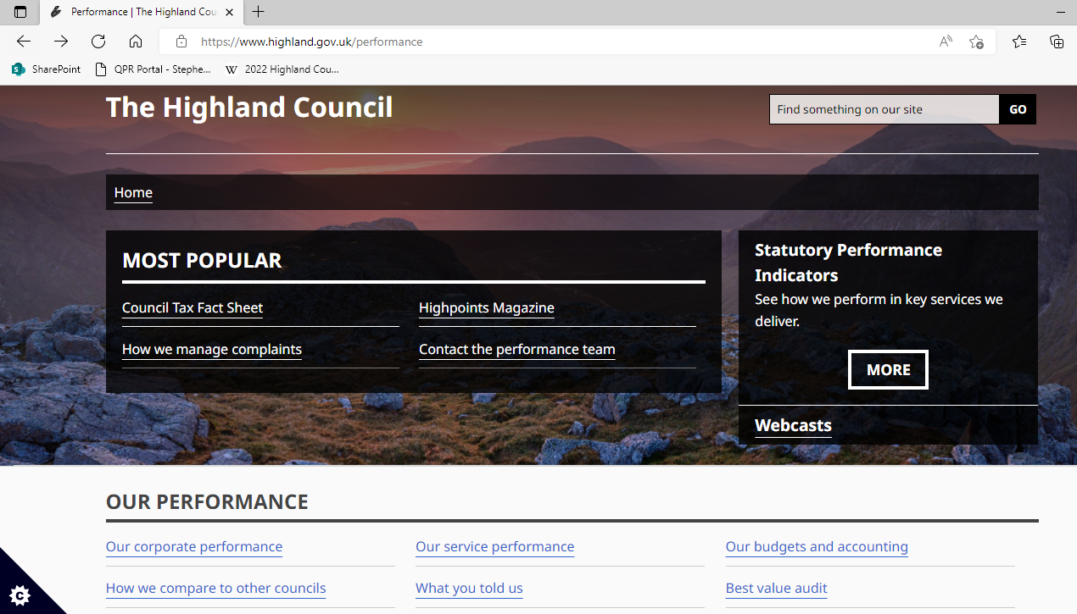
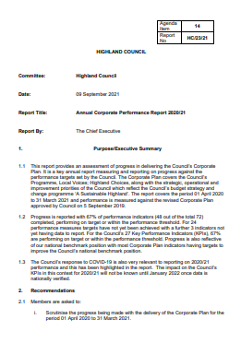
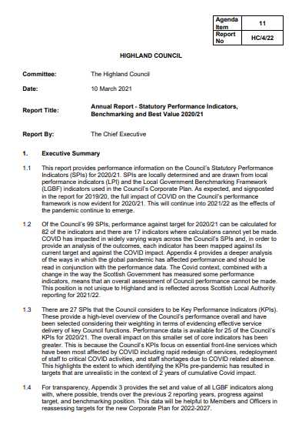
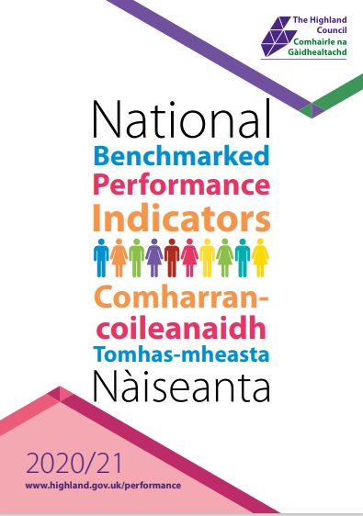
Public Performance Reporting

Slide 12
Corporate Performance BP Model

Slide 13
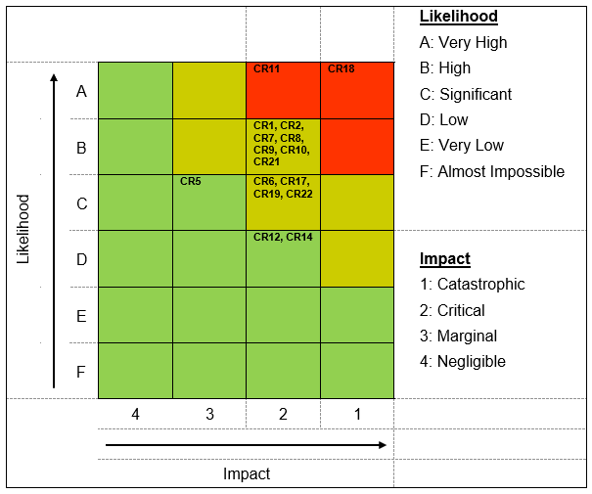
Corporate Risk
  The Council's definition of risk management is:
  “The process of identifying significant risks to the achievement of the Council’s strategic and operational objectives, evaluating their potential consequences and determining and implementing the most effective way of controlling them.”

Slide 14
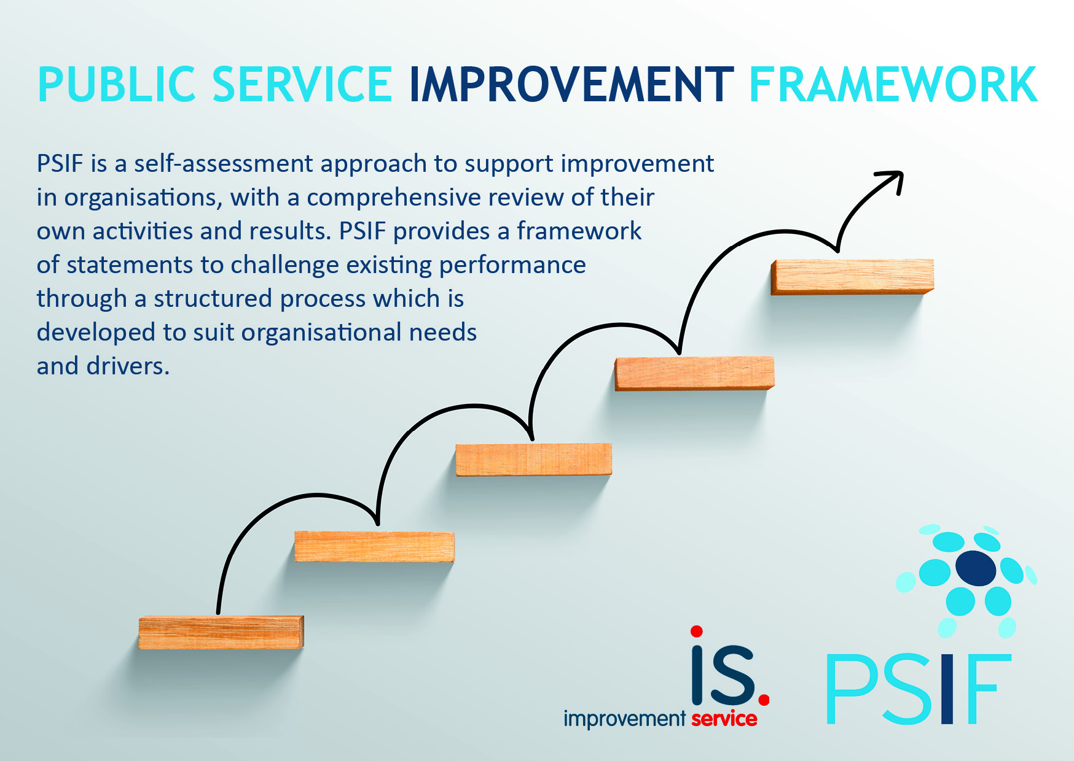
Corporate Self-Assessment
  Programme of self-assessments under development

Slide 15
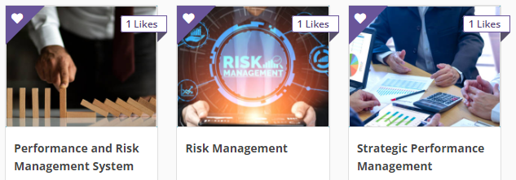

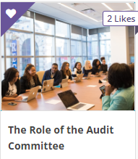
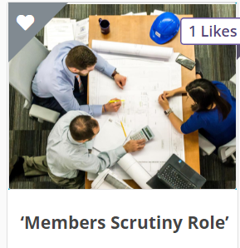
Online Learning
Learning Management System: https://highlandcouncil.traineasy.com
More info at: www.highland.gov.uk/performance

Slide 16
Contact the Team
Evelyn Johnston
- Strategic Lead Corporate Audit and Performance
  - Evelyn.Johnston@highland.gov.uk
  Donna Sutherland
  - Corporate Audit Manager
  - Donna.Sutherland@highland.gov.uk
Stephen Carr
- Corporate Performance Manager
- Stephen.Carr@highland.gov.uk

