Slide 1
Health and Safety for Elected Members
Gena Falconer, OHSW Manager

Slide 2
Health and Safety
Introductions
Content
  What is health and safety?
  Why think about health and safety?
  Responsibilities
  Finding information
  Your role
  When things go wrong
  Are we getting it right?

Slide 3
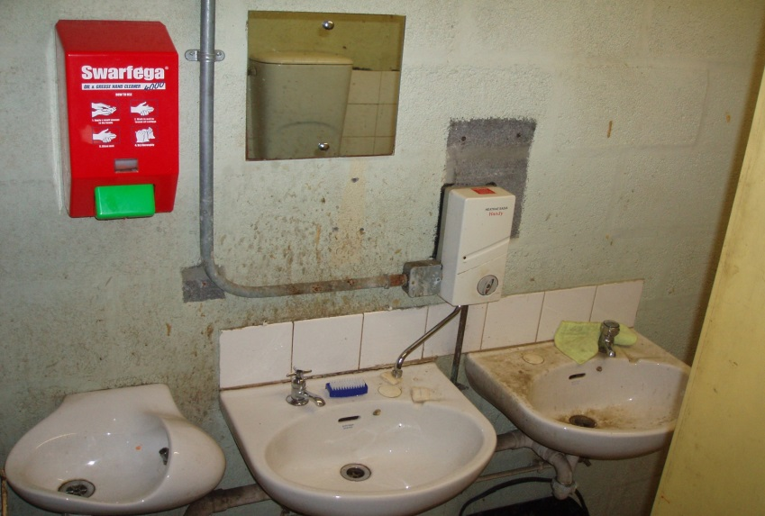
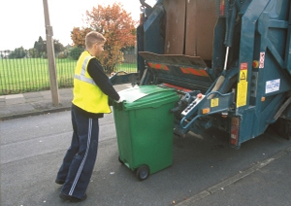
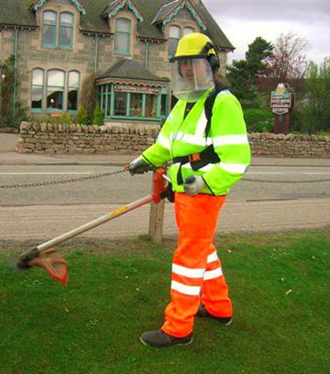
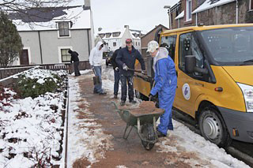
What is health and safety?
Notes:
What do you think when you hear health and safety in relation to HC?

Slide 4

What is health and safety?
Notes:
Or this?

Slide 5
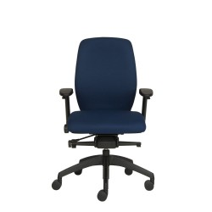

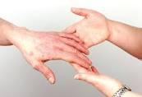
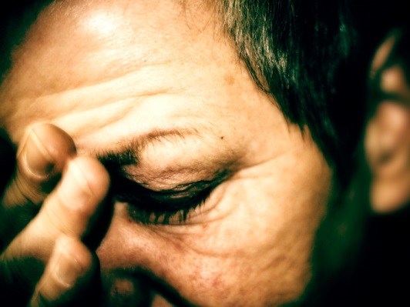
What about?
Notes:
What about these?

Slide 6
Why think of H&S?
Legal: HASAWA etc. 1974 plus regulations
Economic: costs of not doing it
Moral: go home safe
Community: H&S practices in THC will make safer communities
Notes:
Community
Safer buildings, schools etc.
Safer work practices
Take message home

Slide 7
Why think about H&S?
UK 2020/21
142 fatalities
1.6 million working people suffering from a work-related illness
693,000 injuries occurred at work
65,427 injuries to employees reported under RIDDOR
38.8 million working days lost due to work-related illness and workplace injury
THC 2020/21
0 fatalities
681 injuries occurred at work
15 injuries to employees reported under RIDDOR
374 days lost to injuries at work

Slide 8
Why think about H&S?
HSE – Fee for intervention - £160 per hour (per 6 minutes)
Sentencing guidelines
Costs of:
Stopping work
Absence
Investigation time
Replacement staff
Legal costs
Replacement equipment
Additional training, etc.
Notes:
Sentencing guidelines
Fine based on
Guilty plea
H&S culture
% government grant
Corporate and individual fines
Sentencing

Slide 9
Who is responsible?
Employer/Chief Executive
Executive Chief Officers
Line Managers
Employees
OHSW Manager
Notes:
The employer – overall responsibility for health and safety
The chief executive – responsibility for implementing and managing the health and safety strategy and policy for the authority
ECOs – H&P, C&P, P&H – specific roles
Line managers – day to day responsibility for themselves, their employees and others, including members of the public
Employees – responsibility for themselves and others

Slide 10
OHSW Manager
Competent person (Management of Health and safety at Work regulations) 1999
Policy
Training
Guidance
Advocacy
Legal requirements
Governance
Manage H&S team
Manage occupational health
Manage EAP
Health Promotion
Notes:
Central Safety Committee

Slide 11
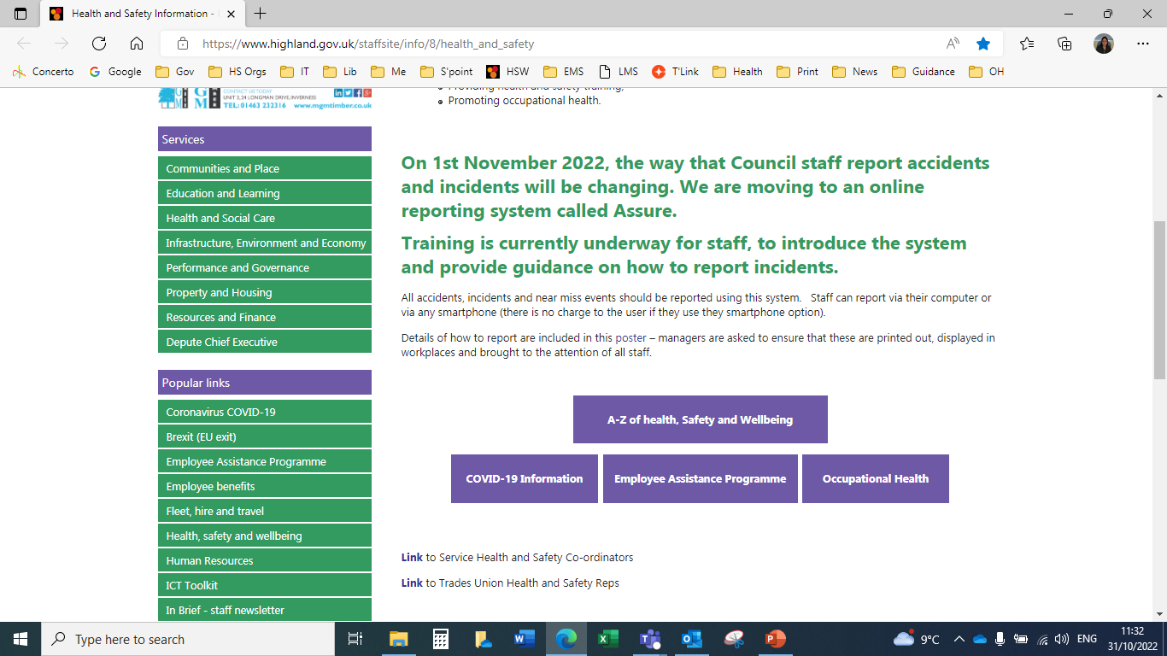
H&S Intranet
Notes:
No Council OHSW info in Internet site - EHOs

Slide 12
Wellbeing
Occupational Health
Employee Assistance Programme (EAP)
Policies and strategies – mental health and well being (Mental Health Reps)
Health promotion
Managing long term conditions
Specific health issues

Slide 13
Role of Trade Unions
Charter
Partnership
Consultation
Accident Investigation
Safety Groups

Slide 14
Your role as Elected Member
What you say, do and decide can have a real impact on the health and safety standards of :
workers
contractors
suppliers
service users
customers
Health and safety champion
Your own safety
Notes:
For example, how many workers the Council employs in total, how many contractors are used for specific services, e.g. in refuse collection.
Redesign – impact on staff
Change – consider health and safety implications
Budget setting
Challenge committee reports if H&S not mentioned in implications section – especially where changes involving people, processes, equipment are included

Slide 15
HSAW etc. Act 1974
Employers’ responsibilities:
Provide sufficient resources for health and safety:
  A safe system/way of performing work.
  A safe place to perform the work in.
  Safe equipment and machinery to perform the work.
  They must ensure work colleagues are competent in their roles.
  They must carry out the relevant risk assessments.

Slide 16
Collective responsibility
Barrow-in –Furness
In 2002, an outbreak of legionnaire’s disease at an arts and leisure centre run by Barrow led to seven deaths
The Council was fined £125,000 plus £90,000 costs
The design services manager was personally fined £15,000
The judge said:
“The failings... went all the way... to the top of the council in terms of its serving officers. It is likely they went beyond the officers to the councillors, because there is no evidence that there was proper attention given to health and safety within the borough”
Notes:
This landmark case shows that elected members could be held accountable. The outcome of this case could have been very different under the recently introduced Corporate Manslaughter and Corporate Homicide Act.

Slide 17
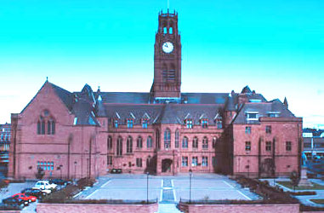
Collective responsibility
Council leader Bill Joughin admitted:
“We had policies written on paper but... it was not part of the culture of the organisation, and there was no chain of command. We ticked all the boxes, but there was not a procedure which ensured it was all adhered to”
Notes:
People don’t have to die or be injured for an organisation to be taken to court and prosecuted.
For example, the Board of Trustees of a national museum was prosecuted and fined £500 and £35,000 costs after legionella was found in an air-cooling system – no one was made ill or died.

Slide 18
Your role as Elected Member
Do I know enough about health and safety and the risks that people face in the Highland Council?
Do I understand the health and safety issues in the service areas I’m involved with?
Has we set the right health and safety strategy and budget?
Do I show commitment to health and safety when I talk to people in the service teams?
Have any decisions I’ve made as an elected member put people at risk?
Has the pandemic made you think or behave differently?
Notes:
Rhetorical questions
How do you find out?

Slide 19
When things go wrong – the law
As an employer, the Council has a legal duty to protect its workers and contractors, as well as the public
If the Council breaks health and safety law, it could be prosecuted or issued with an improvement or prohibition notice
If someone is killed, injured or made ill by their work, or a member of the public is harmed because of the Council's negligence, it could be taken to court
Civil courts
Notes:
Damaging to reputation (and perhaps that of individual elected members), getting health and safety wrong could be costly. Looking at HSE intervention alone, an improvement or prohibition notice could mean having to spend money on sorting out the problem or having to find and pay for an alternative service. The negative publicity these actions attract, particularly if a case goes to court, could be very damaging. See handout.
In certain situations, individual employees, including those at senior level, or even elected members, could be prosecuted. The HSE Local Authority forum raised concerns over the role and responsibilities of elected members within the cabinet structure and questioned whether councillors would be more likely to be prosecuted as individuals for health and safety offences. The HSE Solicitor responded by saying: “Historically, HSE knows of no case where elected members have been prosecuted individually. However, HSE is aware that the decision-making process within councils is changing such that elected members may make decisions ahead of committee agreement. These decisions may have health and safety implications. Where such decision-making occurs, the council should have systems in place to ensure that any decision made is in line with the council’s own policies and procedures relating to health and safety. Depending on the facts of an individual case it may be possible that elected members could be prosecuted under section 36 of HASWA 1974. Ultimately however, this would be a matter for the courts to decide.
Corporate Manslaughter and Corporate Homicide Act, 2008, and the Health and Safety Offences Act, 2009. The first introduced unlimited fines as well as remedial and publicity orders. The second increased fines and made custodial sentences an option for more offences. New sentencing guidance – fines based on Council’s Annual Revenue Budget.

Slide 20
What are the major health and safety issues in this Council?
Covid-19
Vibration
Stress/mental health
Fire
Waste management
Construction
Transport
Manual handling
Notes:
HAVS – HSE Notices, civil claims
Construction – including property maintenance and management, refurbishment, demolition, excavation, and health issues related to asbestos and legionella
Mental health problems – including stress, anxiety and depression
Waste management – this has caused a number of fatal accidents, including to members of the public. It’s an HSE priority
Transport – including road maintenance and safety, managing depots, pedestrian access, school transport and occupational road risks
Fire – including alarm systems and fire procedures in council buildings. Post-grenfell
Musculoskeletal injuries – including bad backs, muscle damage, and injuries caused by slips, falls and repetitive tasks such as intensive keyboard use

Slide 21
Lone Working
“Working without supervision”
Why are you alone?
Consider alternatives
Be ALERT not ALARMED
Check in…..regularly
Check out
Positioning in rooms/venues
Notes:
If face to face, have someone with you (whilst observing confidentiality, physical distancing, etc)
Greater risk if you have medical issues
Sit nearest the door; move objects off table

Slide 22
Getting health and safety right...
saves lives
keeps people from harm
improves morale among the workforce
saves money
improves efficiency
sends out a positive message to others, including employees, contractors and the electorate
sets a good example

Slide 23
Are we getting it right?
Corporate Health Safety And Wellbeing Policy and Plan
Service Policies and Plans
Central Safety Committee
Service and Area Health and Safety Meetings
Suite of training available (workshop and e-learning)
Site visits, inspections, audits
TU health and safety reps

Slide 24
How you can help…
Ensuring OHSW policy exists and is reviewed regularly
Ensure the Council:
  Considers health and safety when setting budgets
  Considers heath and safety during redesign
  Sets targets for reducing injuries and ill health
  Gets reports on specific incidents or accidents
  Gets regular reports on health and safety performance
  Reports publicly on health and safety performance
Sensible risk management
Look for health and safety/risk management implications in reports – challenge?
Notes:
Sensible RM
… isn’t about:
stopping activities for trivial reasons and where the risks have been assessed
generating useless paperwork
creating a totally risk-free environment
scaring people by exaggerating trivial risks
IS about
is about:
protecting workers and the public
balancing benefits and risks – reducing risks that have serious consequences and those that come up more often
making sure that those who create risks manage
them responsibly
helping people understand that, as well as having a right
to protection, they have to take responsibility
for themselves and others

Slide 25
Remember…
Health and safety is part of everything you do
Health and safety is relevant to every Service and team in the Council, and to every activity

Slide 26

Any questions?

