Slide 1
Sustainable Travel Strategy – Fleet and Staff Travel
Ro-innleachd Siubhail Seasmhach - Siubhal Cabhlach & Luchd-obrach
7 February 2023

Slide 2
Agenda
Scottish Government Roadmap
Highland Council Fleet
Highland Council Sustainable Travel Strategy
Progress to Date with Key Activities
Challenges

Slide 3
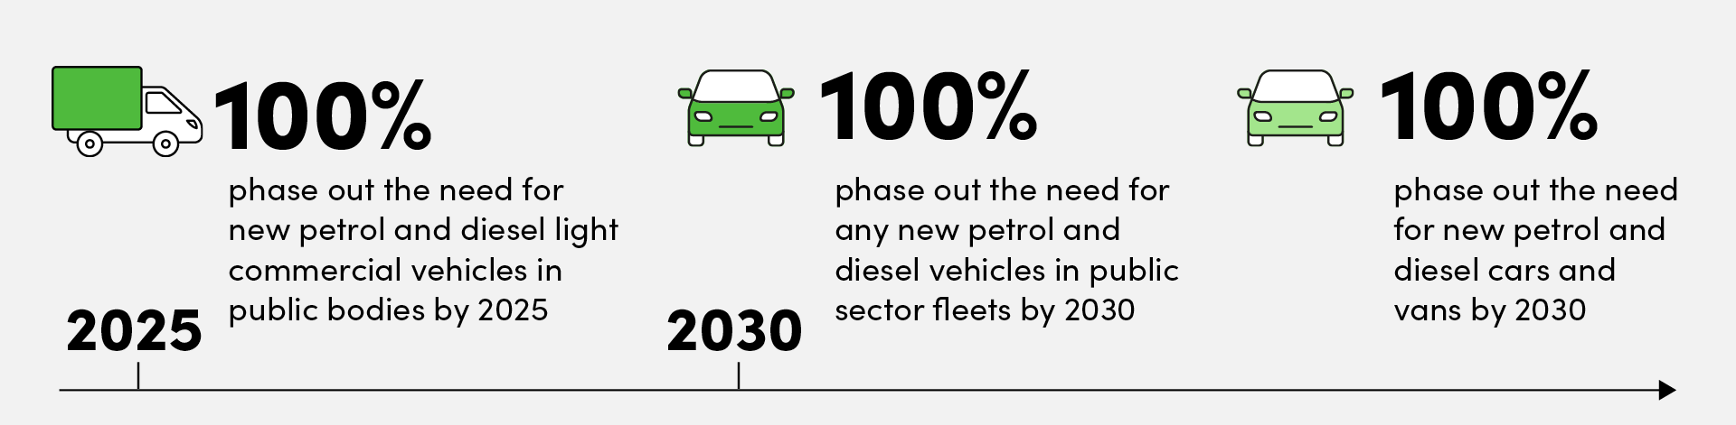
Scottish Government Roadmap
Transport Scotland: Mission Zero for Transport - Zero Emission Vehicle targets
The revisions to Scotland’s 2018-2032 Climate Change Plan include a commitment “to reduce car kilometres by 20% by 2030”
Scotland’s Climate Change Plan update in 2020

Slide 4
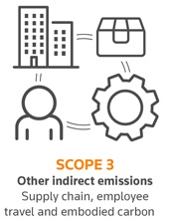
Scottish Government Roadmap
Fleet – Direct scope 1
Fleet Targets Set target date for zero tailpipe emissions from fleet (where possible).
Business Travel – Indirect scope 3
Business travel is all travel required for business purposes that is taken in vehicles that are not owned or leased by the organisation. For example, use of private cars, trains or air travel. Emissions from business travel are indirect emissions and therefore public bodies must have a target to reduce these as quickly as possible in line with any transport mode dependant policies and in keeping with Scotland’s net zero commitments.

Slide 5
How Will We Get There?
Progress to Date
COVID Learning
Highland Council Sustainable Business Travel Strategy
Fleet – what do we have and where do we need to get to?
Key date and activities

Slide 6
Progress to Date
Progress to date:
Decarbonising Light Fleet Committee Report November 2020
Developing the approach to decarbonising the Large Good Vehicle Fleet Committee Report May 2021
Cenex Analysis 2021. Identified fleet not suitable for ULEV in mid term, hydrogen vehicle technology roadmap
Sustainable Business Travel Strategy in development
Vehicle replacement programme developed
£1.8m added to capital review process for EV infrastructure to 2028. Alternative funding models being explored.
Service Plan Targets

Slide 7
Learning From Covid
Benefits of ICT – less travel, less non productive time
‘Digital by Default’

Slide 8
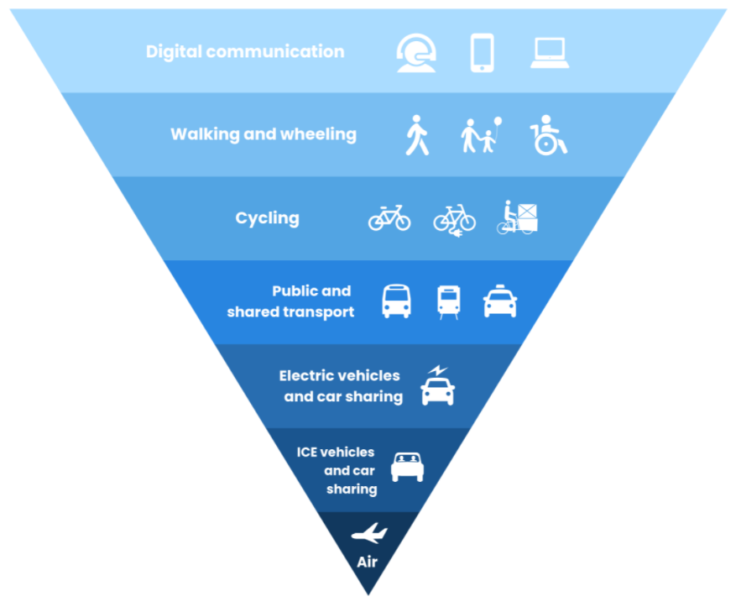
Travel Hierarchy

Slide 9
Highland Council Sustainable Business Travel Strategy
Strategy being developed. Four themes to move towards zero emissions:
Reduce travel though behavioural change
Rationalise and renew the light commercial fleet
Investigate and develop low emissions approach for the large goods vehicles
Build resilience into the Council’s travel project, guidance, and policies

Slide 10
Highland Council Sustainable Business Travel Strategy
Theme 1 Reduce travel through behavioural change
Employee modal shift
Travel hierarchy
Form of travel
Driver behaviour
Travel hierarchy
Driving techniques
Service level targets
Carbon budgets and annual targets to reduce travel miles will be agreed and implemented for each service.
Communications
Down sizing fleet
Changing vehicles type and size

Slide 11
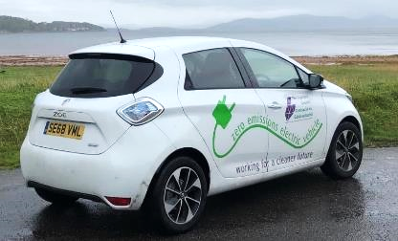
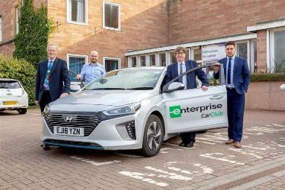
Highland Council Sustainable Business Travel Strategy
Theme 2 Rationalise and renew the light commercial fleet
Fleet utilisation (inc duty cycles) and rationalisation
Fleet ULEV replacement programme to 2030 (asset replacement cycles)
Fleet EV charging infrastructure (inc vehicle location overnight / when not in use, charging infrastructure requirements, vehicles ranges and charge point locations)
Establish infrastructure funding model (Total Cost of Ownership modelling (ICE vs EV) and Procurement methods such as lease versus purchase options
Infrastructure collaboration
Car Club Review
Grey fleet and casual car hire policy review

Slide 12
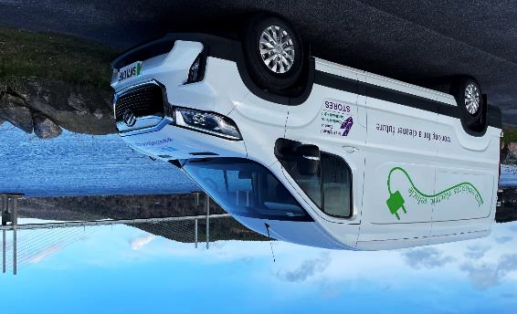
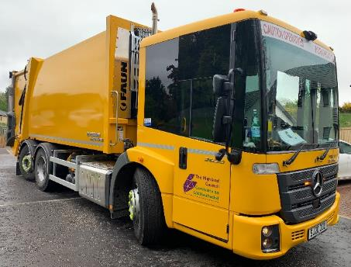
Highland Council Sustainable Business Travel Strategy
Theme 3 Large Goods Vehicles
Investigate private sector fuelling for hydrogen and refuelling infrastructure
Assess hydrogen demand and refuelling requirements and potential supply/generation
Develop and implement a strategy for conversion of HVG to ULEV. Procurement of ULEV in line with the strategy.

Slide 13
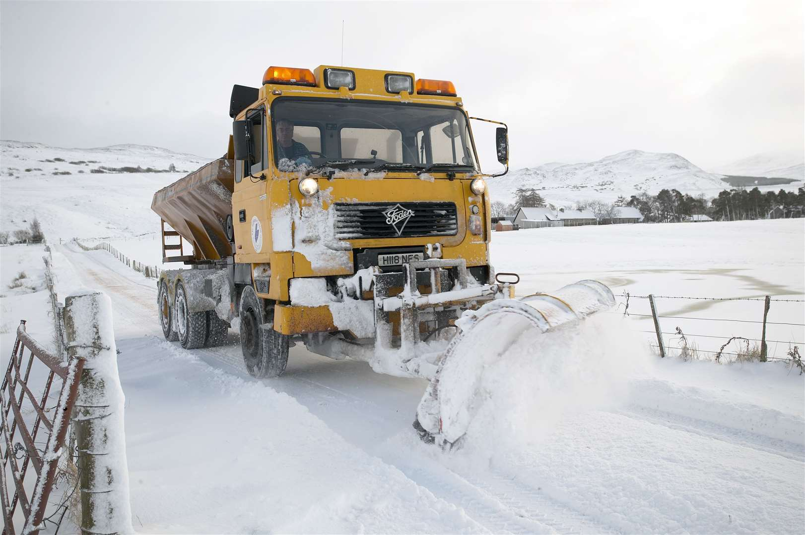
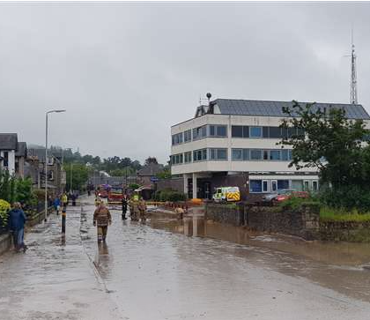
Highland Council Sustainable Business Travel Strategy
Theme 4 Build resilience into the Council’s travel projects, guidance, and policies
Assist with the development of the Council’s Local Climate Impact Profile.
Review guidance for officers travelling in adverse weather.
Build resilience into the transport network and infrastructure.

Slide 14
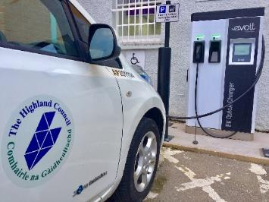
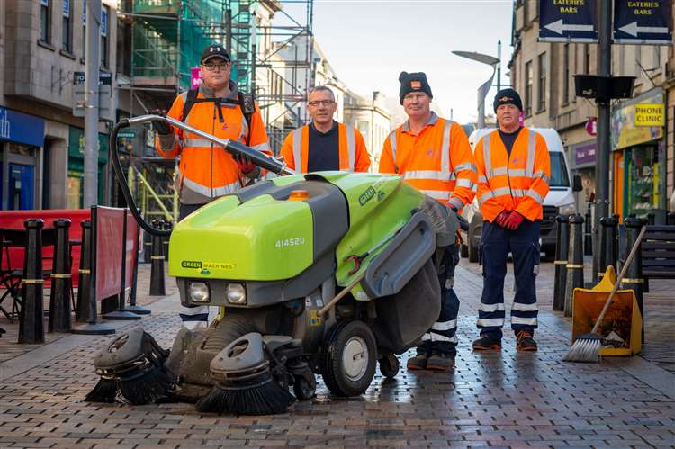
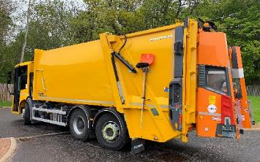
Progress to Date - Fleet
All public bodies with fleet must have a fleet decarbonisation plan as part of their fleet management. This decarbonisation plan may consider:
Can the fleet be consolidated/reduced? ✓
Can miles travelled/fuel used be reduced? ✓
How will the fleet vehicles be converted to zero tail pipe emissions vehicles ✓
How many of the fleet vehicles have market available zero emission alternatives? ✓
Could any vehicle types that don’t have market available zero emission options be replaced by a different vehicle type that has zero emission alternatives? ✓

Slide 15
Progress to Date - Fleet
Identify remaining fleet that does not have current market available zero emissions options, identify and record replacement timescales. ✓
Engage with Transport Scotland / other partners to see how trials or market engagement can be carried out to decarbonise fleet vehicles. e.g. E-cargo trials planned for 2023 to help displace vehicle journeys ✓
Fleet Pathfinder project underway in collaboration with Aberdeen City and Aberdeenshire Council – to explore opportunities of sharing infrastructure, alternative delivery models, opportunities for collaboration and alternative approaches to finance/funding and operation of public sector fleets. ✓

Slide 16
Progress to Date - Business Travel
Organisations should first question if travel is necessary or if work could be done as effectively using remote solutions. If travel is necessary then the sustainable travel hierarchy should be promoted, and staff encouraged to use more sustainable modes of transport.
Review Travel Hierarchy to prioritise sustainable travel ✓
Ban all domestic flights
Introduce organisational policy whereby Director level approval is required for all remaining air travel.
Review car club model ✓
Review grey fleet and casual car hire policy ✓
Review grey fleet and car club report - miles and money ✓

Slide 17
Challenges
Availability of Fleet
Light fleet
Large goods vehicles
Maturity of development and production pipelines and functionality especially electric LGV
Financial
Cost of zero emission vehicles:
Request submitted for £1.8m to be added to the capital programme for EV charging infrastructure
Cost comparison example –
ICE RCV 26 tonne is circa £160k.
EV is circa £400k
Hydrogen is circa £620k
No known external grant funding

Slide 18
Challenges
Financial cont.
Infrastructure
Cost of adapting workshops
Purchasing new equipment to service vehicles
Training staff - drivers and mechanics
Challenging landscape and availability of fuel
Large Highland region, long travel distances
EV charging network
Hydrogen
HVO
Functionality
Power draw

Slide 19
Analysis 2021
Ref Cenex North East Scotland Fleet Review 2021

Slide 20
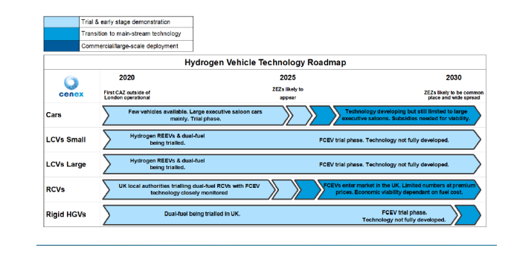
Hydrogen Vehicle Technology Roadmap
Ref Cenex North East Scotland Fleet Review 2021

Slide 21
Current Vehicle Replacement Programme
 | <2021 | 2022 | 2023 | 2024 | 2025 | 2026 | 2027 | 2028 | 2029 | >2030
Car | 4 | 18 | 37 | 35 | 13 | 2 | - | - | - | -
Light Fleet | 13 | 222 | 49 | 188 | 129 | 7 | 5 | - | - | -
RCVs | 24 | 4 | - | 7 | 8 | 8 | 11 | 5 | 9 | 1
Heavy Fleet | 22 | 14 | 22 | 26 | 31 | 32 | 38 | 24 | 24 | 17
Other Plant | 61 | 1 | 18 | 3 | 8 | 1 | 1 | 8 | 3 | 5
Total | 124 | 259 | 126 | 259 | 189 | 50 | 55 | 37 | 36 | 23

Slide 22
Highland Council Fleet
Vehicle Type | No. Vehicles | No. ULEV EV/hybrid) | Annual mileage (miles) | Annual Emissions (tCO2e) | % Number | % Mileage | % Emissions
Light Fleet | 582 | 29 | 5,566,800 | 2,335,200 | 50% | 57% | 35%
Heavy Fleet | 250 | - | 1,921,200 | 2,398,000 | 22% | 20% | 35%
RCVs | 77 | - | 1,027,400 | 1,525,700 | 7% | 11% | 22%
Other Plant | 109 | - | 213,200 | 319,600 | 9% | 2% | 5%
Car | 109 | 72 | 787,100 | 150,500 | 9% | 8% | 2%
Minibuses <14 | 31 | 2 | 238,600 | 101,900 | 3% | 2% | 1%
Total | 1158 | 103 | 9,754,300 | 6,830,900 | 100% | 100% | 100%

Slide 23
Summary and Next Steps
No ‘big bang’ approach to reducing staff travel cost and emissions
Services to develop new ways of working
Funding required to progress
Sustainable Business Travel Strategy will provide a framework for going forward

