Slide 1
Thematic Group – Procurement & Community Wealth Building
Buidheann Chuspair-Solarachadh & Togalach Saibhreas Coimhearsnachd

Slide 2
Thematic Group – Procurement & Community Wealth Building
Context
Context of procurement at The Highland Council, shared service, off contract spend vs on contract.
Spend and supplier numbers in 2022.
Local suppliers %, degree of influence to select.
The Procurement regulations.
Other Councils in the Shared Service and Net Zero.
Net zero and emissions tracking scopes.
Notes:
Context of procurement – THC has spends with nearly 6,000 suppliers in last financial year and nearly £400 Million. The structure of the supply base has a significant number of off contract suppliers within this number and that’s important to recognise as when we start talking about change and influence this is of course more difficult to implement if we don’t have a contractual relationship.
THC is part of a shared service covering Procurement and Commercial services, also included in the shared service are Aberdeen City and Aberdeenshire Councils bring together nearly £1 Billion in leverage. Part of the beauty of the membership of the shared service is the ability to collaborate and share best practice and this is what we will do with regards to Net Zero learning and tools.
As a Public Sector body we are obliged to comply with the Scottish Procurement Regulations – part of this includes not giving preference to local suppliers.
Our start point is in sizing the journey ahead and identifying priorities- we best do this through calculating the scope 3 emissions form our supply chain use.

Slide 3
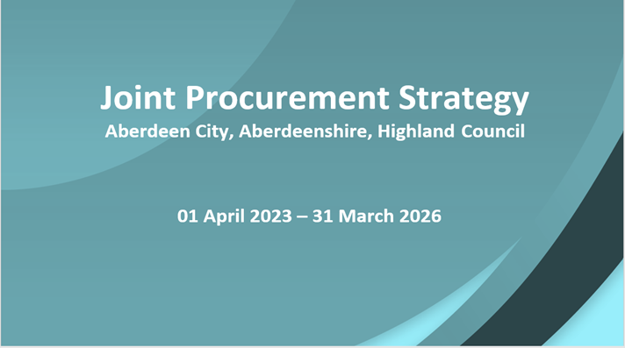
Thematic Group – Procurement & Community Wealth Building
The Joint Procurement Strategy
The Joint Procurement Strategy (JPS) - what is it?
How is it being revised and consulted?
Net Zero is a key element of the strategy.
Community Wealth Building and the JPS.
“set out the procurement and commercial objectives and proposed actions for 2023 through to 2026 reflective of both local and national policies and priorities”.
Notes:
What focus do we place upon Net Zero journey?
Key part of the joint procurement strategy
Shortly to be consulted upon widely
Covers through to march 2026

Slide 4
Thematic Group – Procurement & Community Wealth Building
How will we measure and report ?
Tools- Sustain IQ*
Tools – CO2 Analysis and scope 3 emissions calculations*.
They are auditable, transparent, set clear baseline to monitor journey and impacts.
Enable a Common Language.
Enable the creation of Dashboards.
Change Journey supported by data to measure effectiveness.
https://prezi.com/view/KX3uBZh3HuHsX9I07JYr/
*Please note any content in the links is generic for now until we populate with our own data.
SustainIQ Information (1).pptx
Notes:
Please see links to more information on the tools, on the companies we have selected to help in developing data.

Slide 5
Thematic Group – Procurement & Community Wealth Building
Data driven approach to support delivery of outcomes
Developing embodied carbon calculator – supports Climate Change
Additional Functionality Future Reporting Requirements
Compliance – depository for Insurance, certification
Report on performance of Joint Procurement Strategy
Consultation pillar would support community wealth building
Data used to calculate carbon emissions has hidden added commercial value to the councils.
Its line item level data – what exact product is being bought.
Creates detailed product picture on our activities.
Data also covers our suppliers process of operations when performing scopes.
Notes:
Sustain IQ and Net Zero tracking and reporting.

Slide 6
Thematic Group – Procurement & Community Wealth Building
Examples and Constraints.
Examples of spend and Net Zero journeys.
Waste.
Utilities.
Vehicles.
Materials- janitorial, ppe, garments (cotton vs bamboo)
Constraints to change – available, affordable technology?
Notes:
This is about Change and we do need to recognise this will be a journey with constraints to work within and understand.

Slide 7
Thematic Group – Procurement & Community Wealth Building
Next Steps
Next Steps
Setting targets and priorities with data led intelligence.
Plan (Short term detailed plan-STP) and Timeline (how the journey evolves over the coming stages.)
Notes:
Implement in March the tools- calculate the scope 3 emissions- identify priorities through to July.
Communicate with Supply Chain and present data, priorities and develop with key suppliers a joint agreement to improve in collaboration and openness the path to reduce emissions.- rest of 2023
STP- Identify pilots with key suppliers and develop business cases for change/ adapt processes to undertake first reduction activities.
T/L- journey will progress through stages and years towards Net Zero, respecting the constraints and working in Collaboration with Supply Chain.

