Slide 1
The Highland Council Gu Ruige Neoini Lom: Oighreachd Thogte & Buidheann Cuspaireil Lùtha Towards Net Zero: Built Estate & Energy Thematic Group
Finlay MacDonald
Head of Property & FM
6th March 2023

Slide 2
Scotland at Night…
We can’t hide our emissions……Change is essential
(Please Turn Some Lights Off)
2

Slide 3
Presentation title Alt
Participants of the Built Estate & Energy Thematic Group
Towards Net Zero
Finlay MacDonald
Sharon Barrie
Ronnie Macdonald
Glenn Campbell
Emma Calder
Robert Campbell
Tom Murdison
Simon Swanson
Finance Service
FM
RM
SB
RC
TM
EC
GC
SS
TC
- Head of Property & FM
(Thematic Group Lead)
- Council Energy Manager
- Service Lead - Design & Construction
- SL - Capital Planning & Estate Strategy
- Service Lead - Corporate Property
- Corporate Property Asset Manager
- Building Standards Manager
- Head of Investment & PM – HLH
- Finance Service
3

Slide 4
Presentation title Alt
Scope of the Built Estate & Energy Thematic Group
The Groups focus is on Reducing Carbon Emissions and Improving the Energy Performance (and running costs) of the Councils General Fund Property Estate
This includes key functions such as:
Schools – Both Primary & Secondary
High Life Highland Buildings
Council Offices
SW Facilities
Depots, etc.
Subtitle comes here
4

Slide 5
Presentation title Alt
Extent of the Built Estate (Building Numbers)
Building Function | Number of Actual Buildings | Number of Sites (with an associated building record/s) | Combined Gross Internal Floor Area (Gifa)
Schools inc HLH Estate and PPP1, PPP2 & Wick Campus | 950 | 200 | 489,889m²
Offices | 195 | 47 | 60,630m²
Depots | 109 | 38 | 27,608m²
Others | 657 | 461 | 138,579m²
Totals | 1911 | 746 | 716,706m²
Subtitle comes here
5

Slide 6
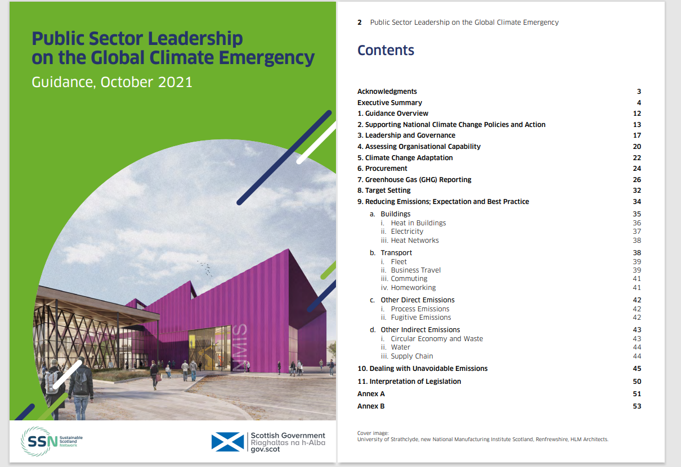
Presentation title Alt
Scottish Government Guidance
Key Target
Decarbonise estate by 2038 at the latest, with zero carbon direct emissions from all buildings.
Subtitle comes here
6

Slide 7
Presentation title Alt
Our Current Challenges
National Net Zero target by 2045
Ageing Built Estate
Capital Programme
Inflation Impact on Capital Investment
Reduction in Property Maintenance Budget
Transition from Fossil Fuels to Renewables
Construction Industry
Energy Reduction Behaviours
Subtitle comes here
7

Slide 8
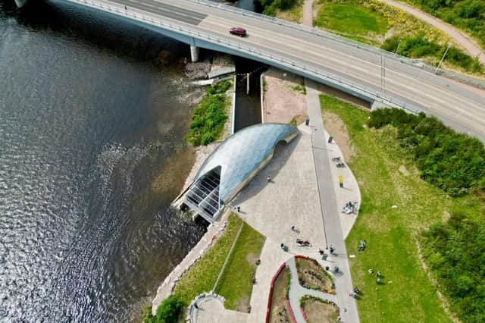
Presentation title Alt
Ness Hydro – Council Energy Generation
Hydro Ness is our 92kW Award Winning Archimedes Screw Hydroelectric Scheme
An interactive visitor experience
Generating renewable energy for Inverness Leisure Centre
Subtitle comes here
8

Slide 9
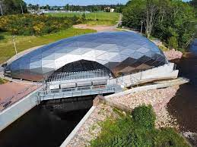
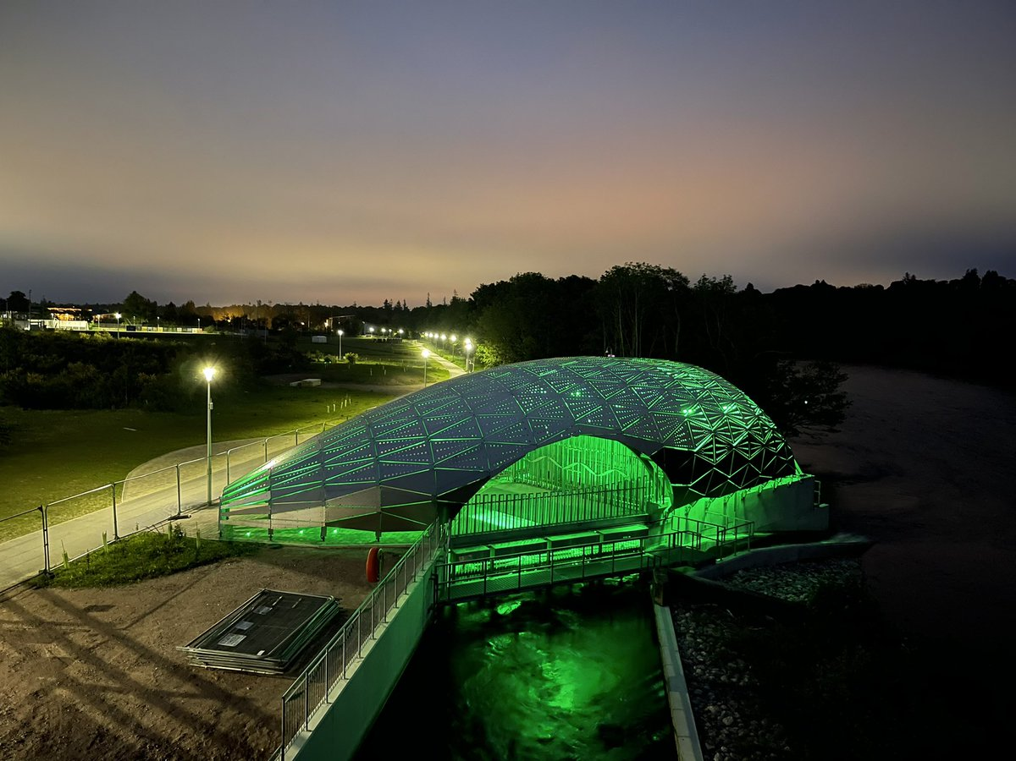
Ness Hydro – Council Energy Generation
Subtitle comes here
Internal LED Evening View
9

Slide 10
Key Project Outcomes
Outcome 1: Energy efficiency of Estate – Effective Strategy for reducing
energy consumption
Outcome 2: Estate Carbon Reduction – Benchmark and produce a plan
with challenging reduction targets
Outcome 3: Support Property Asset Management – Reduce our Assets
Outcome 4: Strategy implementation for Low Carbon Heat Solutions
Outcome 5: Promote increased on-site Renewable Generation
Subtitle comes here
10

Slide 11
Presentation title Alt
The Decarbonisation Plan – Progress so Far
Oil to Biomass: Already 84 Council Sites - Largest in Scotland
Biomass RHI Income - £1.4m income per annum achieved
LED Lighting Projects
Last 3yrs - 128No (mix of schools, leisure centres, library buildings etc )
Investment in the LED Programme – £5.2m
New Photovoltaic Sites – 30No
Investment in the Solar Programme – £2m
Ongoing Boiler Plant Replacement
Closer Scrutiny of Utility Bills – Savings being achieved via challenging Water & Electricity Suppliers
Subtitle comes here
11

Slide 12
Presentation title Alt
Heat Networks – Highland
Wick District Heating Connections (Private Company)
Unit Rates less than current oil cost
Currently a mix of Council Houses/Housing Association properties connected and more to follow
NHS Hospital connected to the DH network
THC Wick Assembly Rooms already connected
THC Considering Pultney House Care Home connection
Need to consider further Heat Networks
Subtitle comes here
12

Slide 13
Presentation title Alt
New Builds – Reducing Carbon & Heat Load
Passivhaus Schools
Tain Campus
Nairn Academy
New Primary Schools
Super Depot Project
More efficient Council Depots and less of them
Subtitle comes here
13

Slide 14
Presentation title Alt
Change and Investment Projects
Reducing the number of Buildings we occupy
Continuing with the installation of LED Lighting
Installation of Photovoltaic Panels
Smart Cities Project (Energy Manager)
Sub-metering for improved accuracy on consumption
Zoning of heating systems to control unnecessary usage
Installation of Building Management Systems
Installation of more efficient Heating Systems
Subtitle comes here
14

Slide 15
Alt
So What are the Key Messages?
Continue to Reduce our Carbon Emissions
Reduce our Estate – Via Asset Management
Reduce our demand for fossil fuels
Contribute to a Greener National Grid
Transition away from oil and gas
Change Hearts & Minds:- Improve Behaviours
Improve the Efficiency of the Estate
Increase
on-site Renewables/ Batteries
Highlight Successful Change and Communicate Benefits
Improve our BMS Energy Control Systems
Invest in Buildings to Reduce Energy Demand
15

Slide 16
Presentation title Alt
Built Estate & Energy Thematic Group
Thank You for Your Time
Comments and Questions?
Subtitle comes here
16

