Slide 1
Adaptation Scotland and climate change adaptation in the national context
Anna Beswick, Adaptation Scotland Programme Manager

Slide 2

About us
Enabling organisations, businesses and communities to adapt to the impacts of climate change
Adaptation Scotland is a programme funded by the Scottish Government and delivered by sustainability charity Sniffer.

Slide 3
Overview
Scotland’s changing climate
Is Scotland Climate Ready?
How can Local Authorities adapts to climate change?

Slide 4

Scotland’s changing climate
Average temperature is increasing
The last decade was 0.69 °C warmer than 1961 – 1990 average.
Scotland’s 10 warmest years on record have all occurred since 1997
The warmest year on record was 2014

Slide 5

Scotland’s changing climate
Rainfall is increasing
The last decade was 9% wetter than 1961 – 1990 average.
Biggest increases have occurred during winter - 19% wetter than 1961 – 1990 average
More heavy rainfall events

Slide 6

Scotland’s changing climate
Sea level rising
Mean sea level around the UK has risen by approx. 1.4mm per year since the start of the 20th Centenary.

Slide 7
The changes in climate that we are already experiencing are projected to continue and intensify

Slide 8

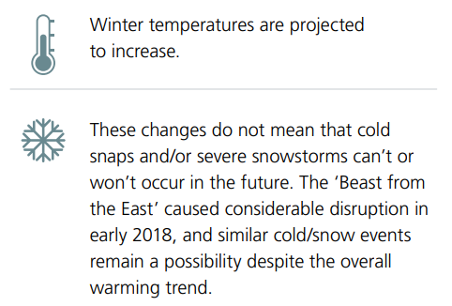
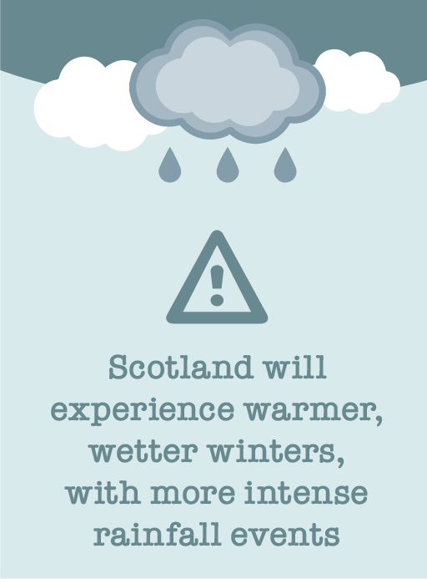
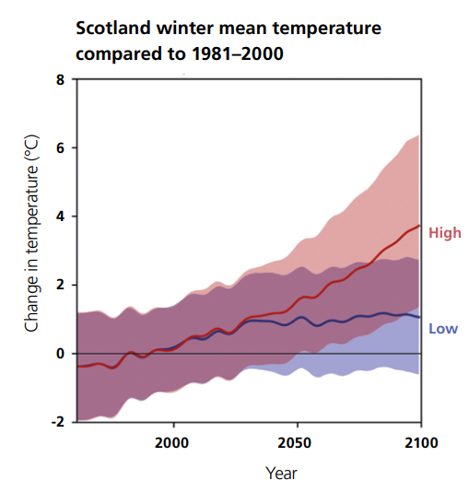
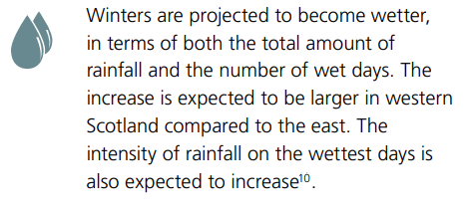
Winter

Slide 9

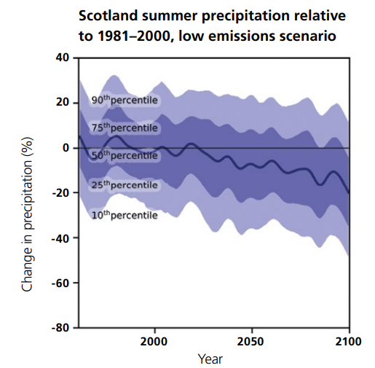
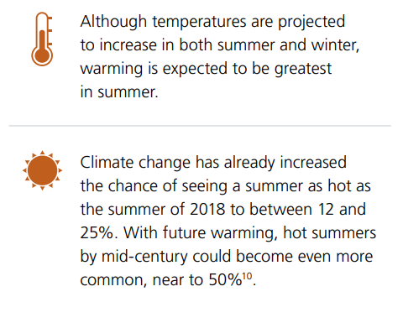
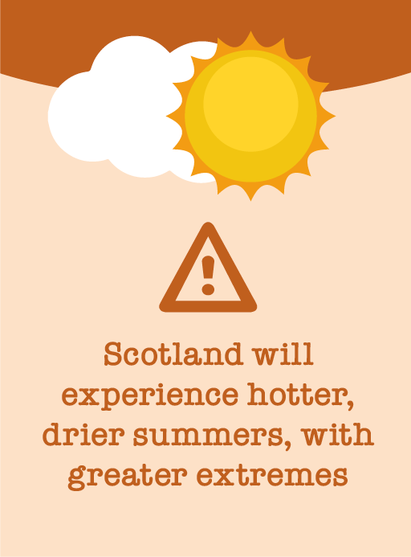
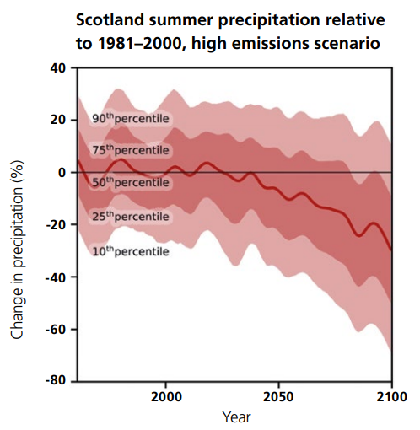
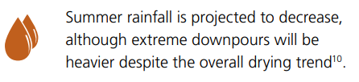
Summer

Slide 10
How will these changes affect Scotland?
The productivity of our agriculture and forests
The occurrence of pests and disease

Slide 11
The health of our natural environment
The quality of our soils

Slide 12
The availability and quality of water
The security of our food supply

Slide 13
The change at our coast
The increased risk of flooding

Slide 14
The health of our marine environment
Our cultural heritage and Identity

Slide 15
The resilience of our businesses
The health and wellbeing of our people

Slide 16
The security and efficiency of our energy supply
Infrastructure – Network Connectivity and Interdependencies

Slide 17
The performance of our buildings

Slide 18

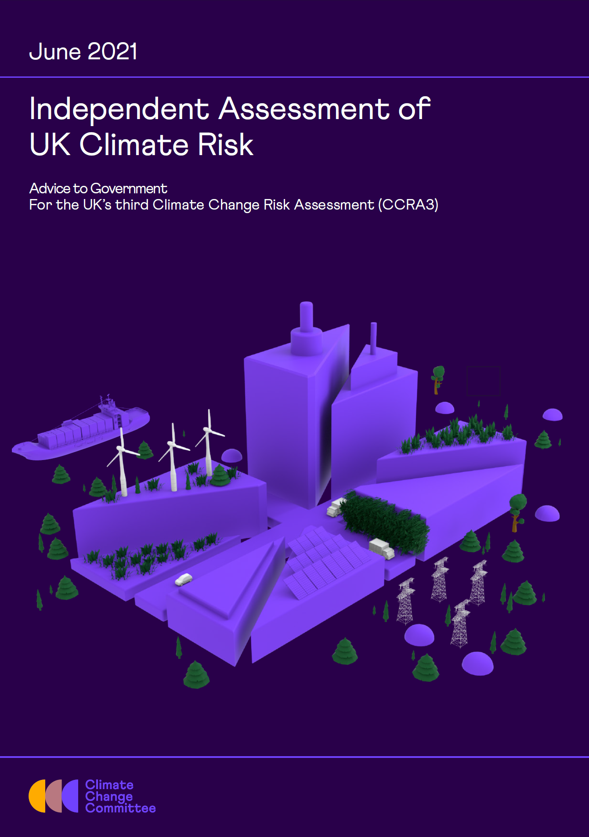

Is Scotland Climate Ready?
The gap between the level of risk we face and the level of adaptation underway has widened.
Adaptation action has failed to keep pace with the worsening reality of climate risk.
Progress in delivering adaptation has stalled
Notes:
Over the past 14 years the Scottish Government has put in place important building blocks for a well-adapting Scotland. The second statutory Adaptation Programme, published in 2019, sets out a strong vision of a Scotland where 'our built and natural places, supporting infrastructure, economy and societies are climate ready, adaptable and resilient to climate change’. The vision and accompanying outcome focused approach are widely recognised as progressive and ambitious.
Scotland’s progress in adapting to climate change is informed by statutory climate risk assessments and independent scrutiny:
The third UK Climate Change Risk Assessment (CCRA3) was published in January 2022 supported by detailed evidence reports produced by the Adaptation Committee of the Climate Change Committee (CCC) (June 2021). These highlight that the gap between the level of risk we face and the level of adaptation underway has widened. Adaptation action has failed to keep pace with the worsening reality of climate risk.
In March 2022, the Adaptation Committee of the CCC published an independent assessment of progress towards the second statutory Adaptation Programme vision. The assessment shows that more needs to be done to translate ambition into action and that progress in delivering adaptation has stalled.

Slide 19
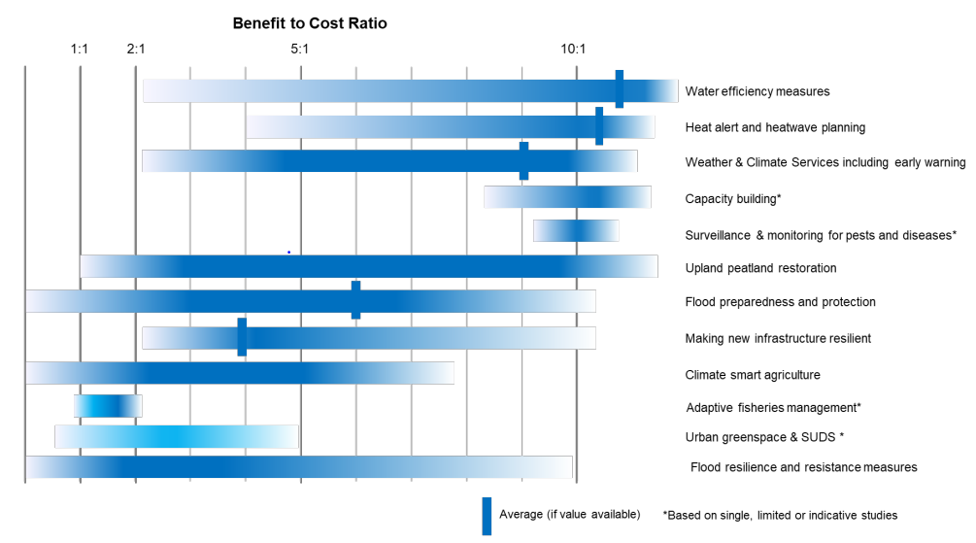
Climate resilience – facing up to the unavoidable impacts of climate change
The benefit-cost ratios typically range from 2:1 to 10:1
Every £1 invested in adaptation could result in £2 to £10 in net economic benefits.
Watkiss, P., Cimato, F., Hunt, A. (2021). Monetary Valuation of Risks and Opportunities in CCRA3. Supplementary Report for UK Climate Change Risk Assessment 3, prepared for the Climate Change Committee, London.

Slide 20


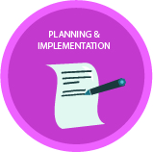

How can local authorities adapt to climate change?
Adaptation is a journey
Those who are most advanced are developing adaptation capabilities

Slide 21
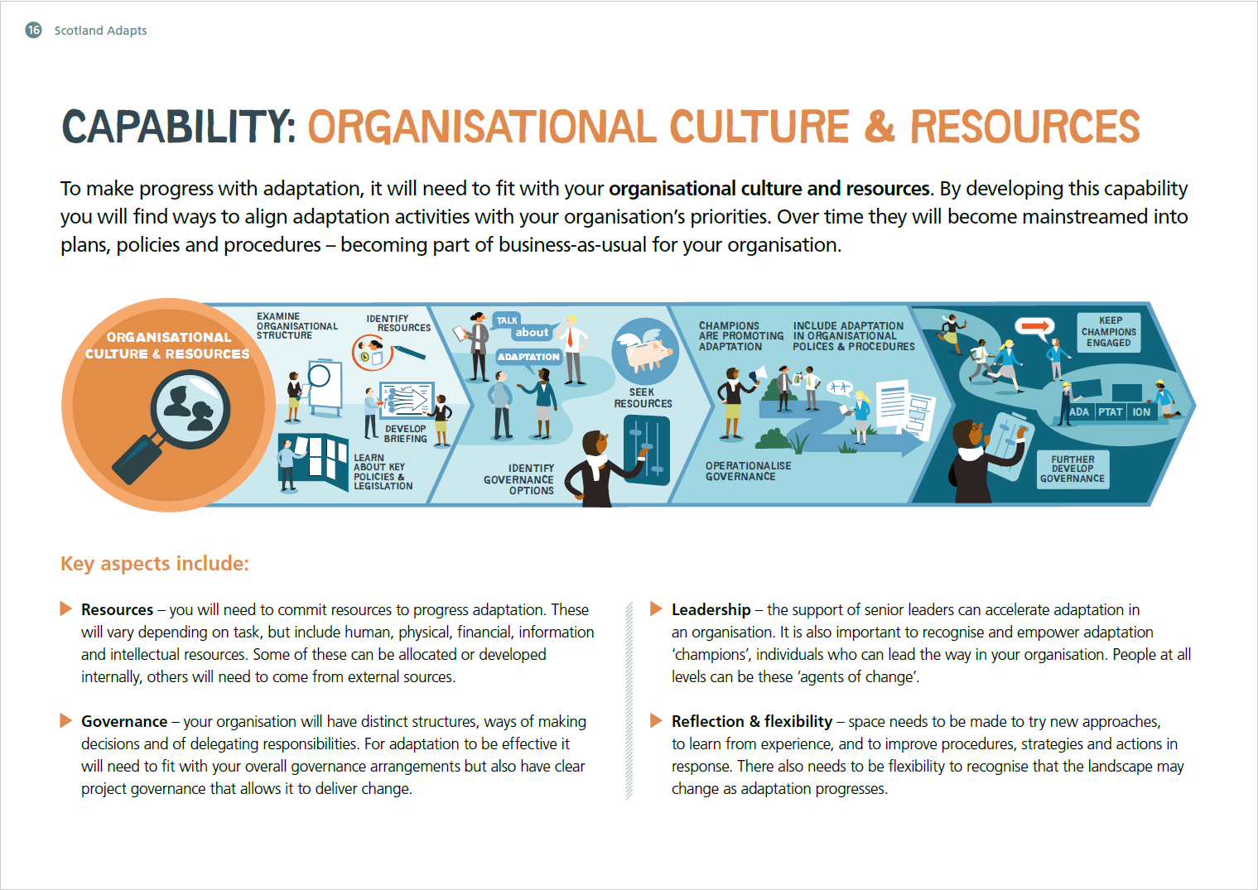


Resources – you will need to commit resources to progress adaptation. These will vary depending on task, but include human, physical, financial, information and intellectual resources. Some of these can be allocated or developed internally, others will need to come from external sources.
Governance – your organisation will have distinct structures, ways of making decisions and of delegating responsibilities. For adaptation to be effective it will need to fit with your overall governance arrangements but also have clear project governance that allows it to deliver change.
Leadership – the support of senior leaders can accelerate adaptation in an organisation. It is also important to recognise and empower adaptation
‘champions’, individuals who can lead the way in your organisation. People at all levels can be these ‘agents of change’.
Reflection & flexibility – space needs to be made to try new approaches, to learn from experience, and to improve procedures, strategies and actions in
response. There also needs to be flexibility to recognise that the landscape may change as adaptation progresses.

Slide 22
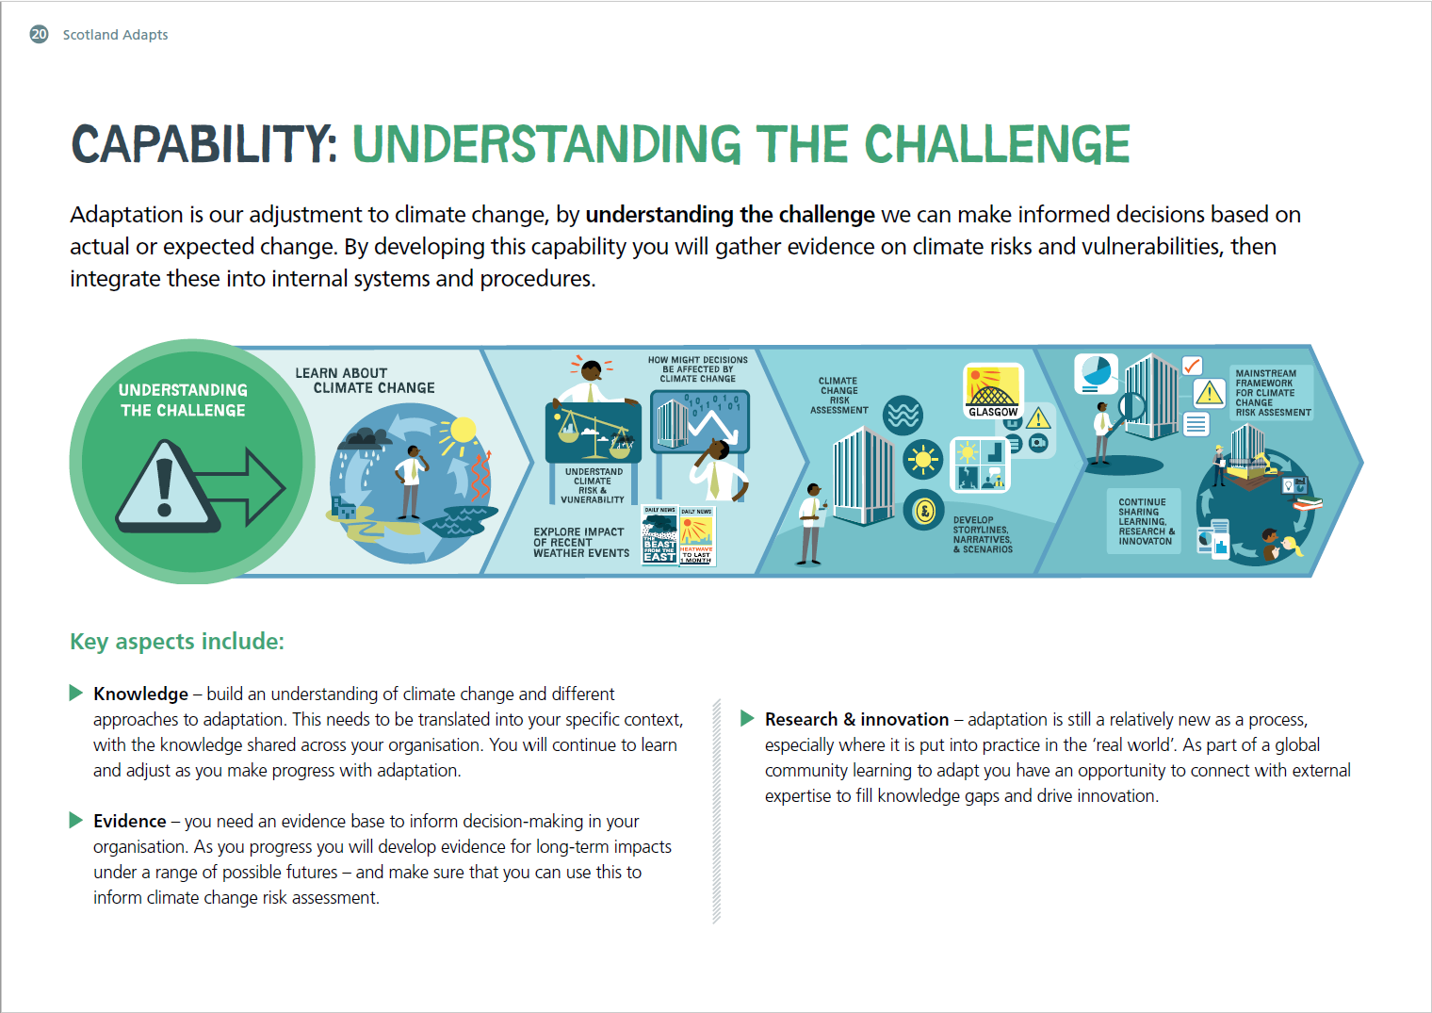


Knowledge – build an understanding of climate change and different approaches to adaptation. This needs to be translated into your specific context, with the knowledge shared across your organisation. You will continue to learn and adjust as you make progress with adaptation.
Evidence – you need an evidence base to inform decision-making in your organisation. As you progress you will develop evidence for long-term impacts under a range of possible futures – and make sure that you can use this to inform climate change risk assessment.
Research & innovation – adaptation is still a relatively new as a process, especially where it is put into practice in the ‘real world’. As part of a global community learning to adapt you have an opportunity to connect with external expertise to fill knowledge gaps and drive innovation

Slide 23
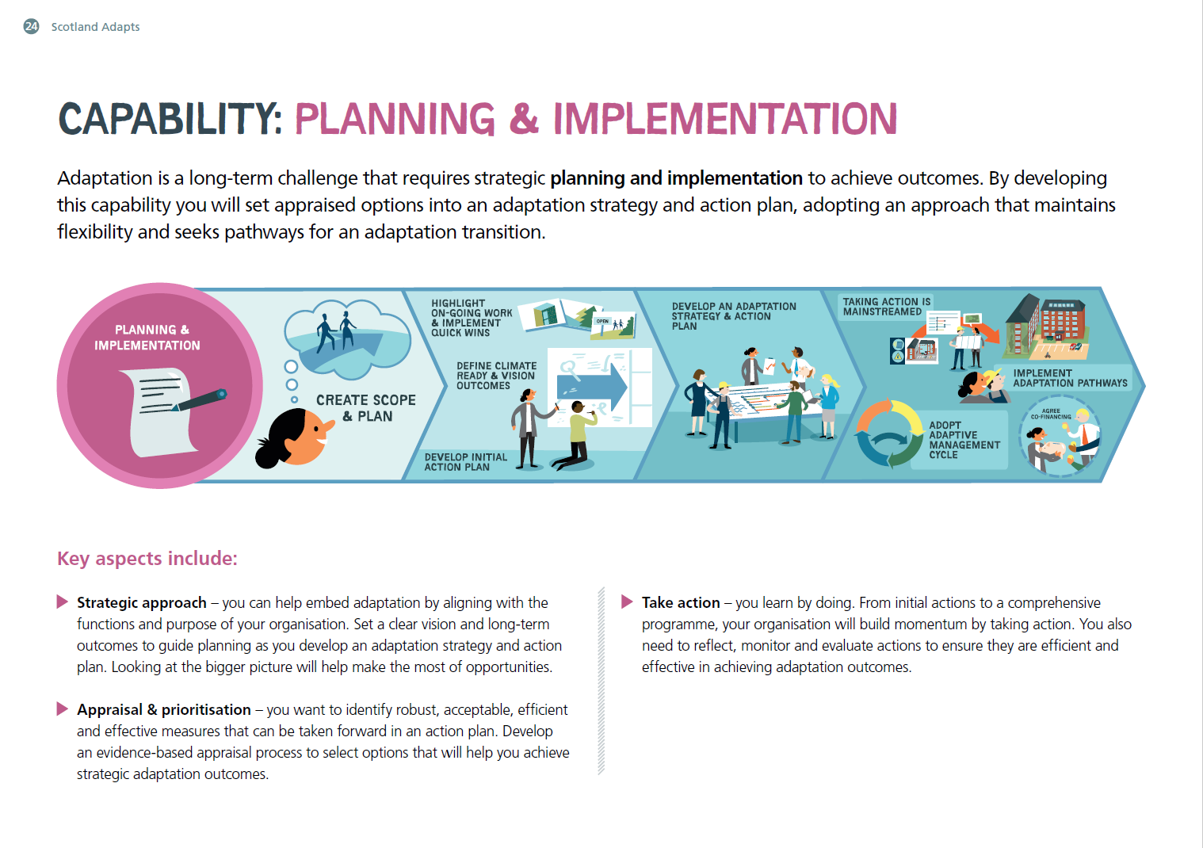


Strategic approach – you can help embed adaptation by aligning with the functions and purpose of your organisation. Set a clear vision and long-term outcomes to guide planning as you develop an adaptation strategy and action plan. Looking at the bigger picture will help make the most of opportunities.
Appraisal & prioritisation – you want to identify robust, acceptable, efficient and effective measures that can be taken forward in an action plan. Develop an evidence-based appraisal process to select options that will help you achieve strategic adaptation outcomes.
Take action – you learn by doing. From initial actions to a comprehensive programme, your organisation will build momentum by taking action. You also need to reflect, monitor and evaluate actions to ensure they are efficient and effective in achieving adaptation outcomes.

Slide 24
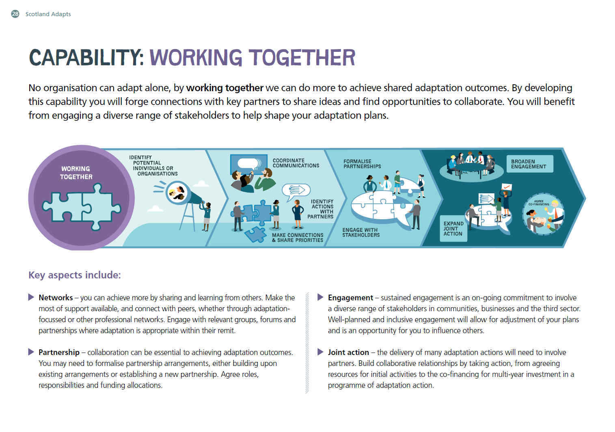


Networks – you can achieve more by sharing and learning from others. Make the most of support available, and connect with peers, whether through adaptation- focussed or other professional networks. Engage with relevant groups, forums and partnerships where adaptation is appropriate within their remit.
Partnership – collaboration can be essential to achieving adaptation outcomes. You may need to formalise partnership arrangements, either building upon existing arrangements or establishing a new partnership. Agree roles, responsibilities and funding allocations.
Engagement – sustained engagement is an on-going commitment to involve a diverse range of stakeholders in communities, businesses and the third sector. Well-planned and inclusive engagement will allow for adjustment of your plans and is an opportunity for you to influence others.
Joint action – the delivery of many adaptation actions will need to involve partners. Build collaborative relationships by taking action, from agreeing resources for initial activities to the co-financing for multi-year investment in a programme of adaptation action.

Slide 25
How can local authorities adapt to climate change?

Slide 26

Examples – Aberdeen City Council
Full strategic climate risk assessment complete
Council Climate Change Plan
City wide plan – Aberdeen Adapts
Integrated across policy:
The Community Planning Aberdeen, Local Outcome Improvement Plan (LOIP) 2016 – 26 includes the stretch outcome for adaptation.
Embedded in Aberdeen City Council Business Case template to ensure climate change is considered in new projects and proposals.
Building Performance Policy checklist includes conducting a climate risk assessment.

Slide 27

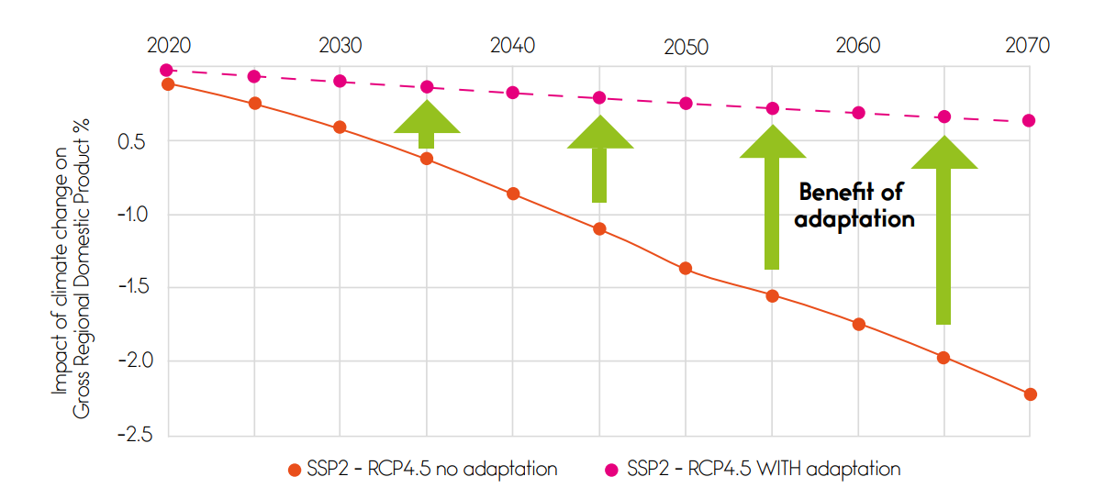
Example –Glasgow Green Deal

Slide 28
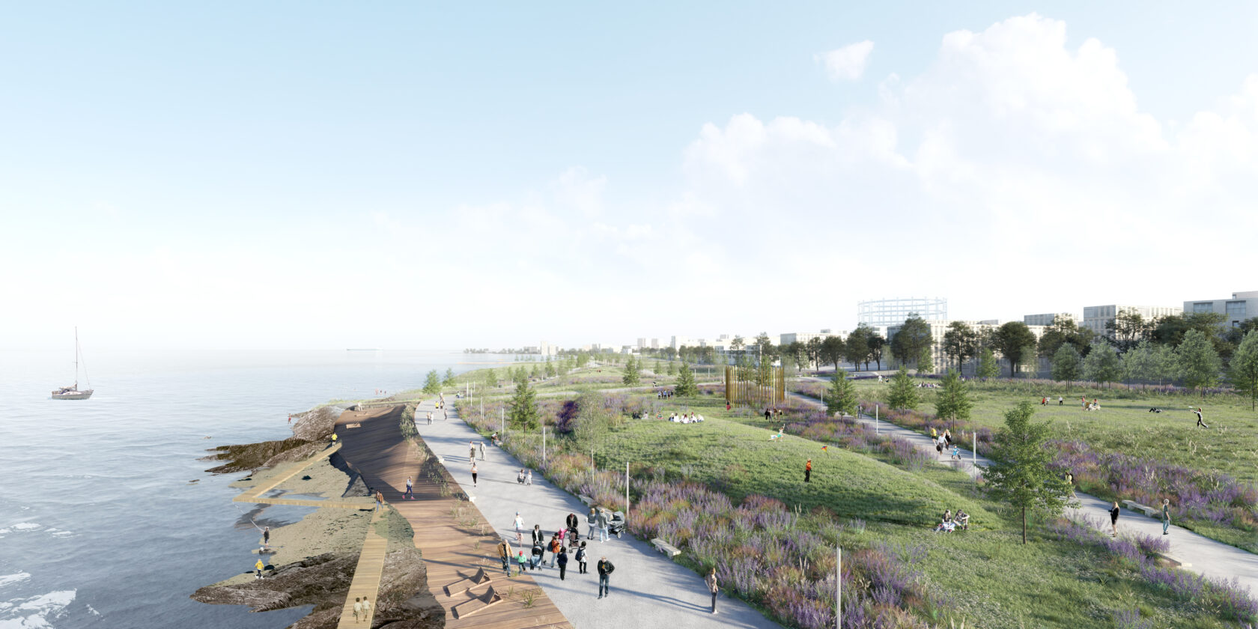
Example – Edinburgh Granton regeneration
‘Delivering Europe’s largest coastal park through creating new and enhanced green spaces’

Slide 29
Questions?

