Slide 1
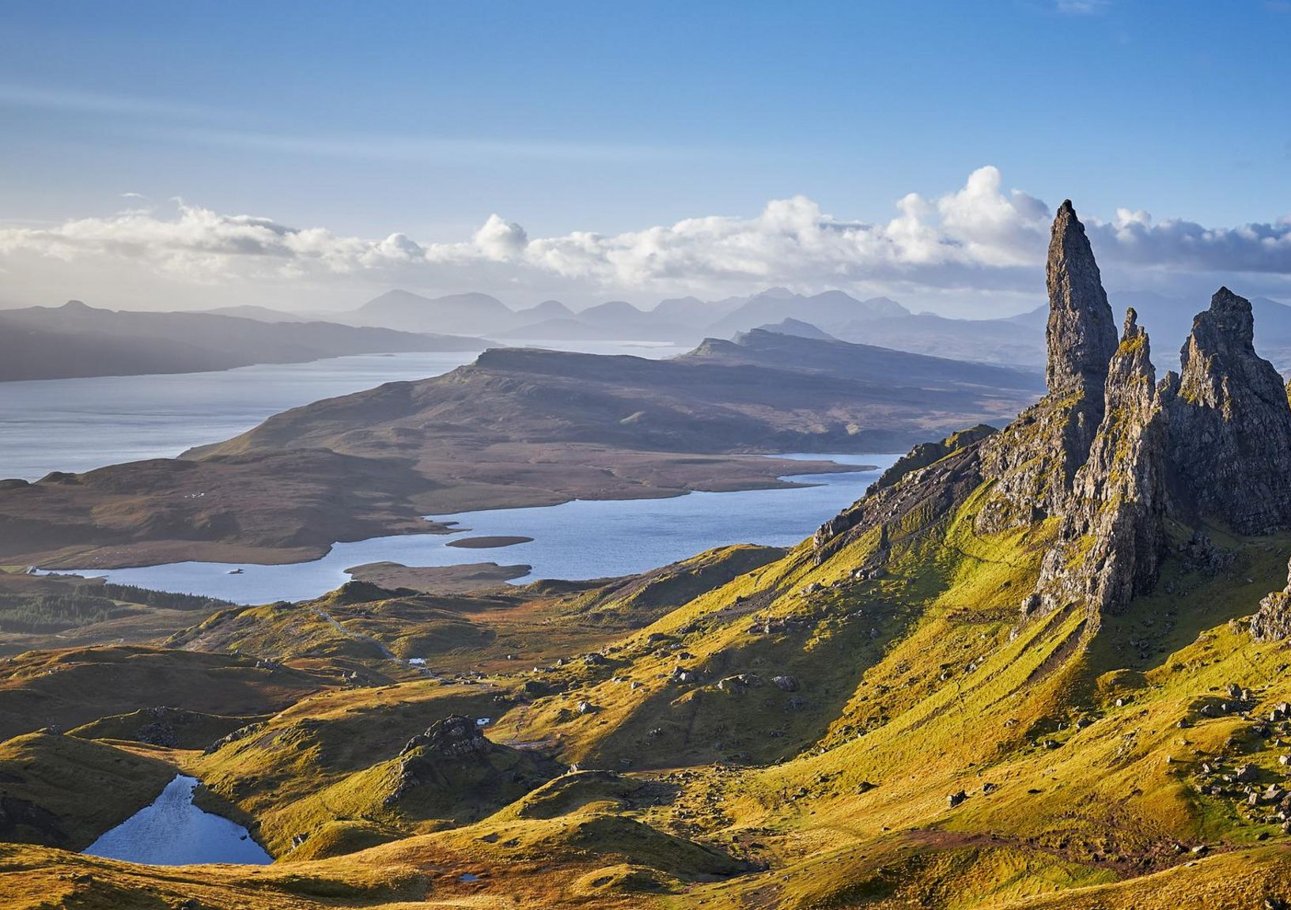

Slide 2
1. Introduction to Highland Adapts and how we work 2. Place-based approach 3. Climate Risk and Opportunity Assessment

Slide 3
The purpose of the Highland Adapts initiative is to bring our communities, businesses, land managers and public sector together to facilitate transformational action towards a prosperous, climate-ready Highland.

Slide 4
Highland Adapts Founding Partners

Slide 5
Guiding Principles
Transformational Action – through brave leadership, we embed hope and prioritise action.
Collaboration – we facilitate working together and the sharing of knowledge, expertise and resources.
Place-based – we are place-centred, with an approach that is bottom-up and fully inclusive.
Evidence-based – all our action is supported by up to date qualitative and quantitative data.
Sustainable – we only endorse robust, resilient and future-proof actions using the blueprint of the UN Sustainable Development Goals to achieve a flourishing, climate-ready future for all.
Influence – we use our presence and connections to support cultural change
Climate and social justice – our work is rooted in a deep understanding of the needs and priorities of communities.
Build capacity – through education, knowledge sharing and facilitating connections we increase confidence and the ability to adapt in others
Celebrate – we communicate and promote ongoing inspiring climate action and initiatives.
Empower – we enable communities/places to increase control over their ability to adapt to and mitigate climate change.

Slide 6
Partnership Objectives
Develop a strong knowledge and evidence base, setting out the climate risks and opportunities that will affect the region
Facilitate information sharing through a range of resources
Identify opportunities to reduce and overcome these climate risks
Develop a shared adaptation strategy and suite of action plans
Support others to use plans to form the basis of projects and activities across the public sector, community, land management and business sector plans, strategies and investments
Support the public sector to embed climate change adaptation throughout their business
Support community climate change action.

Slide 7
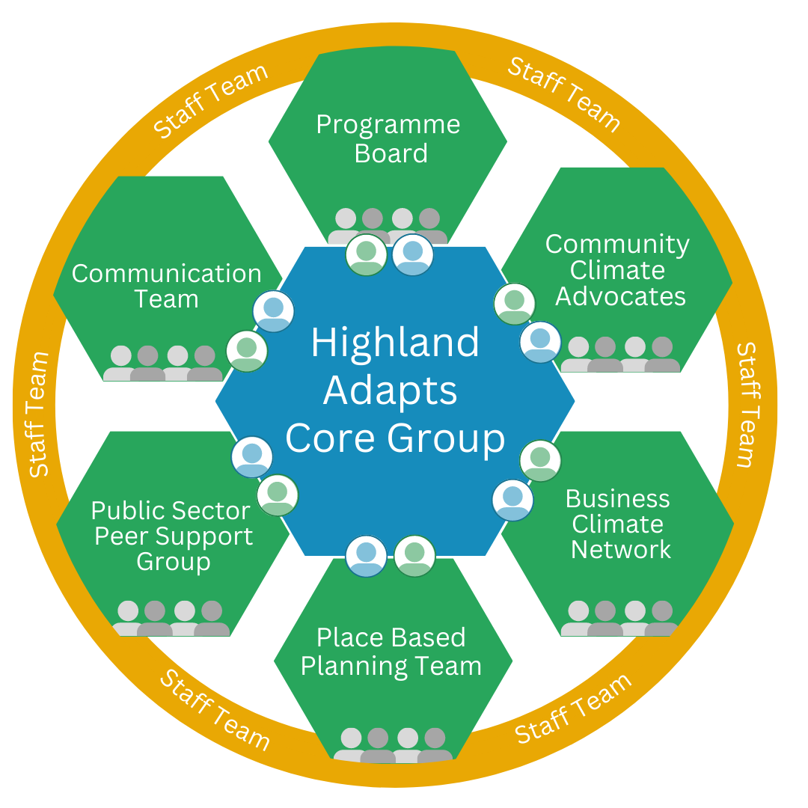
Brave, collaborative, transformational action…
…towards a climate-ready Highland

Slide 8
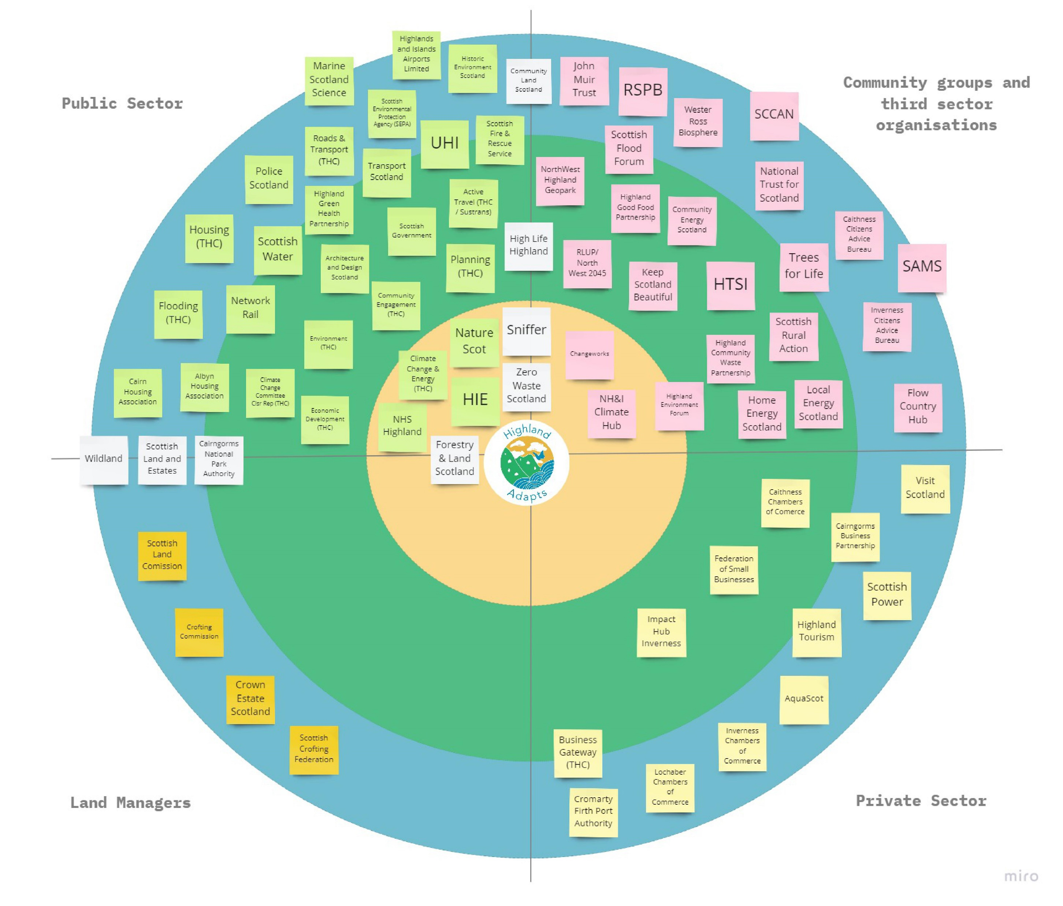

Slide 9
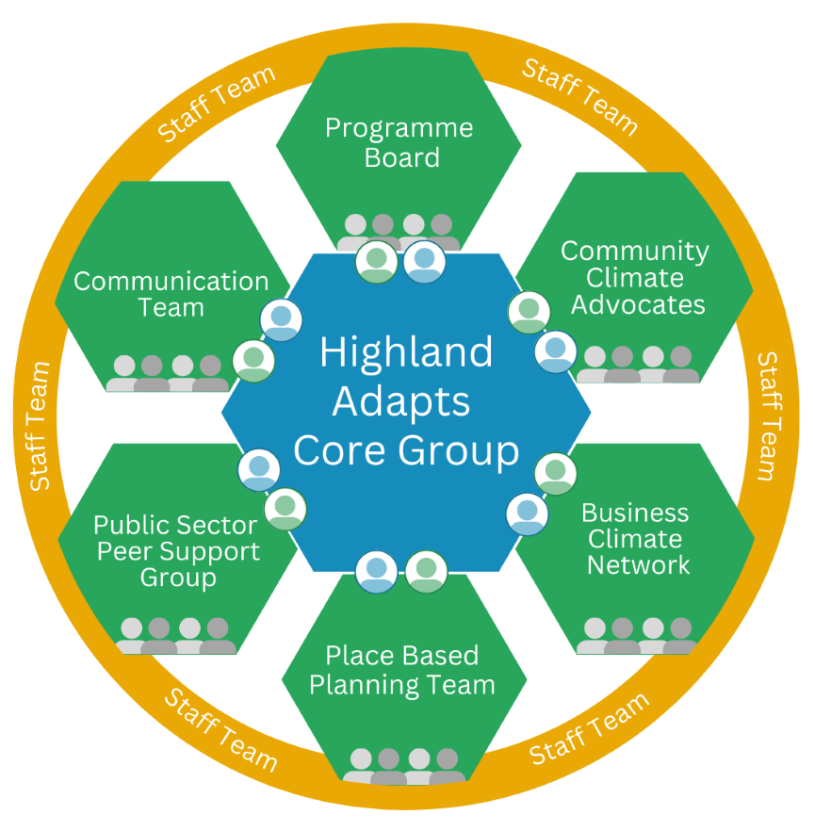
Place Based Planning Team
Notes:
Meet up monthly for community of practitioners, link up what everyone else is doing

Slide 10
Notes:
Hybrid approach, working closely with partners, green health partners, highland youth parliament

Slide 11
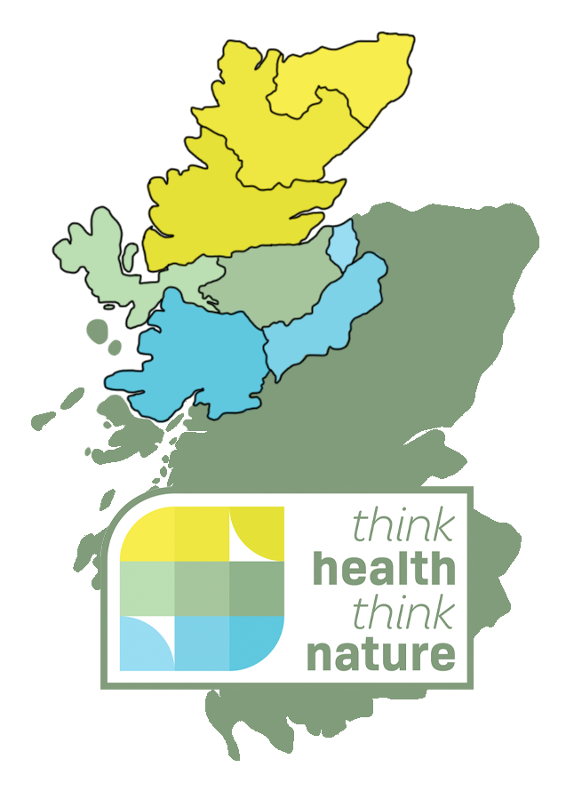
Notes:
Hybrid approach, working closely with partners, green health partners, highland youth parliament

Slide 13
