Slide 1
Highland Climate Risk and Opportunity Assessment

Slide 2
Partnership Objectives
Develop a strong knowledge and evidence base, setting out the climate risks and opportunities that will affect the region
Facilitate information sharing through a range of resources
Identify opportunities to reduce and overcome these climate risks
Develop a shared adaptation strategy and suite of action plans
Support others to use plans to form the basis of projects and activities across the public sector, community, land management and business sector plans, strategies and investments
Support the public sector to embed climate change adaptation throughout their business
Support community climate change action.

Slide 3
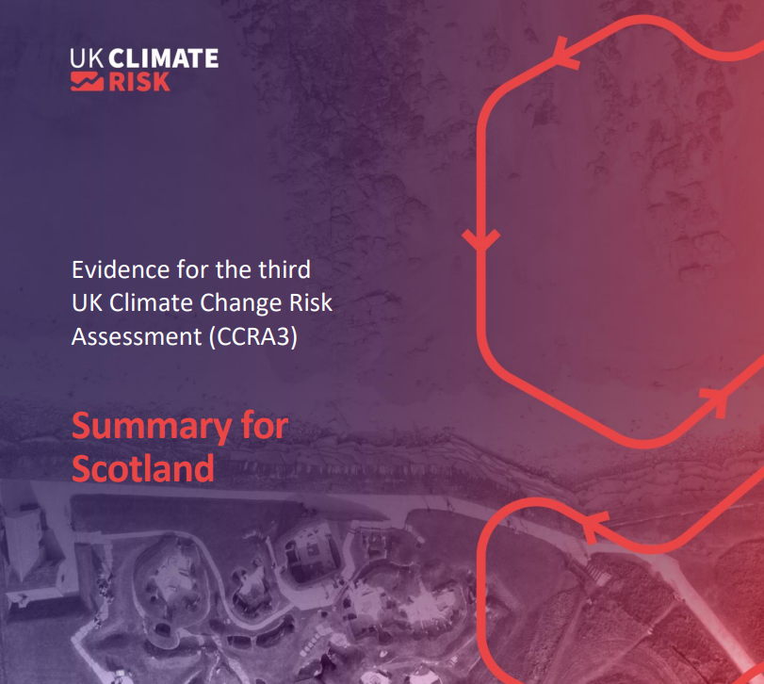

Slide 4
Data provided by agencies and public bodies
Highland
Climate Risk & Opportunity
Assessment Methodology
Targeted Engagement with 3rd Sector
Coastal Change Assessment
Climate Interest Groups, - Climate Hub etc,
OpenCLIM
UK Climate Change Risk Assessment
Feedback from partner led community involvement, e.g. CAT or RLUP
Engagement with land managers and businesses
Stage 1 – Gather
Formal data and evidence sources
Stage 1 – Gather
Evidence & stories of lived experience
People with experience of formal data & evidence & lived experience are involved throughout this process
Emphasis on using published evidence – adding new regional elements where needed
Stage 2 – Identify
Cross sector risks & opportunities
Prioritise bringing in lived experience from across the region – involving people, capturing local stories, building awareness & capacity to respond
Stage 3 – Assess
Economic risks & opportunities
Stage 3 – Assess
Climate Risks & Opportunities
Stage 4 – Publish

Slide 5
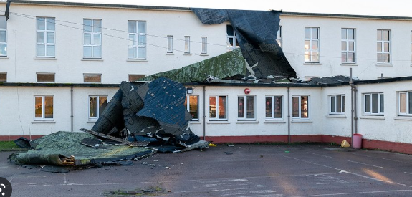
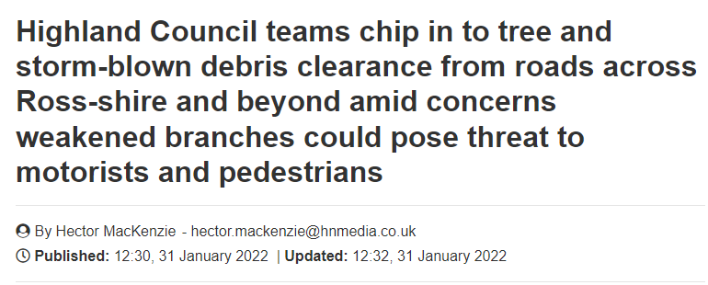
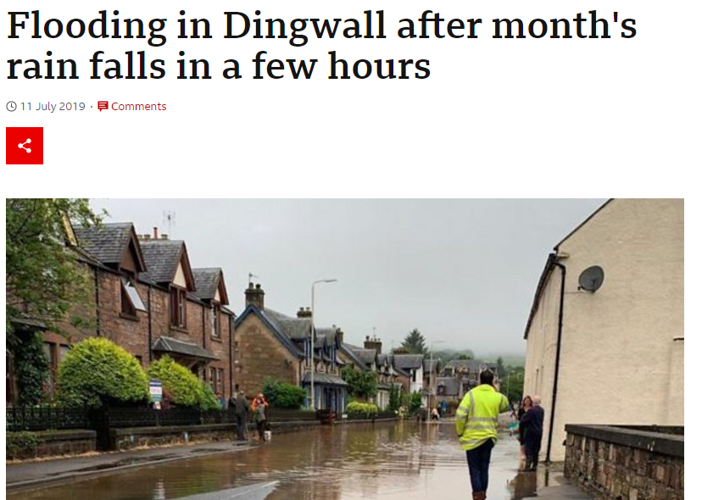
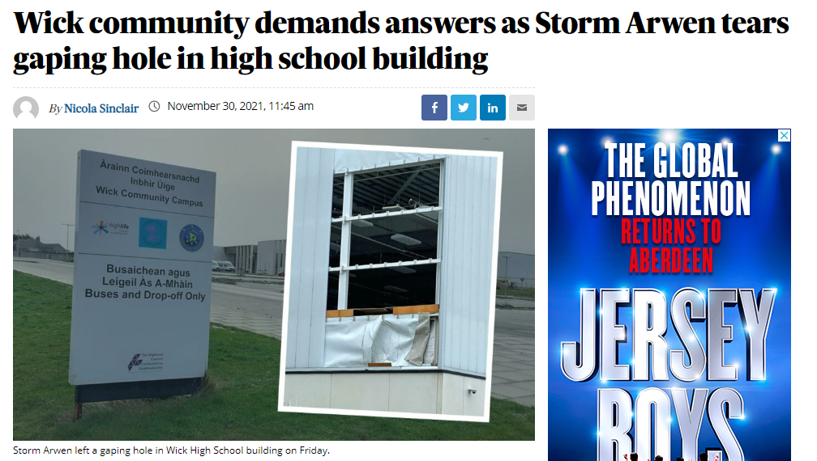
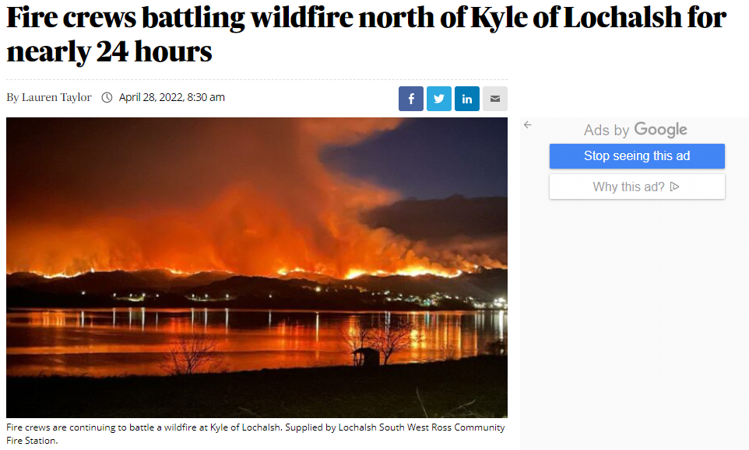
How has the Council been impacted?
Dalneigh Primary School roof dislodged during high winds – December 2021
Drumnadrochit recording -10.4C - January 2023

Slide 6
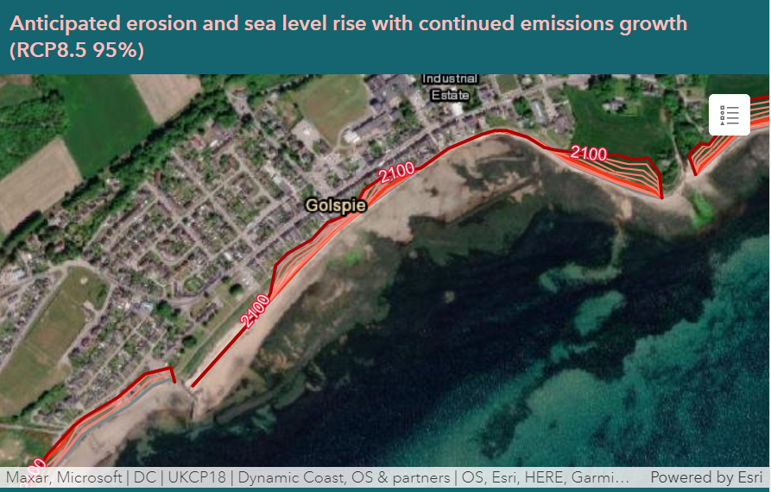
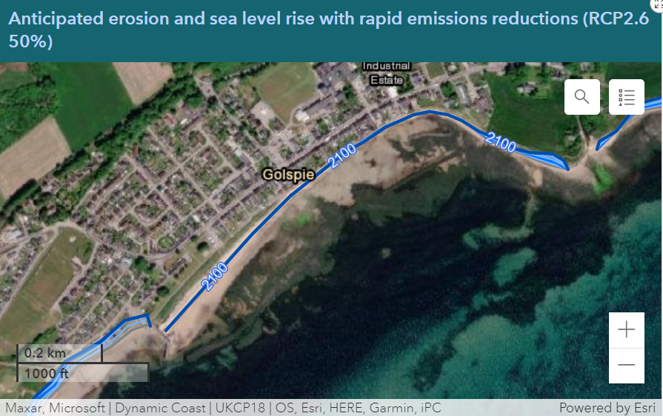

Slide 7
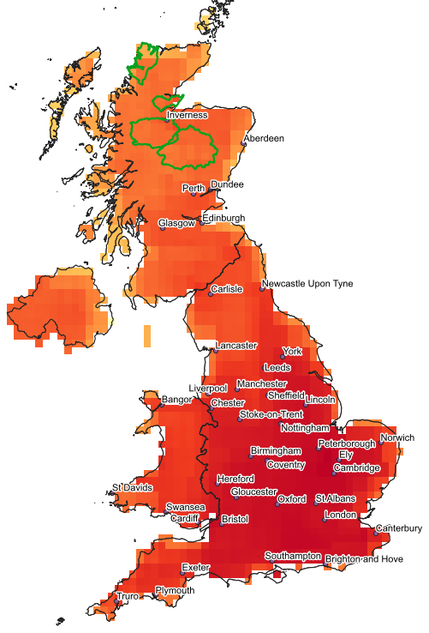
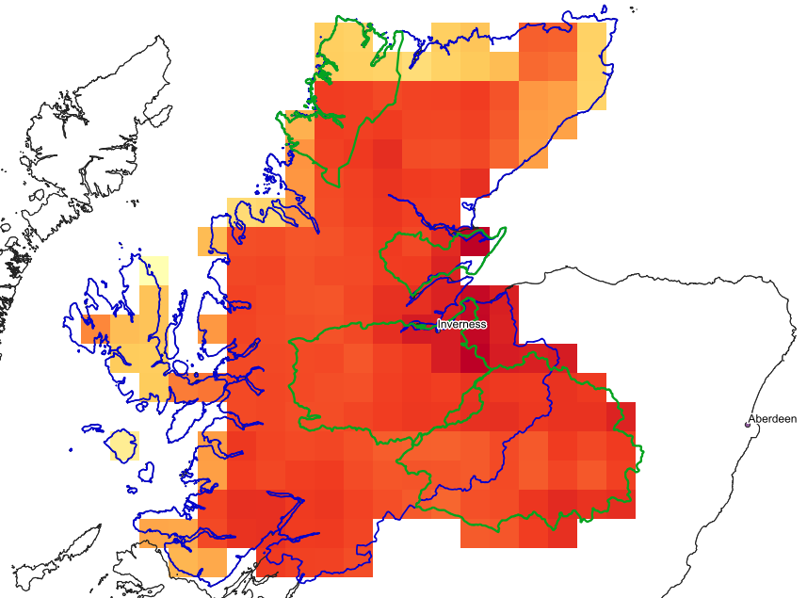
GIS visualisation (work in progress)
Tmax95 anomaly at 2C warming
Summary stats
Min
Max
Mean
Range
Standard deviation
*Preliminary data shown
Notes:
Tmax95 = the mean maximum temperature on days exceeding 95th percentile of summer T_{max}

Slide 8
Urban Flooding using CityCat
2020
2080
2020 - 2080
2020
2080
2020 - 2080

Slide 9
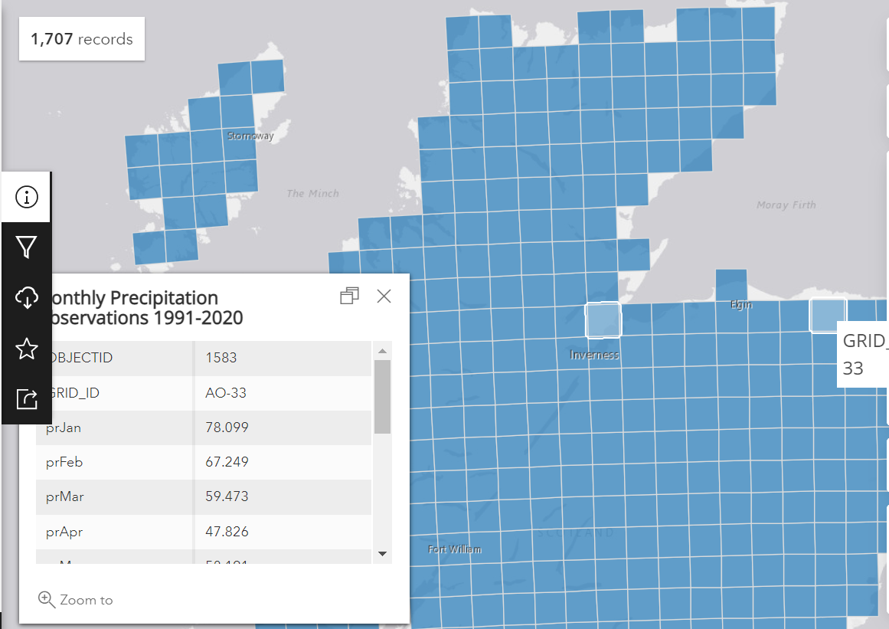
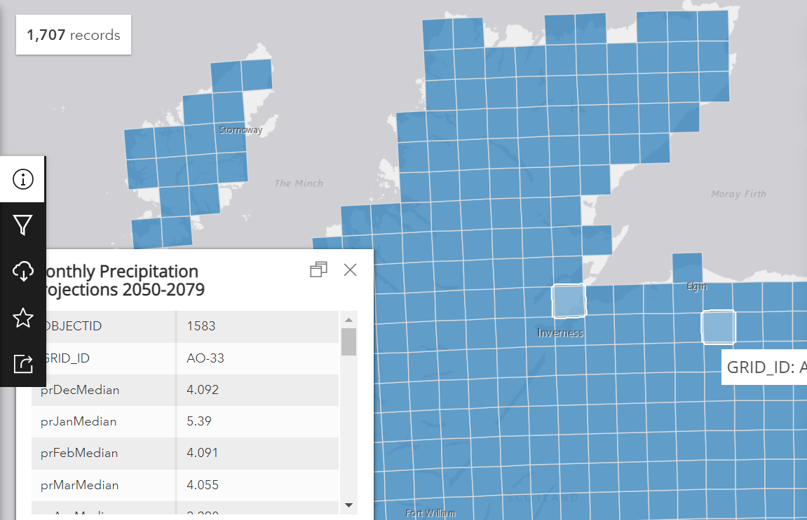
Met Office Data

Slide 10
Questions?

Slide 11
Data provided by agencies and public bodies
Highland
Climate Risk & Opportunity
Assessment Methodology
Targeted Engagement with 3rd Sector
Coastal Change Assessment
Climate Interest Groups, - Climate Hub etc.
OpenCLIM
UK Climate Change Risk Assessment
Feedback from partner led community involvement, e.g. CAT or RLUP
Engagement with land managers and businesses
Stage 1 – Gather
Formal data and evidence sources
Stage 1 – Gather
Evidence & stories of lived experience
People with experience of formal data & evidence & lived experience are involved throughout this process
Emphasis on using published evidence – adding new regional elements where needed
Stage 2 – Identify
Cross sector risks & opportunities
Prioritise bringing in lived experience from across the region – involving people, capturing local stories, building awareness & capacity to respond
Stage 3 – Assess
Economic risks & opportunities
Stage 3 – Assess
Climate Risks & Opportunities
Stage 4 – Publish

Slide 13
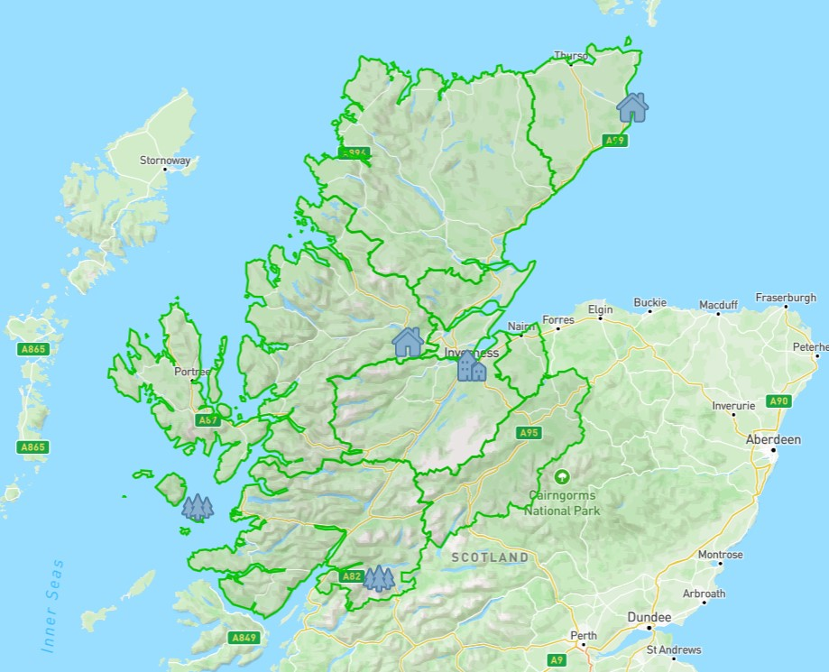
Notes:
We have decided to use commonplace as a tool for us with our partners local stories

Slide 14
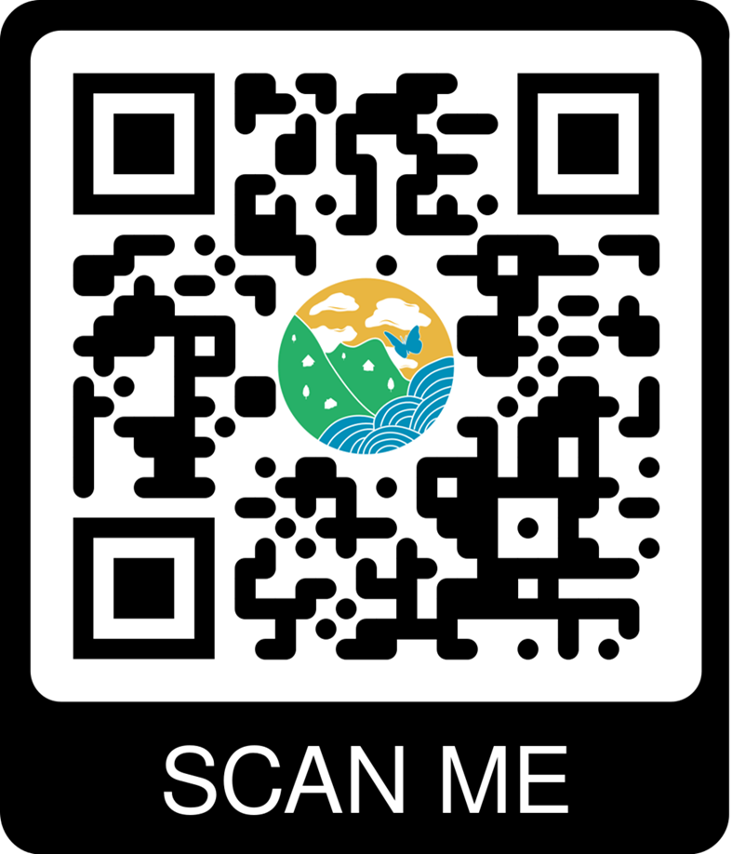
https://highlandadapts.commonplace.is

Slide 15
Risk Assessment Roadmap
Call For Evidence
Lived Experience
Identify Risk & Opportunities
Launched November 2022.
Work with partners and key stakeholders January to August 2023
Spring 2023
Plan for phase 2 of RA
Publish
Assess Risks & Opportunities
From phase 1 conclusions identify priority areas for further assessment
November 2023 – phase 1 of RA – regional wide event .
Summer/autumn 2023

Slide 16
Final Reflections - Adaptation is an iterative journey - Adaptation needs to be imbedded in everything we do - Adaptation = Business continuity

Slide 17
Thank you

