Slide 1
Alan Fraser

Slide 2
Who are we?
Principal Engineer – Alan Fraser
Senior Engineer – Susan Veitch
Engineer – Duncan Sharp
Senior Technician – Richard Bryan
Technician (x2) – Michelle Lawrie & Blair Duncan
Watercourse Inspector – Michael Sinclair
Senior Technical Assistant – Alison Fernie

Slide 3
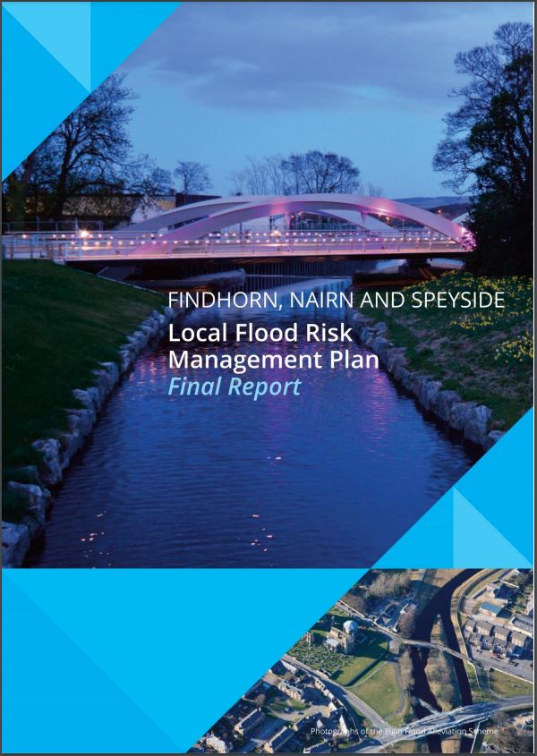
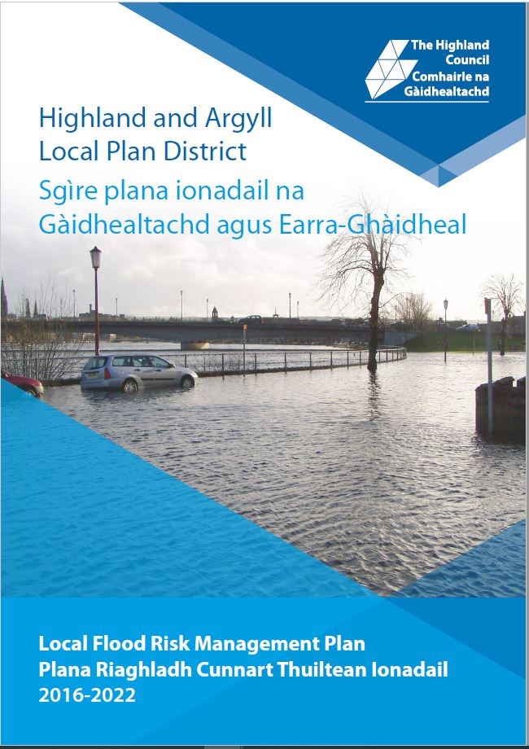
What do we do?
Flood Risk Management (Scotland) Act 2009
Development of Local Flood Risk Management Plans

Slide 4
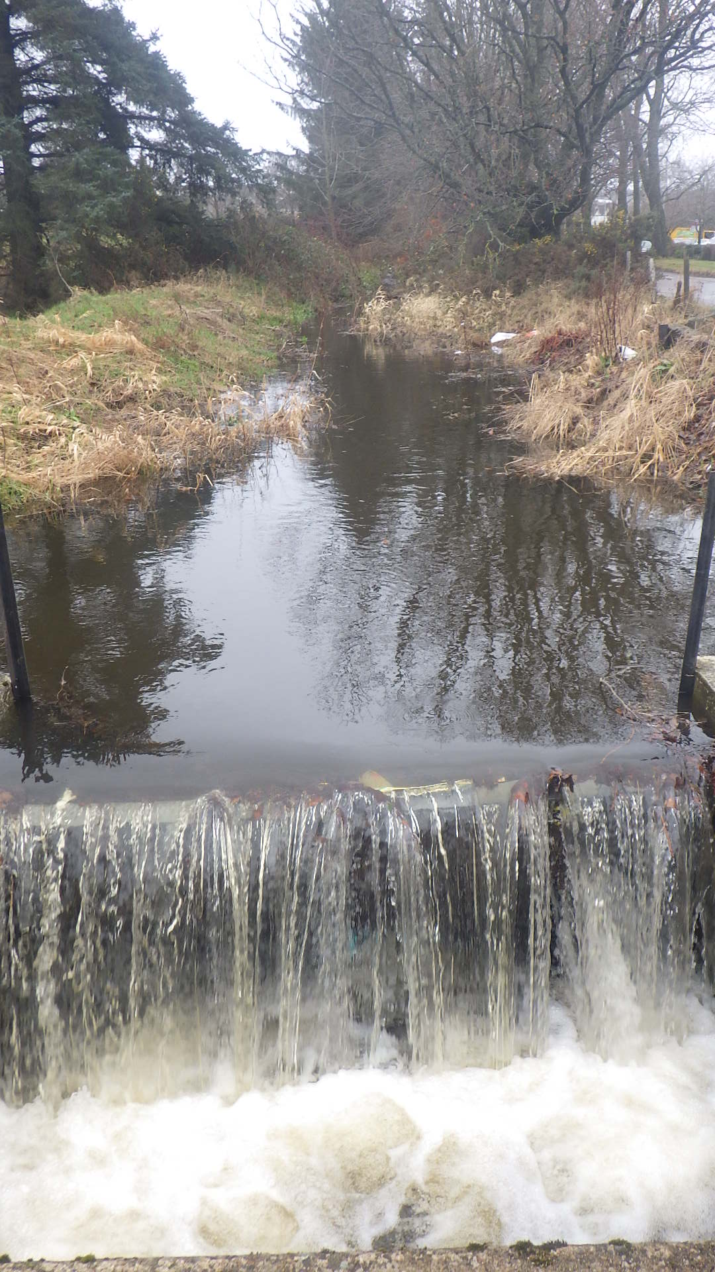
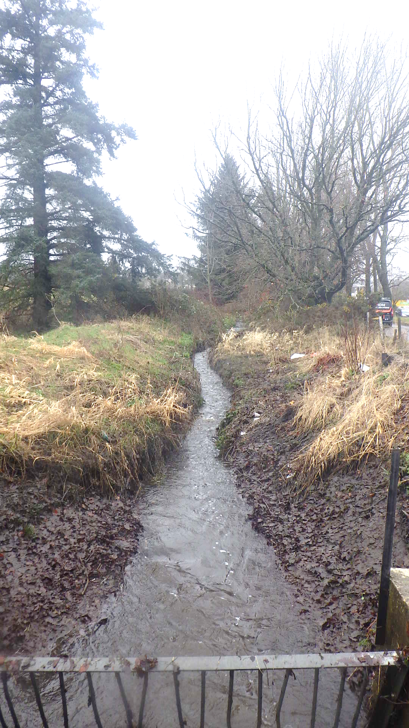
What do we do?
Assessment of Watercourses

Slide 5
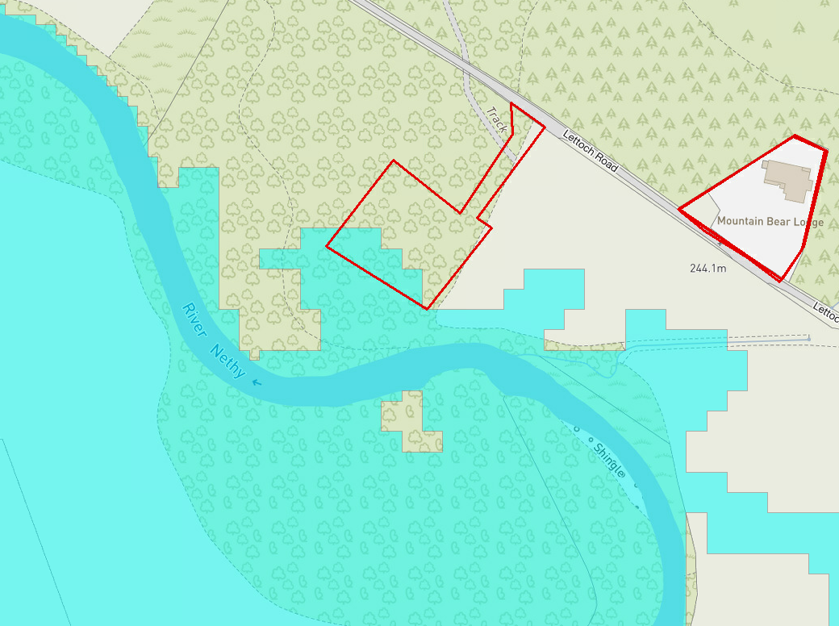
What do we do?
Planning Consultation

Slide 6
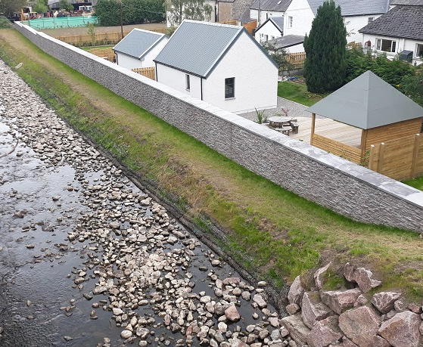
What do we do?
Flood Study and Scheme Development

Slide 7
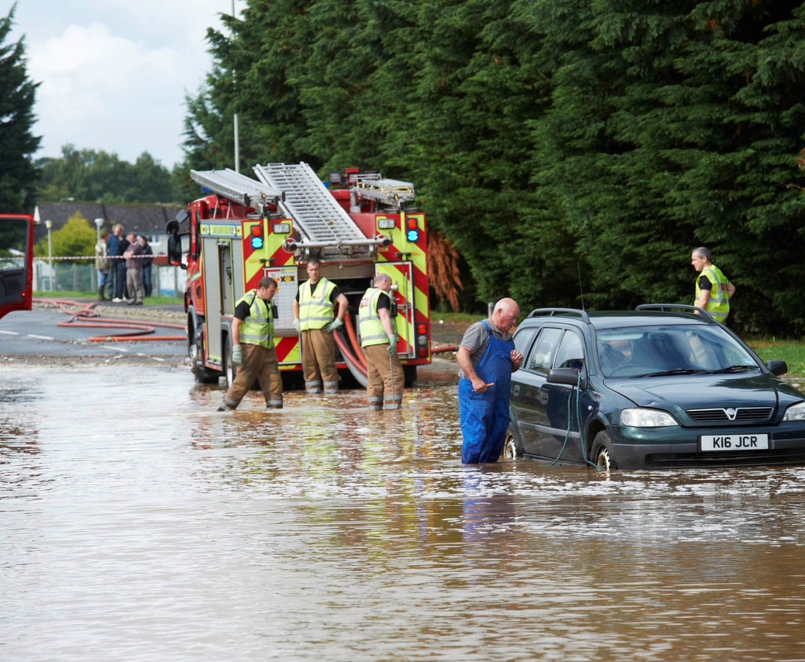
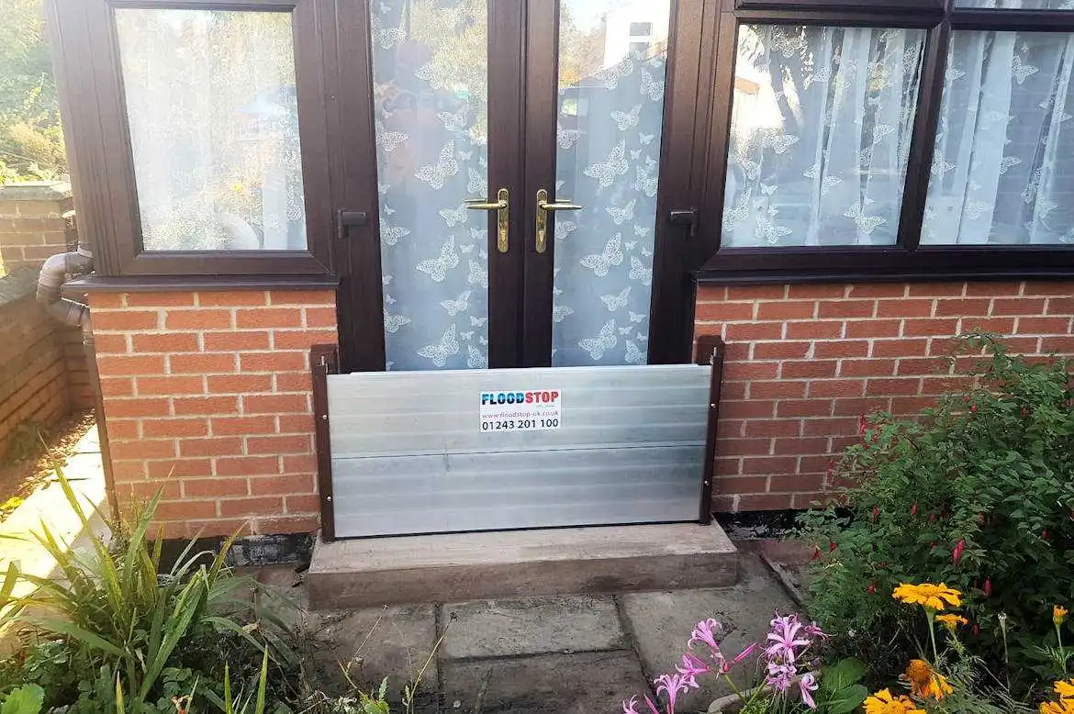
What don’t we do?
NOT an Emergency First Responder
NOT responsible for preventing flooding

Slide 8
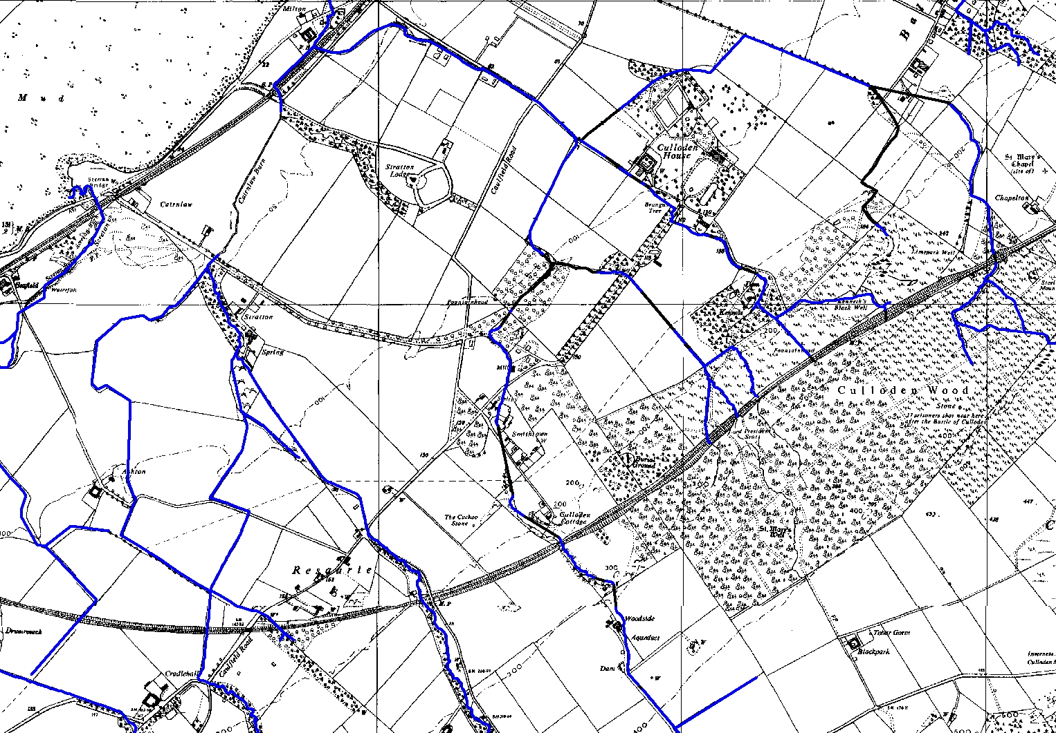
Why a Flood Scheme
Smithton and Culloden ~ 1960

Slide 9
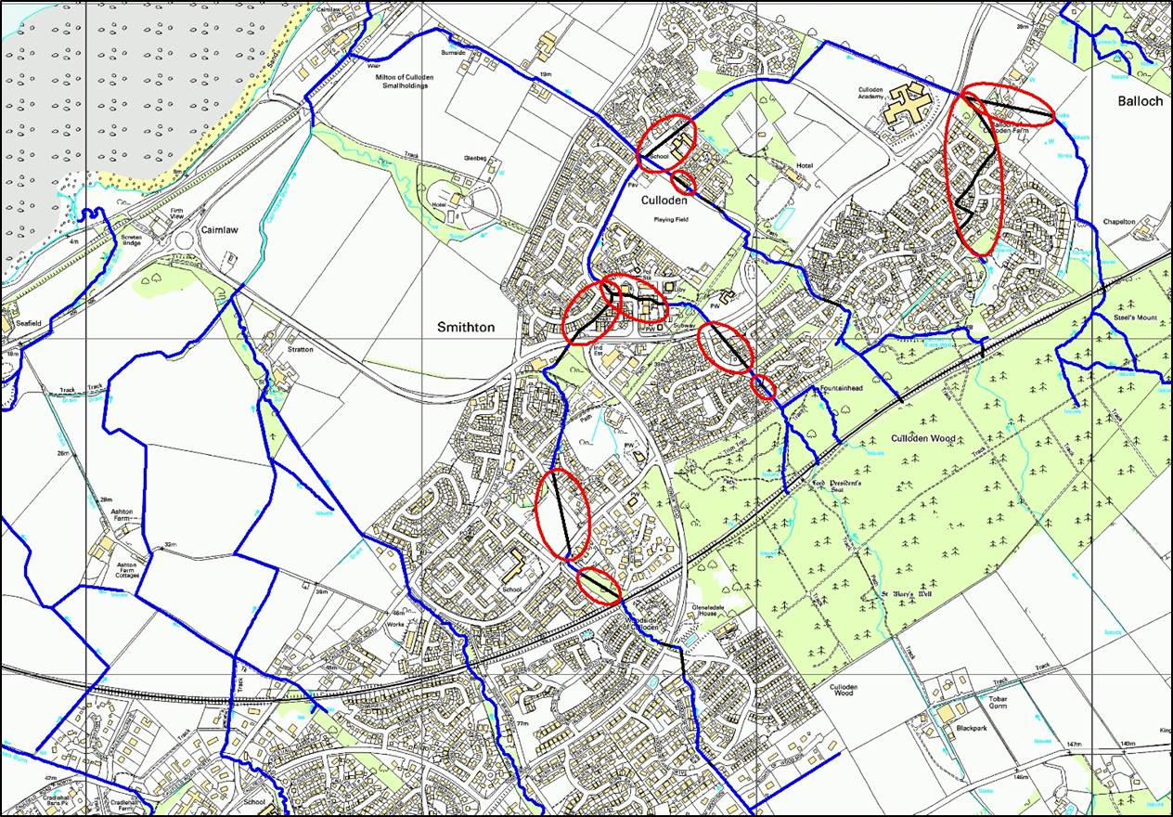
Why a Flood Scheme
Smithton and Culloden - Present

Slide 10
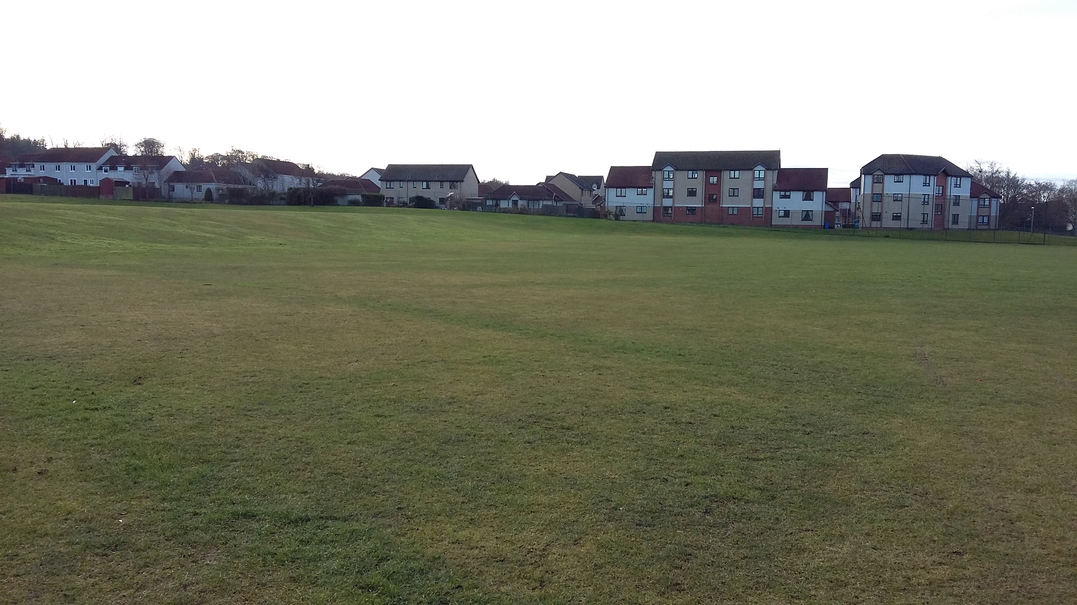
Culloden Burn West Culloden Park
Phase 4 –
Feb 2017

Slide 11
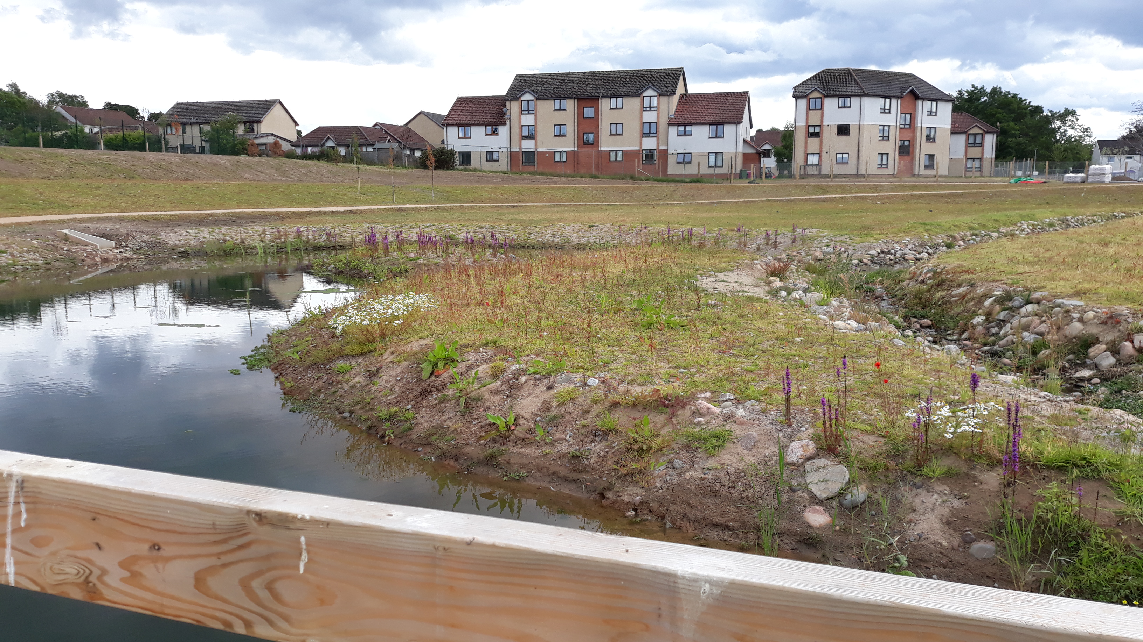
Culloden Burn West Culloden Park
Phase 4 –
July 2020

Slide 12
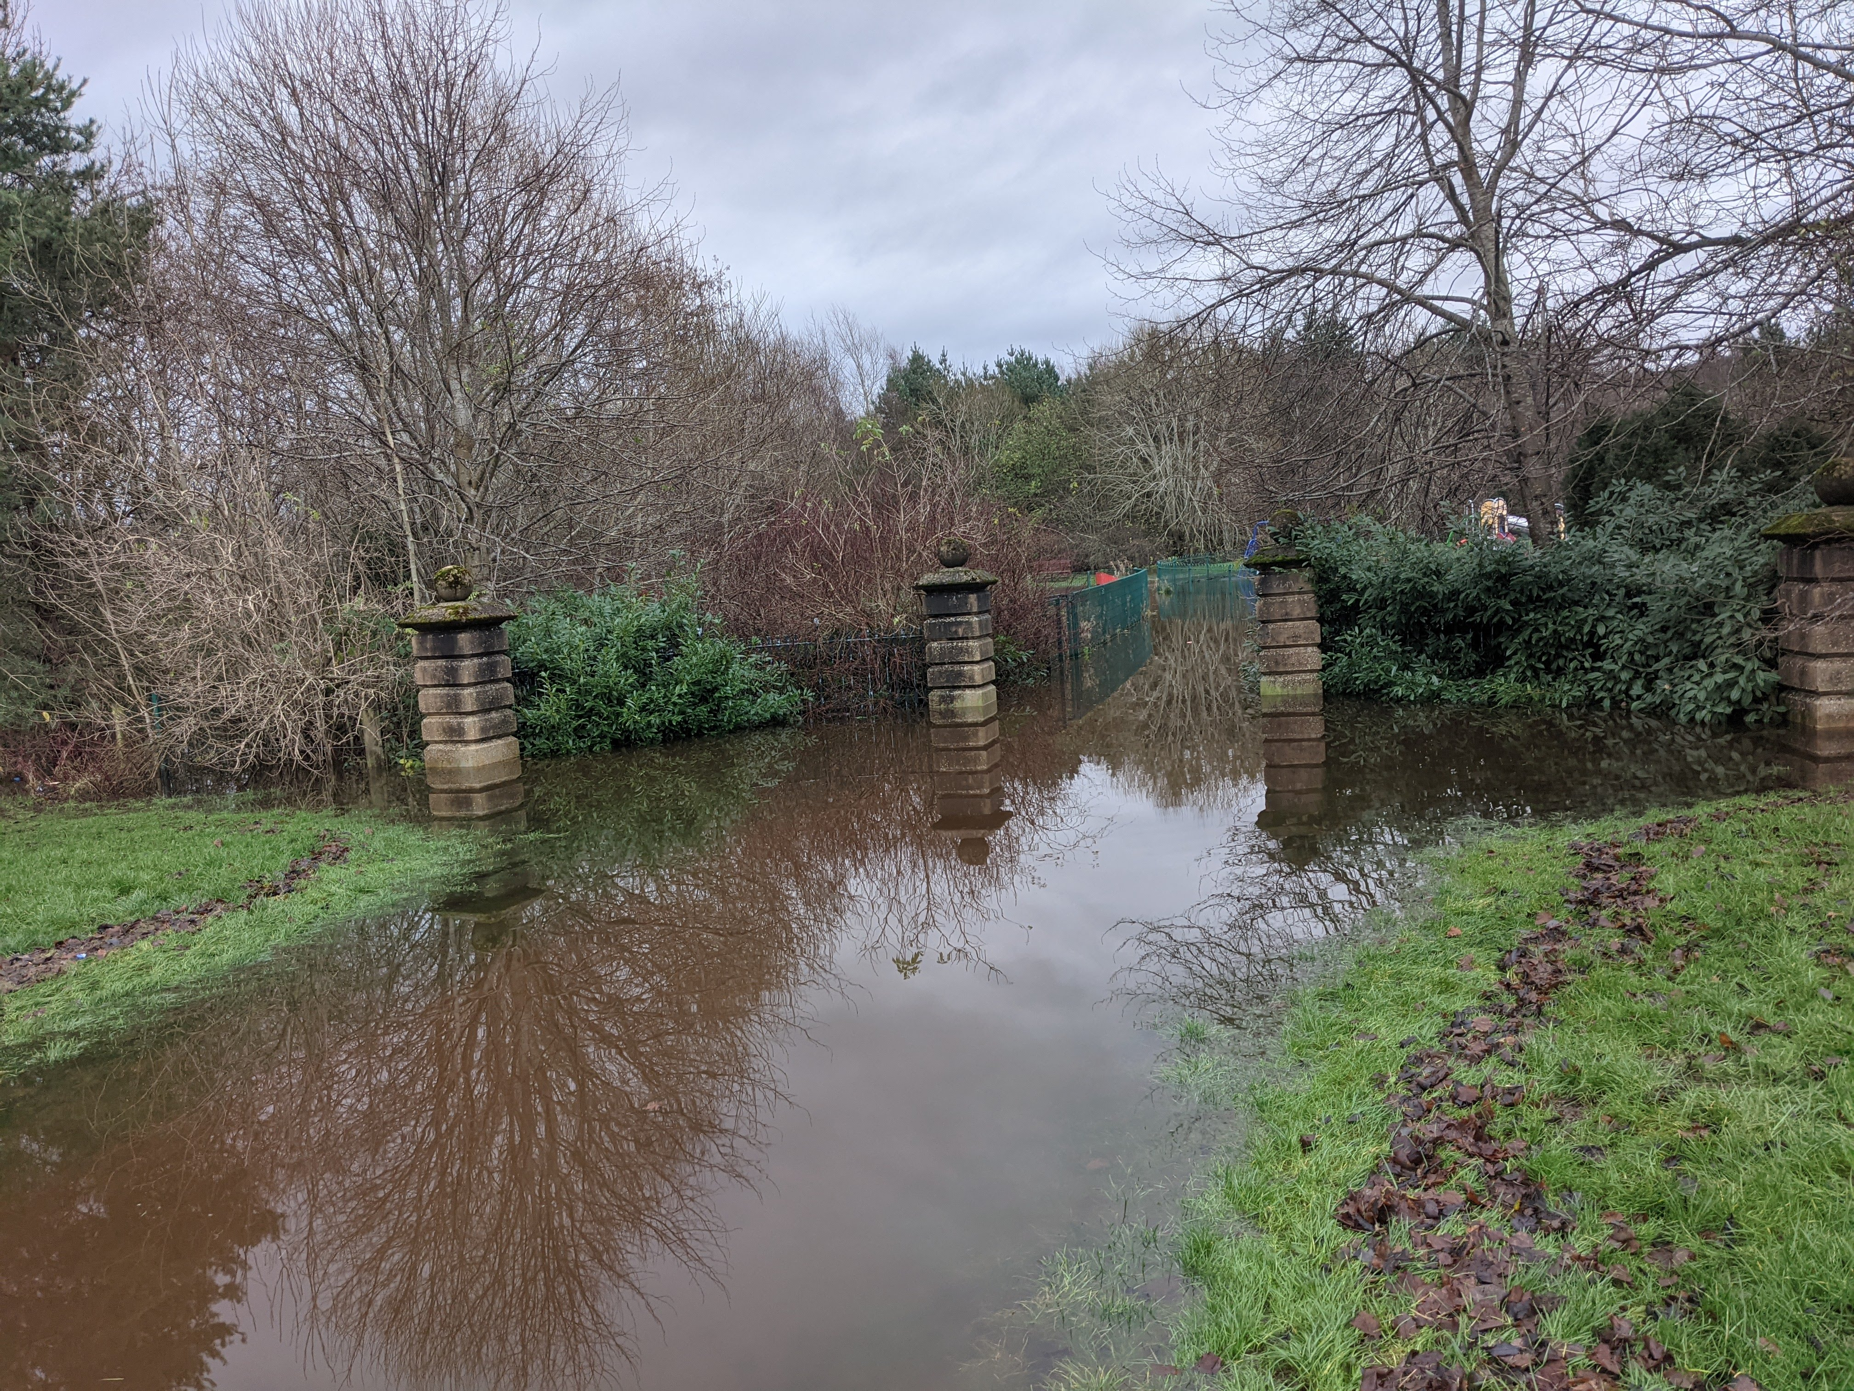
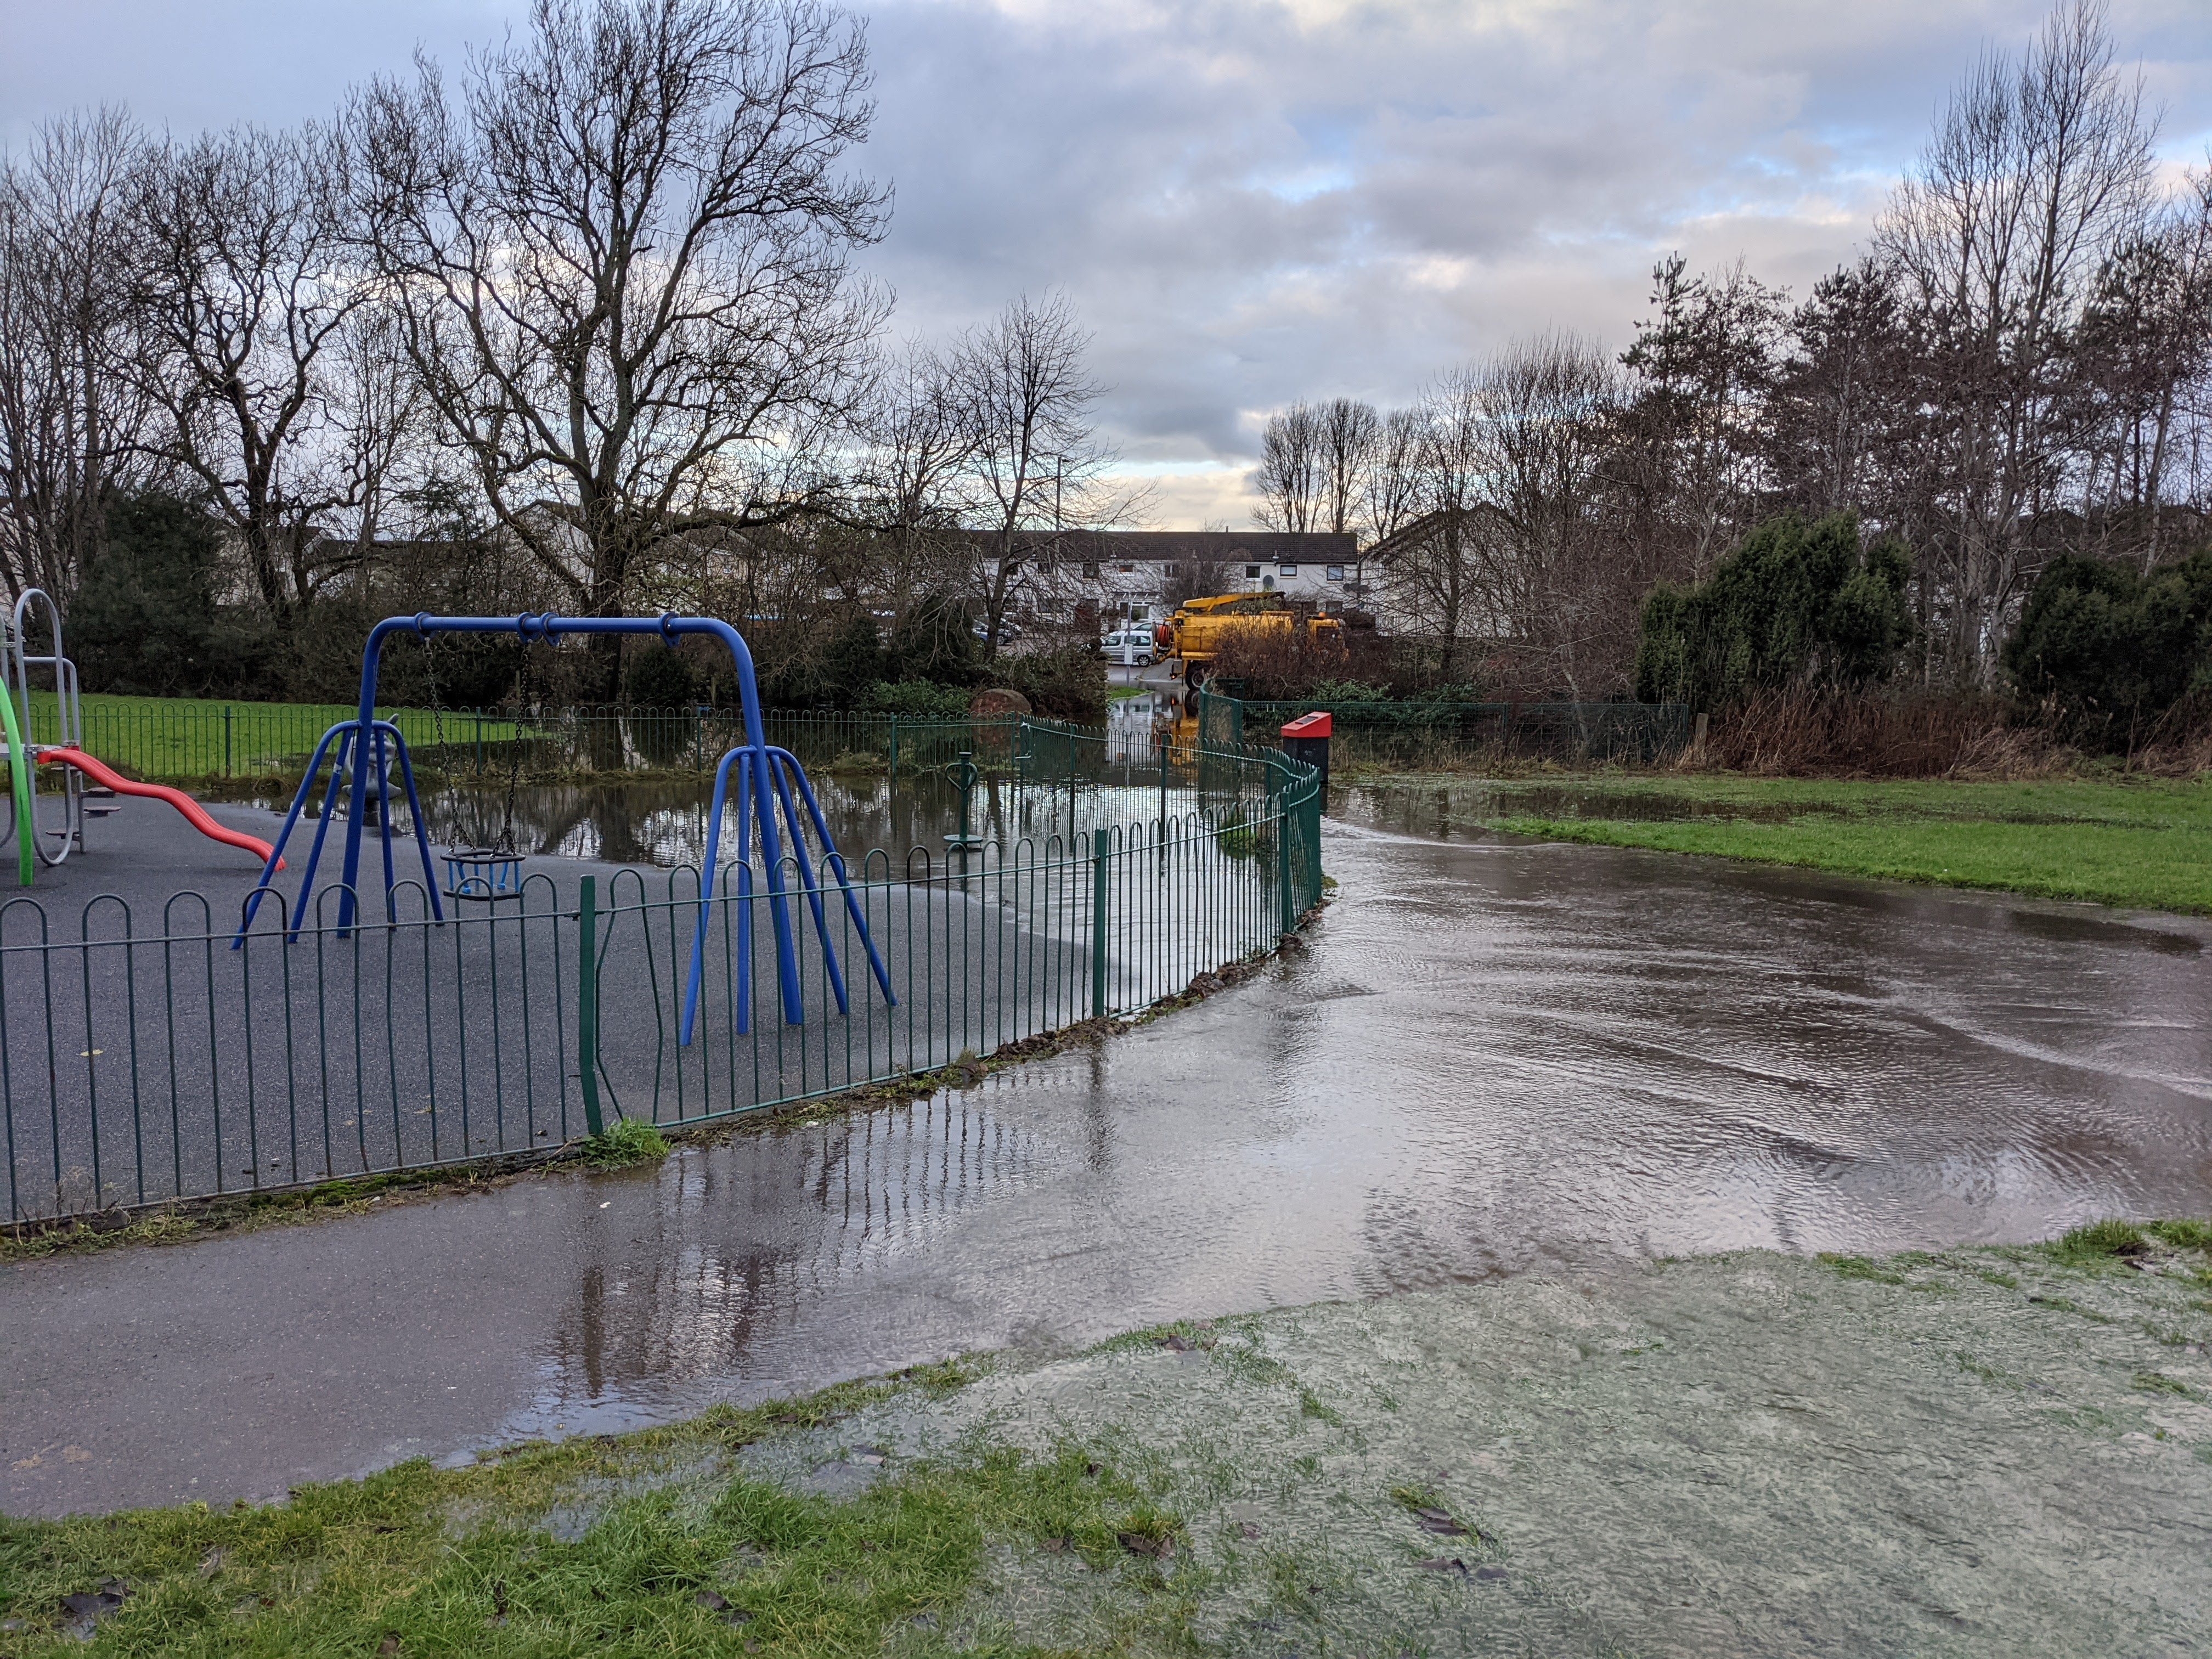
What more can we do?
Castle Heather Park?

