Slide 1
Joe Perry

Slide 2
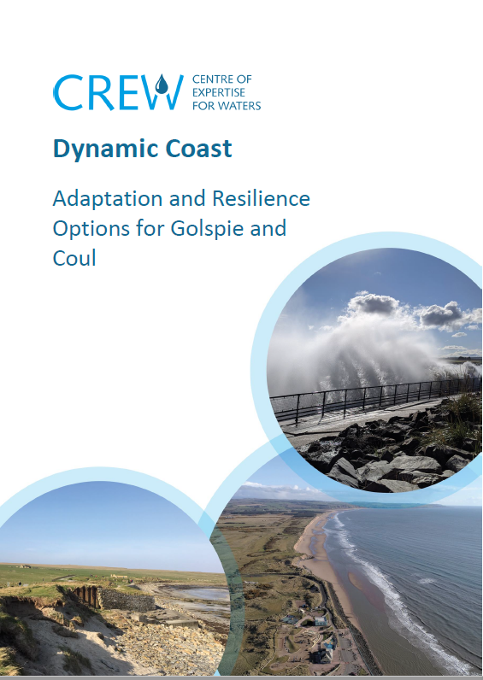
Coastal Erosion and Flooding
Highland has more erodible shore than any other Scottish LA
Extent and rate of erosion anticipated to increase under all emission scenarios
Our coast and its assets and communities need to be safeguarded by building resilience and adaptation planning

Slide 3
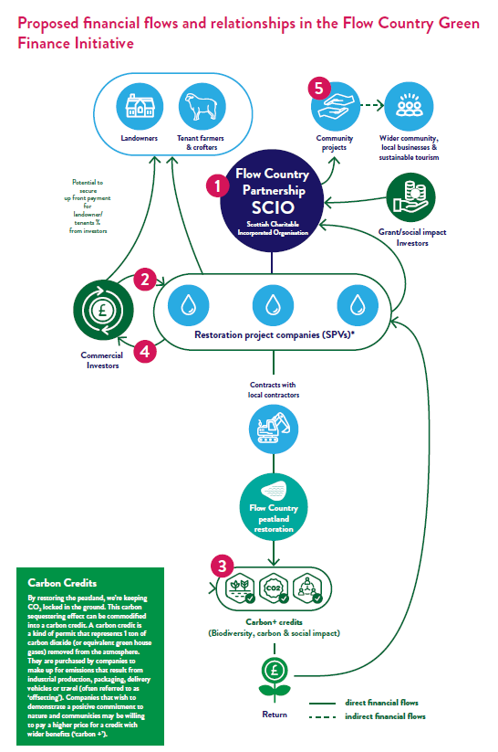
Nature Restoration
Nature restoration is an essential part of climate adaptation
Financing nature restoration will require unlocking public and private finance
Healthy habitats provide numerous ecosystem services, including protection from climate-related natural disasters

Slide 4
Managing Land for Nature
30x30 is the commitment to protect at least 30% of land and sea for nature by 2030
In Highland, the creation of LNCS can increase our contribution to this goal
Designations increase protection on land and improve habitat quality and connectivity

Slide 5
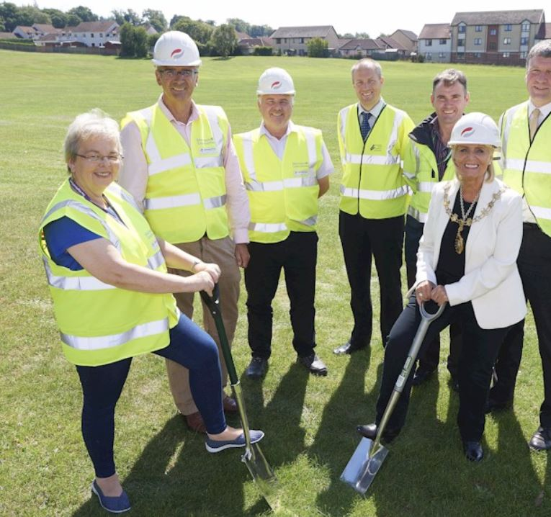
Nature-based Solutions (NBS)
NBS leverage nature and the power of healthy ecosystems to protect people, optimize infrastructure and safeguard a stable and biodiverse future. (IUCN)

Slide 6
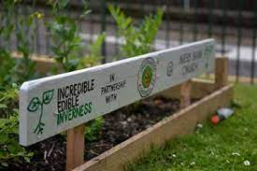
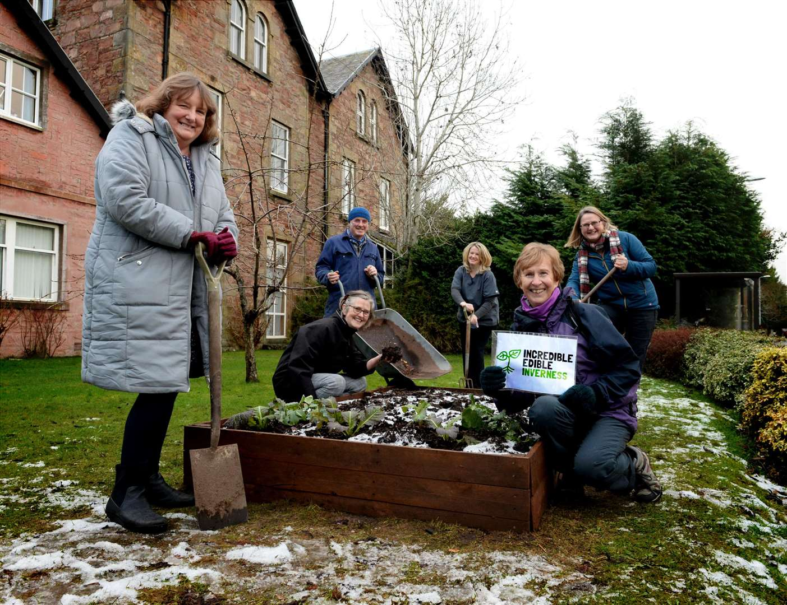
Community Food Growing
Climate change and biodiversity loss are major contributors to food insecurity in the UK
The types of food which can be grown in Highland will change with the changing climate
Community growing projects add resilience

Slide 7
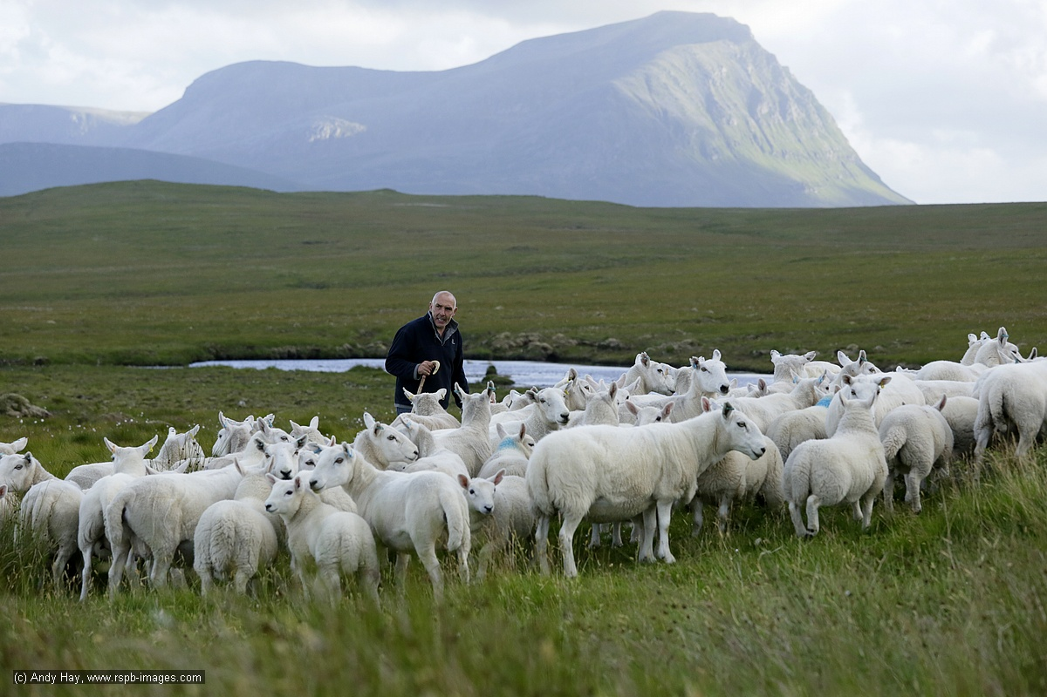
Ecological Strategy
By December 2023 The Highland Council will produce its first Ecological Strategy
This strategy will set out our ambition for a Highland with healthier and more connected natural spaces which benefit local communities and wildlife

