Slide 1
Responding to Emergencies
20th March 2023
Stephen Mardon

Slide 2
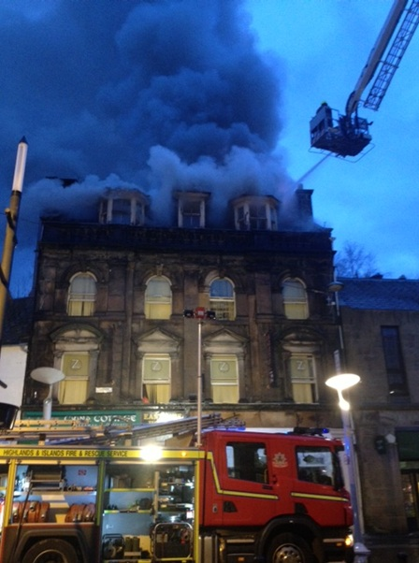
Introduction
Legal Framework
Civil Contingencies Act 2004
Duties and emergency planning structures
Emergency Response
Response and Recovery
Lead agencies
Care for People
Resilience Partnership activation
Response structure
Definition of an Emergency
Strategic Aims
THC Activation
THC key roles
Plans, Guidance & Information
Community Resilience
Case Studies

Slide 3
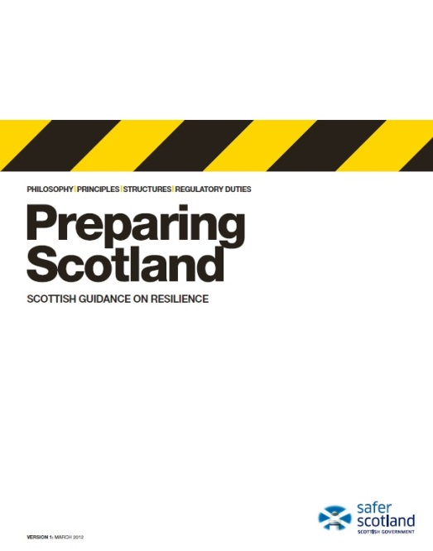
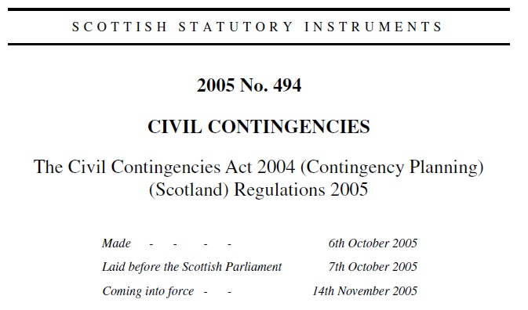
Legal Framework
Civil Contingencies Act 2004
Sets out how UK prepares for emergencies.
Lists those organisations that have a statutory duty to prepare.
Lists the key supporting organisations.
Details duties for all Category 1 & 2 Responders.
Notes:
Emergency Planning, or Resilience as its often referred to today, is not a new concept – its origins were in the 1940s with planning for war – air raid warnings, bomb shelters, etc. Emergency Planning developed through the 1980s and 1990s when the focus changed to planning for and responding to peacetime emergencies, e.g. Bradford Football Disaster, Kings Cross Fire, Piper Alpha, Lockerbie, Hillsborough Tragedy.
Following the fuel crisis and the severe flooding in the autumn and winter of 2000 and the outbreak of Foot and Mouth Disease in 2001, the Deputy Prime Minister announced a review of emergency planning arrangements. The result of this was the Civil Contingencies Act 2004 (the “Act”) which became introduced in Scotland in November 2005 as the Contingency Planning (Scotland) Regulations 2005.
Preparing Scotland is the statutory guidance for the Contingency Planning (Scotland) Regulations 2005 and it provides the framework for civil protection planning, preparation and response.

Slide 4
Category 1 and 2 Responders
Category 1 Responders | Category 2 Responders | Others Responders
Police Fire Authorities Ambulance Services Maritime & Coastguard Agency Local Authorities NHS Boards SEPA Integration Joint Boards | Scottish Water Gas Distributors SSEN Telecommunications NHS National Services Scotland Transport Operators Harbour Authorities HSE Met Office | Voluntary Organisations Central Government – UK & Scotland Military
Notes:
This slide shows all the categories of responders as defined by the CCA. They are broken down into 3 levels.
CATEGORY 1 RESPONDERS ARE THE MAIN ORGANISATIONS INVOLVED IN MOST EMERGENCIES AT LOCAL LEVEL.
While the Act puts responsibilities on Category 1 Responders to prepare and respond to emergencies, Category 2 Responders must co-operate with Category 1 Responders.
The other mentioned have no duties placed on them in the Act, but they are recognised as playing a significant role in supporting Category 1 and 2 responders to meet their responsibilities.

Slide 5
CCA – Legal Duties
Assessing risk of Emergencies
Promotion of Business Continuity
(LA only)
Co-operation
Planning for Emergencies
Information Sharing
7 legal duties on LAs
6 legal duties on other Cat 1s
2 legal duties on Cat 2s
Business Continuity
Warning & Informing the Public
Notes:
The Act formalised many of the informal arrangements which were already in place, with the exception of Business Continuity, which was a new duty.
No matter what the Council may be dealing with internally, it must ensure it can continue to respond to emergencies in its community.
These civil protection duties – with the exception of providing advice and assistance to businesses and voluntary organisations about
business continuity management: which is Local Authority only – fall on all organisations defined as “Category 1 Responders”. Together, Category 1 Responders provide the core emergency response.

Slide 6
Emergency Liaison Groups (ELGs)
CAITHNESS &
SUTHERLAND
ELG
ROSS & CROMARTY
ELG
INVERNESS
ELG
SKYE &
LOCHABER
ELG
NAIRN BADENOCH & STRATHSPEY
ELG

Slide 7
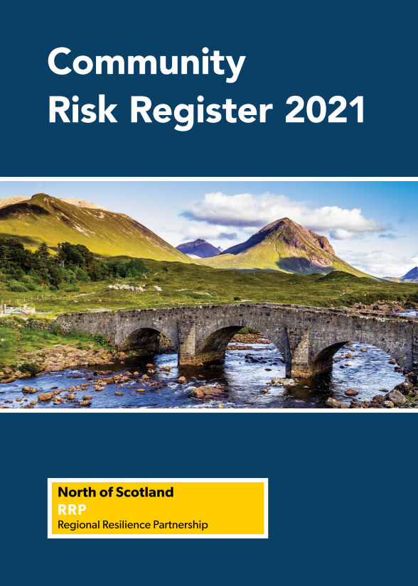
Risk Assessment
Risk assessment underpins everything we do – it informs and prioritises our work.
It is also a CCA requirement.
Some overlap with Corporate Risk Register.
Risks are identified and managed via a
different process:
Pandemic Diseases
Severe Weather
Flooding
Interruption to Utilities
Industrial Site Accidents
Transport Disruption
Pollution and Contamination
Significant Cyber Attack
National Security Risk Assessment
NoSRRP Risk Preparedness Assessment
Assesses risks and considers capability gaps
Process led by SFRS
Scottish Risk Assessment
NoSRRP Work Programme
HILRP Work Programme
Notes:
NSRA
The NSRA is produced every two years by the Civil Contingencies Secretariat (CCS) as a tool used to drive risk management and is an essential part of the way national security is approached. It is an Official Sensitive document, only available on Resilience Direct.
The NSRA assesses the key risks that could potentially damage the safety or security of the UK, or its interests, both domestically and overseas. Each risk is evaluated in a consistent manner using a reasonable worst case scenario approach and is assessed in terms of likelihood and impact. It also draws out the consequences should such a scenario occur.
Historically the CCS produced a National Risk Assessment (NRA) focussed on domestic emergencies over a five year timescale and an NSRA which focussed on broader national security risks (including international risks) over a 20 year timescale, separately. These were combined and, together with previous iterations of the NRA and NSRA, deliver a unified risk assessment framework, which enables the direct comparison of risks that are malicious and non-malicious, as well as those that are domestic and international.
Scottish Risk Assessment
The purpose of the SRA is to help the resilience community in Scotland understand civil contingencies emergencies which Scotland may face within the next five years, and to use this to prepare for and respond to these should they occur.
The SRA provides Scottish context for risks where Scotland would be affected differently to the rest of the UK and is designed to supplement the NSRA, while remaining a stand-alone document.
Community Risk Register
The Community Risk Register (CRR) is the document that the RRPs use to communicate with the general public about risks identified in the RRP RPA that have the highest likelihood and potential to have significant impact and cause disruption to communities.
The purpose of a CRR is to:
Inform the public about the greatest risks and their consequences
Educate the public on what the Resilience Partnership is doing
Provide the public with links to organisations and websites to find out more
Encourage the public to take steps to become better prepared and more resilient in their homes, businesses and community
Act as the Resilience Partnership’s core public warning and informing document
CRRs are a statutory requirement of the RRPs and should be reviewed and updated regularly as the final stage of the RRP RPA.
The CRRs for Resilience Partnerships across Scotland can be found on the Scottish Fire and Rescue Service website at: Your Safety | SFRS (firescotland.gov.uk)

Slide 8
Highlands & Islands Local Resilience Partnership (HILRP)
Chair: David Park, NHS Highland
HILRP is comprised of:
NHS Highland | Scottish Fire & Rescue Service
NHS Orkney | Police Scotland
NHS Shetland | Scottish Ambulance Service
NHS Western Isles | Maritime & Coastguard Agency
The Highland Council | SEPA
Orkney Islands Council | Military Liaison
Shetland Islands Council | Scottish Govt Liaison Officer
Comhairle Nan Eilean Siar | Animal & Plant Health Agency
Integration Joint Boards
Response Capability Group
Chair: SFRS
Care for People Group
Chair: Kate Cochrane, NHS Highland
HILRP
Working Group
Chair: Supt Jenny Valentine, Police Scotland
Additional Deaths Group
Chair: Alan Yates, THC
Inverness ELG
Shetland Emergency Planning Forum
Care for People Team
NB&S ELG
Care for People Team
Care for People Teams
Orkney Local Emergency Coordinating Group
Ross & Cromarty ELG
Care for People Teams
Care for People Team
Lochaber & Skye ELG
Western Isles EP & Coordinating Group
Highlands & Islands
LRP Planning Structure
Care for People Teams
Care for People Team
Caithness & Sutherland ELG
Care for People Teams
Notes:
The Highlands and Islands LRP Working Group The actual delivery of multi-agency work of the HILRP is delivered and coordinated by members of the HILRP Working Group, and also via the various locally based multiagency emergency coordinating groups (ELGs/ECGs), as required.
There are four meetings per year of the HILRP Working Group which offer video and telephone connection via MS Teams. The three island based emergency coordinating groups (ECGs) will normally be represented by their Local Authority Emergency Planning Officer (EPO), or other nominated group member, as agreed at each local group. The Highland ELGs have their business represented by Police Scotland or Highland Council Emergency Planning Department, as required and agreed by each local group. Police Scotland Emergency, Events and Resilience Planning (EERP) North represent Police Scotland at the HILRP Working Group. The membership of the HILRP working group includes Category 1, Category 2 and other agencies and organisations as required

Slide 9
Emergency Phases
Emergencies or incidents generally have 2 main phases:
Response/Acute Phase
Actions carried out immediately before, during, and immediately after a disruptive event, which are aimed at saving lives, protecting welfare and preventing further damage.
Response actions may include activating Resilience Partnerships, providing emergency medical care, search & rescue, firefighting, evacuating and sheltering people in imminent danger, etc.
Recovery Phase
Actions taken to return a community, environment and/or economy to normal or near-normal conditions, including the restoration of basic services.
Typical recovery actions include debris clean up, rebuilding roads and bridges and key facilities, providing housing for people made homeless, welfare assistance, psychosocial support, community development, economic stimulation, etc.
The Recovery Phase is often partially concurrent with the Response/Acute Phase.

Slide 10
Care for People
NHS Highland has lead role in Care for People, incl. activation of Emergency Support Centres (normally managed through the area CfP team, chaired by the NHS Highland District Manager).
This is very unusual – elsewhere LAs are responsible. Consequently national organisations (e.g. Police Scotland) are sometimes unaware or forget where responsibility lies.
THC continues to have an important role in providing welfare support during an emergency, e.g. provision of staff & resources to assist in the running of Emergency Support Centres. Also, advice & assistance in regard to welfare rights & benefits, financial & legal assistance, housing, clothing and emotional welfare support to meet the needs of children & families.
Senior Ward Manager/Ward Managers are the initial THC contact for CfP in UNUSUAL & MAJOR INCIDENTS and will seek to provide assistance through area CfP teams.
In UNUSUAL & MAJOR INCIDENTS, NHS Highland can be contacted via the Raigmore Hospital switchboard – 01463 704000

Slide 11
Activating the Resilience Partnership
Any Category 1 or 2 responder can request the activation of the Highlands and Islands LRP in response to an emergency or incident.
Every response should be proportionate and adhere to the principle of subsidiarity. In many incidents, operational or local response arrangements will be co-ordinated by the ELGs/ECGs across the Highlands and Islands.
If an incident occurs out of office hours, a call should be made to the Police Scotland Area Control Room and the On Call Police Emergency Procedures Advisor (EPA) should be requested. The Police EPA should then contact the On Call Scottish Government (SG) NoSRRP Coordinator who will assist with the activation and notification process.
On Call Scottish Govt NoSRRP Coordinator
Resilience Partnership
Call 101: Police Scotland Area Control Room
On Call Police Emergency Procedures Advisor

Slide 12
Highland Response Structure
Operational & Tactical > 95% Strategic <5%
Operational
Tactical
Strategic
Inner Cordon
Local Police Station*
Divisional Police Headquarters*
Emergency Liaison Group(s)
Chaired by Police Area Commander(s)
LRP
Strategic Group
Chaired by Police Divisional Commander
Scottish Government Resilience Room (SGoRR)
RVP
Emergency Liaison Group(s)
Chaired by Local Police Commander(s)
Forward Control Point
Emergency Liaison Group(s)
Chaired by Local Police Commander(s)
Care for People Team(s)
Chaired by NHS Highland District Manager
Scientific & Technical Advice Cell (STAC)
Chaired by Director of Public Health, NHS Highland
Outer Cordon
Emergency Support Centre(s)
Recovery Working Group (RWG)
Chaired by Head of Environmental Health, THC
*or ‘virtually’ via teleconference or MS Teams
Ward Manager(s) provide THC’s tactical lead(s). ELGs also attended by Roads & Transport, Education & Learning, Environmental Health, Housing & Property, Health & Social Care, etc.
Multi-agency representation from Emergency Services, NHS Highland, SEPA, BEAR Scotland, SSEN, British Red Cross, Met Office, etc.
LRP Strategic Group attended by organisations’ strategic leads, incl. THC Chief Executive or Depute
Highland Council HQ*
THC Gold Group
Notes:
Operational (Bronze) – Where services are delivered. The ‘at-scene’ hands-on work at the site(s) of an emergency.
Tactical (Silver) – Where actions taken at Operational level are supported and co-ordinated for maximum effectiveness & efficiency, and where actions are taken to implement strategies set by the strategic level.
Strategic (Gold) – Where a strategy is decided to manage wider issues, such as resourcing, recovery & reputation.

Slide 13
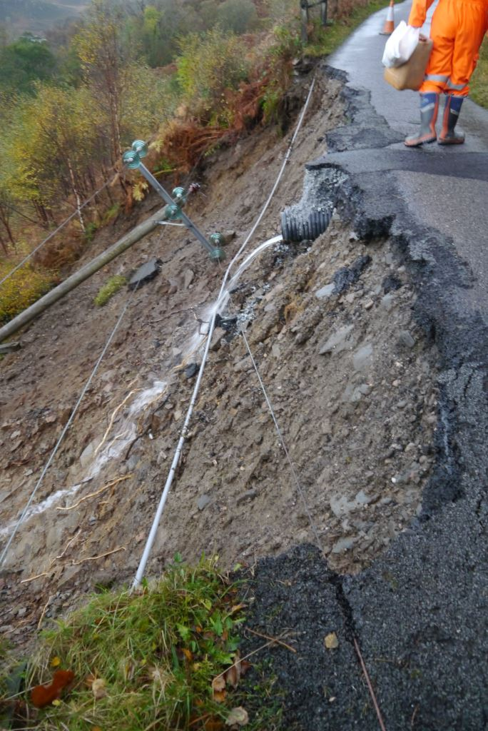
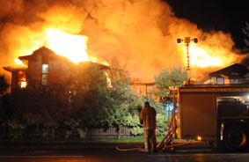
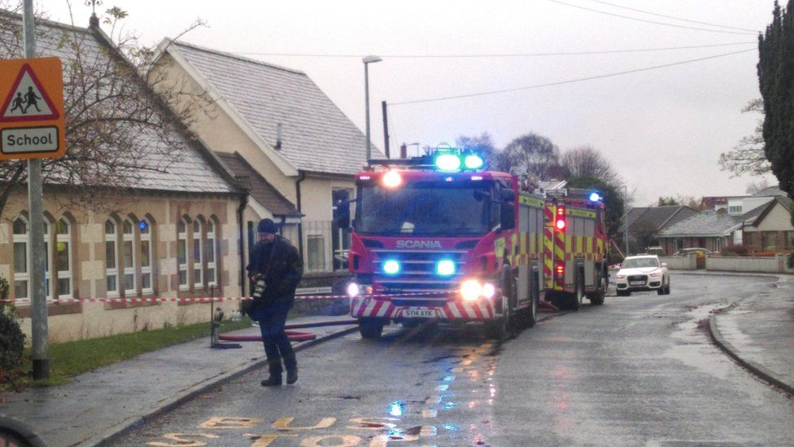
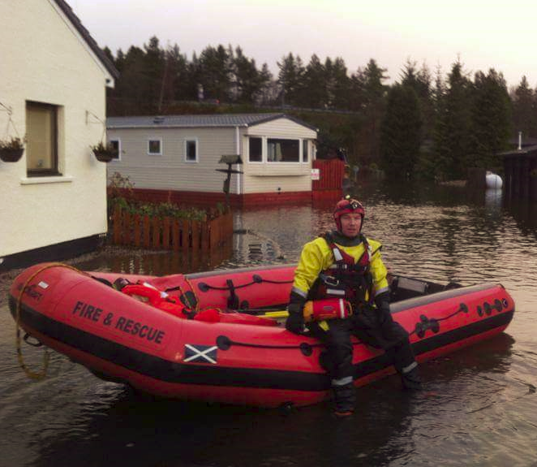
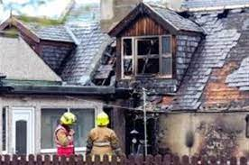
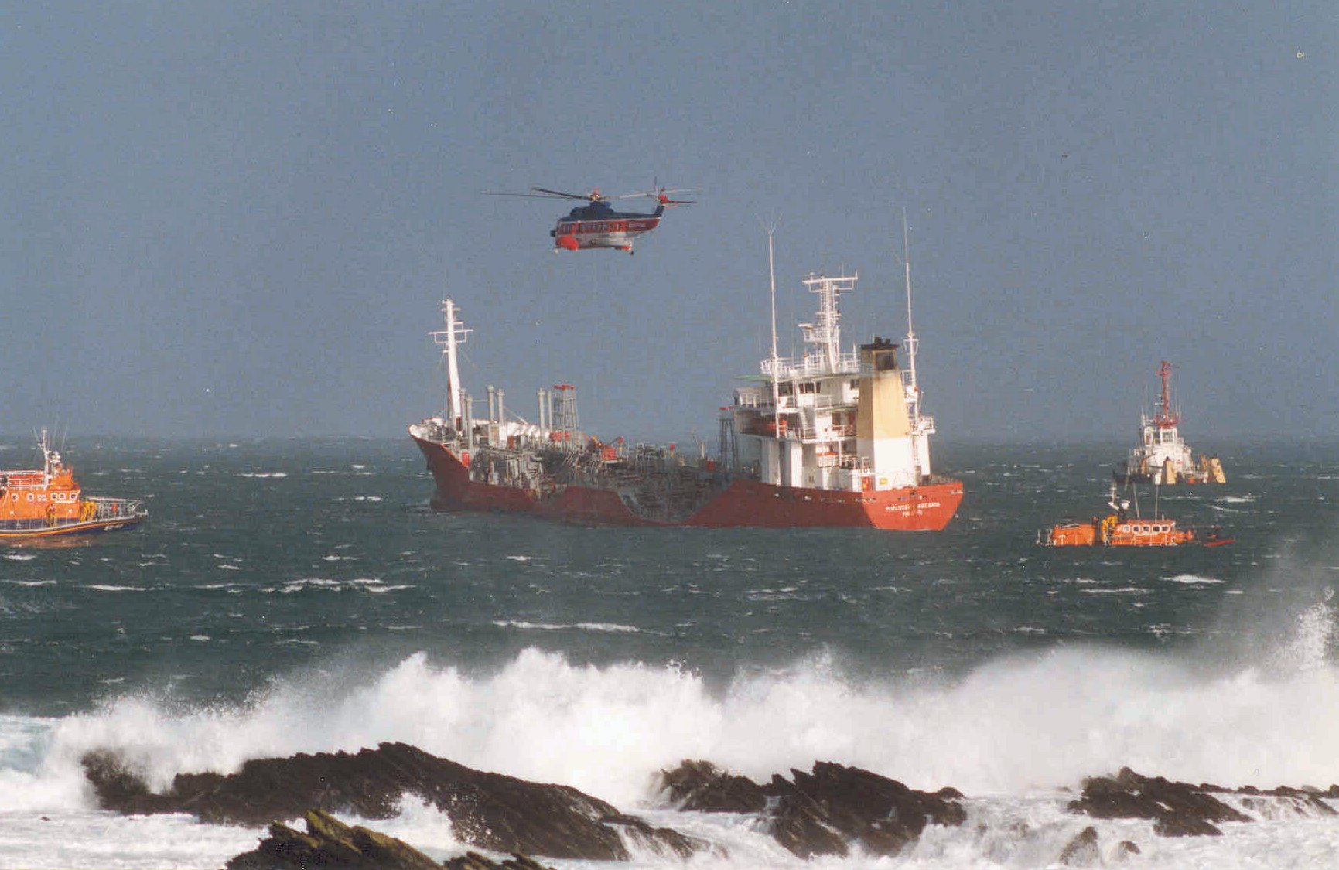
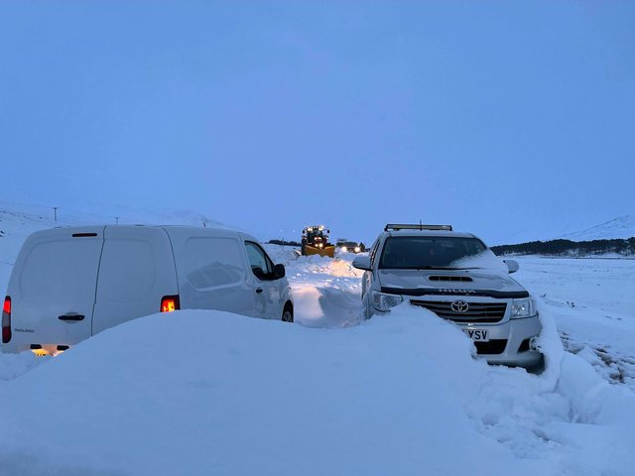
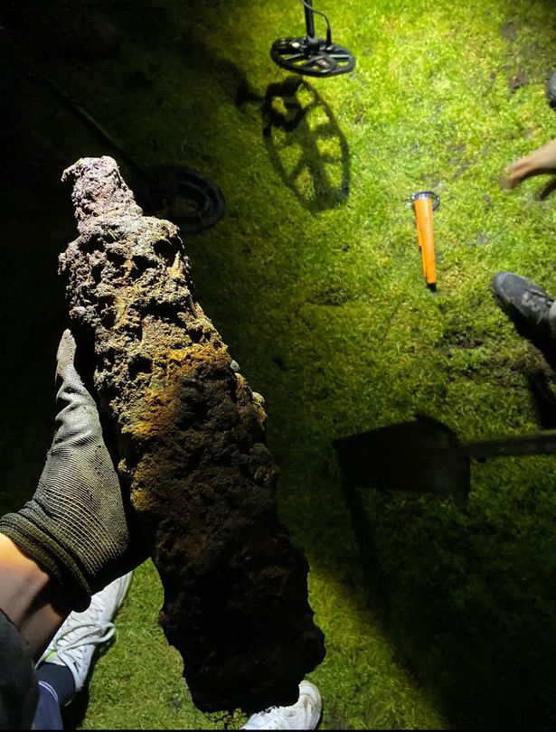
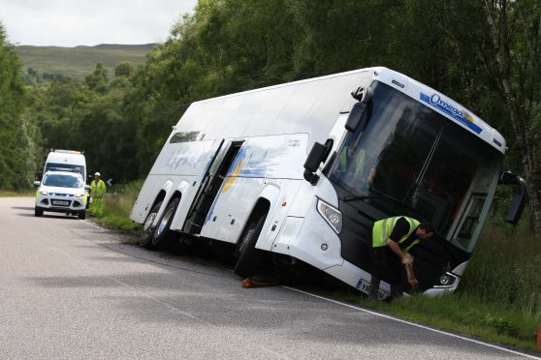
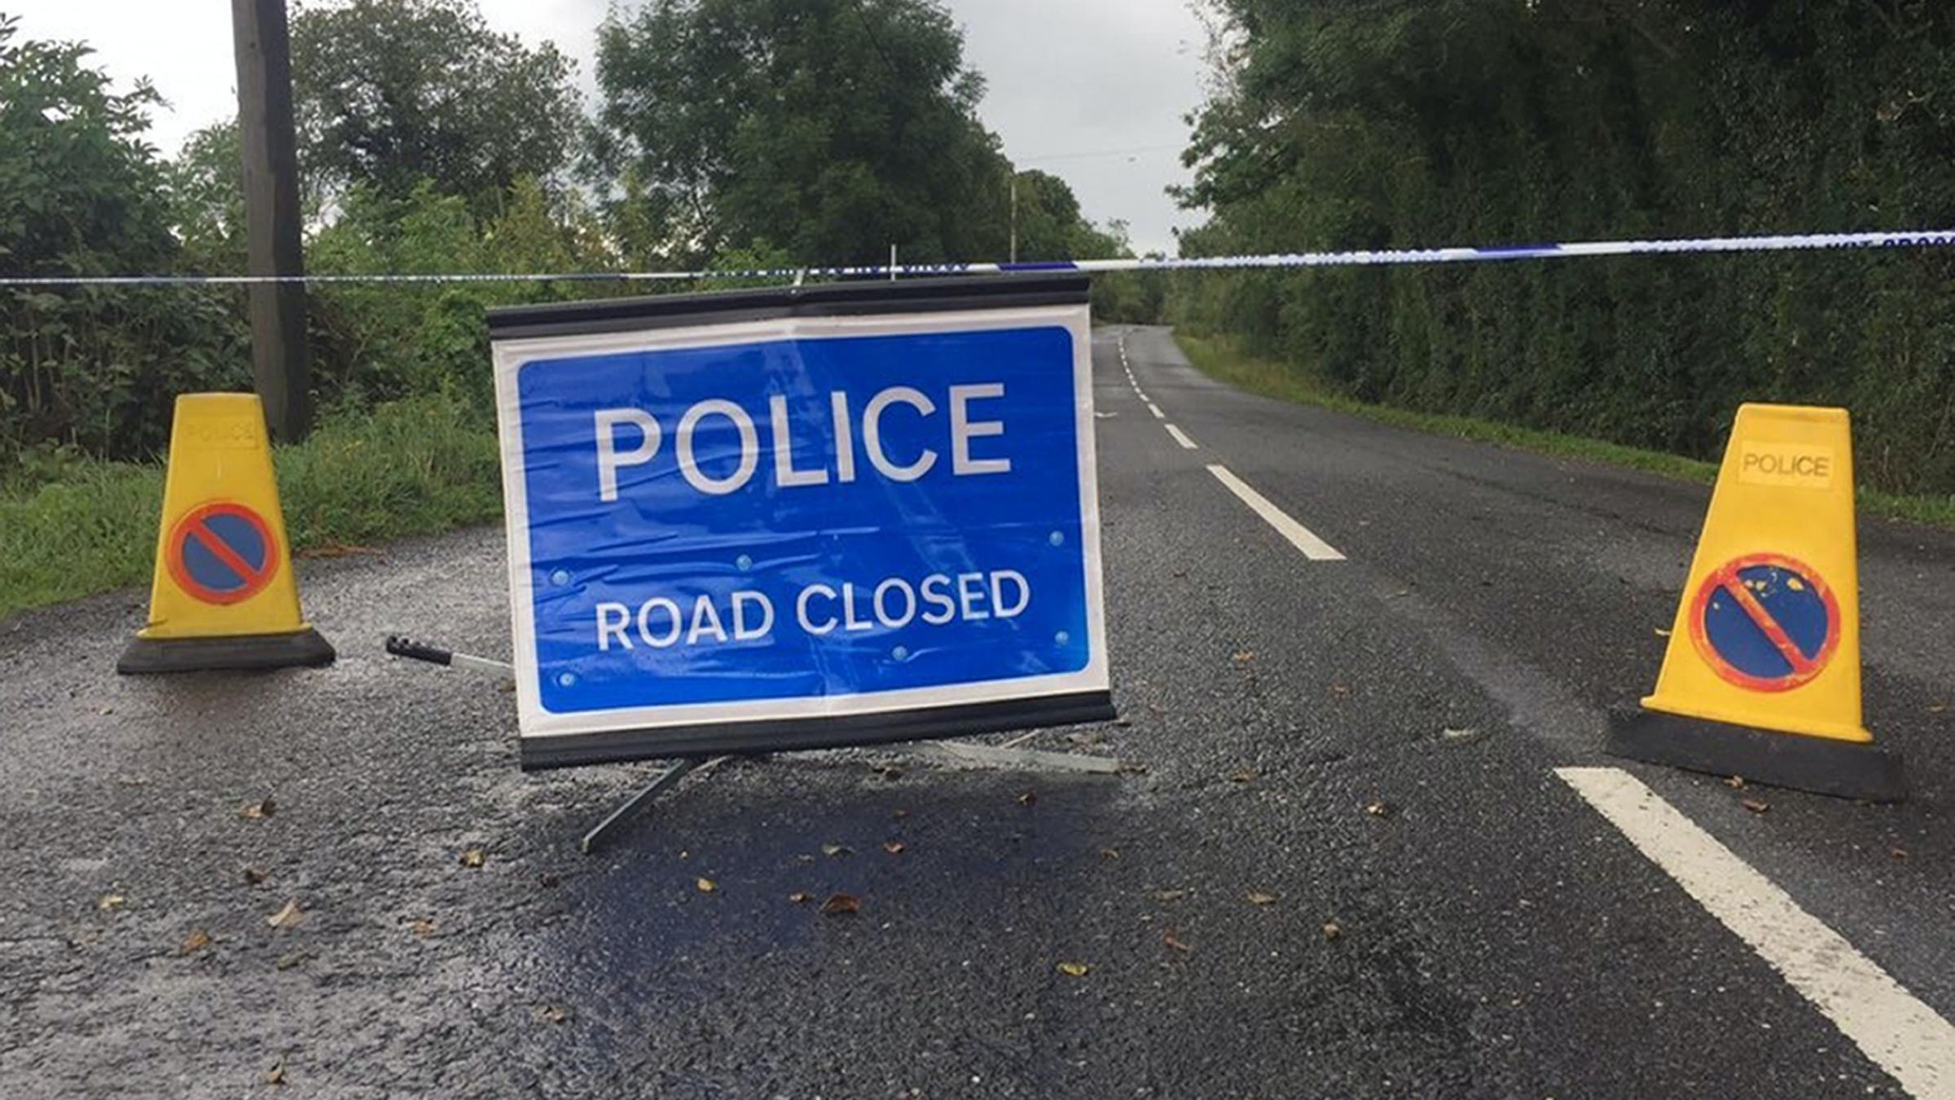
Levels of Emergency
ROUTINE
UNUSUAL
MAJOR
Notes:
Consequence, not cause.
Not rigid classification: Routine incident can become an Unusual incident, an Unusual incident can become a Major Incident

Slide 14
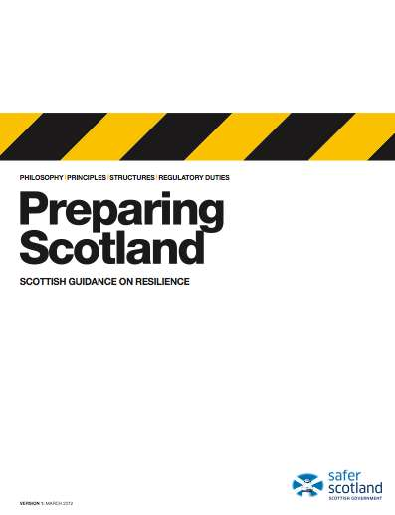
Strategic Aims
Protect human life, property and the environment
Maintain critical / essential services
Minimise the harmful effects of the emergency
Promote a swift return to normality or a state as close to normality as is practicable
Support the local community and its part in the recovery
Notes:
These are common aims taken from Preparing Scotland guidance. They are recommended to help focus the mind from the very beginning. As a group, you will tailor them to reflect your needs and the developing situation. However, always keep your aims at the heart of decision making considerations.

Slide 15
General Emergency Plan Alerting Cascade
Emergency Services
(or THC internal alert)
Out-of-Hours
Out-of-hours Service Centre
Office Hours
Resilience Team
THC
Duty Officer
ROUTINE INCIDENT
Senior/Ward
Manager(s)
1st Tier
UNUSUAL INCIDENT
Corporate Comms
Senior/Ward
Manager(s)
Relevant Service Area Manager(s)
Other relevant THC staff
THC Duty
ECO
THC Duty
ECO
Resilience Team
Affected
Ward
Members(s)
2nd Tier
Corporate Comms
Senior/Ward Manager(s)
Affected
Ward Member(s)
Chief
Executive
Relevant ELT Members
Resilience Team
MAJOR INCIDENT
LRP Strategic Representative
Resilience Team
Council
Leader
Service
Managers

Slide 16
Plans, Guidance & Information
The Highland Council General Emergency Plan
Maps out organisation & management structure of THC’s response to an UNUSUAL or MAJOR INCIDENT, including an Alerting Cascade, Immediate Actions Guide and Draft Agenda for first Gold meeting.
HILRP Response Guidance
HILRP Recovery Guidance
Highland Care for People Guidance
The Highland Council Oil Pollution Contingency Plan
Emergency Communications Directory (ECD)
Lists office & OOH contact details of key THC staff and partner agencies
Available on THC’s ‘Emergency Plans’ SharePoint site
Available in the SharePoint ‘Gold Folder’, or request a copy from Resilience Team

Slide 17
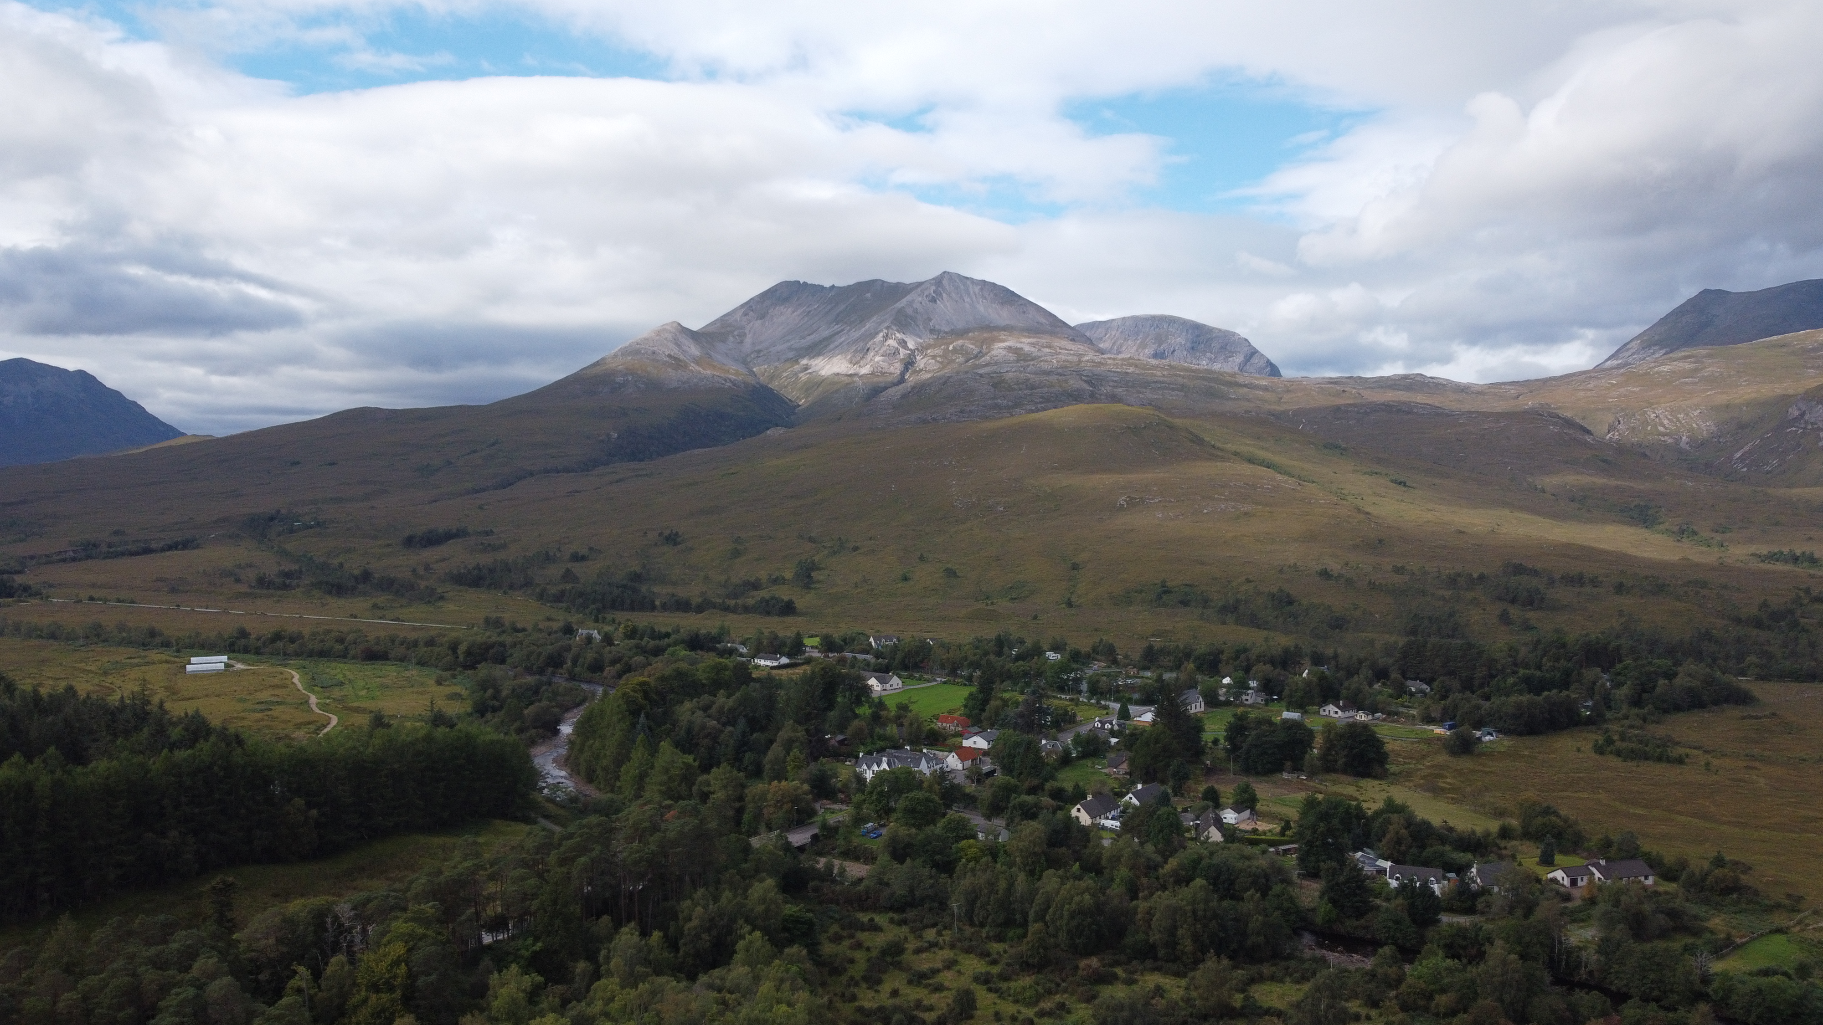
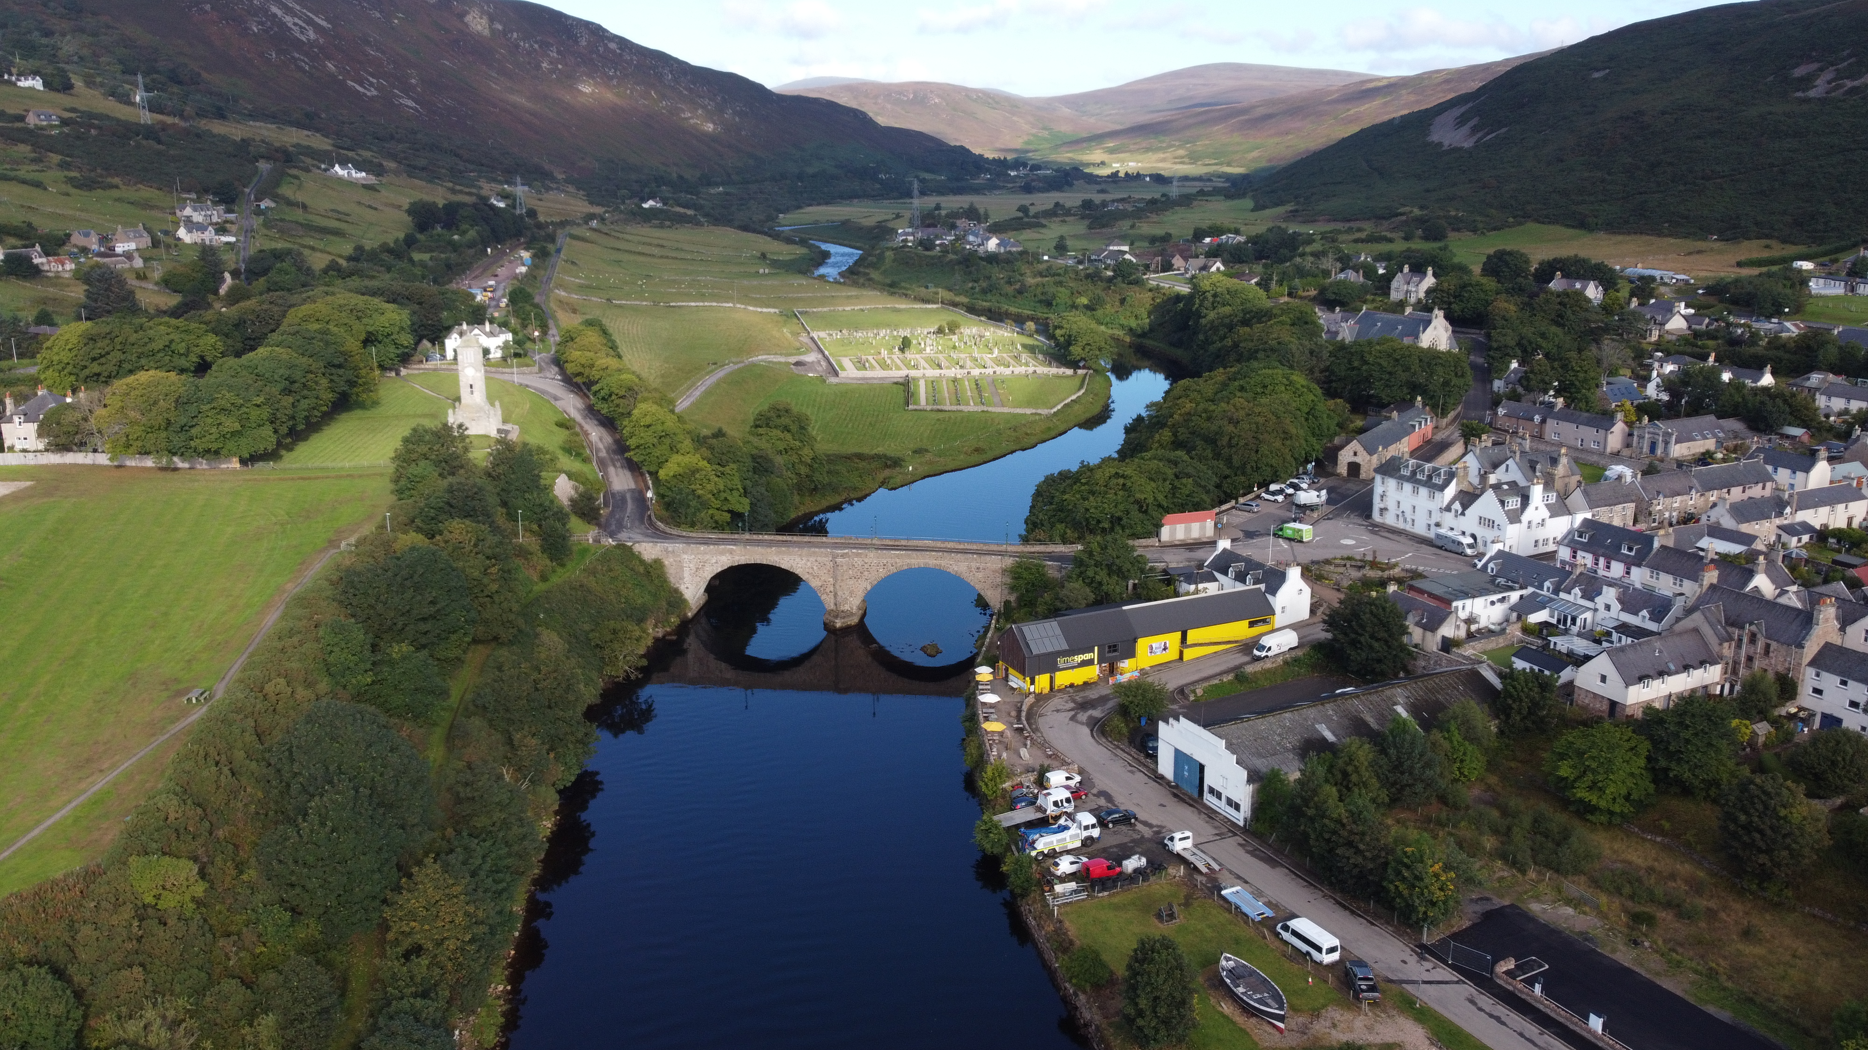
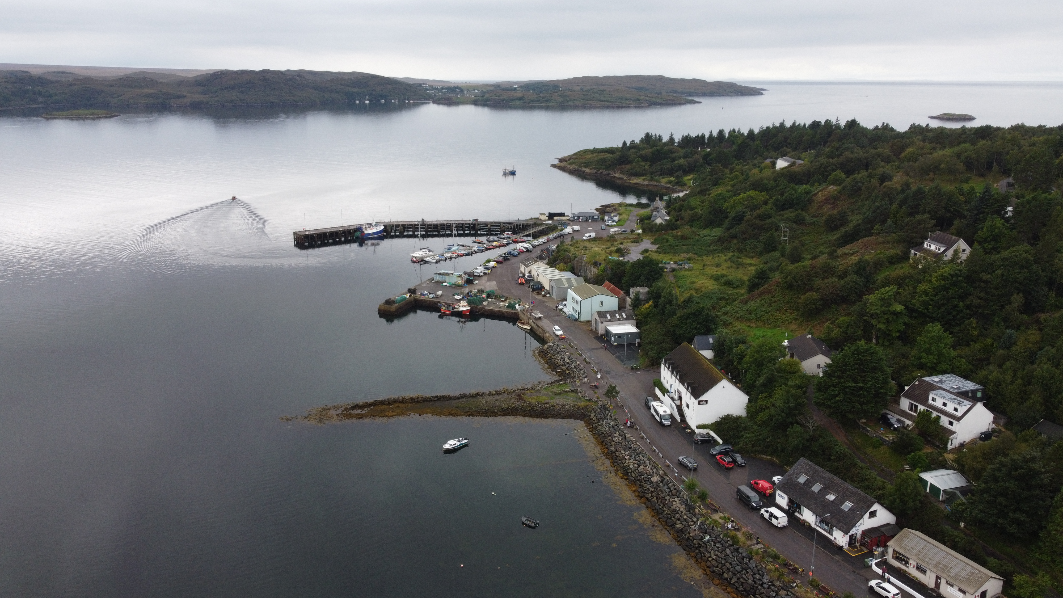
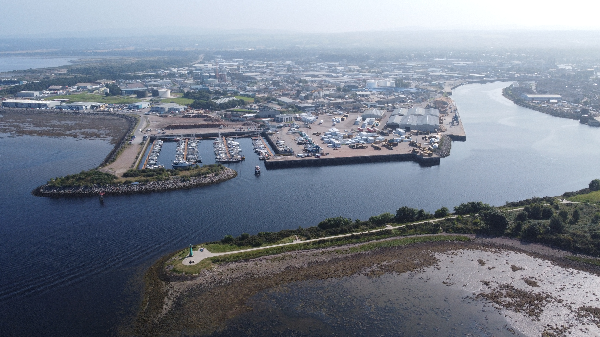
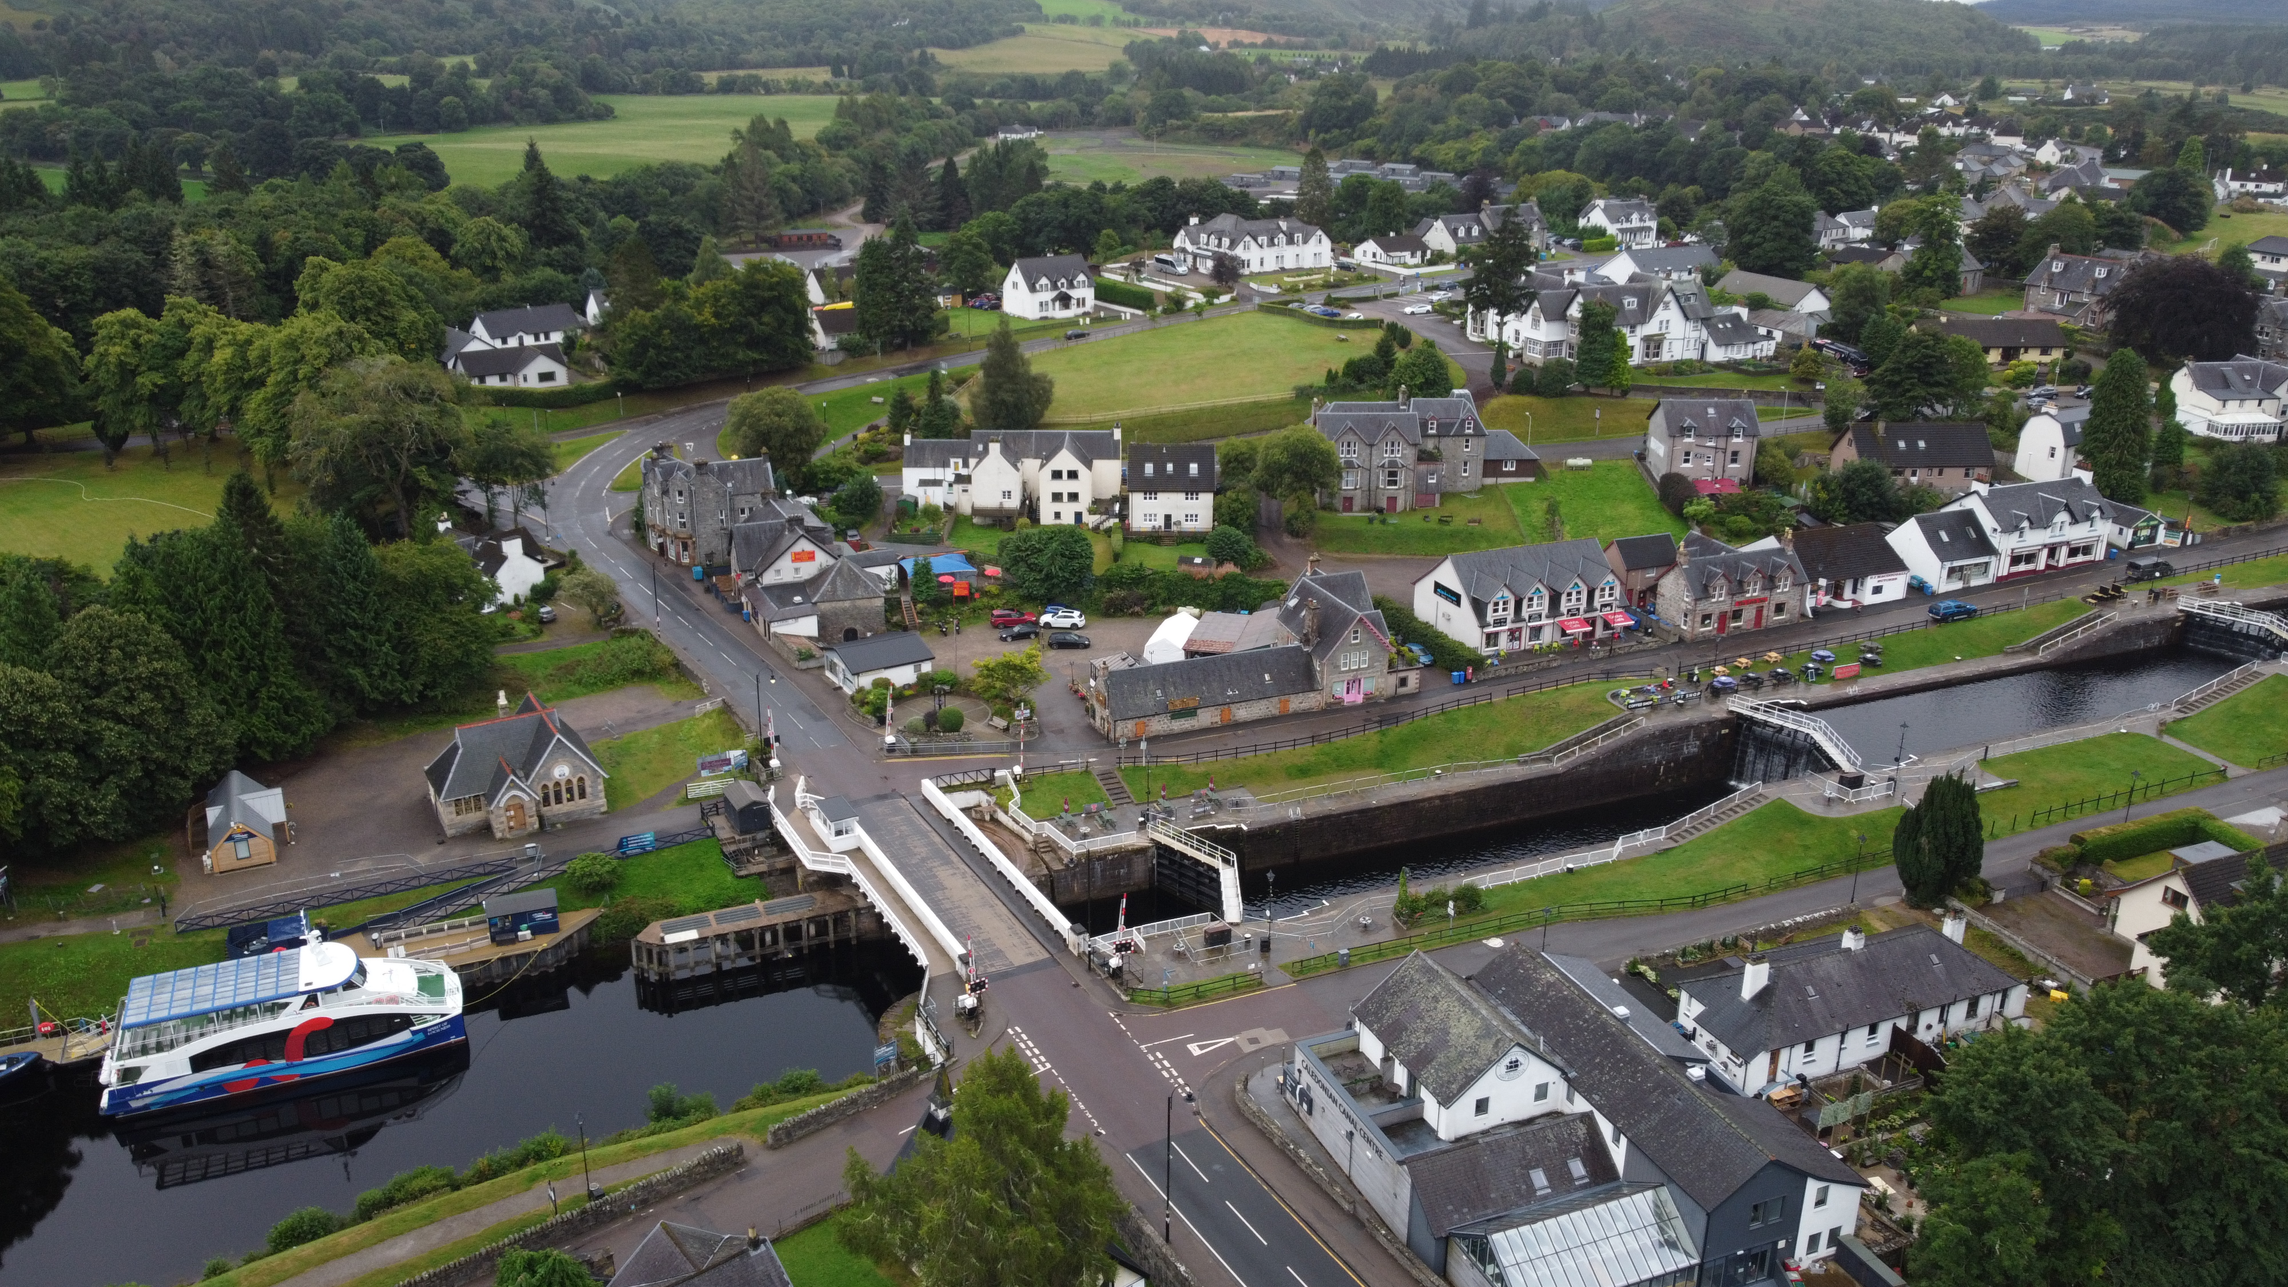
Climate Ready Places
UPLANDS
LOWLANDS
COASTAL
INDUSTRIAL
SUBURBS
CITY

