Slide 1
Members Induction 2022
- How the Council Works -
Kate Lackie
Stewart Fraser
Paul Nevin

Slide 2
How the Council Works
Today’s Briefing:-
Overview – Highland Council
Getting Started
Good Corporate Governance
Roles & Responsibilities
Strategic and Area Decision Making
Codes of Conduct – Councillors & Officers
Case studies

Slide 3
How the Council Works
Highland Council:-
Largest local authority in UK
Deliver services to 235,430 residents
10,000 staff
Annual Net Revenue Budget £640m
Commission major services – for example from NHS Highland, High Life Highland

Slide 4
Getting Started
Welcome Pack
Induction Programme
Members Intranet - https://www.highland.gov.uk/membersintranet/
  Key Documents
  Service Structures
  Improvement Service Induction Materials
  Managing constituent complaints and Enquiries
  Submitting expenses and accessing payslips

Slide 5
How the Council Works
Key Documents
Induction Notebooks
Standing Orders
Councillors’ Code of Conduct & Guidance
Scheme of Delegation
Financial Regulations
Contract Standing Orders

Slide 6
How the Council Works
Induction Notebooks
Notebook 1: Getting Started with your Roles and Responsibilities
Notebook 2: Being a Community Leader
Notebook 3: Governing Effectively: Keeping Your Eye on the Big Picture
Notebook 4: Developing Your Working Relationships with Officers
Notebook 5: Developing Your Working Relationships with Other Elected Members
Notebook: Navigating the New Council: a Consideration of Opportunities and Challenges
Accessible from the Members Intranet

Slide 7
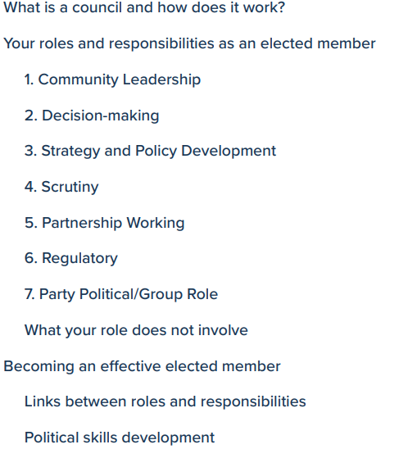
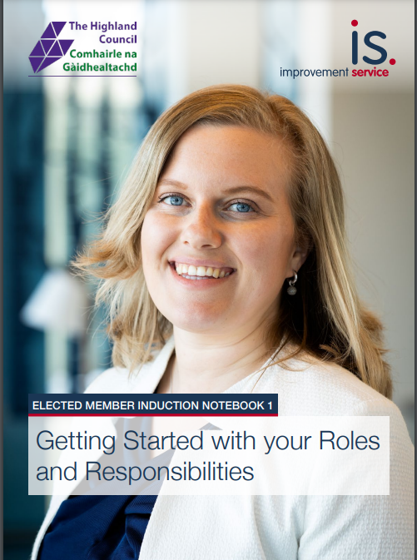
Getting Started

Slide 8
How the Council Works
Good Corporate Governance:-
Corporate governance is concerned with the structures and process for decision-making and accountability, controls and behaviour at the top of organisations.
Put simply, this is the need for any organisation to have appropriate working arrangements in place to ensure that it achieves its agreed priorities and outcomes.
Both Councillors and Officers have roles and responsibilities in achieving strong corporate governance.

Slide 9
How the Council Works
Councillors Roles:-
Full Council is the governing body of the Council that determines policy and ensures quality of Service Delivery
Councillors are elected to determine policy, not to engage in the direct operational management of services
Officers advise and serve the whole Council and Councillors have the right to expect advice which is candid, expert and impartial.

Slide 10
Improvement Service Handbook – Governing Effectively
Make sure clear outcomes and priorities are in place.
Ensure resources are in place to achieve these outcomes and priorities and they are used efficiently.
Scrutinise and monitor the delivery of services to ensure the performance expectations are achieved.
Ensure the Council is transparent and accountable back to the communities that elected them.
Take responsibility and be held to account for decisions you have taken: a key requirement of the duty of Best Value.
Finally Councillors are responsible for ensuring that partnerships are appropriately governed, properly held to account and their performance scrutinised.

Slide 11
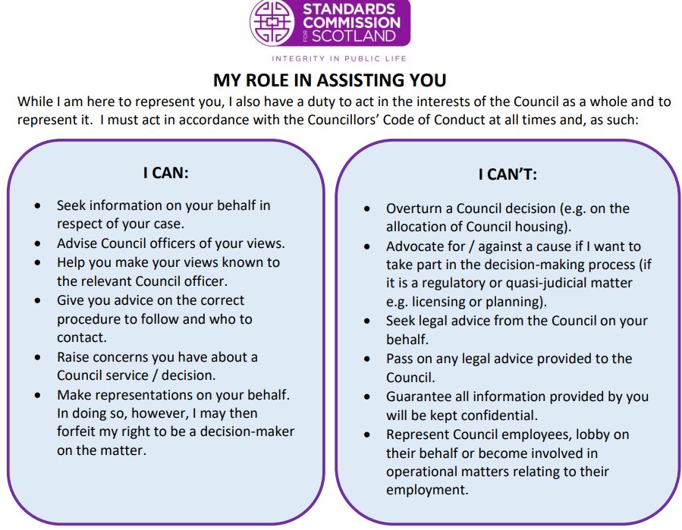

Slide 12
How the Council Works
Officers’ Role
Day to day running of Council services
Providing professional advice to allow Councillors to make informed decisions
Implement the decisions made by Councillors
Observe strict political neutrality and serve all Councillors

Slide 13
How the Council Works
Statutory Roles
Head of Paid Service (Chief Executive)
Monitoring Officer
Chief Financial Officer
Chief Social Work Officer
Chief Education Officer
Data Protection Officer

Slide 14
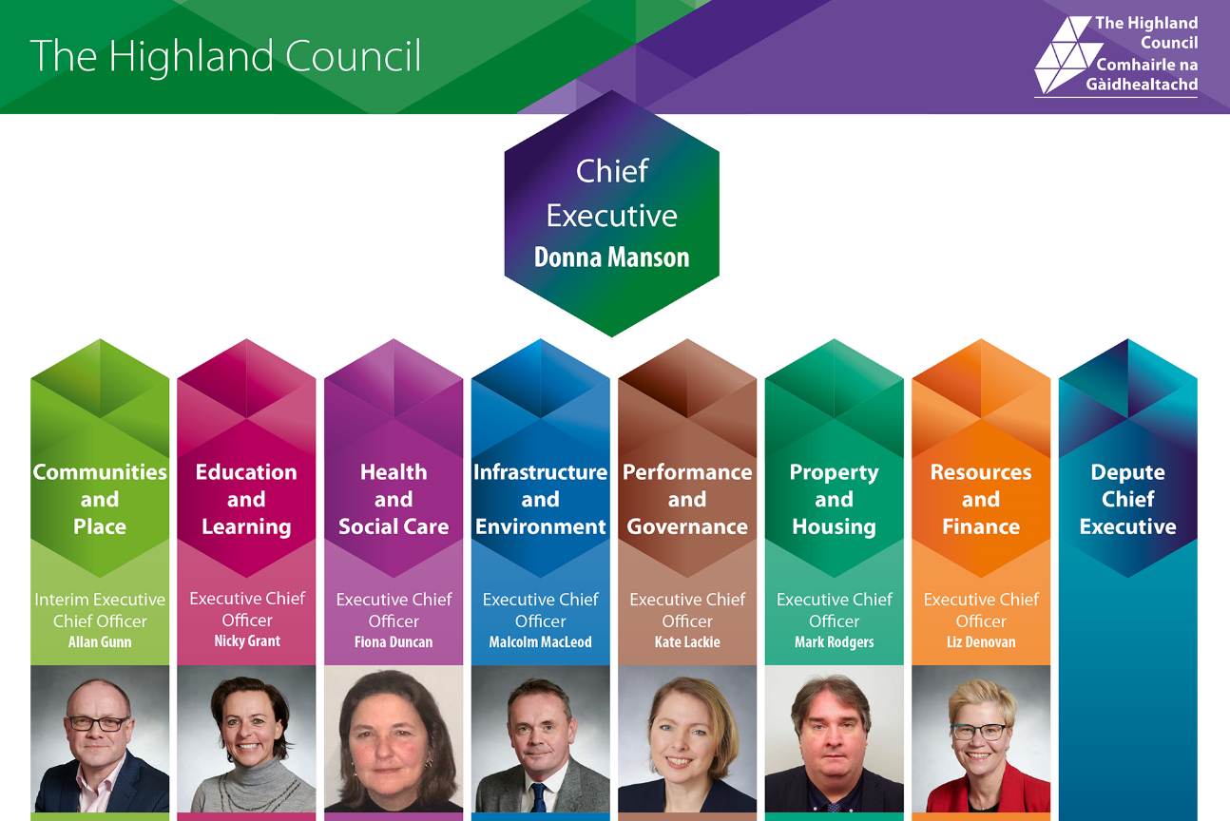
How the Council Works

Slide 15
How the Council Works
Highland Council:-
74 Elected Members – 36 newly elected
21 Wards: 11 four-member and 10 three-member
Decision Making Structure
  Full Council;
  7 Strategic Committees;
  5 Regulatory committees;
  11 Area Committees and a range of other committees and boards
  Timetable of Meetings

Slide 16
How the Council Works
What to expect in the coming weeks
Full Council 26 May
Full Council 2 June
Regulatory Meetings plus Special Council
Strategic Committees?
Full Council 30 June
Recess

Slide 17
Standing Orders
Rooted in the Local Government (Scotland) Act
The way in which formal business is conducted
  Power and duties of the Convener/Chair
  Quorum, Voting, Motions, Amendments
  Questions, Notices of Motion
  How and when to speak
  Decisions
Practice Run for 26 May
  Calling the roll
  Voting

Slide 18
How the Council Works
Strategic v. Local
Strategic
Local
Partnerships

Slide 19
Local Area Committees
Remit set out in the Scheme of Delegation
Decision making forum for local issues
Scrutiny on key areas of local business – e.g. police and fire, education
Discussion
  on local projects where decision making sits elsewhere e.g. Rails to Grantown
  updates from community groups or organisations and partnership updates
Motions – can be used to hold a local discussion on matters of note or concern

Slide 20
Area Business Meetings
Purpose:
Private space for briefing Members on confidential issues
Discussion on areas of development
For consulting members on key matters where officers have delegated decision making
Discussion on potential items for Area Committee meetings and on items due to come to Area Committee
Frequency – one per month
Additional one-off briefing sessions can be arranged by Services if required
How – default by teams but can be in person if required
Action note is taken, not minutes

Slide 21
Additional Roles, Responsibilities and Remits
Senior Appointments
External bodies and Boards
Hearing appeals
Signing powers
Personal safety, health and wellbeing

