Slide 1
Resilience
Elected Members Briefing

Slide 2
Overview
Legal Framework
Highland Council Resilience Team
Civil Contingencies Preparedness & Response Structure
General Emergency Plan (GEP)
Role of Elected Members
Examples of incidents since 2010
Community Resilience

Slide 3
Legal Framework

Slide 4
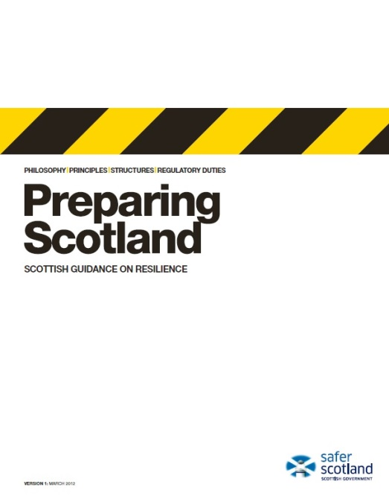
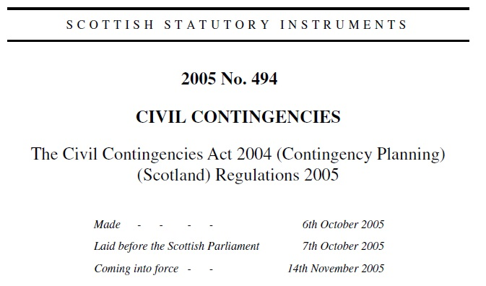
Civil Contingencies Act 2004
Sets out how UK & Scotland prepares for emergencies.
Lists those organisations that have a statutory duty to prepare.
Lists the key supporting organisations.
Details duties for all Category 1 & 2 Responders.
Notes:
Emergency Planning, or Resilience as its often referred to today, is not a new concept – its origins were in the 1940s with planning for war – air raid warnings, bomb shelters, etc. Emergency Planning developed through the 1980s and 1990s when the focus changed to planning for and responding to peacetime emergencies, e.g. Bradford Football Disaster, Kings Cross Fire, Piper Alpha, Lockerbie, Hillsborough Tragedy.
Following the fuel crisis and the severe flooding in the autumn and winter of 2000 and the outbreak of Foot and Mouth Disease in 2001, the Deputy Prime Minister announced a review of emergency planning arrangements. The result of this was the Civil Contingencies Act 2004 (the “Act”). The Civil Contingencies Act seeks to minimise disruption in the event of an emergency and to ensure the UK is better prepared to deal with a range of emergencies. The Act applies to the whole of the UK.
The Contingency Planning (Scotland) Regulations 2005 set out further detail on the application of the Act in Scotland, with particular regard to the duties and roles of responders.
Preparing Scotland is the statutory guidance for the Contingency Planning (Scotland) Regulations 2005 and it provides the framework for civil protection planning, preparation and response.

Slide 5
What is an Emergency?
“An event or situation that threatens serious damage to human welfare in a place in the UK or to the environment of a place in the UK, or war or terrorism which threatens serious damage to the security of the UK”.
“To constitute an emergency this event or situation must require the implementation of special arrangements by one or more Category 1 responders.”
The Civil Contingencies Act 2004 (Contingency Planning) (Scotland) Regulations 2005
Notes:
Human welfare: For example: loss of life, injury, illness or homelessness; disruption to food, money or energy supplies, disruption to communication systems, transport systems or health systems
The environment: For example, contamination of land, water or air with biological, chemical or radioactive matter or the destruction of animal or plant life.
The security of the UK: War or terrorism

Slide 6
Category 1 and 2 Responders
Category 1 | Category 2 | Others
The Highland Council Police Scotland Scottish Fire & Rescue Service Scottish Ambulance Service NHS Highland MCA SEPA Integration Joint Boards | Scottish Water Gas Distributors Electricity Distributors Telecommunications NHS National Services Scotland Transport Operators Harbour Authorities HSE Met Office | Voluntary Organisations Business Partners Central Government – UK & Scotland Military The Community
Notes:
This slide shows all the categories of responders as defined by the CCA. These are the key organisations responsible for ensuring the effective management of emergencies in Scotland. They are broken down into 3 levels.
CATEGORY 1 RESPONDERS ARE THE MAIN ORGANISATIONS INVOLVED IN MOST EMERGENCIES AT LOCAL LEVEL.
While the Act puts responsibilities on Category 1 Responders to prepare and respond to emergencies, Category 2 Responders must co-operate with Category 1 Responders.
The other mentioned have no duties placed on them in the Act, but they are recognised as playing a significant role in supporting Category 1 and 2 responders to meet their responsibilities.

Slide 7
CCA – Legal Duties
7 legal duties
on LAs
Assessing risk of Emergencies
Promotion of Business Continuity
(LA only)
Co-operation
Planning for Emergencies
Information Sharing
Business Continuity
Warning & Informing the Public
Notes:
The Act formalised many of the informal arrangements which were already in place, with the exception of Business Continuity, which was a new duty.
No matter what the Council may be dealing with internally, it must ensure it can continue to respond to emergencies in its community.
These civil protection duties – with the exception of providing advice and assistance to businesses and voluntary organisations about business continuity management: which is Local Authority only – fall on all organisations defined as “Category 1 Responders”. Together, Category 1 Responders provide the core emergency response.

Slide 8
Risk Assessment
  Risk assessment underpins everything we do – it informs and prioritises our work.
  It is also a CCA requirement.
  UK National Security Risk Assessment
  & Scottish Risk Assessment
  North of Scotland Regional Resilience Partnership (NoSRRP)
  Risk Preparedness Assessment 2022/24 (informs the CRR)
  NoSRRP Work Programme 2022/24
  Highlands & Islands Local Resilience Partnership (HILRP)
  Work Plan 2022/24
Notes:
It is important that responders have a realistic understanding of the hazards and/or threats for which they should be prepared. As such, assessment is a key part of preparation.
The initial aspects of assessment are based around the concept of anticipation. The aim is for responders to systematically identify new or changing hazards and threats from both local and wider environments. This process, sometimes known as horizon-scanning, may include political, environmental, social, technological, economic and legal factors.
Having identified relevant hazards and threats, responders must assess the likelihood of such events taking place and the potential impact upon communities. This process allows responders and others to measure risk and to base planning priorities appropriately.

Slide 9
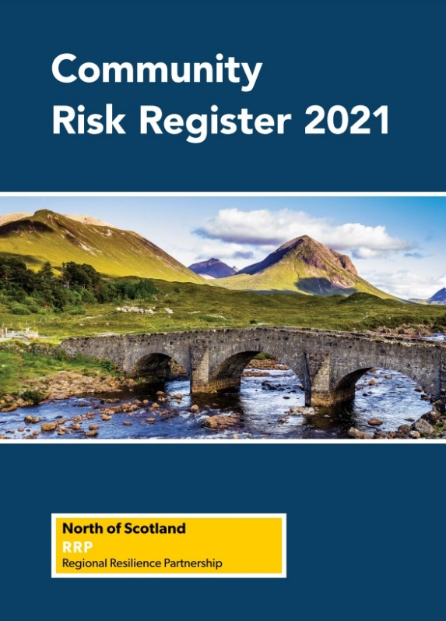
Risk Assessment
  NoS RRP Community Risk Register
  Pandemic Diseases
  Severe Weather
  Flooding
  Interruption to Utilities
  Industrial Site Accidents
  Transport Disruption
  Pollution and Contamination
  Significant Cyber Attack
Notes:
The CCA requires RRPs to prepare a Community Risk Register for their area.
The NoS RRP Community Risk Register highlights risks that have the highest likelihood and potential to have significant impact, causing disruption to the North of Scotland region and its communities.
Risks are identified through:
professional judgement from a range of contributors
historical evidence
scientific input and expert analysis.
The CRR covers non-malicious emergencies (natural occurrences, accidents) rather than threats (eg, terrorist incidents). Although North of Scotland RRP addresses Terrorist threats within its risk assessment work, the sensitivity of the information supporting its assessments, means that details will not be made available in the public domain.
Contributors:
• Local Authorities in North of Scotland RRP
• Police Scotland
• Scottish Fire and Rescue Service
• Scottish Ambulance Service
• NHS Health Boards in the North of Scotland RRP
• Scottish Environment Protection Agency (SEPA)
• HM Coastguard (MCA)
• Met Office
• Transport Scotland
• Scottish Water
• Scottish Government

Slide 10
Risk Assessment
Highland Council Corporate Risk Register
Corporate risks are potential barriers to the council achieving its priorities.
These risks have potential to disrupt large parts of our service.
Corporate Risk Register is scrutinised every 3 months by the Audit & Scrutiny Committee.
Some risks appear in both the Community Risk Register and our Corporate Risk Register, e.g. COVID-19, Significant Cyber Attack.

Slide 11
Emergency Planning Cycle
7. Validate in exercises – and in response
Taken from Preparing Scotland
6. Train key staff
EMBED
8. Maintain, review & consider revision
5. Issue and disseminate
1. Take direction from risk assessment
4. Agreement and finalise
CONSULT
2. Set objectives
3. Determine actions & responsibilities
Notes:
2 key activities:
Consult – preparing arrangements through effective engagement with those who will implement them
Embed – ensuring that plans and arrangements are adopted as part of a responder’s routine

Slide 12
Emergency Response - Objectives
Save Life
Prevent escalation
Relieve suffering
Investigate
Safeguard the environment
Protect property
Restore normality
Notes:
These are the same objectives for all agencies responding to emergencies

Slide 13
Emergency Response - Principles
Response should:
Concentrate on the effects rather than the cause;
Be planned and undertaken as an extension of normal activities.
Notes:
The 2 basic principles are:
The response should focus on the effects of the incident not the cause, i.e. if someone is evacuated then it doesn’t matter so much what has caused the evacuation but it is important that those evacuated get the support they need.
The definition of an emergency under the CCA focuses on the consequences, i.e. ‘damage to human welfare or the environment’, ‘damage to security of the UK’.
This all-risks approach, concentrating on consequences rather than causes, allows a process of generic planning which can be adapted readily to fit a wide range of issues around response and recovery.
Resilience does not depend on a large establishment of civil contingencies experts. What individuals do in their day-to-day roles should form the basis of their role in an emergency. Planning should therefore ensure that, wherever possible, individuals, organisations and groups of organisations use the skills they already have to meet the urgent needs of communities at times of crisis. Those responding should generally be doing their normal jobs – just in extraordinary circumstances, i.e. social workers will be offering emotional support – they won’t be filling sandbags!

Slide 14
Levels of Command
Three levels of command:
Operational (Bronze)
Where services are delivered – the ‘at-scene’, hands-on work at the site(s) of an emergency.
Tactical (Silver)
Where actions taken at Operational level are supported and co-ordinated for maximum effectiveness & efficiency, and
Where actions are taken to implement strategies set by the Strategic level
Strategic (Gold)
Where a strategy is decided to manage wider issues, such as resourcing, recovery & reputation
Notes:
Operational: normal day-to-day, small scale incidents may be managed entirely at the operational level. Might include establishing cordons, traffic management, etc.
Tactical: If a strategic group has yet to meet or is not required due to the scale of the emergency, then generally the tactical group will adopt a generic strategy based upon the following:
Protect human life
Protect property and the environment
Minimise the harmful effects of the emergency
Support the local community and its part in the response/or recovery
Promote a swift return to normality or a state as close to normality as is practicable.
Strategic: The purpose of the strategic level is:
To consider the emergency in its wider context
Determine longer-term and wider impacts and risks with strategic implications
Define and communicate the overarching strategy and objectives for the emergency response
Establish the framework, policy and parameters for lower-level tiers
Monitor risks, impacts and progress towards defined objectives

Slide 15
Emergency Phases
Emergencies generally have 2 distinct phases:
Response/Acute Phase
When actions are taken to save lives and prevent further damage, e.g. search & rescue, firefighting, sheltering people in imminent danger
Recovery Phase
Following the Response/Acute Phase when actions are taken to return the community, environment and/or economy to ‘normal’, e.g. repairing/rebuilding properties, ongoing welfare provision, etc.
Notes:
Lockerbie
Grenfell
Park Primary
COVID-19

Slide 16
Lead Responders
During Response/Acute Phase:
Police Scotland – usually (where there is a need to protect life and property)
NHS Highland for public health matters, e.g. pandemic flu
MCA for offshore emergencies
Fire and Rescue Service – Wild fires, etc
THC for onshore oil spills
Notes:
Police Scotland – lead for flooding when intervention is necessary to protect life and property, etc.

Slide 17
Care for People (CfP)
In Highland, NHS Highland has lead role in terms of care for people, including activation of Emergency Support Centres
This is uncommon in Scotland/UK: LAs usually have responsibility.
Follows integration of local Health and Social Care Services in 2012.

Slide 18
Emergency Response - Role
THC’s role in an emergency is to:
Assist NHS Highland & BRC in establishing Emergency Support Centres, identification of vulnerable people and other Care for People aspects;
Provide assistance & resources to the emergency services, as requested by them;
Co-ordinate response by voluntary agencies;
Liaise with utility companies;
Lead the rehabilitation of the community by aiding the recovery process;
In the event of an oil spill, act as lead agency
in shoreline clean-up;
Continue to provides its critical services.

Slide 19
Recovery
In the latter stages of a major emergency, the Chief Executive of the local authority (or other appropriate agency) may take over responsibility for coordinating aspects of the recovery.
This is known as the “Recovery” phase.
The Recovery phase of the response may last for weeks, months or even years, and have major human and financial implications – no less than the original emergency phase.
Notes:
E.g. Grenfell Tower, Lockerbie, etc.
From the beginning of an emergency, Council staff are already planning for the recovery phase and involved in relevant decisions that might have long term consequences. Elected members should have a similar overview and awareness of consequences.
A Recovery Group may be set up to manage the rebuilding, restoration and rehabilitation of the community and environment.
Experience of emergencies in Scotland has demonstrated the importance of involving the community in its own recovery. Effective communication and support for self-help activities are important considerations for responders. Those co-ordinating recovery should remain aware that various communities within an area may be affected differently and that new communities of circumstance may be created by the emergency itself.

Slide 20
Other legislation
Incudes:
COMAH (Control of Major Accident Hazards Regulations)
REPPIR (Radiation Emergency Preparedness & Public Information Regulations)
Notes:
COMAH is a regulatory framework set up to protect people and the environment from, and limit the consequences of, major accidents occurring within establishments (such as industrial plants, warehousing facilities, etc.) that are covered by the regulations.
Establishments are categorised as either lower or upper tier, depending on the quantity of hazardous materials stored at the premises.
In Highland there are currently 5 upper tier sites.
For each upper tier establishment, HSE defines a PIZ around the site. This area is set to take account of both the likelihood and effects (for people only, not the environment) of possible Major Accidents – it is the area in which persons are liable to be affected by a Major Accident occurring at the site. Under Regulation 18, business premises and residents within the PIZ must receive a letter with safety information from the Site Operator at least once every 3 years.
The statutory requirements for Local Authorities under COMAH are Regulation 13 which requires a local authority to prepare off-site plans for all upper tier establishments in its area, and Regulation 14 which requires a local authority to review and test these plans every 3 years.
COMAH is enforced by the ‘Competent Authority’, which in Scotland comprises HSE and SEPA. Failure of the LA to comply with Regulation 13 or 14 will lead to the CA serving an improvement notice.
To meet Regulation 14, each exercise must be followed up by debrief sessions, an exercise report and an action plan, and the need to ensure that any improvements identified are promoted and adopted by the Council and partner agencies.
In addition to the upper tier sites, there are 14 lower tier sites, and although the Council has no statutory responsibility in respect of these, it is prudent to maintain liaison (e.g. via ELGs) and support their emergency preparedness by attending exercises, etc.
REPPIR: There are three REPPIR sites in Highland. Regulations are similar, in that they require Local Authorities to produce detailed off-site emergency plans with the purpose of restricting, so far as is reasonably practicable, public exposure in the event of a reasonably foreseeable radiation emergency.
The Competent Authority for REPPIR is the Office for Nuclear Regulation (ONR). Rather than a PIZ, REPPIR sites have a DEPZ (Detailed Emergency Planning Zone).
The off-site emergency plan should describe arrangements to prevent or restrict radiation exposure of both the public and emergency workers in the DEPZ. It should include, for example, advice on aid and countermeasures such as sheltering, evacuation and, in the case of operational reactor sites, the administration of stable potassium iodate tablets.
Local authorities are responsible for the development, consultation and implementation of the emergency plan – and also for the exercising of the Plan every 3 years.

Slide 21
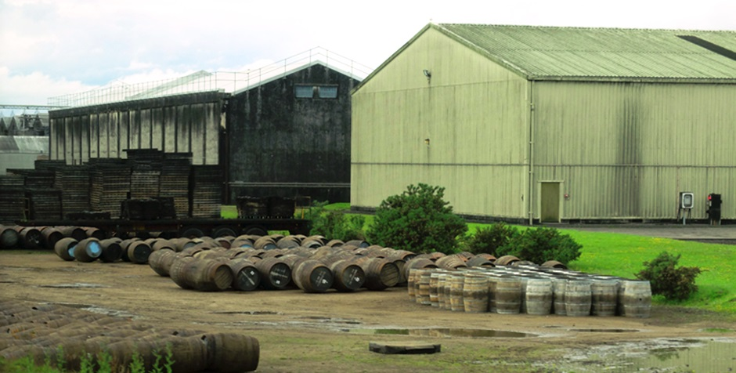
COMAH
Nigg Oil Terminal
Whyte & Mackay Distillery, Invergordon
Fort William Smelter
Loch Ewe Oil Fuel Depot
MOWI Fish Feed Plant, Isle of Skye

Slide 22
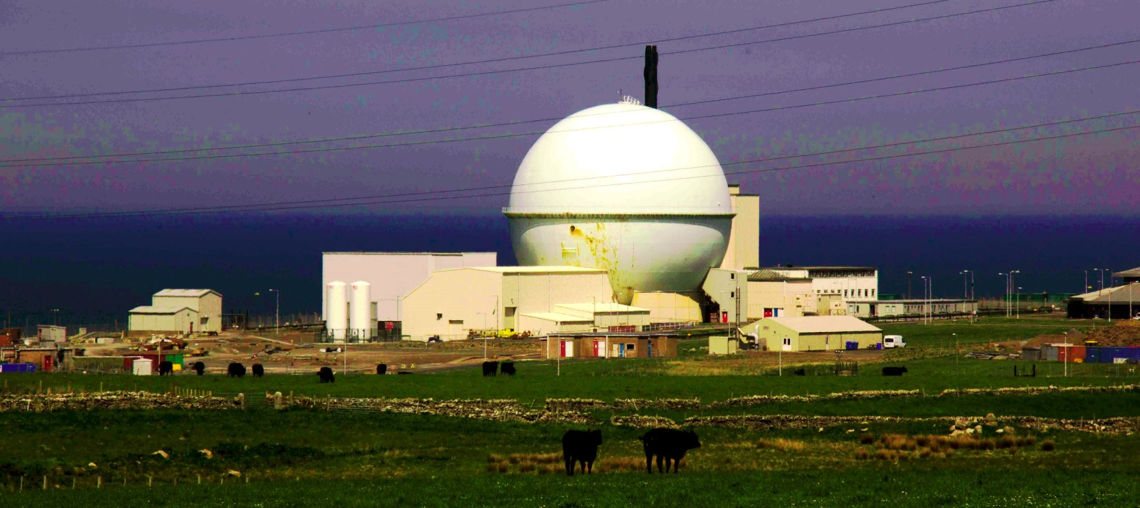
REPPIR
DSRL – Dounreay Site Restoration Ltd
Vulcan NRTE – RN Nuclear Reactor Test Establishment
Loch Ewe Operational Berth

Slide 23
Highland Council
Resilience Team

Slide 24
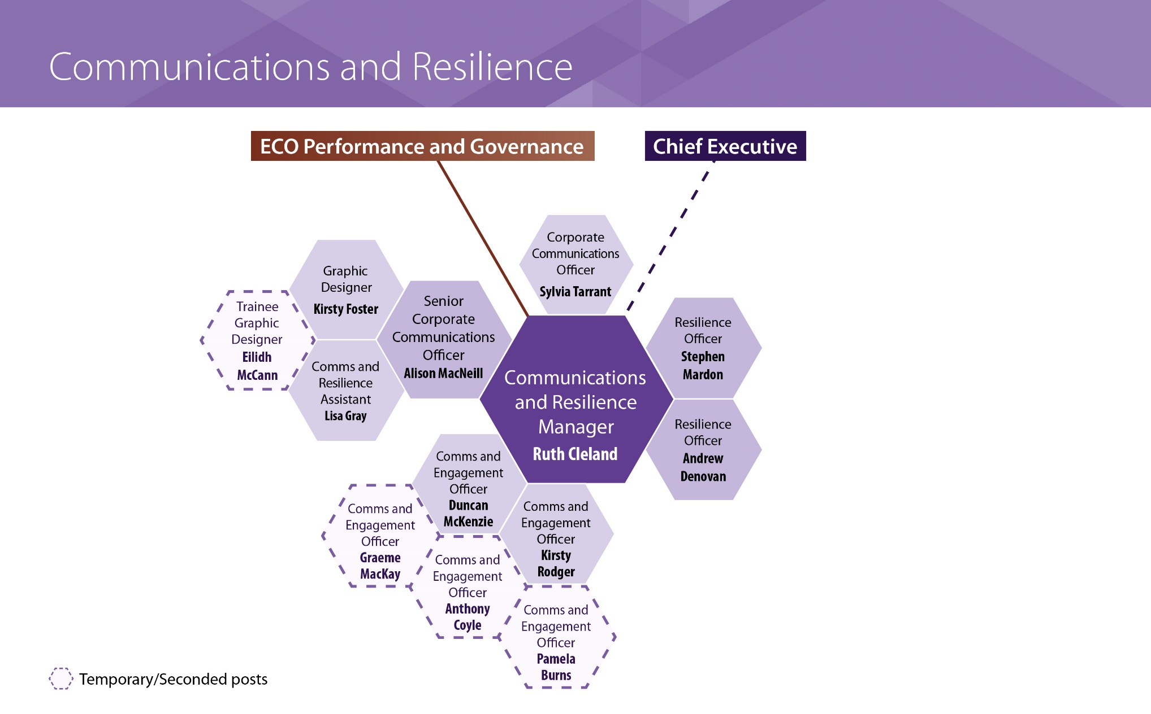
Communications and Resilience

Slide 25
Resilience Team
Provide an emergency planning service to THC.
The Team’s role is to:
Ensure Council’s obligations under CCA, COMAH, REPPIR and other relevant legislation are met;
Develop & deliver training programmes & exercises, all intended to prepare THC to deal with a Major Incident when it occurs;
Provide advice to those managing the response;
Maintain important links with numerous different organisations;
Help formulate Council’s BC arrangements;
Prepare plans to cover a variety of potential emergencies.

Slide 26
Resilience Team - Plans
  Plans are a legal requirement.
  Four types of plan:
  General Incident Plan, e.g. HILRP Response Guidance, THC GEP
  Risk Specific Plans, e.g. Oil Pollution Contg Plan
  Site Specific Plans – fixed hazard sites & schools
  Function Specific Plans, e.g. Business Continuity, Care for People, Mass Fatalities Plans
  Plans are developed in such a way that THC’s response can be implemented without the direct response of the Resilience Officer although, if available, we will provide advice and guidance.
Notes:
Multi-agency with a lead organisation. Different levels of plan (local, NoSRRP, national).
Plans must deal with effects not causes. No plan should exist if covered by the generic incident response plan.
Plans should not just cover the roles and responsibilities of agencies in the initial stages but should also cover recovery and public communications:
Consideration of recovery should be part of day to day management. The aim is to reach a point where additional demands on services have been reduced to the level at which they were before the incident occurred, often described as ‘ a return to normality’.
However the incident, and its effects, are likely to create a new ‘normality’, raising serious issues for the local authority. Including rebuilding the community, managing the financial implication, managing resources, responding to welfare needs and developing strategic issues.
The media play an significant role in warning and informing the public and it is important that the role of communication, and the assistance the media could provide, be considered.
Hand over
In the first instance the police will usually lead the co-ordination of the response (exceptions may include pandemic influenza, animal health emergencies etc) however, the Council Chief Executive assumes overall responsibility for the recovery stage.

Slide 27
Business Continuity Plans
  A Business Continuity Plan (BCP) is a system of prevention and recovery from potential threats to a company or organisation.
  BCPs ensure that personnel and assets are protected and able to function quickly following a disruptive incident.
  All Services should have BCPs.
  Impacts from loss of key roles, staff shortages, building loss, utility loss and ICT loss are considered, along with mitigation and contingency measures.
  Training and exercising.

Slide 28
Civil Contingencies
Preparedness & Response Structure

Slide 29
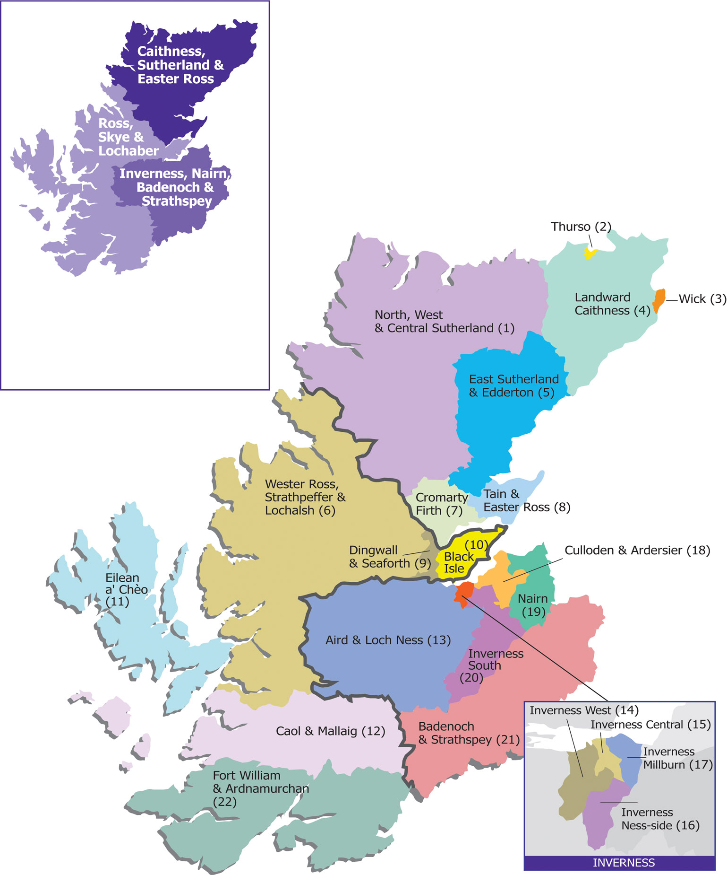
5 ELGs*
CAITHNESS &
SUTHERLAND
ELG
*Emergency Liaison
Groups
ROSS & CROMARTY
ELG
INVERNESS
ELG
SKYE &
LOCHABER
ELG
NAIRN BADENOCH & STRATHSPEY
ELG
Notes:
The system in Highland recognises that local knowledge and participation is key to a successful response, consistent with the principle of subsidiarity.
ELGs are unique to the Highlands and Islands and reflect the geographical challenge of exercising Command and Control from a central location.
ELGs meet several times a year to promote emergency preparedness. They are chaired by Police Scotland and attended by Category 1 and 2 agencies, as well as the BRC. Typical THC representation comprises the Ward Manager, Area Roads Manager and Area Care & Learning Manager. Any agency can call an ELG.
Thanks to MS TEAMS, ELGs now meet virtually. This has made them more inclusive, easier to attend, and for documents to be shared effectively

Slide 30
Highlands & Islands Local Resilience Partnership (HILRP)
CONTEST Protect & Prepare Group
Response Sub Group
Highlands &
Islands
Planning
Structure
Mass Fatalities Sub Group
HILRP
Working Group
Inverness ELG
Care for People Team
Shetland Emergency Planning Forum
NB&S ELG
Care for People Teams
Highland Care for People Group
Orkney Local Emergency Coordinating Group
Ross & Cromarty ELG
Care for People Teams
Lochaber & Skye ELG
Western Isles EP & Coordinating Group
Care for People Teams
Caithness & Sutherland ELG
Care for People Teams
Notes:
CONTEST is the UK’s counter terrorism strategy. Consists of 4 strands – the four ‘Ps’ – Prevent, Pursue, Protect and Prepare.
This framework is the key to the ‘Cooperation’ and ‘Information sharing’ duties as set out by the CCA.
It is ‘coordination through consensus’.

Slide 31
North of Scotland Regional Resilience Partnership (NoSRRP)
HILRP
The Highland Council
Shetland Islands Council
Orkney Islands Council
Comhairle Eilean nan Siar
Grampian LRP
Aberdeen City Council
Aberdeenshire Council
Moray Council
Tayside LRP
Angus Council
Tayside Council
Dundee City Council
Perth & Kinross Council
Response Capability Group
Risk & Capability Group
People Capability Group
Training & Exercising Capability Group
Public Communications Sub Group
Mass Fatalities Sub Group
Security/CBRN Sub Group
Mass Casualties Sub Group
NoSRRP
Planning
Structure
Critical Infrastructure/ Utilities Sub Group
Public Health Sub Group
Resilient Telecomms Sub Group
Animal Health Sub Group
Notes:
RRPs were introduced in November 2013. There are 3 RRPs in Scotland, providing the framework for managing resilience activities over a wide area basis. RRPs cover East, West and North of Scotland.
Composition of the NoS Regional Resilience Partnership – showing Local Authorities only (other responding agencies are also members).
NoSRRP has 4 Capability Groups. Two of these Capability Groups have Sub Groups, or specific work streams.

Slide 32
Forward Control Point
Emergency Services
Tactical – Emergency Liaison Group(s)
Chair: Police Scotland
Membership: Cat 1 & 2 Orgs + others
Location: Area Police Station
Highland
Response
Structure
Public Communications
Group
Chair: Police Scotland, or MCA for offshore incidents
Membership: Cat 1 & 2 Orgs + others
Care for People Team
Chair: NHS Highland
Core members: NHS Highland, THC & BRC
LRP Tactical Oversight Group
Chair: Police Scotland
Membership: Cat 1 & 2 Orgs + others
Location: Divisional Police HQ Inverness
Scottish Government
LRP Strategic
Chair: Police Scotland
Membership: Cat 1 & 2 Orgs + others
Location: Divisional Police HQ Inverness
Notes:
There are three levels of command. In Scotland, the terms Strategic, Tactical and Operational are used. In other areas of the UK, the terminology of Gold, Silver and Bronze is more common.
The number of levels used depends on the nature and extent of the incident. The structure builds from the bottom up.
If required, other response cells may be set up, including:
Recovery Working Group – usually chaired by THC, but could be NHS Highland, etc.
STAC (Scientific and Technical Advice Cell) – chaired by Director of Public Health, NHS Highland.

Slide 33
General Emergency Plan (GEP)

Slide 34
Key Purpose of GEP
To outline:
The organisational and management structure of the Council’s response
How the need for an emergency response is recognised… then the alerting and activation procedures
How the Council’s response will integrate with that of other Cat 1 & 2 Responders
Must be:
Flexible (generic) for all circumstances
Consistent with site-specific and other plans
Notes:
It is about having the correct systems in place – accountable, flexible and robust – to know what to do next.

Slide 35
Aims & Objectives of THC (Section 3)
In responding to an emergency, principal aims of THC are:
Provide assistance to the emergency services;
Ensure the speedy restoration of any normal services which may have been disrupted or destroyed;
Provide professional/technical advice, personnel, transport, equipment, use of premises and any other resources required during an emergency;
Co-ordinate the situation when the emergency services have completed their phase of the emergency response;
Enable the Council to continue to deliver appropriate services during any emergency response;
To comply with the CCA and it’s accompanying regulations.
Notes:
Recovery: E.g. Grenfell Tower, Lockerbie, etc.
From the beginning of an emergency, Council staff are already planning for the recovery phase and involved in relevant decisions that might have long term consequences. Elected members should have a similar overview and awareness of consequences.
A Recovery Group may be set up to manage the rebuilding, restoration and rehabilitation of the community and environment.

Slide 36
3 Categories of Incident (Section 4)
ROUTINE (Level 1)
Day-to-day incidents, requiring no or very limited outside assistance. Not dealt with in the GEP.
UNUSUAL (Level 2)
Will require a number of Category 1 & 2 Responders to work together.
MAJOR (Level 3)
Will require a full multi-agency response.

Slide 37

ROUTINE (Level 1) Incidents
E.g., minor weather-related incidents; fire alarm activation; contained floods; small-scale utility outages; minor building damage; temporary closure of transport routes caused by RTCs/infrastructure failure
Usually handled at site level with Area Officers, Duty Officers, facilities management, possibly local Police, and local fire resources or public health
Quickly or easily resolved
Localised & contained impact on department/building/ infrastructure/environment
No casualties, no threat to life, no panic
Minor impact on staff and minimal impact on service users/the public/other agencies (more inconvenience than risk to welfare)
Minor reputational risk
Local media interest
Notes:
Read from GEP

Slide 38

UNUSUAL (Level 2) Incidents
E.g., severe weather resulting in overnight power outages/road closures; building fire/gas leak/unexploded ordnance requiring evacuation of people to an Emergency Support Centre; cargo vessel aground; major wildfires; minor pollution/contamination incidents
Likely to require formation of an ELG & Care for People Team to co-ordinate local multi-agency Tactical response
Typically involves human welfare issues, and/or some risk or damage to property and the environment
Moderate impact on staff and on service users/the public/other agencies
Reputational risk
Local and regional media interest, with potential for some national coverage
Potential to escalate to a MAJOR INCIDENT
Notes:
Read from GEP

Slide 39

MAJOR (Level 3) Incidents
E.g., severe weather resulting in large-scale impacts; major fire/ explosion; civil unrest; terrorism; widespread and prolonged power outage; hazardous substance spill; major flooding; major oil spill; major shipping incident; prolonged closure of a major lifeline route; large-scale public health incident/outbreak, large-scale communications outage, CBRN incidents; any incident involving mass casualties
In addition to an ELG & Care for People Team, likely to require LRP Strategic, as well as THC Tactical & Gold Groups
Likely to be major impact on staff and service delivery
Reputational risk – corporate & individual responses may be scrutinized by the media and in subsequent public enquiry
Intense local, regional and national media interest, with potential for international coverage
Ministerial involvement from Scottish and UK Governments
Notes:
Read from GEP

Slide 40
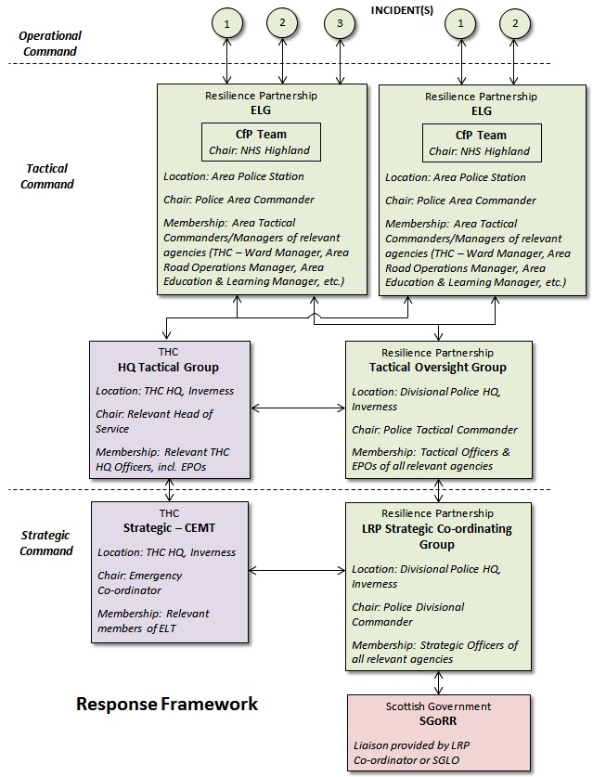
Response Framework (Section 6)
GEP, page 26

Slide 41
Role of
Elected Members

Slide 42
Role of Elected Members
Emergency Response phase:
Civic/strategic lead for Council, acting as spokesperson
Recovery phase (once Emergency Response phase is over):
Leading the community
Overview
Leadership and Support to their constituents.
Sharing approved information and advice with the community.
Source of local knowledge, help and specialist advice.
Kerslake Report. Recommendation:
“That civic leaders taking a highly visible role in response to and recovery from major incidents enhances community reassurance and confidence”. (Pgs 205-6)
Notes:
During an incident Elected Members have a limited role. During the recovery stage, they have a major role since recovery will be led by THC.

Slide 43
Role of Elected Members
Areas which the Elected Member may assist:
Provide a focus for community concerns;
The public face of THC at the local level;
Identify problems and vulnerabilities in the community that may require priority attention and feed them back Ward Managers;
Enhance local community liaison and engagement;
Visit people affected and provide a listening ear and to give reassurance;
Assist with VIP visits;
Assist with debrief sessions with the community.
Notes:
This is the general role of the elected member, as with other responders the role doesn’t change its just the circumstances in which you are carrying out the role which is more challenging.
The public face of THC at the local level:
Being a source of strength, inspiration and leadership for the local community, by acting as a community champion
Explaining the reasons for decisions taken in dealing with recovery
Enhancing local community liaison and engagement:
Having knowledge of local personalities and resources
IMPORTANT: However an Elected Member is involved, they must keep a log of significant actions and events. This information will be essential for subsequent debriefs and any official inquiries related to the emergency, e.g. The Grenfell Inquiry

Slide 44
Crisis Communication
Stages of crisis media reporting
1 The Story unfolding {information, live pictures, facts figures, soundbites}
2 The human stories {testimonies, impact on people, places, organisations, stories, photos, relatives, deceased}
3 Analysis and Criticism {why did it happen, who is responsible, blame, public enquiry, political comment}

Slide 45
Crisis Communication
Supporting the response/recovery
Be prepared - know the facts
Squash false rumour/conjecture
Express sympathy with those affected
Public reassurance – agencies working together to manage the incident
Reinforce the key messages – where to get information, help, water, food, shelter etc
Be - Quick to praise and Slow to attribute blame

Slide 46
Examples of incidents since 2010
Notes:
Some case studies to quickly run through.

Slide 47
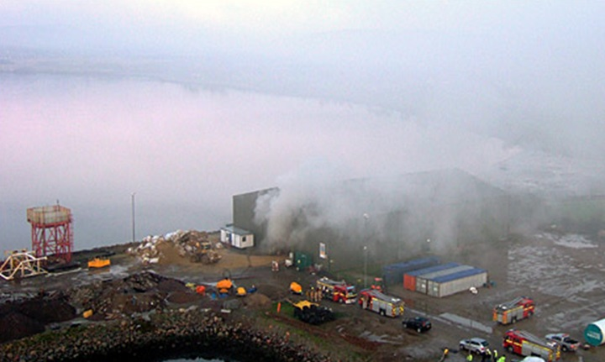
Invergordon Fish Meal Shed Fire, January 2010
200m cordon put in place.
Pupils and staff at Park Primary, South Lodge Primary and Invergordon Academy sent home.
Residents advised to remain indoors with windows and doors closed.

Slide 48
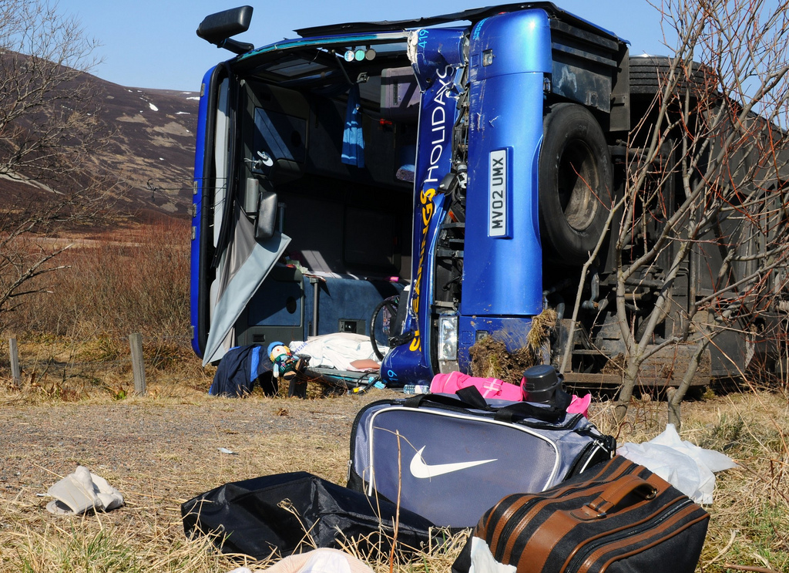
Shearings A9 Bus Crash, April 2010
32 elderly passengers & 1 driver: 14 injured.
‘Major Incident’ declared and Tactical Group established.
Emergency Support Centre set up by THC in Highlander Hotel, Newtonmore.
Notes:
Other incidents involving tourist buses include:
Coach carrying 45 Austrians left the road and toppled into a ditch north of Syre, Sutherland, in 2003.
Coach with 26 Chinese tourists veered off the A82 in 2015
Coach with 50 tourists onboard left the A86 nr Laggan in 2016.

Slide 49
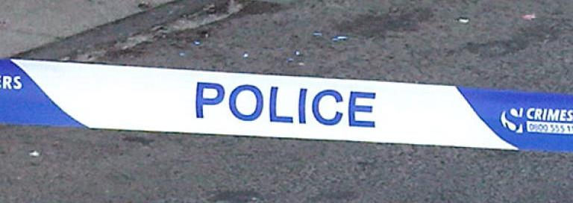
Unexploded Ordnance, Shandwick, May 2010
Fisherman recovered mine, dismantled it and took part of it into his home in Shandwick… then reported discovery to Coastguard.
Police evacuated 20 homes and established a 50m cordon, as advised by Navy EOD.
Memorial Hall in Balintore set up as Emergency Support Centre.
School buses and other traffic diverted by THC.
Notes:
Similar incidents in recent years include the discovery of wartime ordnance at:
Nairn and Rosemarkie beaches
At Kinellan, nr Strathpeffer
Assembly Rooms in Wick

Slide 50
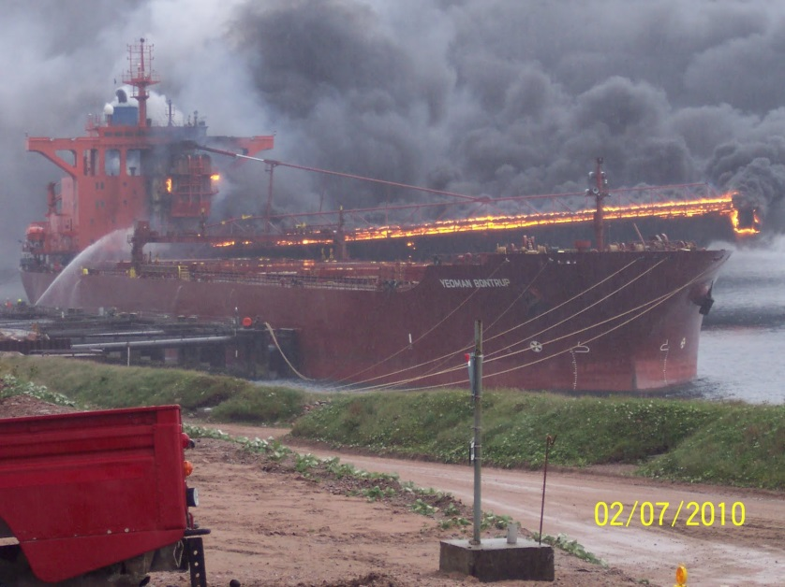
Yeoman Bontrupp, July 2010
Explosion and major fire on board 100,000 tonne bulk carrier at Glensanda Quarry.
No road access
SCU set up at Glensanda and Environment Group established.
869 tonnes of HFO in bunkers and 61 tonnes of MGO.
6 days to extinguish fire.
Notes:
Shipping incidents are relatively common, owing to Highland’s 4,905km of coastline – 21% of the Scottish total – and busy shipping lanes such as the Minch & Pentland Firth. The coast is relatively unmodified and ecologically sensitive, and the Highland economy depends on its status as a clean and unpolluted resource, so these events when they happen have potential to cause significant impact.
Yeoman Bontrupp, July 2010
Explosion and major fire on board the 100,000 tonne bulk carrier, Yeoman Bontrup at Glensanda Quarry
Operation hampered by remote location on Morvern peninsula – no road access
SOSREP in control, with SCU set up at Glensanda
Scottish Environment Group set up
MCA mobilised pumping and breathing apparatus from Dundee and Barnsley
Briggs on site
6 days to extinguish all fires
839 tonnes of HFO in bunkers and 61 tonnes of MGO
If vessel sunk due to fire, or grounded due to firefighting water, fuel tanks may have punctured

Slide 51
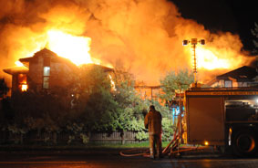
Culloden Court Care Home Fire, October 2010
59 residents & 12 staff evacuated.
Smithton Primary School established as an Emergency Support Centre by THC.

Slide 52
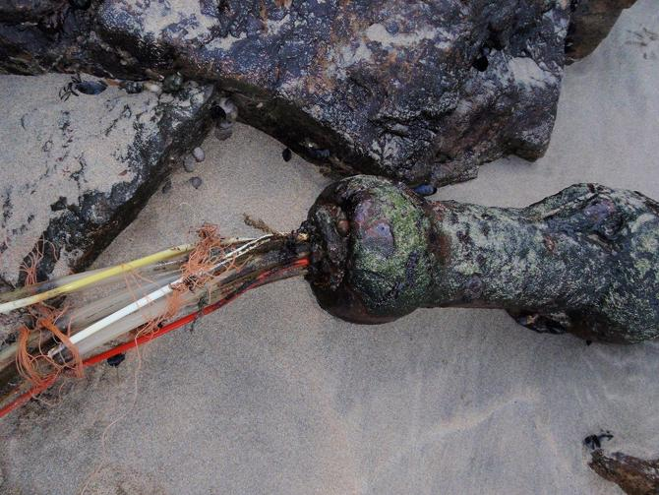
Loch Carron Cable Theft, June 2012
Thieves damage sub-sea fibre optic cable.
10,000 phone, broadband users affected + mobile phone services.
10 communities lost 999 service.
Multi-agency Tactical Group set up address impacts, e.g. on GP Practices, ATM machines, filling stations, shops, visitors.

Slide 53
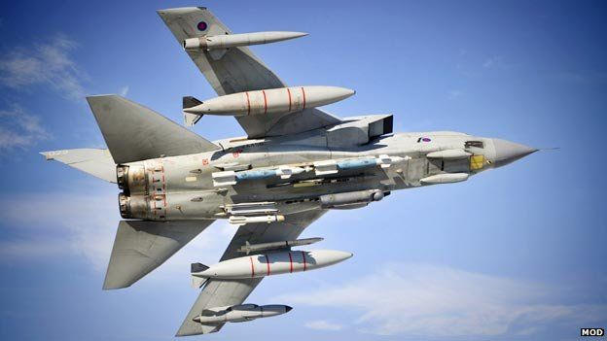
RAF Lossiemouth Tornado Crash, July 2012
Two Tornado GR4 jets crash into Moray Firth, near Helmsdale.
RAF requested assistance from THC to accommodate specialist team searching for wreckage along coastline.
Golspie High School is used.
Notes:
The Resilience Team maintains links with RAF, Army and Royal Navy Liaison Officers.
RAF also lost a Tornado in the Minch in 2011
RN’s HMS Astute grounded on Skye in 2010

Slide 54
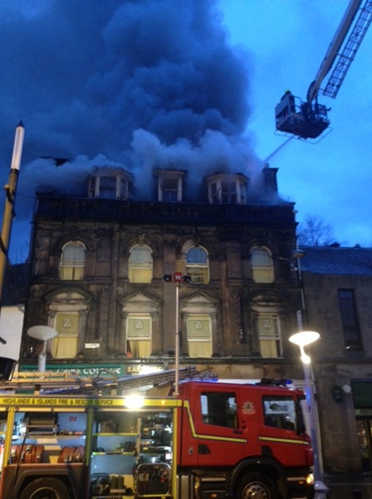
Eastgate Backpackers Hostel Fire, April 2013
Fire breaks out shortly after 5 a.m.
54 persons evacuated.
Emergency Support Centre established by BRC & THC in the Spectrum Centre.
BRC provided support with arranging accommodation, food & clothing and liaising with foreign embassies.

Slide 55
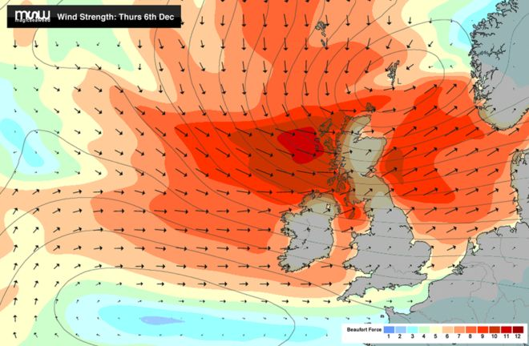
Severe Weather, Dec 2013
Met Office issued Amber ‘be prepared’ warnings for high winds, up to 90mph, across H&Is.
SEPA predicted coastal flooding.
Tactical Oversight Group set up, chaired by Police Tactical Commander.
Local response managed by ELGs, chaired by Police Area Commanders.
Power was lost to 130,000 homes across Scotland – care for vulnerable people.

Slide 56
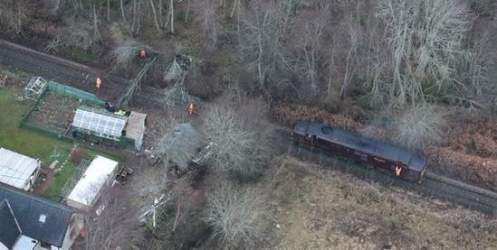
Jetstream Storms, 8th-13th Jan 2015
Met Office issued Amber ‘be prepared’ warnings for high winds, up to 100mph.
First storm on 8th & 9th:
  113mph Stornoway, 110mph Loch Glascarnoch.
  75,000 homes in H&Is without power.
  Rail services suspended.
Second storm on 10th:
  100mph Shetland.
Third storm on 12th:
  70mph wind, followed by snow.
Many customers without power for >2 days.
Radio & phone masts down, roads closed.
11 welfare facilities set up by SSEN.
Notes:
Severe weather event with gale force winds resulting in:
Extensive and long term power outages
Networks down – phone and service centres
Radio masts down and affected BBC Highland
Roads closed with trees and branches
Building damage
Flooding
Extended time period affecting resilience – followed by ice and snow storms during following days
Photo is of Dingwall. ScotRail cleared over 400 trees from their network
Positives:
Early warning to public of storms and risk of disruption and power outages
Council use of social media
ELGs worked well where they were stood up early
Good internal communication between Ward Managers and comms
Community pulled together
SSE social media worked well with lots of updates
Communities very positive and not critical
Communications with Members – keeping informed
SSE got everyone connected very quickly considering scale
Challenges:
It happened over the weekend.

Slide 57
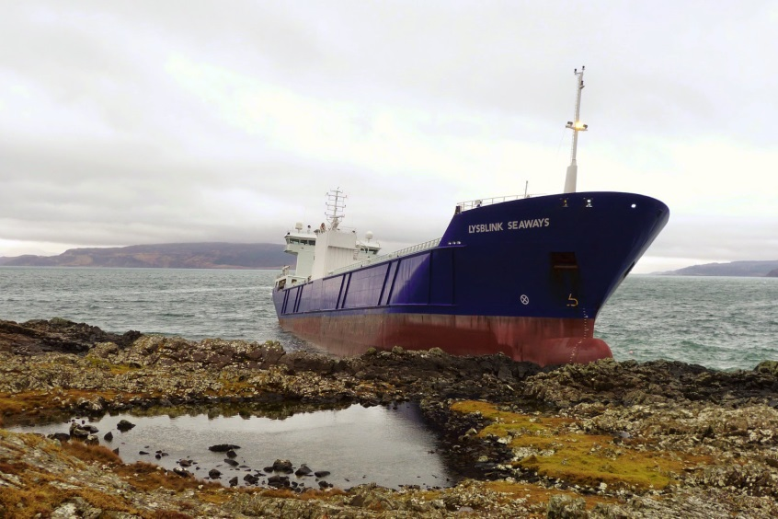
MV Lybslink Seaways, February 2015
Ran aground at Kilchoan, carrying 274 tonnes of MGO and cargo of paper.
SOSREP set up a SCU at Kilchoan Coastguard building, ten Kilchoan Community Centre
Council deployed oil spill response equipment to area (at MCA request), with 4 THC staff.
Notes:
Passing through Sound of Mull, ran aground at Kilchoan
274 tonnes of MGO and 5.5 tonnes of lubricating oil
SOSREP set up SCU at Kilchoan Coastguard building, then Kilchoan Community Centre
Scottish Environment Group established
Council deployed Tier 2 equipment (at MCA request), with 4 staff
THC’s response managed by Council Oil Pollution Officer
Assistant Area Community Services Manager deployed to Kilchoan as LO with MCA/Contractors
National Stockpile & Briggs deployed by MCA
Council’s absorbent boom used (by Briggs) and suitable skip sourced

Slide 58
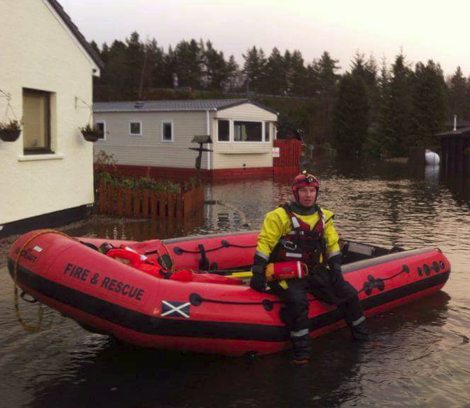
Aviemore Holiday Park Flooding, Dec 2015
All 103 premises searched – 22 adults, 3 children & 7 dogs rescued.
Emergency Support Centre set up at MacDonald Highlands Hotel, Aviemore.
NB&S ELG met to co-ordinate incident.
Notes:
Challenging rescue for SFRS:
Water up to 4ft deep near the river, with moderate current in places
Debris in water (gas cylinders, bins, etc.)
Submerged obstructions/holes
Reporting of recent hurricanes has seen members of the public wading waist deep through similar waters. There’s an important message here, the same with incidents that might involve fires or toxic substances: the site of an emergency can be a dangerous place. As Elected Members you need to consider your own safety first – do not attempt to visit the site, and follow the guidance of the emergency services at all times. It is essential that you do not become part of the emergency.

Slide 59
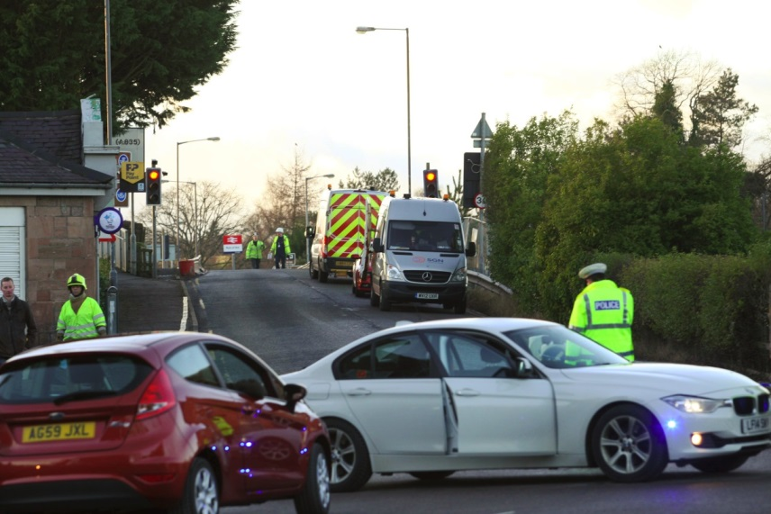
Muir of Ord Gas Leak, February 2016
Gas pipeline ruptured under railway bridge.
SFRS established 200m cordon.
200 homes, schools and businesses affected – advised to stay in doors with windows shut.
Gas supply to homes interrupted.
R&C ELG identified vulnerable people and ensured appropriate support.
Notes:
Gas pipeline on Great North Road, Muir of Ord, was ruptured by workers clearing ground under the railway bridge. This resulted in a major gas leak and the emergency services were alerted. The SFRS instigated a 200 metre cordon around the scene. The RVP was identified and the Police Incident Officer held on scene coordination meetings with partner agencies and the Local Emergency Liaison Group was activated at Dingwall Police Station.
The affected area included in excess of 200 homes, schools and a number of businesses. Local residents including schools in the area were requested to stay indoors with windows shut. Network Rail were informed and a suspension of train services made as a precaution.
The Ross & Cromarty ELG continued to meet in Recovery in light of the fact that over 200 homes would be without gas for a number of days. The Care for People sub group chaired by the NHS identified vulnerable people in the affected area and ensured appropriate support provided.

Slide 60
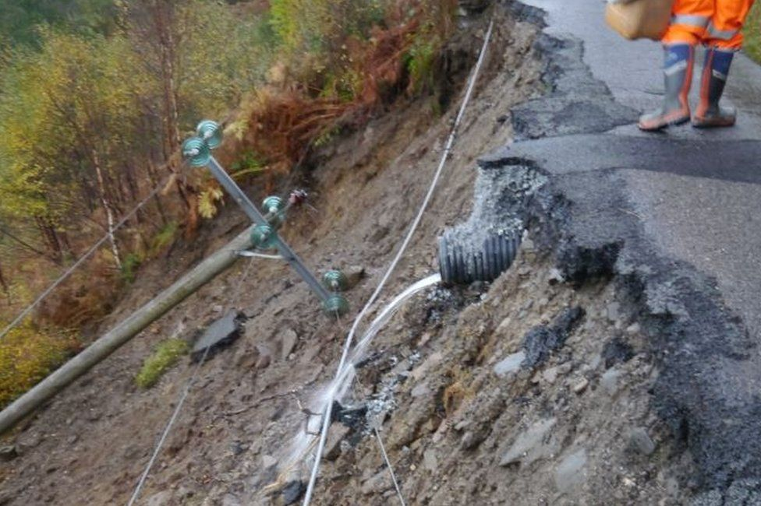
Inverie Landslip, October 2017
15 metre section of road between Scottas and Airor, Knoydart, collapsed without warning.
Lifeline route serving 16 properties.
Multi-agency co-ordination to maintain access for emergency services and support for the community.

Slide 61
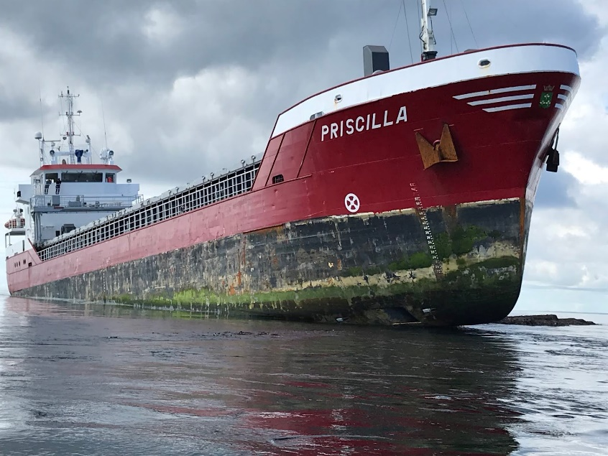
MV Priscilla, July 2018
Ran aground near Muckle Skerry in the Pentland Firth.
Carrying 25 tonnes of MGO and cargo of fertiliser.
Cargo removal took several days – weather remained unusually calm.
Vessel successfully recovered and no pollution.
Notes:
Ran aground near Muckle Skerry, Pentland Firth
Cargo of fertiliser and 25 tonnes of MGO
Scottish Environment Group formed
Cargo had to be unloaded to allow vessel to refloat
Cargo removal took several days – luckily weather remained calm throughout
Vessel recovered and no pollution, but had weather/sea conditions been rough the outcome would have been different

Slide 62
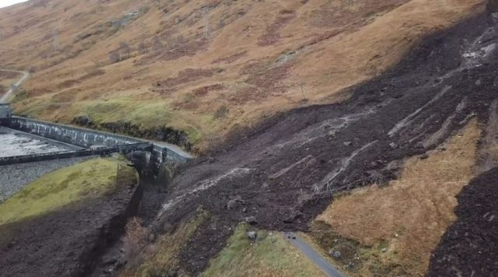
Loch Quoich Landslide, November 2018
1km long landslip severed HV transmission line to Skye and Western Isles.
Blocked road to Barisdale Estate
ELG met to support visitors, residents and livestock affected.
Temporary All Terrain Vehicle (ATV) route established.

Slide 63
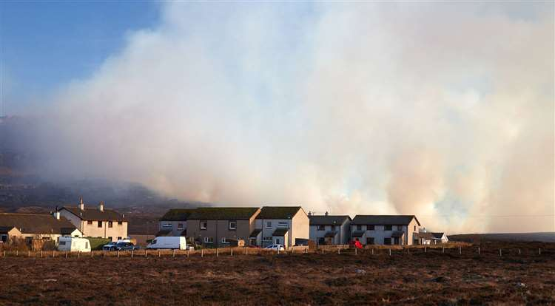
Durness Wildfire, April 2019
Five people from 11 properties evacuated to nearby hotels as fire came within 30 metres of their homes.
Residents returned home later same day.
ELG and local Care for People team stood up.
Wildfire took 4 days to bring under control, and at one point was spread over 3 miles.

Slide 64
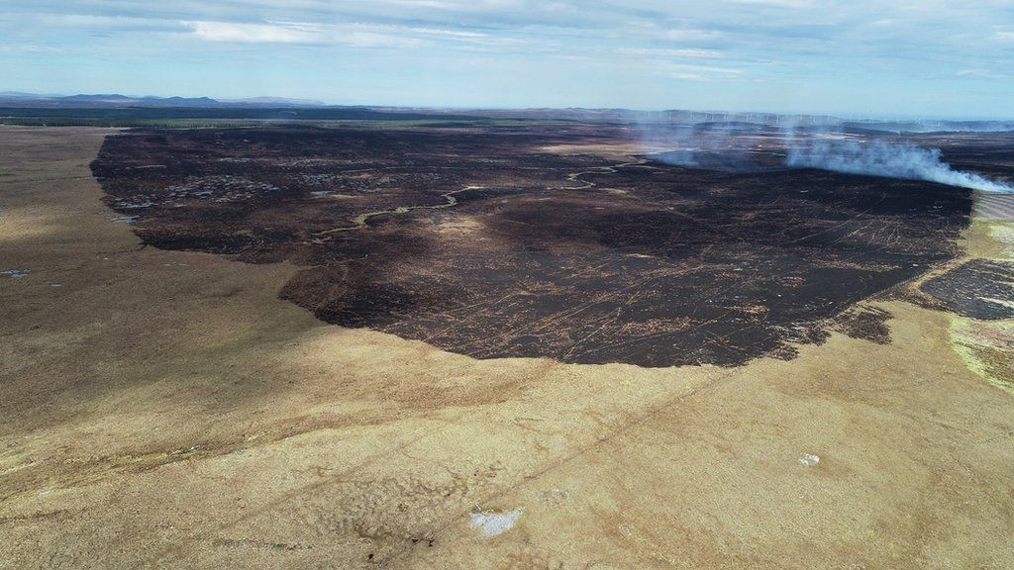
Melvich & Strathy Wildfire, May 2019
Wildfire burned for 6 days across >20,000 acres, including 1,482 acres of RSPB Forsinard Flows nature reserve.
Affected electricity to 800 homes.
A836 (NC500 route) temporarily closed due to drifting smoke – school bus route impacted and children kept in school until safe to travel.

Slide 65
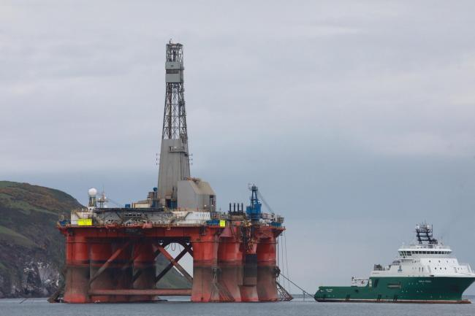
Oil Rig Protest in Cromarty Firth, June 2019
5 environmental campaigners board an oil rig, occupying it for 4 days.
Major police operation to remove them from the platform.
A Multi-Agency Coordination Centre (MACC) established at Divisional Police HQ – attended by Highland Council Resilience Officers
Notes:
Environmentalists scaled the TransOcean-owned vessel Paul B Loyd, which was berthed in the Cromarty Firth in June ready to sail out to BP’s Vorlich North Sea oilfield
A helicopter, the RNLI lifeboat, coastguard and Cromarty City Port Authority staff were all on standby in case of an emergency rescue. It was estimated it cost the operators £120,000 a day and BP an unknown amount, and the police operation, which included a specialist rope access team, cost £140,000.
The charge against the activists stated that they boarded an oil platform without permission or lawful authority, refused to leave, attached themselves to said platform by tethers or chains, placed themselves and others in potential danger and prevented persons going about their business between June 9 and 14.

Slide 66
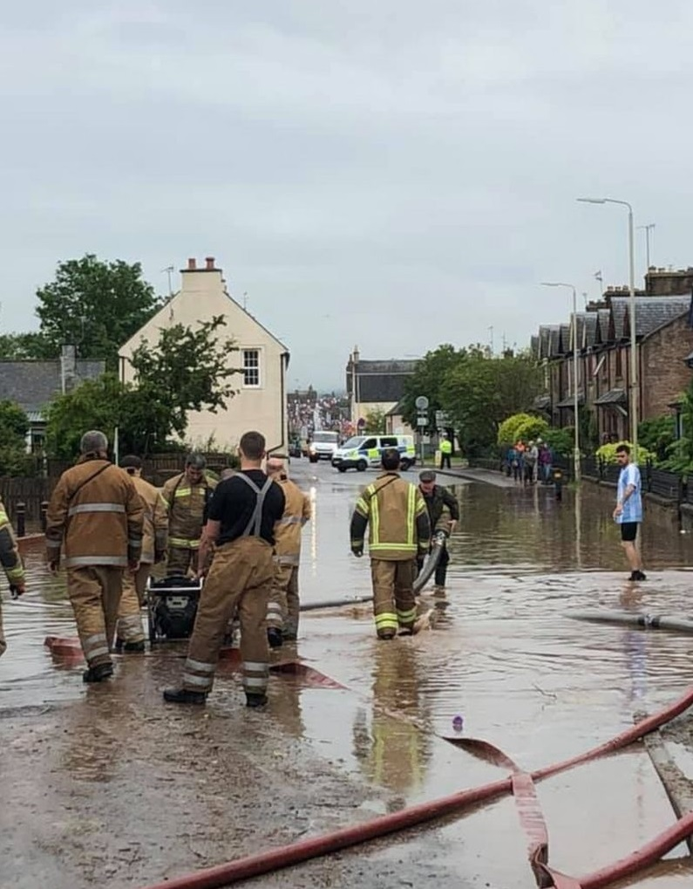
Dingwall Flooding, July 2019
Heavy downpours caused flooding to parts of Dingwall.
Council staff, sandbags & equipment deployed.
LRP meeting held following afternoon to assess wider impacts over next 24hrs.
Multi-agency Drop in Session held for the public.
Notes:
On Wednesday 10 July, Dingwall experienced an exceptional period of weather, after which the Met Office confirmed that a month’s-worth of rain had fallen within an hour on a very localised area. The volume of water resulted in the drainage system being unable to
cope. In addition, a high tide restricted the flow of the water to dispersal to the sea.
Areas affected included Munro Place, Burn Place, Simpson Place, Achany Road, Blackwells Street, Bridaig Avenue, Pefferside Park and a number of individual properties in the wider area. Mainly private properties affected. 2 council buildings affected and 1 elderly couple evacuated.
Community engagement: a multi-agency drop in session attended by c.60 persons took place on 6th August in the Council Offices, Dingwall. Agencies attending comprised Scottish Flood Forum, SEPA, Police Scotland, SFRS, NHS Highland, and THC’s Development & Infrastructure, Flood Management Team, Community Services, Roads & Housing Teams, providing advice and answering questions.

Slide 67
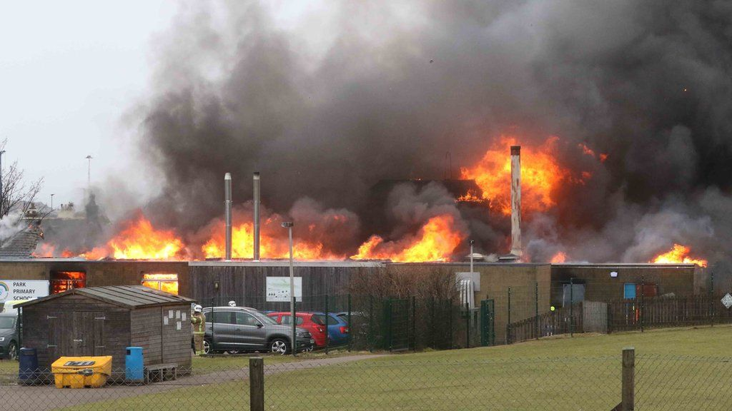
Park Primary Fire, February 2020
Major fire destroys school building.
All children & staff safely evacuated to Invergordon Academy.
Children's possessions lost in the fire.
176 pupils & 32 nursery children required temporary school accommodation.
Notes:
Blaze happened on a Monday morning, with SFRS alerted at about 1000hrs.
All children were safely evacuated before the fire escalated, but they had to leave possessions, such as coats, behind. Members of the public and other Highland schools donated personal and classroom items, and THC also granted each child £100 to cover the cost of lost possessions. Although not physically harmed, there were concerns about the children suffering trauma and they were offered psychological counselling.
Lessons were temporarily accommodated at Invergordon Academy from Thursday of the same week. A series of meetings were held with parents and the community to keep them informed and involved in the decision making process.

Slide 68
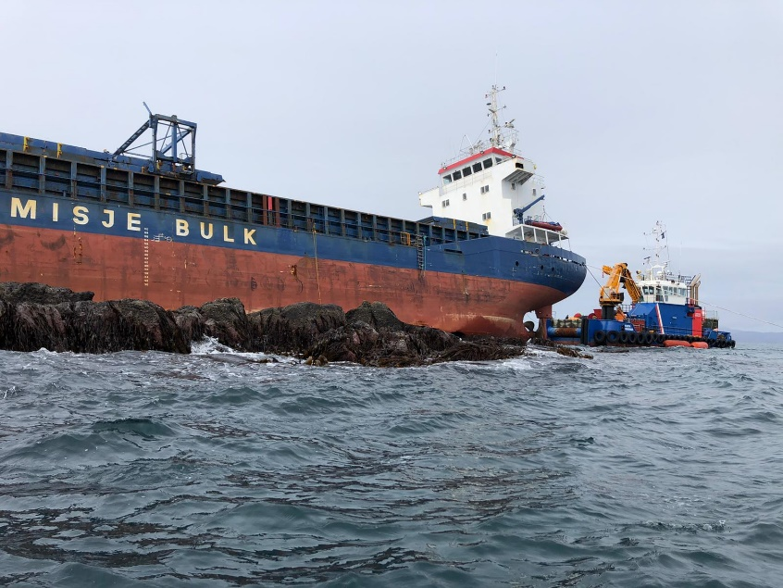
MV Kaami, March 2020
Grounded in the Minch (same day as first UK Covid-19 Lockdown was announced).
Carrying 63 tonnes of MGO and nearly 2000 tonnes of SRF pellets.
Recovery took 43 days, involving 25 SCU and 12 Scottish Environment Group meetings.
Vessel was towed to Kishorn dry dock, and broken up.
Notes:
Went aground in the Minch, between Skye & Lewis (same day first UK Covid-19 Lockdown was announced)
Carrying 63 tonnes of MGO and nearly 2000 tonnes of SRF (Solid Recovered Fuel) in pellet form, which is composed of shredded recycled cardboard and plastic
All cargo was recovered; vessel towed to Kishorn to be broken up

Slide 69
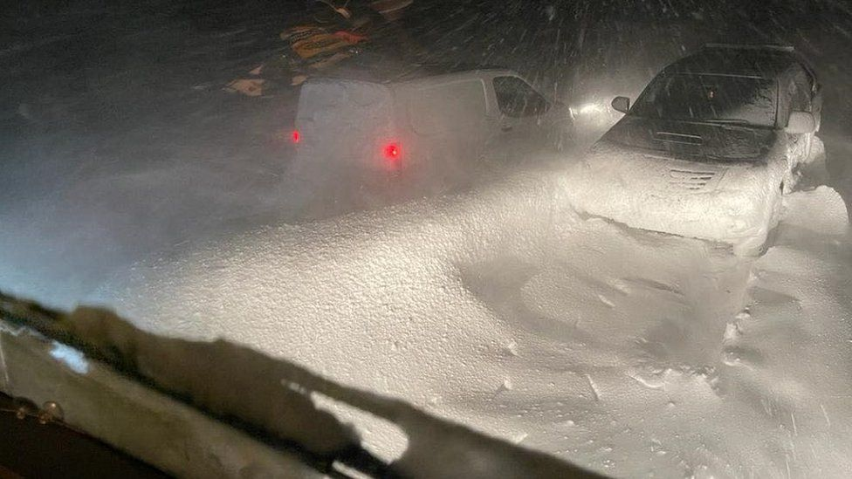
Vehicles stuck in snow on A835, February 2021
22 vehicles, including a bus, stranded overnight in snow between Garve and Ullapool.
‘Major Incident’ declared.
ELG, local CfP Team and LRP stood up.
Rest centres established in Lochbroom Leisure Centre and Aultguish Inn.
Notes:
The A835 Incident happened overnight on 5th February 2021, involving 22 vehicles, including a bus, becoming stranded in snow on a remote and exposed section of the A835 between Garve and Ullapool. Initially, a lorry became stuck, which blocked the road and very quickly the route filled in with drifting snow. To the west, a rest centre was established in the Lochbroom Leisure Centre, and to the east, at the Aultguish Inn. The local community was very proactive. Most people trapped in their vehicles remained in them overnight, as evacuation was not safe/possible. Dundonnell Mountain Rescue carried out regular welfare checks of vehicle occupants.

Slide 70
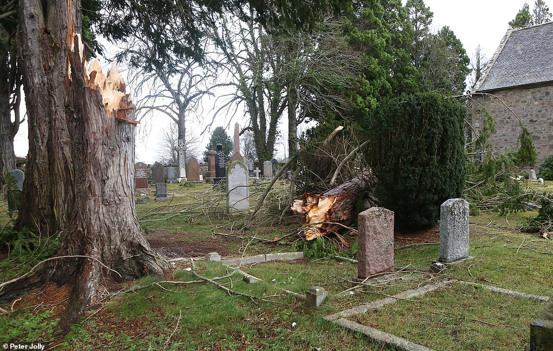
Storms Malik & Corrie, January 2022
Met Office Amber warning for wind, and SSEN Red Alert.
LRP met in preparation, and in response.
Extensive road closures – Muir of Ord cut off and A9 closed at Golspie.
Thousands without power in Highland – four days to restore all customers.
SSEN deployed welfare facilities.
Notes:
Storm Malik – Friday 28th January 2022
Storm Corrie – Sunday 30th January 2022

Slide 71
Community
Resilience

Slide 72
Community Resilience
In 2011, Scottish Government developed a Toolkit for creating Community Resilience Plans, followed in 2020 with new guidance and template plan:
To encourage individuals and communities to be more resilient;
Recognising that different communities have different risks/resources and are best placed to draw up their own plans.
The Resilience Team and SSEN have been working together to promote CRPs to Community Councils. Many Highland communities now have CRPs.
Resilience Team recently produced 2 YouTube videos, introducing community resilience and producing your community resilience plan.
Notes:
Scottish Government has recognised that during emergencies the responding agencies have to prioritise their resource and it may be that some communities may not get immediate assistance.
Scottish Government defines Community Resilience as “…communities and individuals harnessing resources and expertise to help themselves prepare for, respond to and recover from emergencies, in a way that complements the work of the emergency services”.
Experience has shown that individuals and communities do help each other in emergencies and Scottish Government are encouraging communities to prepare their own emergency plans to build on this.
Community Emergency Plans should include:
A Risk Assessment (carried out by the community itself)
An inventory of local skills and resources
Key locations, e.g. local buildings that can be used as Reception Centres
Emergency Call out list, together with a telephone cascade
List of Community Organisations that may be able to provide assistance in an emergency
Activation triggers and initial actions.
Lots of information about Community Plans, including a template plan and examples of completed plans, is hosted on the Scottish Government’s ReadyScotland website.

Slide 73

Ready Scotland
Scottish Government’s advice on preparing for and dealing with emergencies.
Notes:
Preparation is not an activity confined solely to responders. Individuals, communities and organisations of every type should consider how best to prepare themselves for emergencies. The Ready Scotland website provides a wealth of information and guidance for individuals, for example practical suggestions on preparing for adverse weather or developing a personal emergency plan. Similarly, ready Scotland provides advice for community groups.

Slide 74
Questions?

Slide 75
Abbreviations
BC Business Continuity
BRC British Red Cross
CBRN Chemical, Biological, Radiological & Nuclear
CCA Civil Contingencies Act
CfP Care for People
COMAH Control of Major Accident Hazards
CRP Community Resilience Plan
CRR Community Risk Register
DEPZ Detailed Emergency Planning Zone
DSRL Dounreay Site Restoration Limited
EH Environmental Health
ELG Emergency Liaison Group
EM Emergency Mortuaries
EOD Explosive Ordnance Disposal
EP Emergency Planning
GEP General Emergency Plan
GP General Practioner
HFO Heavy Fuel Oil
HILRP Highlands & Islands Local Resilience Partnership
HSE Health & Safety Executive
LA Local Authority
LO Liaison Officer
LRP Local Resilience Partnership
MCA Maritime & Coastguard Agency
MGO Marine Gas Oil
MF Mass Fatalities
MRC Marine Response Centre

Slide 76
Abbreviations, cont.
NB&S Nairn, Badenoch & Strathspey
NHS National Health Service
NoSRRP North of Scotland Regional Resilience Partnership
NRTE Naval Reactor Test Establishment
ONR Office for Nuclear Regulation
OPCP Oil Pollution Contingency Plan
PI Pandemic Influenza
PIZ Public Information Zone
RAF Royal Air Force
REPPIR Radiation (Emergency Preparedness & Public Information) Regulations
RN Royal Navy
RRP Regional Resilience Partnership
RVP Rendezvous Point
SCU Salvage Control Unit
SEPA Scottish Environment Protection Agency
SFRS Scottish Fire & Rescue Service
SOSREP Secretary Of States Representative
SFR Solid Recovered Fuel
SSEN Scottish & Southern Electricity Networks
TEZ Temporary Exclusion Zone
THC The Highland Council
VIP Very Important Person

