Slide 1
Using the Performance and Risk Management System (PRMS)

Slide 2
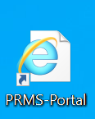
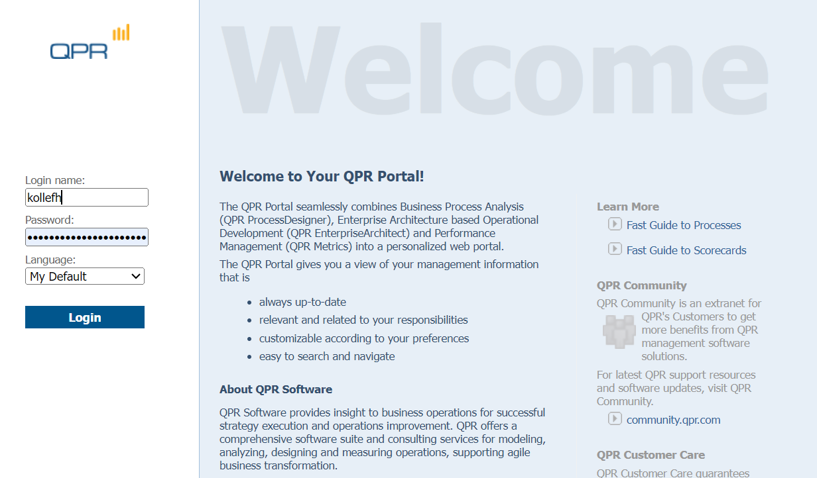
Find the PRMS-Portal icon on your desktop
Login with the username & password you use on your Council laptop
Note: Only use your short daily username eg. "kollefh", without: @highland.gov.uk

Slide 3
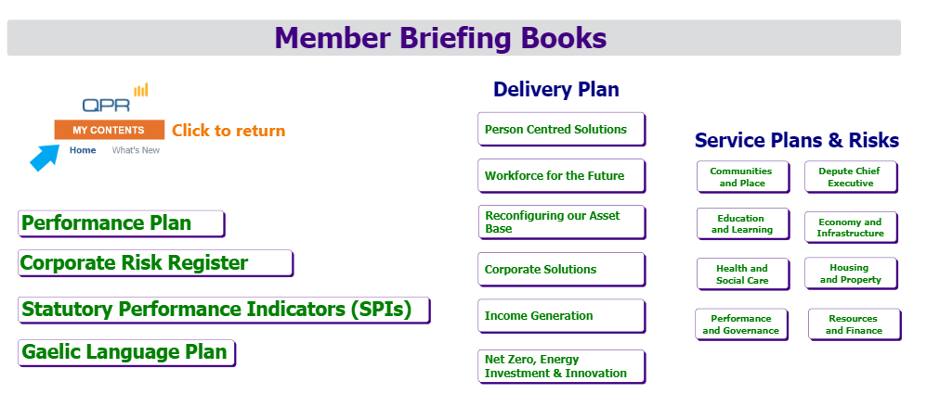
View Briefing Books by topic on your Homepage
Delivery Plan - Corporate Solutions Portfolio Members Report
Portfolio Briefing Books

Slide 4
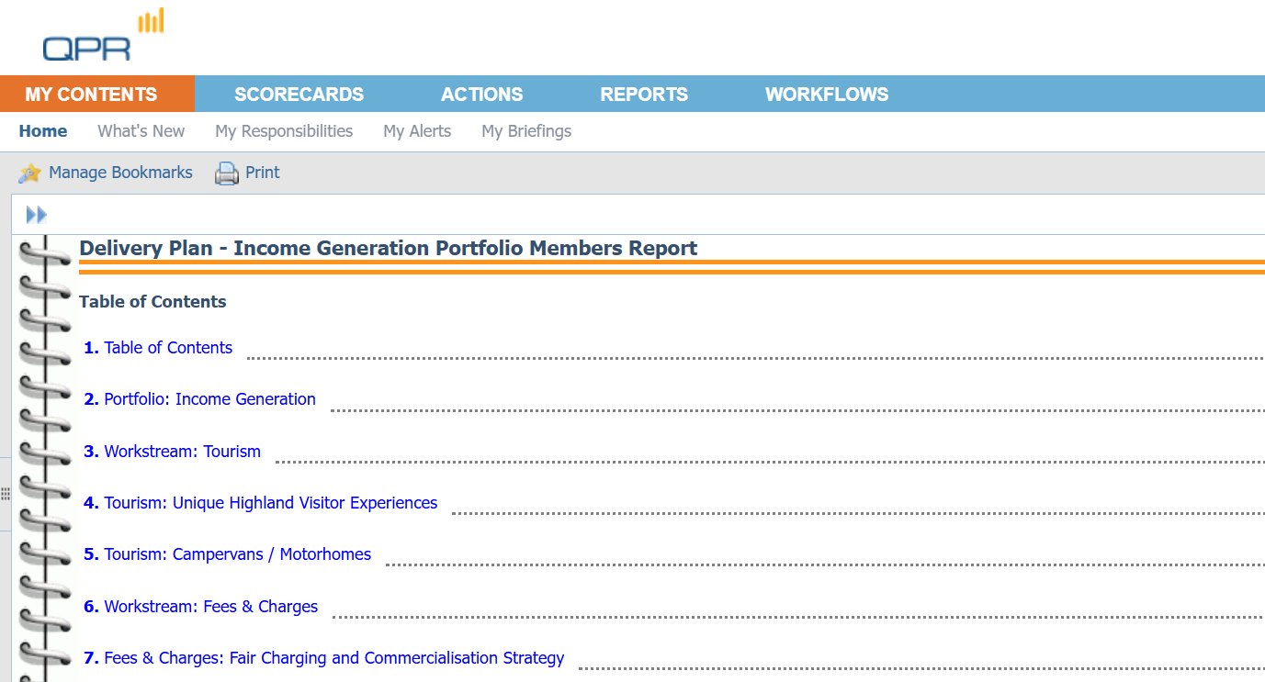
To return to the homepage, always click ‘My Contents’ and ‘Home’ in the top left of your screen

Slide 5
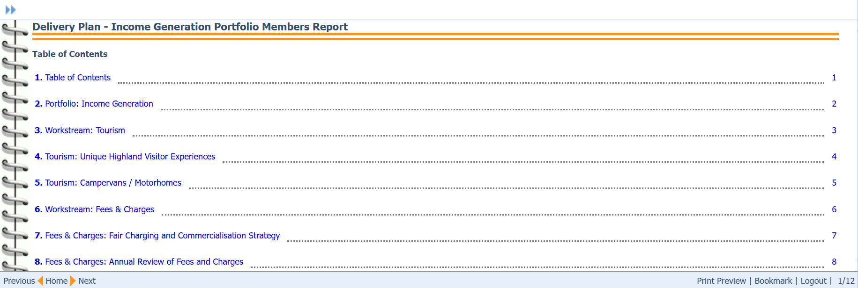
Each Briefing Book has a Table of Contents
Navigate within the Briefing Book
Information is presented in Lists or Dashboards (see next pages)

Slide 6
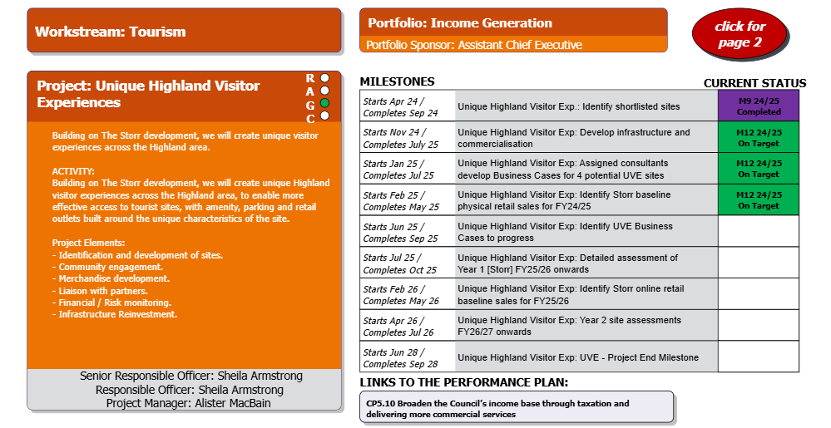
Briefing Book Project Pages
Click to next page
Click on an item or element to learn more

Slide 7

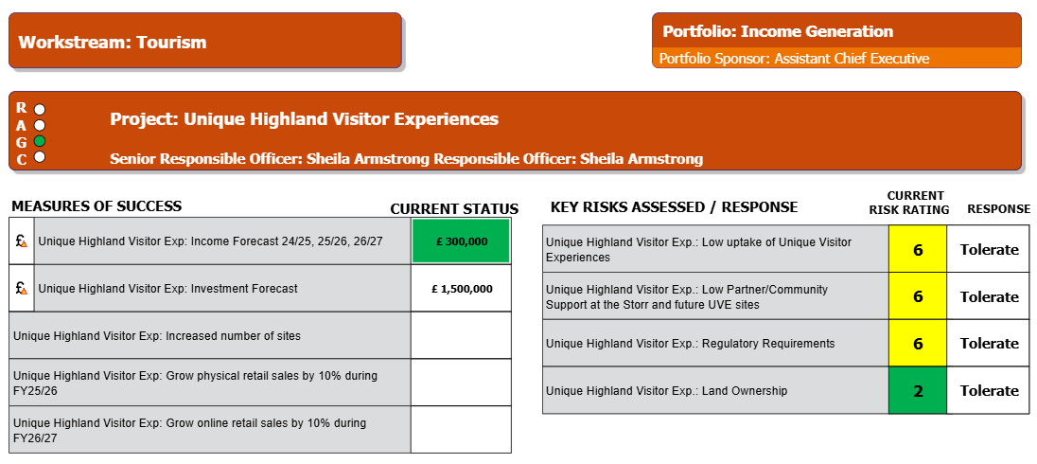
Briefing Book Project Page 2
Use the Navigate tool to expand or move the dashboard
Click an element to learn more

Slide 8
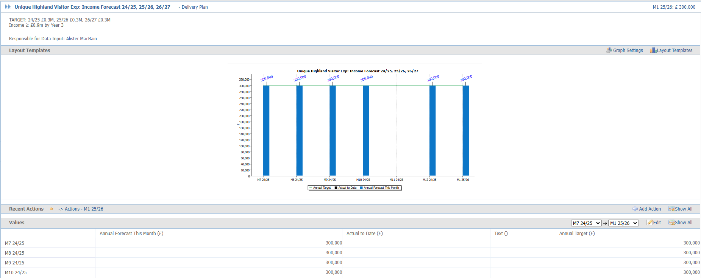

Element View
Detailed description
Graph showing data over time
Raw data values and commentary – you may need to scroll down to see this
Use the ‘back’ button to return to the Briefing Book

Slide 9
Four main types of elements:
  Performance Indicators:
  Updated with a numerical value
  These represent Measures of Success
  Different measurement periods (Financial Year, Financial Quarter, etc)
  Financial Indicators:
  This element represents any Approved Income, Savings or Investment associated with the project.
  Actions or Milestones:
  Updated with a RAG Assessment
Risks & Risk Actions
  Work done to mitigate Risks to the Council
  Risks are updated with a Risk rating
  Risk Actions are updated with a RAG Assessment

Slide 10

Red-Amber-Green (RAG) Rating
Actions, Milestones & Risk Actions
Performance Indicators
No significant progress
Some slippage
On Target
Alarm
(In – between)
On Target
Completed
Not Updated
Performance Indicators only have a RAG if a target value is set.
All Actions, Milestones & Risk Actions have a RAG rating.

Slide 11
Time Periods
Data may be presented in different time periods:
Financial (FY or FQ):
  Year (April – March)
  Quarter (3-month period)
Calendar Year (CY): January - December
Academic Year (AY): August – July

